Slide 1
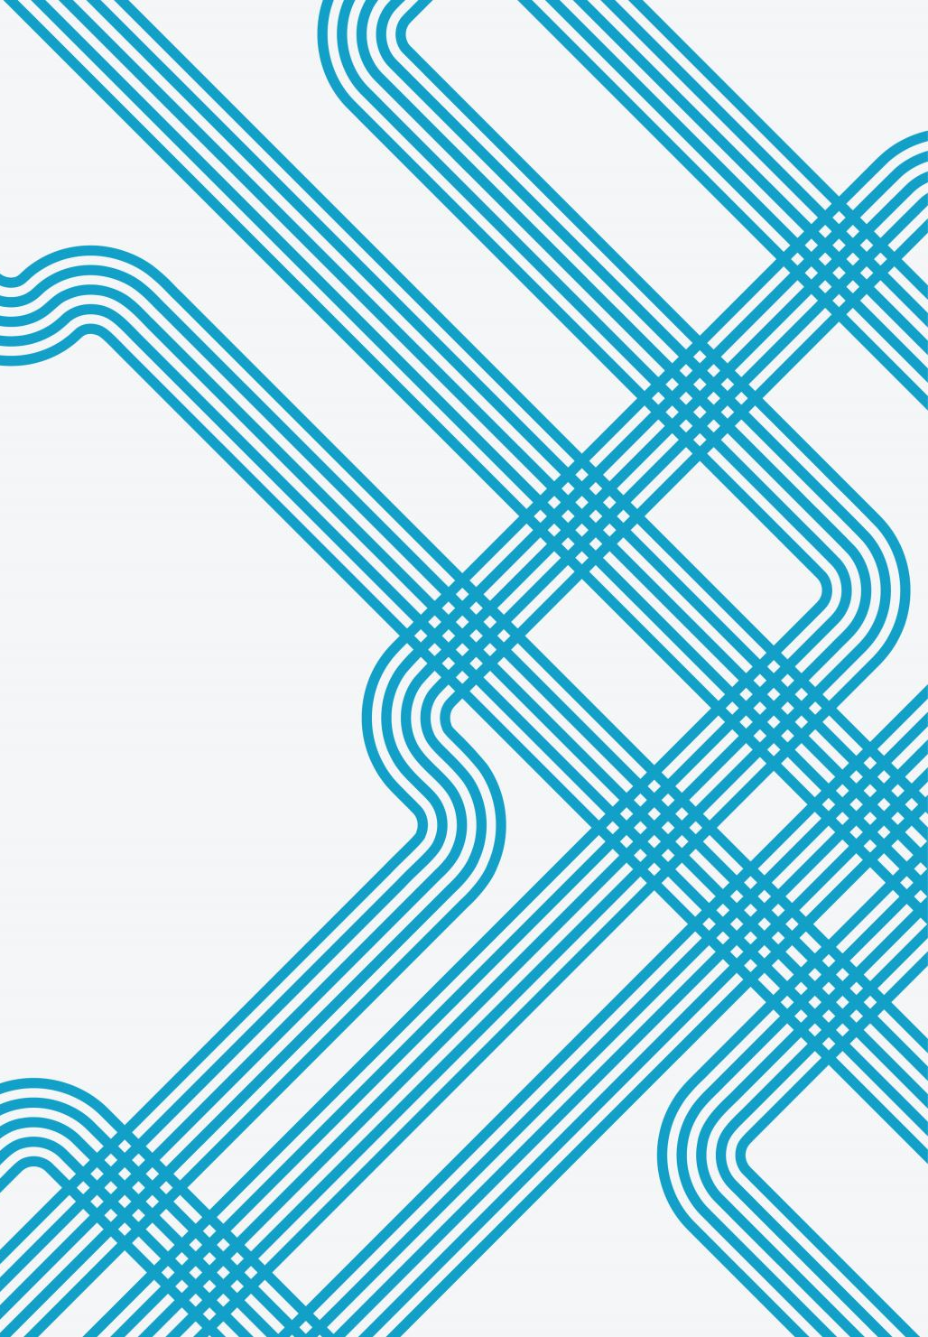
The graph of 𝑦=$\sqrt{x}$
4C
Notes:
https://create.kahoot.it/details/b21c54d8-5f81-4843-9ef0-0aea06032b6e
https://create.kahoot.it/details/4f20949e-e120-4114-9340-f8934c66695f

Slide 2
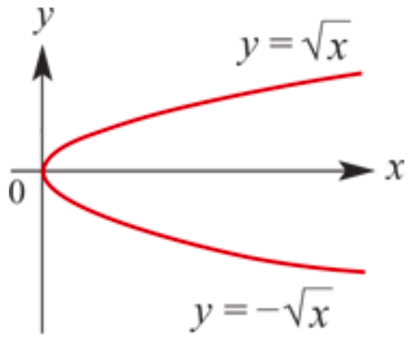
The graph of 𝑦=$\sqrt{x}$
The rule 𝑦= $\sqrt{x}$=$x^{\frac{1}{2}}$for 𝑥≥0
corresponds to the upper part of the graph shown. It is one arm of the parabola 𝑥=$y^{2}$.

Slide 3
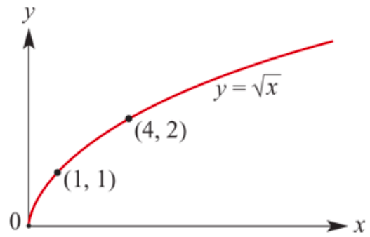
The graph of 𝑦=$\sqrt{x}$
Coordinates of points on the graph of 𝑦=$\sqrt{x}$include (0,0), (1,1), (4,2) and (9,3).
Starting point is (0,0)
All graphs of the form
𝑦=$\text{a}\sqrt{x−h}$+𝑘
will have the same basic shape as the graph of 𝑦=$\sqrt{x}$.
Starting point is (h,k)

Slide 4
Dilation
𝑦= $\sqrt{x}$
𝑦= $4\sqrt{x}$
𝑦= $\frac{1}{4}\sqrt{x}$
a=1
a=4
a= $\frac{1}{4}$

Slide 5
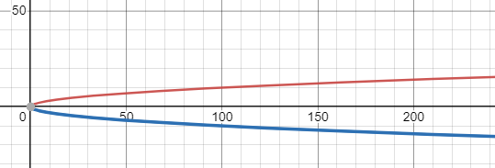
Reflection
𝑦= $\sqrt{x}$
𝑦=$−\sqrt{x}$
a=1
a= $−$1

Slide 6
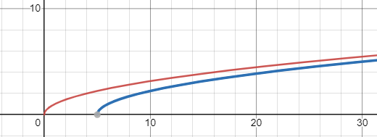
Translation: Translated 5 units to the right
𝑦= $\sqrt{x}$
𝑦=$\sqrt{x−5}$
h=0, k=0 → starting point (0,0)
h=5, k=0 → starting point (5,0)

Slide 7
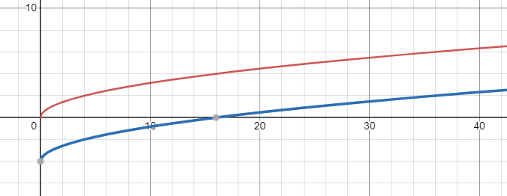
Translation: Translated down 4 units
𝑦= $\sqrt{x}$
𝑦=$\sqrt{x}$ $−$4
h=0, k=0 → starting point (0,0)
h=0, k= $−$4 → starting point (0, $−$4)

Slide 8
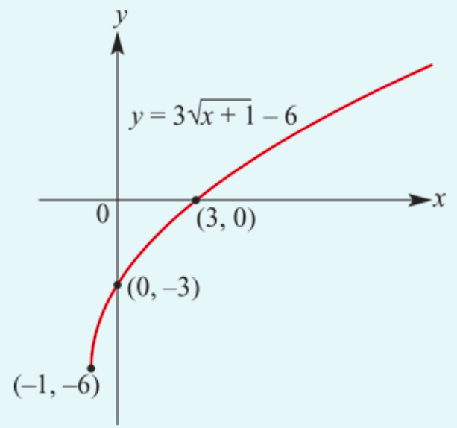
Sketch the graph of 𝑦=3$\sqrt{x+1}−6$.
The graph is formed by dilating the graph of 𝑦= $\sqrt{x}$from the 𝑥-axis by factor 3 and then translating 1 unit to the left and 6 units down.
The rule is defined for 𝑥≥−1.
The set of values the rule can take (the range) is all numbers greater than or equal to −6, i.e. 𝑦≥−6.
When 𝑥=0, 𝑦=−3
When 𝑦=0, 3$\sqrt{x+1}−6$=0
3$\sqrt{x+1}=6$
$\sqrt{x+1}=2$
$x$+1=4
$x$=3
h= ―1, k= ―6
Starting point:(―1, ―6)

Slide 9
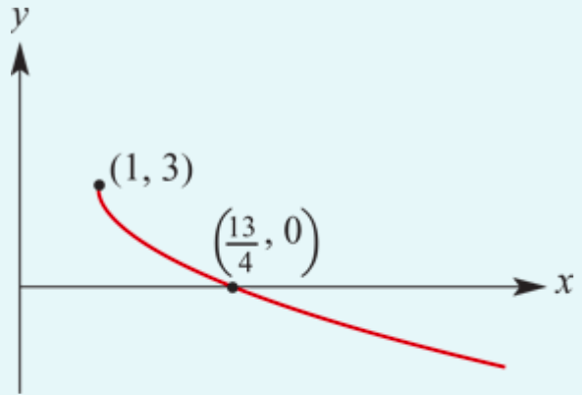
Sketch the graph of 𝑦=−2$\sqrt{x−1}+3$.
The graph is formed by dilating the graph of 𝑦= −$\sqrt{x}$from the 𝑥-axis by factor 2, reflecting this in the 𝑥-axis and then translating it 1 unit → and 3 units up.
The rule is defined for 𝑥≥1.
The set of values the rule can take (the range) is all numbers less than or equal to 3, i.e. 𝑦≤3.
When 𝑦=0: 0=−2$\sqrt{x−1}+3$
2$\sqrt{x−1}=3$
Square both sides:
4(𝑥−1)=9
𝑥−1=$\frac{9}{4}$
Therefore 𝑥= $\frac{9}{4}$+1= $\frac{13}{4}$
h= 1 , k= 3
Starting point:(1, 3)

Slide 10
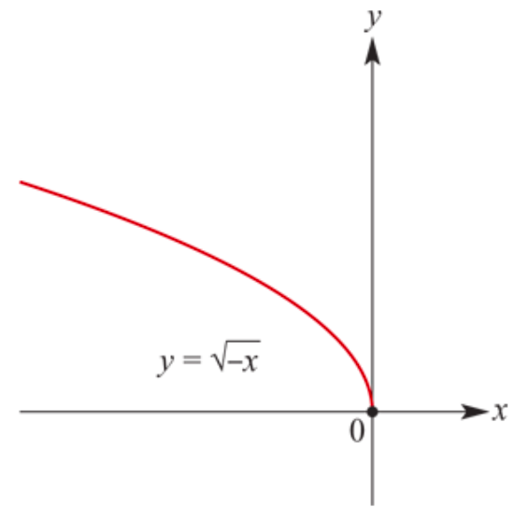
The graph of 𝑦=$\sqrt{−x}$
The rule
𝑦=$\sqrt{−x}$ for 𝑥≤0
yields a graph which is the reflection of the graph of 𝑦 𝑦=$\sqrt{x}$in the 𝑦-axis.
All graphs of the form
𝑦=$\text{a}\sqrt{−(x−h)}$+𝑘
will have the same basic shape as the graph of 𝑦=$\sqrt{−x}$.

Slide 11
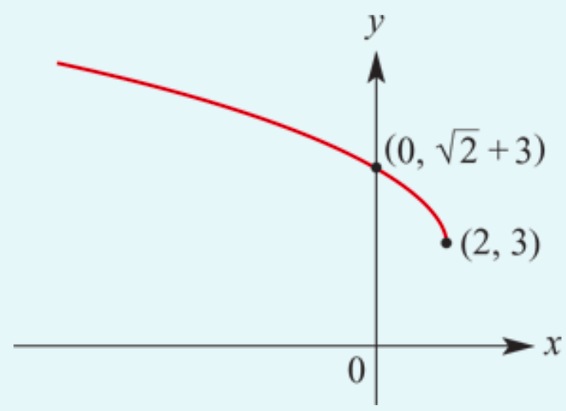
Sketch the graph of 𝑦=$\sqrt{2−x}+3$. Note: $\sqrt{2−x}$= $\sqrt{−(x−2)}$
We can write the rule as
𝑦=$\sqrt{−(x−2)}+3$
The rule is defined for 𝑥≤2.
The set of values the rule can take (the range) is all numbers greater than or equal to 3, i.e. 𝑦≥3.
When 𝑥=0, 𝑦= $\sqrt{2}$+3.

Slide 12
Section summary
All graphs of the form 𝑦=𝑎 $\sqrt{x−h}$+𝑘 will have the same basic shape as the graph of 𝑦= $\sqrt{x}$. The graph will have endpoint (ℎ,𝑘).
The graph of 𝑦= $\sqrt{−x}$is the reflection in the 𝑦-axis of the graph of 𝑦= $\sqrt{x}$.

