Slide 1
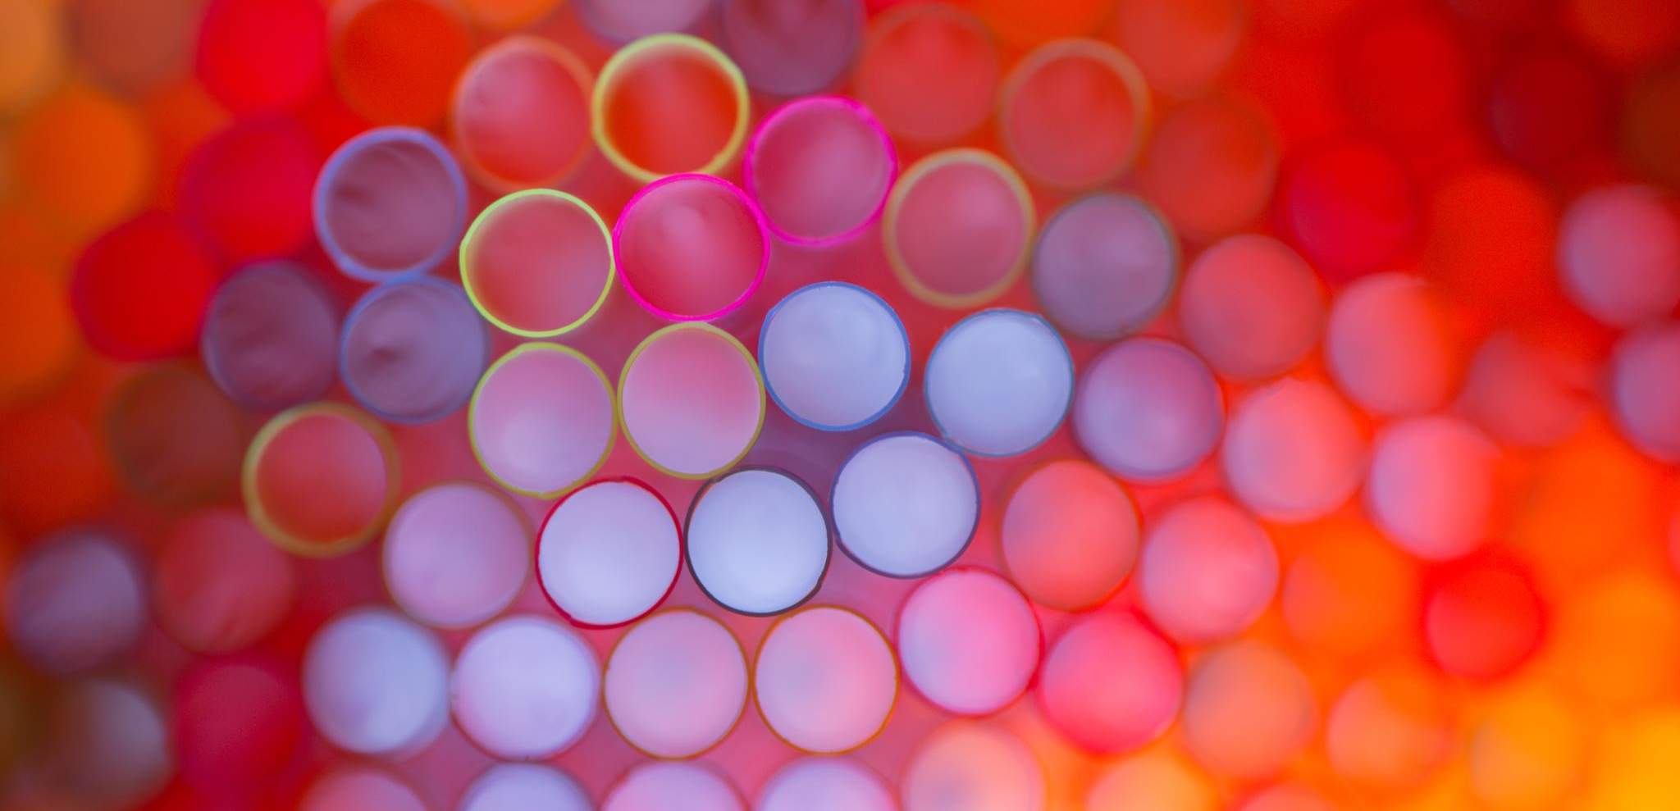
Circles
4D
Notes:
https://create.kahoot.it/details/1124bfb7-9076-4d90-aa68-11a28df8f111

Slide 2
What can you spot? Conic graphs
Circle
Obtained when the plane is parallel to the base of the cones.
Ellipse
The plane is less steep than the surface of the cone.
Parabola
Plane is parallel to the surface of the cone.
Hyperbola
The plane is steeper than the surface of the cone, so intersects both cones.

Slide 3
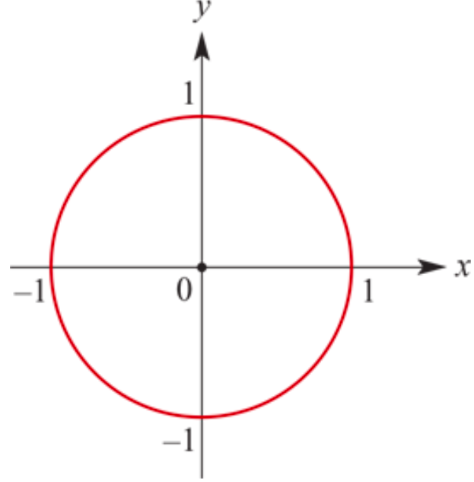
Equation of a Circle: ‘centre--radius’ form
Is 𝑥² + 𝑦² =𝑟²
Where
The circle has centre (0,0)
It’s radius is 𝑟

Slide 4
Determine the equation of the circle
Write down the equation of the circle with centre (−3,5) and radius 2.
Solution
If the radius is 2 and the centre is the point (−3,5), then the equation will be
(𝑥−(−3))² +(𝑦−5)² = 2²
(𝑥+3)² +(𝑦−5)² = 4

Slide 5
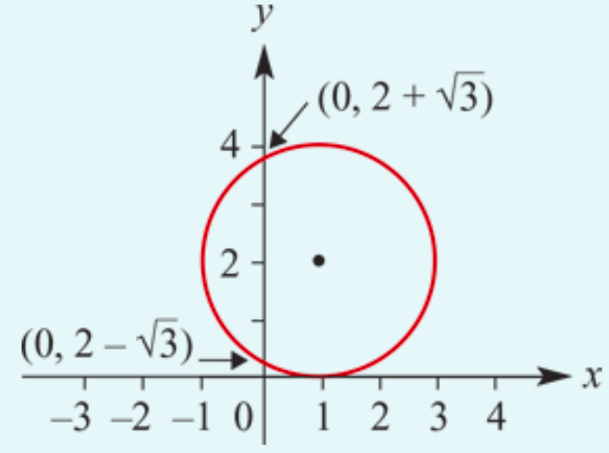
Sketch the graph of the circle
Find the centre and radius of the circle (𝑥-1)² +(𝑦−2)² = 4
The equation (𝑥-1)² +(𝑦−2)² = 4 defines a circle of radius 2 with centre at (1,2).
We can sketch the circle with a little extra work.
When 𝑥=0,
(0-1)² +(𝑦−2)² = 4
1+(𝑦−2)² =4
(𝑦−2)² =3
Hence 𝑦=2±$\sqrt{3}$

Slide 6
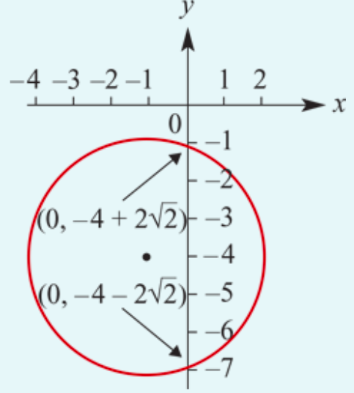
Sketch the graph of the circle
Sketch the graph of the circle (𝑥+1)² +(𝑦+4)² = 9
The circle has radius 3 and centre (−1,−4).
The 𝑦-axis intercepts → When 𝑥=0,
(0+1)² +(𝑦+4)² = 9
1+(𝑦+4)² = 9
(𝑦+4)² = 8
Hence 𝑦= −4±$\sqrt{8}$ = −4±$2\sqrt{2}$

Slide 7
The general form for the equation of a circle
The ‘centre--radius’ form of a circle:
(𝑥-ℎ)² +(𝑦− 𝑘)² = 𝑟².
Expanding the equation of a circle gives:
(𝑥² −2ℎ𝑥+ ℎ² ) +(𝑦² −2𝑘𝑦+ 𝑘² ) = 𝑟²
𝑥² +𝑦² −2ℎ𝑥 −2𝑘𝑦 + ℎ² + 𝑘² − 𝑟² =0
Let 𝑐=ℎ² + 𝑘² − 𝑟². → General Form of a circle:

Slide 8
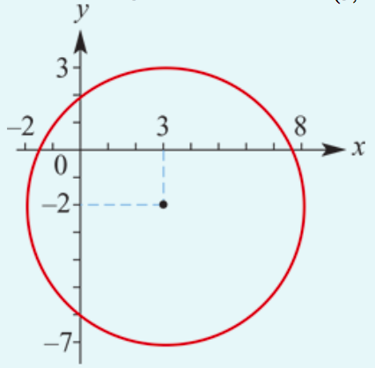
Sketch the graph of the circle
Find the radius and the coordinates of the centre of the circle with equation
𝑥² +𝑦² −6𝑥 +4𝑦 − 12 =0
and hence sketch the graph.
By completing the square for both 𝑥 and 𝑦 we have
𝑥² −6𝑥 +9 −9 +𝑦² +4𝑦 +4 −4 −12 =0
(𝑥² −6𝑥 +9) +(𝑦² +4𝑦 +4) −9 −4 −12 =0
(𝑥-3)² +(𝑦+2)² −25=0
(𝑥-3)² +(𝑦+2)² = 5²
The radius is 5 and the centre is at (3,−2).

Slide 9
Semicircles
Transposing the general equation of the circle 𝑥² + 𝑦² = 𝑟² to make 𝑦 the subject, we have
𝑦² = 𝑟² − 𝑥²
𝑦=±$\sqrt{\text{r}\text{2}\text{ − }\text{x}\text{2} }$
We can now consider two separate rules
𝑦=+$\sqrt{\text{r}\text{2}\text{ − }\text{x}\text{2} }$ & 𝑦= −$\sqrt{\text{r}\text{2}\text{ − }\text{x}\text{2} }$
Which correspond to the top half and bottom half of the circle respectively.
Similarly, solving for 𝑥 will give you the semicircles to the left and right of the 𝑦-axis:
𝑥=±$\sqrt{\text{r}\text{2}\text{ −}\text{y}\text{2} }$

Slide 10
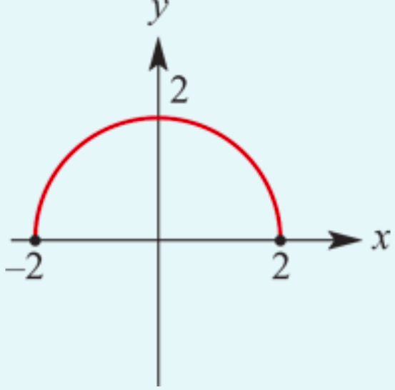
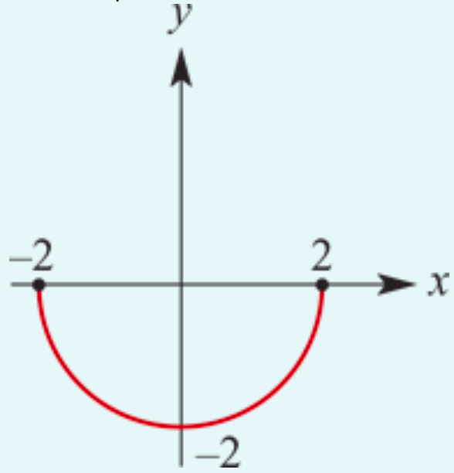
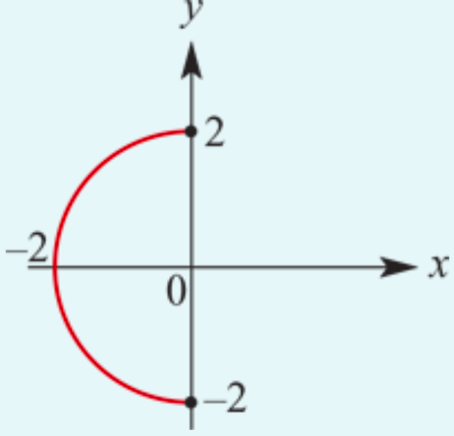
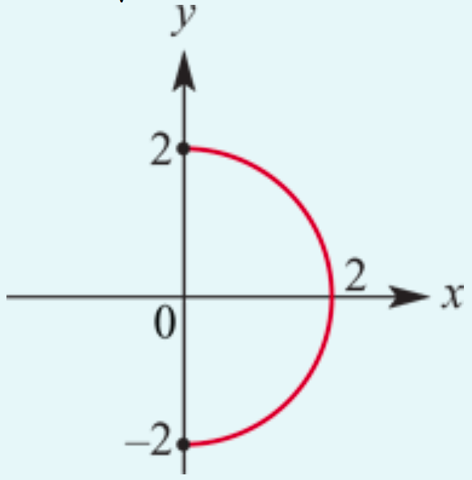
Sketch the graph of the semicircle
Sketch the graphs of:
𝑦 =+$\sqrt{\text{4}\text{− }\text{x}\text{2} }$
𝑥=− $\sqrt{\text{4}\text{−}\text{y}\text{2} }$
𝑦=− $\sqrt{\text{4}\text{− }\text{x}\text{2} }$
𝑥=+ $\sqrt{\text{4}\text{−}\text{y}\text{2} }$

Slide 11
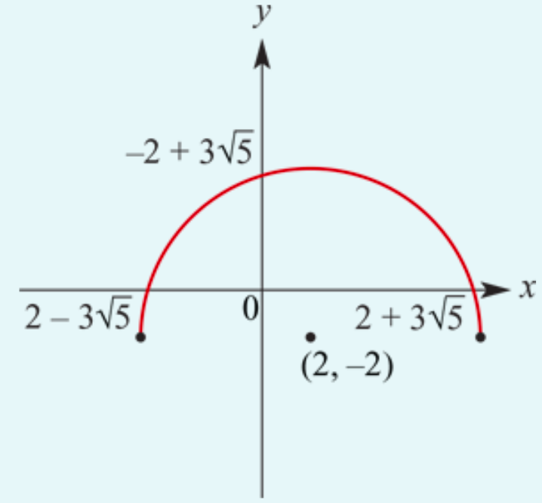
Sketch the graph of the semicircle 𝑦=−2+$\sqrt{\text{49}\text{−}\text{(}\text{x}\text{−}\text{2)}\text{2} }$
It is a semicircle of the circle (𝑥-2)² +(𝑦+2)² = 49
The centre is at the point (2,−2).
𝑦=$\sqrt{\text{4}\text{9}\text{−}\text{x}\text{2} }$ translated 2 units → 2 units down.
𝑦-axis intercept → When 𝑥=0,
𝑦= −2+$\sqrt{\text{49}\text{−}\text{(}\text{0}\text{−}\text{2)}\text{2} }$= −2+$\sqrt{\text{4}\text{5} }$= −2+3$\sqrt{\text{5} }$
𝑥-axis intercepts → When 𝑦=0,
0=−2+$\sqrt{\text{49}\text{−}\text{(}\text{x}\text{−}\text{2)}\text{2} }$
2=$\sqrt{\text{49}\text{−}\text{(}\text{x}\text{−}\text{2)}\text{2} }$
$\text{4=}\text{49}\text{−}\text{(}\text{x}\text{−}\text{2)}\text{2}$
$\text{(}\text{x}\text{−}\text{2)}\text{2}$=45
$\text{x}\text{−}\text{2}$=±3$\sqrt{\text{5} } → \text{x}$=2±3$\sqrt{\text{5} }$

Slide 12
Section summary
The ‘centre--radius’ form of a circle with centre (ℎ,𝑘) and radius 𝑟 is
(𝑥-ℎ)² +(𝑦− 𝑘)² = 𝑟²
The general form for the equation of a circle is
𝑥² +𝑦² −2ℎ𝑥 −2𝑘𝑦 + 𝑐 =0
The two separate rules for semicircles with their base on the 𝑥-axis are
𝑦=+$\sqrt{\text{r}\text{2}\text{ − }\text{x}\text{2} }$ & 𝑦= −$\sqrt{\text{r}\text{2}\text{ − }\text{x}\text{2} }$
The two separate rules for semicircles with their base on the 𝑦-axis are
𝑥=+$\sqrt{\text{r}\text{2}\text{ −}\text{y}\text{2} }$. & 𝑥= −$\sqrt{\text{r}\text{2}\text{ −}\text{y}\text{2} }$

