Slide 1
Quadratic equations
3C
Notes:
https://create.kahoot.it/details/efac1ab1-a8f4-4382-a264-5d337a986684

Slide 2
Solving a quadratic equation by factorisation
Step 1 Write the equation in the form 𝑎$x^{2}$+𝑏𝑥+𝑐=0.
Step 2 Factorise the quadratic expression.
Step 3 Use the result that 𝑚𝑛=0 implies 𝑚=0 or 𝑛=0 (or both); this is known as the null factor theorem.
For example, to solve the equation $x^{2}$−𝑥=12:
$x^{2}$−𝑥=12
$x^{2}$−𝑥 − 12=0 (Step 1)
(𝑥−4)(𝑥+3)=0 (Step 2)
∴ 𝑥−4=0 or 𝑥+3=0 (Step 3)
x=4 or x= − 3
In the simplest cases, the first two steps may have been done already.

Slide 3
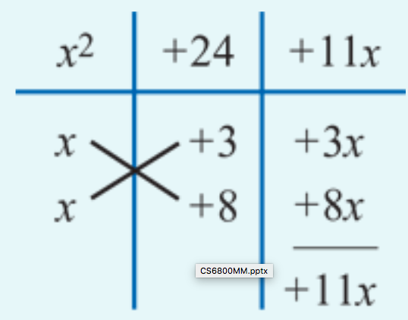
Solve $x^{2}$+11𝑥+24=0.
Factorising gives
$x^{2}$+11x+24=0
(x+3)(x+8)=0
x+3=0 or x+8=0
x= − 3 or x= − 8
The quadratic can also be factorised in the following way:
$x^{2}$+11𝑥+24= $x^{2}$+8𝑥+3𝑥+24=𝑥(𝑥+8)+3(𝑥+8)=(𝑥+8)(𝑥+3)
Note: We can check the answer for this example by substituting into the equation:
${\text{(−3)}}^{2}$+11(−3)+24=0
${\text{(−}\text{8}\text{)}}^{2}$+11(−8)+24=0

Slide 4
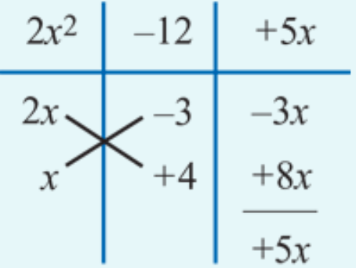
Solve 2$x^{2}$+5𝑥−12=0.
Factorising gives
${2x}^{2}$+5x − 12=0
(2𝑥−3)(𝑥+4)=0
2𝑥−3 =0 or x+4=0
x= $\frac{3}{2}$ or x= − 4
The quadratic can also be factorised in the following way:
${2x}^{2}$+5x − 12= ${2x}^{2}$+8x − 3x − 12=2𝑥(𝑥+4)−3(𝑥+4)=(2𝑥−3)(𝑥+4)

Slide 5
Applications of quadratic equations
The perimeter of a rectangle is 20 cm and its area is 24 ${cm}^{2}$. Calculate the length and width of the rectangle.
Solution
Let 𝑥 cm be the length of the rectangle and 𝑦 cm the width.
Then 2(𝑥+𝑦)=20 and thus 𝑦=10−𝑥.
The area is 24 ${cm}^{2}$ and therefore 𝑥𝑦=𝑥(10−𝑥)=24.
i.e. 10𝑥− $x^{2}$=24
$x^{2}$−10𝑥+24=0
(𝑥−6)(𝑥−4)=0
Thus the length is 6 cm or 4 cm. The width is 4 cm or 6 cm.
$∵$($−$6) $×$ $\left(−4\right)$=24
1 −6
−4
1$×\left(−6\right)+1×\left(−4\right)=−10$

Slide 6
Section summary
To solve a quadratic equation by factorisation:
Step 1 Write the equation in the form 𝑎$x^{2}$+𝑏𝑥+𝑐=0.
Step 2 Factorise the quadratic polynomial.
Step 3 Use the result that 𝑚𝑛=0 implies 𝑚=0 or 𝑛=0 (or both).

