Slide 1
Graphing quadratics
3D

Slide 2
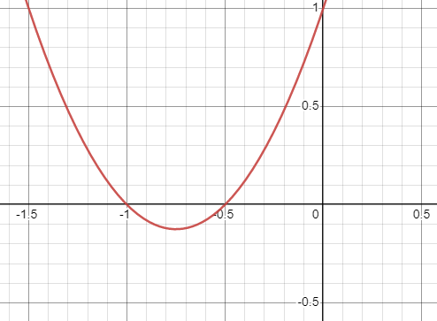
Expression Equation function
Expression: $2x^{2}+3x+1$
Can expand or factorise (2x+1)(x+1)
Equation $2x^{2}+3x+1$=0
Can be solved $x_{1}=−1,$ $x_{2}=−\frac{1}{2}$
Function $y=2x^{2}+3x+1$
Can sketch $y=(2x+1)(x+1)$

Slide 3
X-intercept
X-intercept
Vertex
Notes:
NOTE: That this graph has a minimum point, but no maximum point as the graph does to positive infinity. It is this vertex that the lesson is focused on.

Slide 4
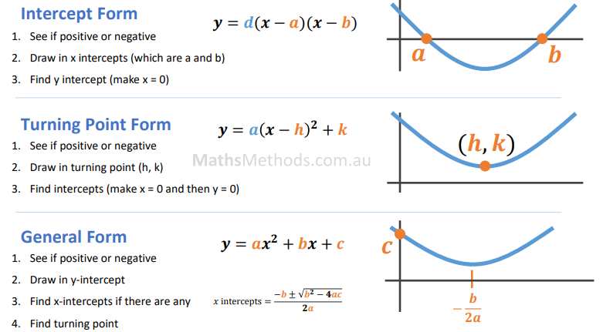
Symmetry line: x=h
Symmetry line: x=$−\frac{b}{2a}$
discriminant: Δ= $b^{2}−4ac$

Slide 6
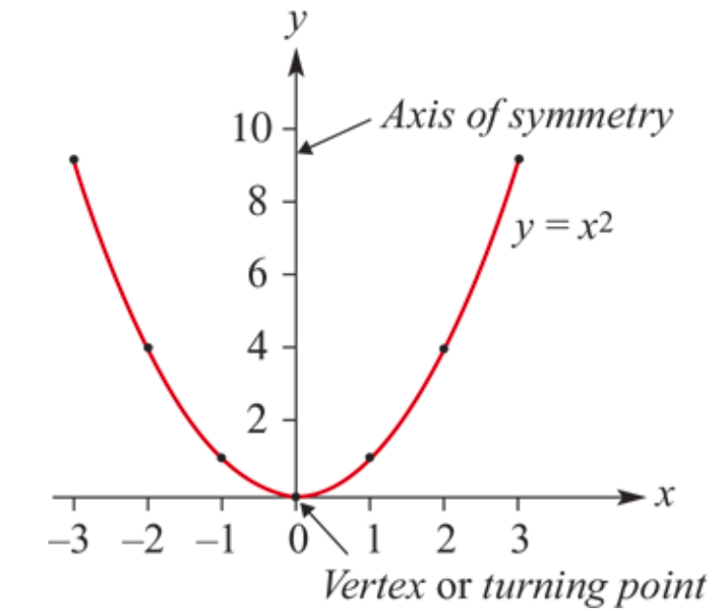
The parabola 𝑦=$x^{2}$
A quadratic polynomial function is defined by the general rule 𝑦=𝑎$x^{2}$+𝑏𝑥+𝑐
where 𝑎, 𝑏 and 𝑐 are constants and 𝑎≠0. This is called polynomial form.
The simplest quadratic function is 𝑦= $x^{2}$. If a table of values is constructed for 𝑦= $x^{2}$for −3≤𝑥≤3, these points can be plotted and then connected to produce a continuous curve.

Slide 7
Features of the graph of 𝑦= $x^{2}$:
The graph is called a parabola.
The possible 𝑦-values are all positive real numbers and 0. (This is called the range of the quadratic.)
The graph is symmetrical about the 𝑦-axis. The line about which the graph is symmetrical is called the axis of symmetry.
The graph has a vertex or turning point at the origin (0,0).
The minimum value of 𝑦 is 0 and it occurs at the turning point.

Slide 8
Transformations of 𝑦= $x^{2}$
By a process called completing the square (to be discussed in Section 3E), all quadratics in polynomial form 𝑦=𝑎$x^{2}$+𝑏𝑥+𝑐 may be transposed into what will be called the turning point form:
𝑦=𝑎${\text{(}\text{x}\text{−}\text{h}\text{)}}^{2}$+𝑘
We first consider the effect of changing the value of 𝑎 for our basic graph of 𝑦=$x^{2}$.
We then consider the effect of changing ℎ and 𝑘 for graphs of the form 𝑦=𝑎$x^{2}$. Graphs of the form 𝑦=𝑎${\text{(}\text{x}\text{−}\text{h}\text{)}}^{2}$+𝑘 are formed by translating the graph of 𝑦=𝑎$x^{2}$. The graph of 𝑦=𝑎${\text{(}\text{x}\text{−}\text{h}\text{)}}^{2}$+𝑘 is exactly the same shape as 𝑦=𝑎$x^{2}$. All of these graphs are indeed congruent to 𝑦=𝑎$x^{2}$ and each other.

Slide 9
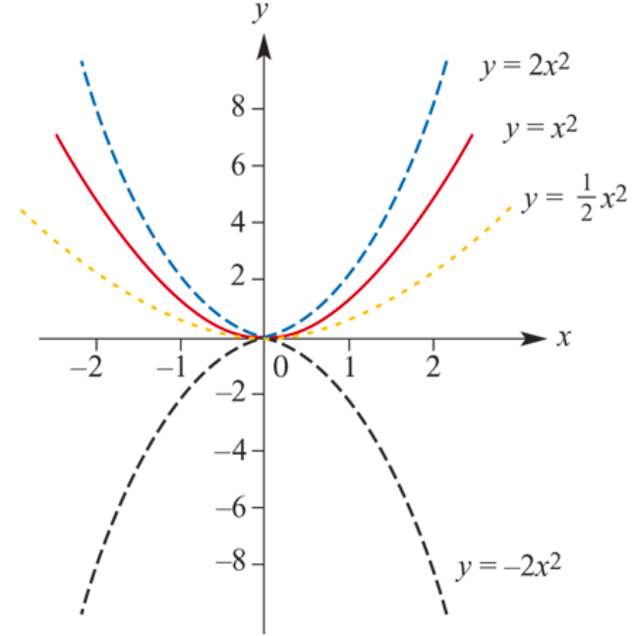
Graphs of 𝑦=𝑎$x^{2}$
a=2 If 𝑎>1, the graph is ‘narrower’. $x^{2}$Dilation of factor 2 from the 𝑥-axis.
a=$\frac{1}{2}$ If 0<𝑎<1, the graph is ‘broader’.
We first consider graphs of the form 𝑦=𝑎$x^{2}$. In this case both ℎ=0 and 𝑘=0. In the basic graph of 𝑦=$x^{2}$, the value of 𝑎 is 1.
a=$−$2, When 𝑎 is negative, the graph is a reflection in the 𝑥-axis from 𝑦=2$x^{2}$.
Notes:
The transformation which produces the graph of 𝑦=2𝑥^2 from the graph of 𝑦=𝑥^2 is called a dilation of factor 2 from the 𝑥x-axis.

Slide 10
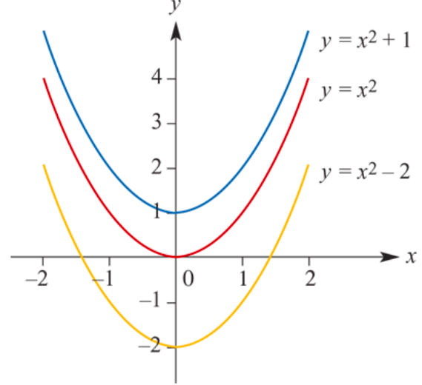
Graphs of 𝑦= $x^{2}$+𝑘
𝑘=1 Up1 unit of the 𝑦-axis. The vertex is (0,1) and the range ≥1.
𝑘=−2 Down 2 units of the 𝑦-axis. The vertex is (0,−2) and the range ≥−2.
𝑦=$x^{2}$
𝑦=$x^{2}$− 2 (𝑘=−2)
𝑦=$x^{2}+1$ (𝑘=1)
All other features of the graph are unchanged. The axis of symmetry is still the 𝑦-axis.
Notes:
The transformation which produces the graph of 𝑦=2𝑥^2 from the graph of 𝑦=𝑥^2 is called a dilation of factor 2 from the 𝑥x-axis.

Slide 11
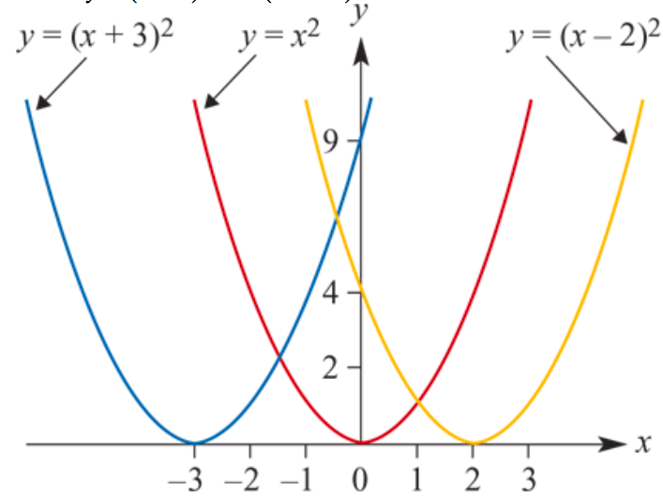
Graphs of 𝑦=${\text{(}\text{x}\text{−}\text{h}\text{)}}^{2}$
ℎ=−3 Vertex(−3,0) and the axis of symmetry → 𝑥=−3.
ℎ=2 Vertex (2,0) and the axis of symmetry →𝑥=2.
𝑦=$x^{2}$
𝑦=${(x\text{−}2)}^{2}$ (h=2)
𝑦=${(x\text{+3})}^{2}$ (h=$\text{−}$3)
In both cases, the range is unchanged and $≥0$.
Notes:
The transformation which produces the graph of 𝑦=2𝑥^2 from the graph of 𝑦=𝑥^2 is called a dilation of factor 2 from the 𝑥x-axis.

Slide 12
Transformations of 𝑦= a${\text{(}\text{x}\text{−}\text{h}\text{)}}^{2}$+k
By combining dilations, reflections and translations, we can sketch the graph of any quadratic expressed in the form 𝑦= a${\text{(}\text{x}\text{−}\text{h}\text{)}}^{2}$+k :
The vertex → (ℎ,𝑘).
The axis of symmetry is 𝑥=ℎ.
If ℎ and 𝑘 are positive, then the graph of 𝑦= a${\text{(}\text{x}\text{−}\text{h}\text{)}}^{2}$+k is obtained from the graph of 𝑦=𝑎$x^{2}$ by translating ℎ units in the positive direction of the 𝑥-axis and 𝑘 units in the positive direction of the 𝑦-axis.
Similar results hold for different combinations of ℎ and 𝑘 positive and negative.

Slide 13
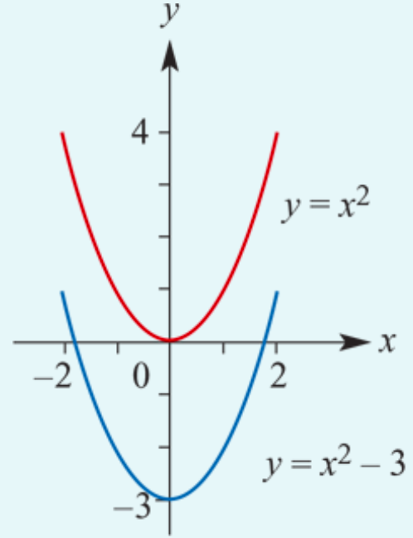
Sketch the graph of 𝑦= $x^{2}$−3.
The vertex is now at (0,−3). The axis of symmetry → line 𝑥=0.
To find the 𝑥-axis intercepts, let 𝑦=0:
0= $x^{2}$−3
$x^{2}$=3
$x$= ±$\sqrt{3}$
Hence the 𝑥-axis intercepts are ±$\sqrt{3}$.

Slide 14
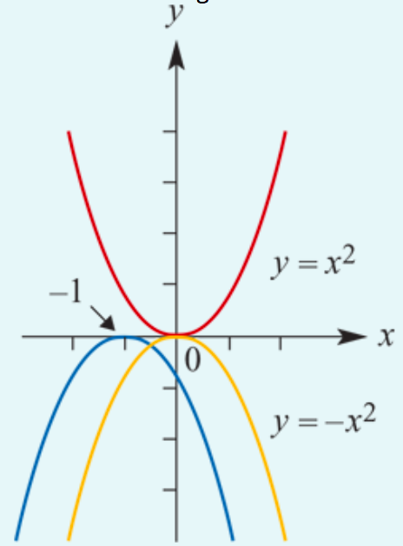
Sketch the graph of 𝑦=− ${\text{(}\text{x}\text{+1)}}^{2}$.
The graph of 𝑦=− ${\text{(}\text{x}\text{+1)}}^{2}$is obtained from the graph of 𝑦= ${\text{x}}^{2}$ by a reflection in the 𝑥-axis followed by a translation of 1 unit in the negative direction of the 𝑥-axis.
The vertex is now at (−1,0).
The axis of symmetry → 𝑥=−1.
The 𝑥-axis intercept is −1.

Slide 15
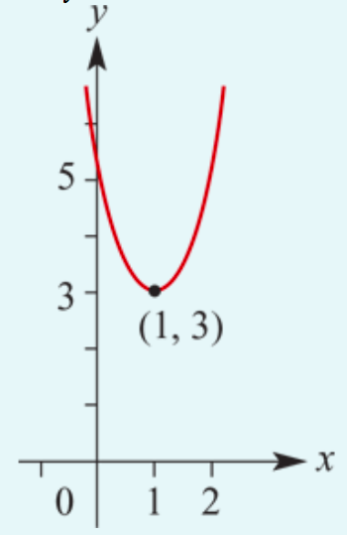
Sketch the graph of 𝑦=2 ${\text{(}\text{x}\text{−}\text{1)}}^{2}$+3.
The vertex has coordinates (1,3).
The axis of symmetry is the line 𝑥=1.
The graph will be narrower than 𝑦= $x^{2}$.
The range will be 𝑦≥3.
𝑦-axis intercept
When 𝑥=0, 𝑦=2 ${\text{(}\text{0}\text{−}\text{1)}}^{2}$+3=5.
𝑥-axis intercepts
In this example, the minimum value of 𝑦 is 3. Therefore this graph has no 𝑥-axis intercepts.

Slide 16
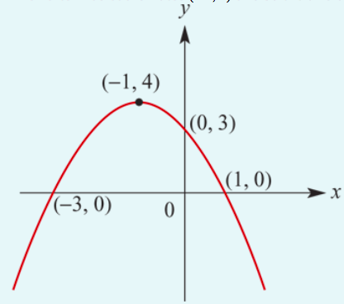
Sketch the graph of 𝑦=−${(x+1)}^{2}$+4.
The vertex has coordinates (−1,4)
The axis of symmetry → line 𝑥=−1.
When 𝑥=0, 𝑦=− ${(0+1)}^{2}$+4=3.
∴ the 𝑦-axis intercept is 3.
When 𝑦=0, −${(x+1)}^{2}$+4=0
${(x+1)}^{2}$=4
$x+1$=±2
$x=1$or $x=$−3
∴ the 𝑥-axis intercepts are 1 and −3.

Slide 17
Section summary
The graph of 𝑦= $x^{2}$ is called a parabola. The vertex (or turning point) is the point (0,0) and the axis of symmetry is the 𝑦-axis.
The graph of 𝑦=− $x^{2}$ is the reflection of the graph of 𝑦= $x^{2}$ in the 𝑥-axis.
For 𝑦=𝑎$x^{2}$ and 𝑎>1, the graph is ‘narrower’ than the graph of 𝑦=$x^{2}$.
For 𝑦=𝑎$x^{2}$ and 0<𝑎<1, the graph is ‘broader’ than the graph of 𝑦=$x^{2}$.
All quadratic functions in polynomial form 𝑦=𝑎$x^{2}$+𝑏𝑥+𝑐 may be transposed into the turning point form 𝑦=𝑎${\text{(}\text{x}\text{−}\text{h}\text{)}}^{2}$+𝑘.

Slide 18
Section summary
The graph of 𝑦=𝑎${\text{(}\text{x}\text{−}\text{h}\text{)}}^{2}$+𝑘 is a parabola congruent to the graph of 𝑦=𝑎$x^{2}$.
The vertex (or turning point) is the point (ℎ,𝑘).
The axis of symmetry is 𝑥=ℎ.
If ℎ and 𝑘 are positive numbers, then the graph of 𝑦=𝑎${\text{(}\text{x}\text{−}\text{h}\text{)}}^{2}$+𝑘 is obtained from the graph of 𝑦=𝑎$x^{2}$ by translating ℎ units in the positive direction of the 𝑥-axis and 𝑘 units in the positive direction of the 𝑦-axis.
Similar results hold for different combinations of ℎ and 𝑘 positive and negative.

