Slide 1
Graphing quadratics in polynomial form
3F

Slide 2
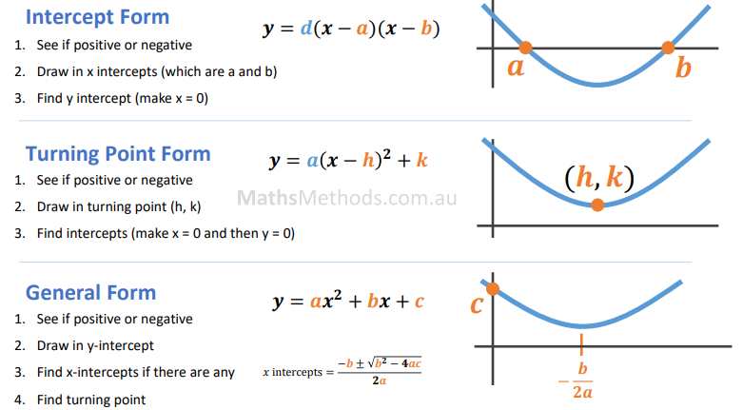

Slide 3
Graphing quadratics in polynomial form
Rather than converting a quadratic to turning point form in order to sketch its graph.
We can
Find the 𝑥- and 𝑦-axis intercepts
Find the axis of symmetry from polynomial form by other methods
Use these details to sketch the graph.

Slide 4
Step 1 Find the 𝑦-axis intercept
Let 𝑥=0. For the general quadratic 𝑦=𝑎$x^{2}$+𝑏𝑥+𝑐, this gives
𝑦 =𝑎 ${(0)}^{2}$+𝑏(0)+𝑐
𝑦 =𝑐
Hence the 𝑦-axis intercept is always equal to 𝑐.

Slide 5
Step 2 Find the 𝑥-axis intercepts
Let 𝑦=0. In general, this gives
0=𝑎$x^{2}$+𝑏𝑥+𝑐
In order to solve such an equation it is necessary to factorise the right-hand side and then use the null factor theorem.

Slide 6
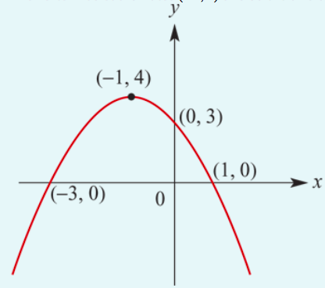
Step 3 Find the equation of the axis of symmetry
Once the 𝑥-axis intercepts have been found, the equation of the axis of symmetry can be found by using the symmetry properties of the parabola. The axis of symmetry is the perpendicular bisector of the line segment joining the 𝑥-axis intercepts.

Slide 7
Step 4 Find the coordinates of the turning point
The axis of symmetry gives the 𝑥-coordinate of the turning point. Substitute this into the quadratic polynomial to obtain the 𝑦-coordinate.
𝑦=−${(x+1)}^{2}$+4

Slide 8
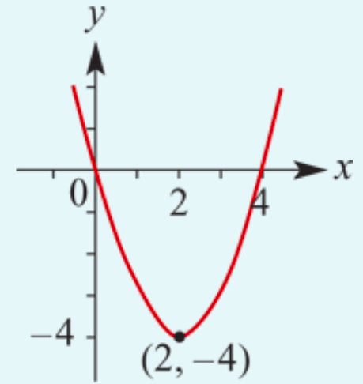
Find the 𝑥- and 𝑦-axis intercepts and the turning point, and hence sketch the graph of 𝑦=$x^{2}$−4𝑥.
Step 1 𝑐=0. Therefore the 𝑦-axis intercept is 0.
Step 2 Let 𝑦=0. Then
0=$x^{2}$−4𝑥= 𝑥(𝑥−4)
∴𝑥=0 or 𝑥=4
The 𝑥-axis intercepts are 0 and 4.
Step 3 The axis of symmetry is the line with equation 𝑥=$\frac{0+4}{2}$, that is, 𝑥=2.
Step 4 When 𝑥=2, 𝑦= $2^{2}$−4×2=−4. The turning point has coordinates (2,−4).

Slide 9
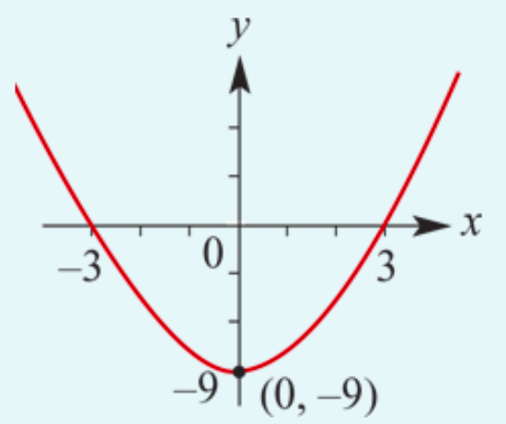
Find the 𝑥- and 𝑦-axis intercepts and the turning point, and hence sketch the graph of 𝑦=$x^{2}$−9.
Step 1 𝑐= −9. Therefore the 𝑦-axis intercept is −9.
Step 2 Let 𝑦=0. Then
0= $x^{2}$−9 = (𝑥+3)(𝑥−3)
∴𝑥=3 or 𝑥=−3
The 𝑥-axis intercepts are 3 and −3.
Step 3 The axis of symmetry is the line with equation 𝑥=$\frac{3−3}{2}$, that is, 𝑥=0.
Step 4 When 𝑥=0, 𝑦= $0^{2}$−9=−9. The turning point has coordinates (0,−9).

Slide 10
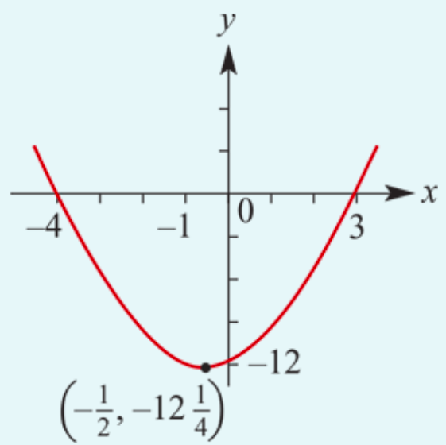
Find the 𝑥- and 𝑦-axis intercepts and the turning point, and hence sketch the graph of 𝑦=$x^{2}$+𝑥−12.
Step 1 𝑐= −12. Therefore the 𝑦-axis intercept is −12.
Step 2 Let 𝑦=0. Then
0= $x^{2}$+𝑥−12 = (𝑥+4)(𝑥−3)
∴𝑥=3 or 𝑥=−4
The 𝑥-axis intercepts are 3 and −4.
Step 3 The axis of symmetry is the line with equation 𝑥=$\frac{3−4}{2}$, that is, 𝑥= −$\frac{1}{2}$.
Step 4 When 𝑥= −$\frac{1}{2}$, 𝑦= ${(\text{−}\frac{1}{2})}^{2}$+(−$\frac{1}{2}$)−12 =−12$\frac{1}{4}$. The turning point has coordinates (−$\frac{1}{2}$, −12$\frac{1}{4}$).

Slide 11
Section summary
Steps for sketching the graph of a quadratic function given in polynomial form:
Step 1 Find the 𝑦-axis intercept.
Step 2 Find the 𝑥-axis intercepts.
Step 3 Find the equation of the axis of symmetry.
Step 4 Find the coordinates of the turning point.

