Slide 1
Solving quadratic inequalities
3G

Slide 2
To solve a quadratic inequality (for example, $x^{2}$+𝑥−12>0):
Step 1 Solve the corresponding equation (for example, $x^{2}$+𝑥−12=0).
Step 2 Sketch the graph of the quadratic polynomial (for example, 𝑦= $x^{2}$+𝑥−12).
Step 3 Use the graph to determine the set of 𝑥-values which satisfy the inequality.

Slide 3
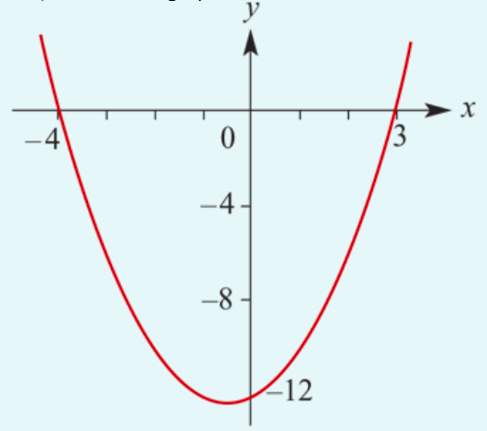
Solve $x^{2}$+𝑥−12>0.
Step 1 Solve the equation
$x^{2}$+𝑥−12=0
(𝑥+4)(𝑥−3)=0
∴𝑥=−4 or 𝑥=3
Step 2 Sketch the graph of the quadratic 𝑦= $x^{2}$+𝑥−12.
Step 3 From the graph it can be seen that
$x^{2}$+𝑥−12 > 0 when 𝑥 < −4 or 𝑥 > 3.

Slide 4
Section summary
When solving quadratic inequalities of the form 𝑎$x^{2}$+𝑏𝑥+𝑐 ≤0 (or with ≥, > or <), it is best to sketch the graph of 𝑦=𝑎$x^{2}$+𝑏𝑥+𝑐.
Or
Using Mathematica

