Slide 1
The general quadratic formula
3H
Notes:
https://drive.google.com/drive/folders/1eXK2LhICKNPuCREked-A8CB5yen-L11V
https://docs.google.com/presentation/d/16kNWM5itQMdWKI_fZ-YU9S4BRpOsVqQriGLKYIJPGiw/edit#slide=id.gcf340aa6bf_0_6

Slide 2
Proof of the Quadratic Formula
By completing the square, show that the solution of $ax^{2}+bx+c=0$ is
$$x=\frac{−b±\sqrt{b^{2}−4ac}}{2a}$$
$$ax^{2}+bx+c=0 \\ x^{2}+\frac{b}{a}x+\frac{c}{a}=0 \\ {\left(x+\frac{b}{2a}\right)}^{2}−\frac{b^{2}}{4a^{2}}+\frac{c}{a}=0 \\ {\left(x+\frac{b}{2a}\right)}^{2}=\frac{b^{2}}{4a^{2}}−\frac{c}{a}=\frac{b^{2}−4ac}{4a^{2}} \\ x+\frac{b}{2a}=±\sqrt{\frac{b^{2}−4ac}{4a^{2}}}=±\frac{\sqrt{b^{2}−4ac}}{2a} \\ x=−\frac{b}{2a}±\frac{\sqrt{b^{2}−4ac}}{2a} \\ =\frac{−b±\sqrt{b^{2}−4ac}}{2a}$$

Slide 3
quadratic formula
$$x=−\frac{b}{2a}±\frac{\sqrt{b^{2}−4ac}}{2a}$$
Derived from this general formula:
The axis of symmetry is the line with equation 𝑥= $−\frac{b}{2a}$
If $b^{2}$−4𝑎𝑐 > 0, there are two solutions.
If $b^{2}$−4𝑎𝑐 = 0, there is one solution.
If $b^{2}$−4𝑎𝑐 < 0, there are no real solutions.

Slide 4
Solve each of the following equations for 𝑥 by using the quadratic formula:
1. $x^{2}$−𝑥−1=0
2. $x^{2}$−2𝑘𝑥−3=0
Solution:
1. Here 𝑎=1, 𝑏=−1 and 𝑐=−1.
$x=\frac{−b±\sqrt{b^{2}−4ac}}{2a}$= $\frac{−(−1)±\sqrt{{(−1)}^{2}−4×1×(−1)}}{2×1}$ = $\frac{1±\sqrt{1+4}}{2}$ = $\frac{1±\sqrt{5}}{2}$
2. Here 𝑎=1, 𝑏=−2𝑘 and 𝑐=−3.
$x=\frac{−b±\sqrt{b^{2}−4ac}}{2a}$= $\frac{−(−2k)±\sqrt{{(−2k)}^{2}−4×1×(−3)}}{2×1}$ = $\frac{2k±\sqrt{{4k}^{2}+12}}{2}$ = $\frac{2k±2\sqrt{k^{2}+3}}{2}$ = $k±\sqrt{k^{2}+3}$
Note that $k^{2}+$3 ≥ 0 for all values of 𝑘,since $k^{2}$≥ 0.
$$x=\frac{−b±\sqrt{b^{2}−4ac}}{2a}$$

Slide 5
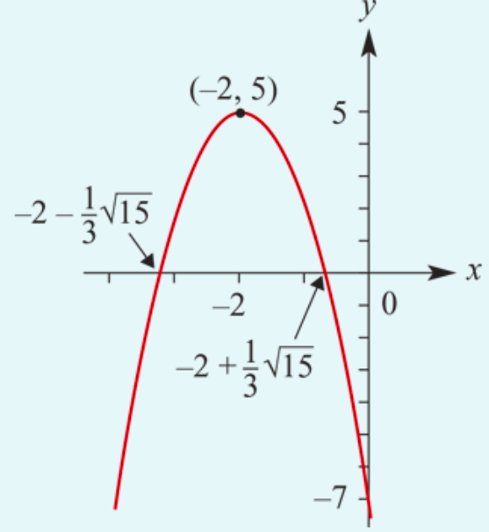
Sketch the graph of 𝑦=−3$x^{2}$−12𝑥−7. Use the quadratic formula to calculate the 𝑥-axis intercepts.
$$x=\frac{−b±\sqrt{b^{2}−4ac}}{2a}$$
Solution: a= −3, b= −12, c= −7
Since 𝑐=−7, the 𝑦-axis intercept is −7.
Axis of symmetry 𝑥= $−\frac{b}{2a}$
𝑥= $−\frac{b}{2a}$= $−\frac{−12}{2×(−3)}$=−2
Turning point
When 𝑥=−2, 𝑦=−3$×{\text{(−2)}}^{2}$−12$×$(−2)−7=5.
The turning point coordinates are (−2,5).
𝑥-axis intercepts
$x=\frac{−b±\sqrt{b^{2}−4ac}}{2a}$= $\frac{−(−12)±\sqrt{{(−12)}^{2}−4×(−3)×(−7)}}{2×(−3)}$
= $\frac{12±\sqrt{144−84}}{−6}$ = $\frac{12±2\sqrt{15}}{−6}$ = $−$2$∓\frac{1}{3}\sqrt{15}$
≈−3.29 or −0.71 (to two decimal places)

Slide 6
Section summary
The solutions of the quadratic equation 𝑎$x^{2}$+𝑏𝑥+𝑐=0, where 𝑎≠0, are given by the quadratic formula
$x=\frac{−b±\sqrt{b^{2}−4ac}}{2a}$
From the formula it can be seen that:
If $b^{2}$−4𝑎𝑐 > 0, there are two solutions.
If $b^{2}$−4𝑎𝑐 = 0, there is one solution.
If $b^{2}$−4𝑎𝑐 < 0, there are no real solutions.

