Slide 1
The discriminant
3I

Slide 2
Discriminant
In the previous section we found that the solutions to the quadratic equation 𝑎$x^{2}$+𝑏𝑥+𝑐=0 are given by
$x=\frac{−b±\sqrt{b^{2}−4ac}}{2a}$
The expression under the square root sign is called the discriminant. We write
Δ= $b^{2}−4ac$

Slide 3
The number of 𝑥-axis intercepts
There are three different possibilities for the number of 𝑥-axis intercepts of a parabola:
zero – the graph is either all above or all below the 𝑥-axis
one – the graph touches the 𝑥-axis and the turning point is the 𝑥-axis intercept
two – the graph crosses the 𝑥-axis.
For a parabola 𝑦=𝑎$x^{2}$+𝑏𝑥+𝑐, we can use the discriminant Δ= $b^{2}$−4𝑎𝑐 to determine when each of these three situations occur.

Slide 4
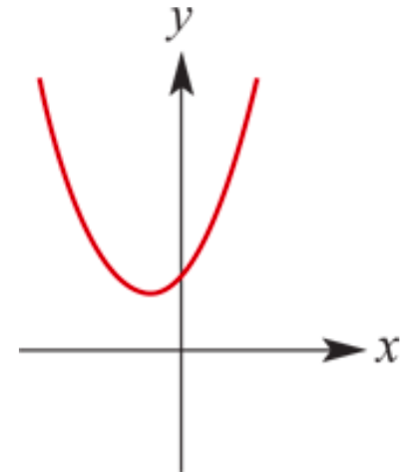
The number of 𝑥-axis intercepts
If the discriminant $b^{2}$−4𝑎𝑐 <0, then the equation 𝑎$x^{2}$+𝑏𝑥+𝑐=0 has no solutions and the corresponding parabola will have no 𝑥-axis intercepts.

Slide 5
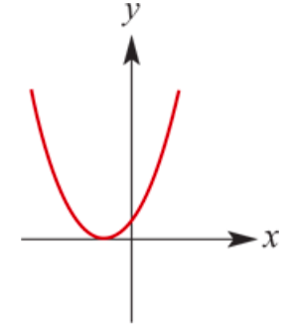
The number of 𝑥-axis intercepts
If the discriminant $b^{2}$−4𝑎𝑐 = 0, then the equation ${ax}^{2}$+𝑏𝑥+𝑐=0 has one solution and the corresponding parabola will have one 𝑥-axis intercept. (We sometimes say the equation has two coincident solutions.)

Slide 6
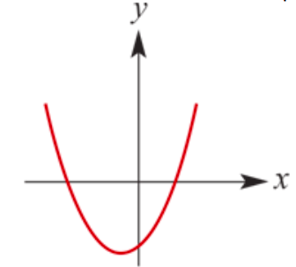
The number of 𝑥-axis intercepts
If the discriminant $b^{2}$−4𝑎𝑐 >0, then the equation ${ax}^{2}$+𝑏𝑥+𝑐=0 has two solutions and the corresponding parabola will have two 𝑥-axis intercepts.

Slide 7
Find the discriminant of each of the following quadratics and state whether the graph of each crosses the 𝑥-axis, touches the 𝑥-axis or does not intersect the 𝑥-axis.
𝑦= $x^{2}$−6𝑥+8
𝑦= $x^{2}$−8𝑥+16
𝑦=2$x^{2}$−3𝑥+4
Solution
Δ= $b^{2}$−4𝑎𝑐 = ${(−6)}^{2}$−4×1×8=4
As Δ>0, the graph intersects the 𝑥-axis at two distinct points, i.e. there are two distinct solutions of the equation $x^{2}$−6𝑥+8=0.
Δ= $b^{2}$−4𝑎𝑐 = ${(−8)}^{2}$−4×1×16=0
As Δ=0, the graph touches the 𝑥-axis, i.e. there is one solution of the equation $x^{2}$−8𝑥+16=0.
Δ= $b^{2}$−4𝑎𝑐 = ${(−3)}^{2}$−4×2×4=−23
As Δ<0, the graph does not intersect the 𝑥-axis, i.e. there are no real solutions for the equation 2$x^{2}$−3𝑥+4=0.

Slide 8
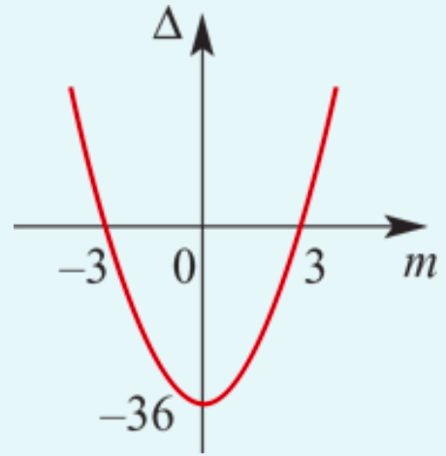
Find the values of 𝑚 for which the equation 3$x^{2}$−2𝑚𝑥+3=0 has: one solution; no solution; two distinct solutions.
Solution
For the quadratic 3$x^{2}$−2𝑚𝑥+3, the discriminant is Δ=4$m^{2}$−36.
1. For one solution:
Δ=0
$\text{4}m^{2}\text{−36}$=0
$m^{2}$=9
∴𝑚=±3
2. For no solution:
Δ<0
$\text{4}m^{2}\text{−36}$<0
From the graph, this is equivalent to −3<𝑚<3
3. For two distinct solutions:
Δ>0
$\text{4}m^{2}\text{−3}\text{6}$>0
From the graph it can be seen that 𝑚>3 or 𝑚<−3

Slide 9
Show that the solutions of the equation 3$x^{2}$+(𝑚−3)𝑥−𝑚=0 are rational for all rational values of 𝑚.
Solution
Δ=${\text{(}\text{m}\text{−3)}}^{2}$−4×3×(−𝑚)
=$m^{2}$−6𝑚+9+12𝑚
=$m^{2}$+6𝑚+9
= ${(m+3)}^{2}$≥0 for all 𝑚
Furthermore, Δ is a perfect square for all 𝑚.

Slide 10
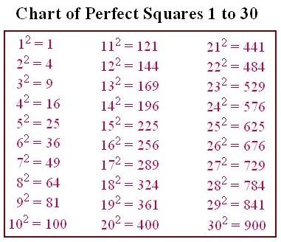
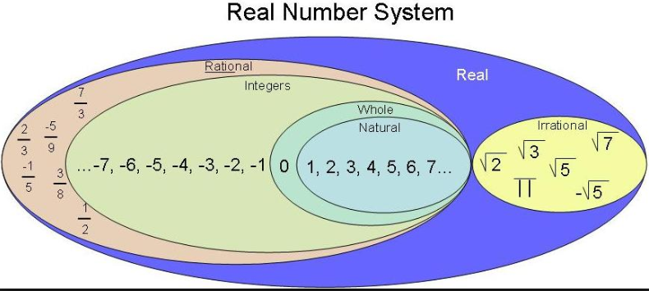
Section summary
The discriminant Δ of a quadratic polynomial 𝑎$x^{2}$+𝑏𝑥+𝑐 is
Δ=$b^{2}$−4𝑎𝑐
For the equation 𝑎$x^{2}$+𝑏𝑥+𝑐=0:
If Δ>0, there are two solutions.
If Δ=0, there is one solution.
If Δ<0, there are no real solutions.
For the equation 𝑎$x^{2}$+𝑏𝑥+𝑐=0 where 𝑎, 𝑏 and 𝑐 are rational numbers:
If Δ is a perfect square and Δ≠0, then the equation has two rational solutions.
If Δ=0, then the equation has one rational solution.
If Δ is not a perfect square and Δ>0, then the equation has two irrational solutions.

