Slide 1
Solving simultaneous linear and quadratic equations
3J

Slide 2
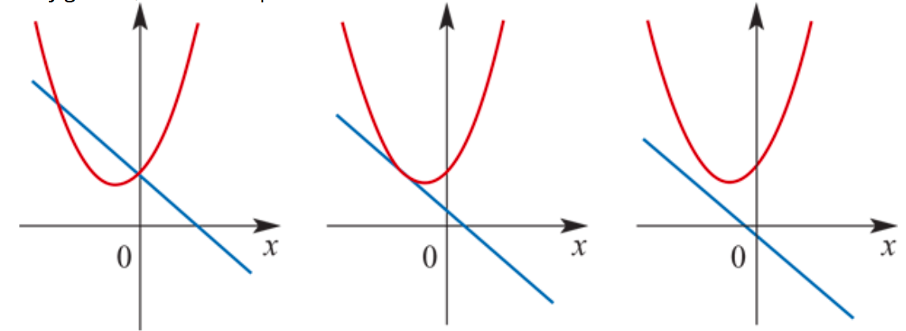
Solving simultaneous linear and quadratic equations
The straight line intersects, touches or does not intersect the parabola we may get two, one or zero points of intersection.
If there is one point of intersection between the parabola and the straight line, then the line is a tangent to the parabola.

Slide 3
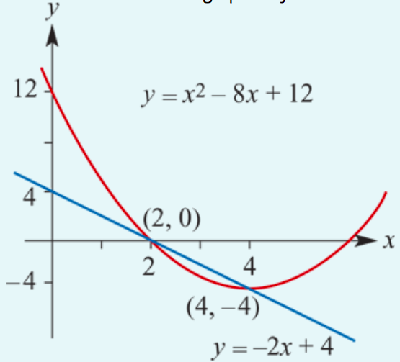
Find the points of intersection of the line with equation 𝑦=−2𝑥+4 and the parabola with equation 𝑦=$x^{2}$−8𝑥+12.
At the point of intersection:
$x^{2}$−8𝑥+12= − 2𝑥+4
$x^{2}$−6𝑥+8=0
(𝑥−2)(𝑥−4)=0
Hence 𝑥=2 or 𝑥=4.
When 𝑥=2, 𝑦=−2×2+4=0.
When 𝑥=4, 𝑦=−2×4+4=−4.
Therefore the points of intersection are (2,0) and (4,−4).

Slide 4
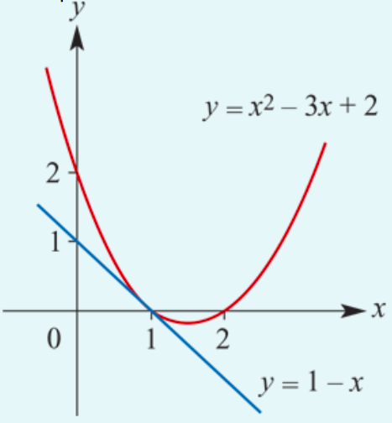
Prove that the straight line with the equation 𝑦=1−𝑥 meets the parabola with the equation 𝑦=$x^{2}$−3𝑥+2 once only.
At the point of intersection:
$x^{2}$−3𝑥+2= 1−𝑥
$x^{2}$−2𝑥+1=0
${\text{(}\text{x}\text{−}\text{1}\text{)}}^{2}$=0
Therefore 𝑥=1 and 𝑦=1−1=0.
The straight line just touches the parabola at (1,0).

Slide 5
Section summary
To find the points of intersection of a straight line 𝑦=𝑚𝑥+$c_{2}$and a parabola 𝑦=𝑎$x^{2}$+𝑏𝑥+$c_{1}$:
Form the quadratic equation 𝑎$x^{2}$+𝑏𝑥+$c_{1}$=𝑚𝑥+$c_{2}$
Rearrange the equation so that the right-hand side is zero: 𝑎$x^{2}$+(𝑏−𝑚)𝑥+($c_{1}$−$c_{2}$)=0
Solve the equation for 𝑥 and substitute these 𝑥-values into the equation of the line to find the corresponding 𝑦-values.
The discriminant applied to the second equation, 𝑎$x^{2}$+(𝑏−𝑚)𝑥+($c_{1}$−$c_{2}$)=0, can be used to determine the number of intersection points:
If Δ>0, there are two intersection points.
If Δ=0, there is one intersection point.
If Δ<0, there are no intersection points.

Slide 6
Mathematica

