Slide 1

Families of quadratic polynomial functions
3K
Notes:
https://www.transum.org/software/SW/Starter_of_the_day/Students/Quadratic.asp?Level=3

Slide 2
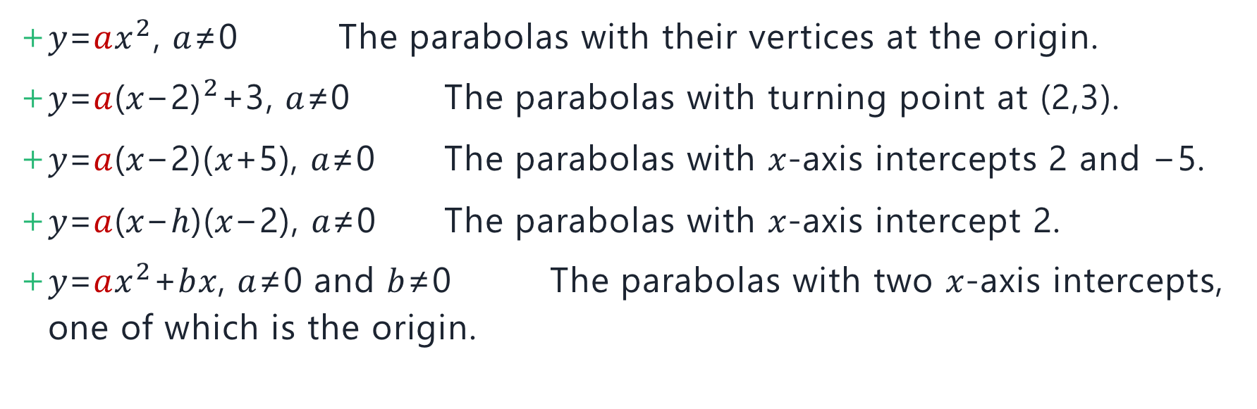
Families of quadratics
𝑦=𝑎$x^{2}$, 𝑎≠0 The parabolas with their vertices at the origin.
𝑦=𝑎${\text{(}\text{x}\text{−2)}}^{2}$+3, 𝑎≠0 The parabolas with turning point at (2,3).
𝑦=𝑎(𝑥−2)(𝑥+5), 𝑎≠0 The parabolas with 𝑥-axis intercepts 2 and −5.
𝑦=𝑎(𝑥−ℎ)(𝑥−2), 𝑎≠0 The parabolas with 𝑥-axis intercept 2.
𝑦=𝑎$x^{2}$+𝑏𝑥, 𝑎≠0 and 𝑏≠0 The parabolas with two 𝑥-axis intercepts, one of which is the origin.

Slide 3
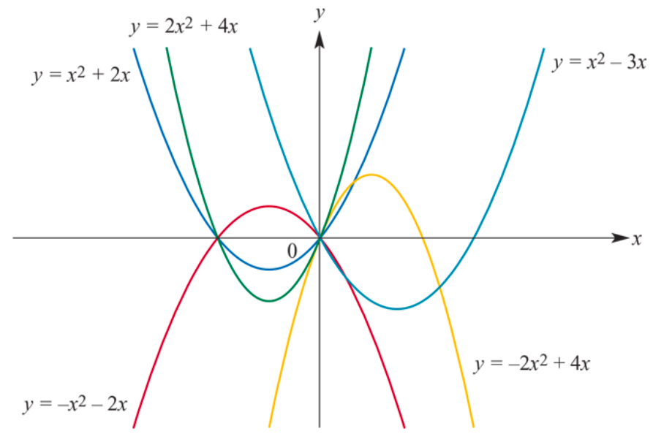
Families of quadratics
For 𝑦= 𝑎$x^{2}$+𝑏𝑥 some possible curves are shown below.

Slide 4

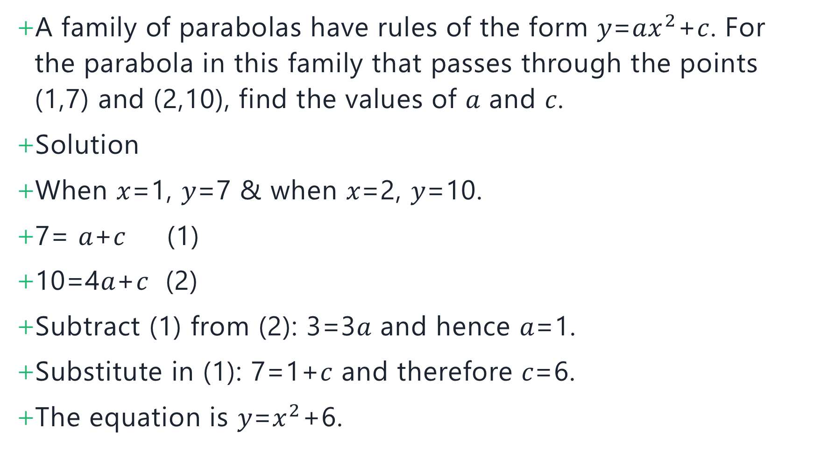
A family of parabolas have rules of the form 𝑦=𝑎$x^{2}$+𝑐. For the parabola in this family that passes through the points (1,7) and (2,10), find the values of 𝑎 and 𝑐.
Solution
When 𝑥=1, 𝑦=7 & when 𝑥=2, 𝑦=10.
7= 𝑎+𝑐 (1)
10=4𝑎+𝑐 (2)
Subtract (1) from (2): 3=3𝑎 and hence 𝑎=1.
Substitute in (1): 7=1+𝑐 and therefore 𝑐=6.
The equation is 𝑦=$x^{2}$+6.

Slide 5
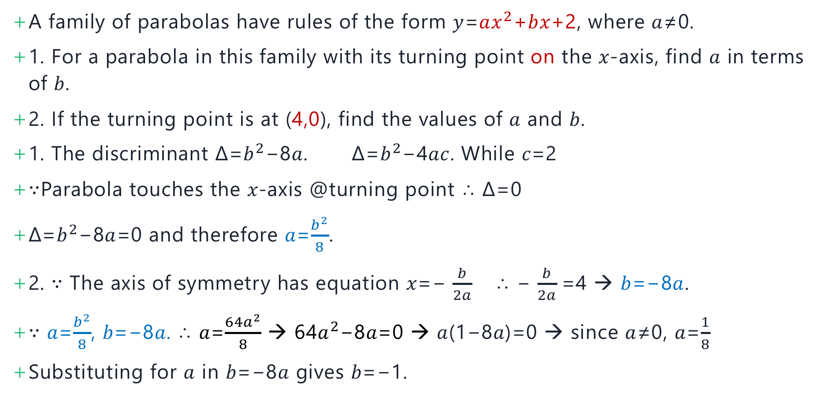
A family of parabolas have rules of the form 𝑦=𝑎$x^{2}$+𝑏𝑥+2, where 𝑎≠0.
1. For a parabola in this family with its turning point on the 𝑥-axis, find 𝑎 in terms of 𝑏.
2. If the turning point is at (4,0), find the values of 𝑎 and 𝑏.
1. The discriminant Δ=$b^{2}$−8𝑎. Δ=$b^{2}$−4𝑎𝑐. While 𝑐=2
∵Parabola touches the 𝑥-axis @turning point ∴ Δ=0
Δ=$b^{2}$−8𝑎=0 and therefore 𝑎=$\frac{b^{2}}{8}$.
2. ∵ The axis of symmetry has equation 𝑥=− $\frac{b}{2a}$ ∴ − $\frac{b}{2a}$=4 → 𝑏=−8𝑎.
∵ 𝑎=$\frac{b^{2}}{8}$, 𝑏=−8𝑎. ∴ 𝑎=$\frac{64a^{2}}{8}$ → 64$a^{2}$−8𝑎=0 → 𝑎(1−8𝑎)=0 → since 𝑎≠0, 𝑎=$\frac{1}{8}$
Substituting for 𝑎 in 𝑏=−8𝑎 gives 𝑏=−1.

Slide 6
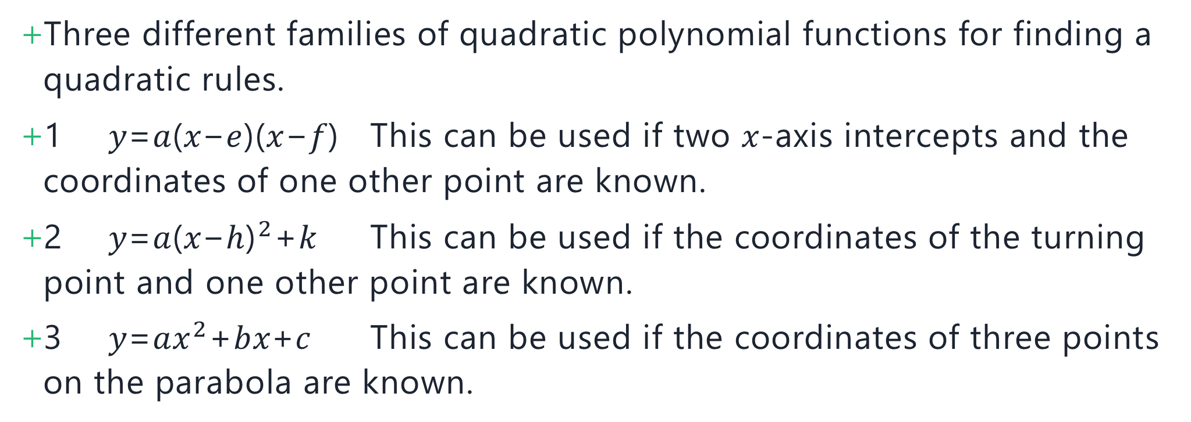
Determining quadratic rules
Three different families of quadratic polynomial functions for finding a quadratic rules.
1 𝑦=𝑎(𝑥−𝑒)(𝑥−𝑓) This can be used if two 𝑥-axis intercepts and the coordinates of one other point are known.
2 𝑦=𝑎${\text{(}\text{x}\text{−}\text{h}\text{)}}^{2}$+𝑘 This can be used if the coordinates of the turning point and one other point are known.
3 𝑦=𝑎$x^{2}$+𝑏𝑥+𝑐 This can be used if the coordinates of three points on the parabola are known.

Slide 7
A parabola has 𝑥-axis intercepts −3 and 4 and it passes through the point (1,24). Find the rule for this parabola.
Solution
∵ Two 𝑥-axis intercepts given. Use 𝑦=𝑎(𝑥−𝑒)(𝑥−𝑓).
𝑦=𝑎(𝑥+3)(𝑥−4)
When 𝑥=1, 𝑦=24.
Therefore24= 𝑎(1+3)(1−4)
24=−12𝑎
𝑎=−2
The rule is 𝑦=−2(𝑥+3)(𝑥−4).

Slide 8
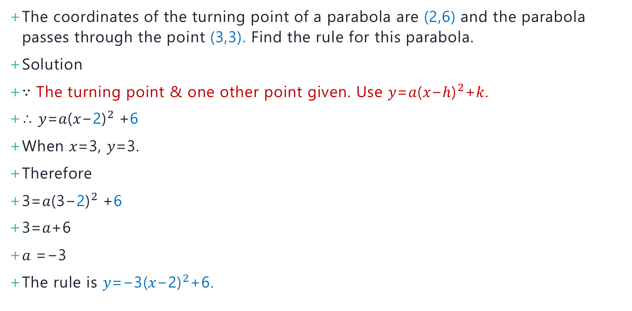
The coordinates of the turning point of a parabola are (2,6) and the parabola passes through the point (3,3). Find the rule for this parabola.
Solution
∵ The turning point & one other point given. Use 𝑦=𝑎${\text{(}\text{x}\text{−}\text{h}\text{)}}^{2}$+𝑘.
∴ 𝑦=𝑎${\text{(}\text{x}\text{−}\text{2}\text{)}}^{2}$+6
When 𝑥=3, 𝑦=3.
Therefore
3=𝑎${\text{(}\text{3}\text{−}\text{2}\text{)}}^{2}$+6
3=𝑎+6
𝑎 =−3
The rule is 𝑦=−3${\text{(}\text{x}\text{−}\text{2}\text{)}}^{2}$+6.

Slide 9
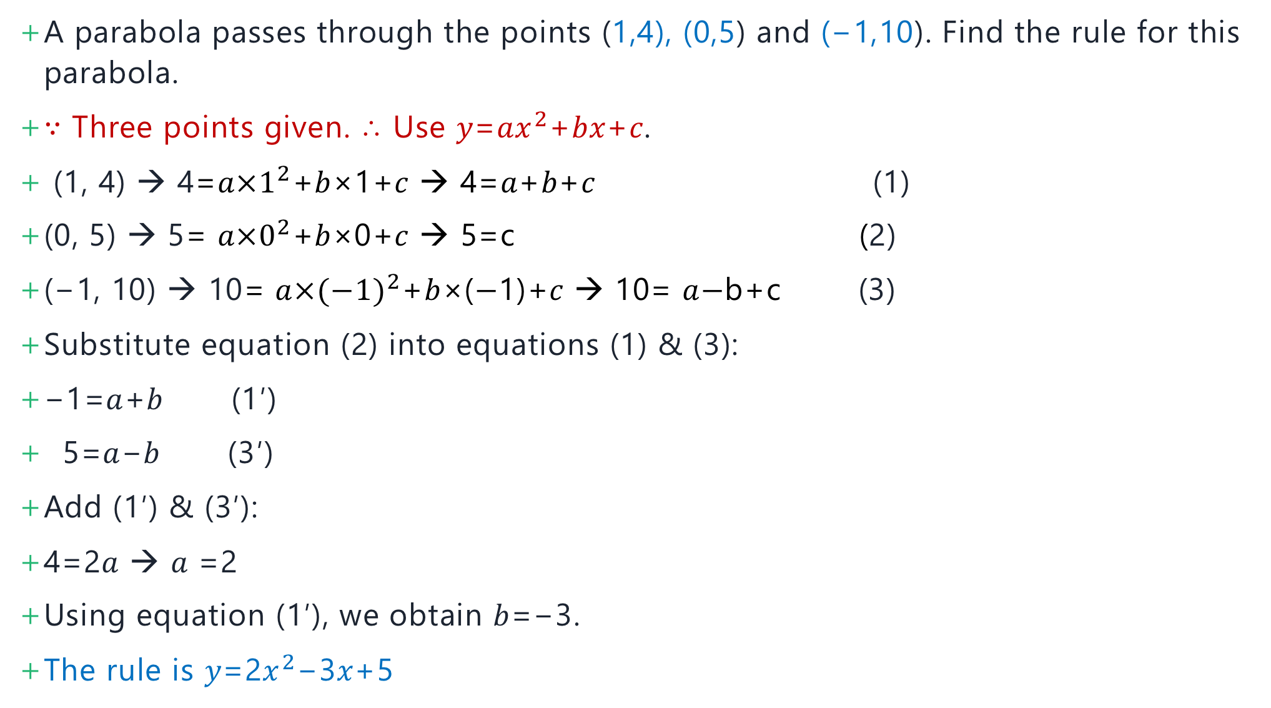
A parabola passes through the points (1,4), (0,5) and (−1,10). Find the rule for this parabola.
∵ Three points given. ∴ Use 𝑦=𝑎$x^{2}$+𝑏𝑥+𝑐.
(1, 4) → 4=𝑎${×1}^{2}$+𝑏×1+𝑐 → 4=𝑎+𝑏+𝑐 (1)
(0, 5) → 5= 𝑎${×0}^{2}$+𝑏×0+𝑐 → 5=c (2)
(−1, 10) → 10= 𝑎${×(−1)}^{2}$+𝑏×($−$1)+𝑐 → 10= 𝑎$−$b+c (3)
Substitute equation (2) into equations (1) & (3):
−1=𝑎+𝑏 (1′)
5=𝑎−𝑏 (3′)
Add (1′) & (3′):
4=2𝑎 → 𝑎 =2
Using equation (1′), we obtain 𝑏=−3.
The rule is 𝑦=2$x^{2}$−3𝑥+5

Slide 10
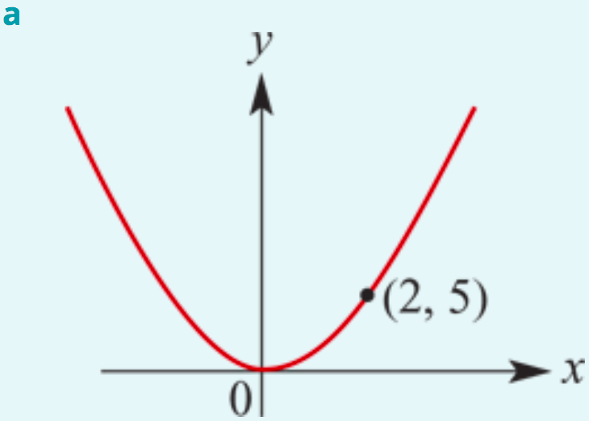
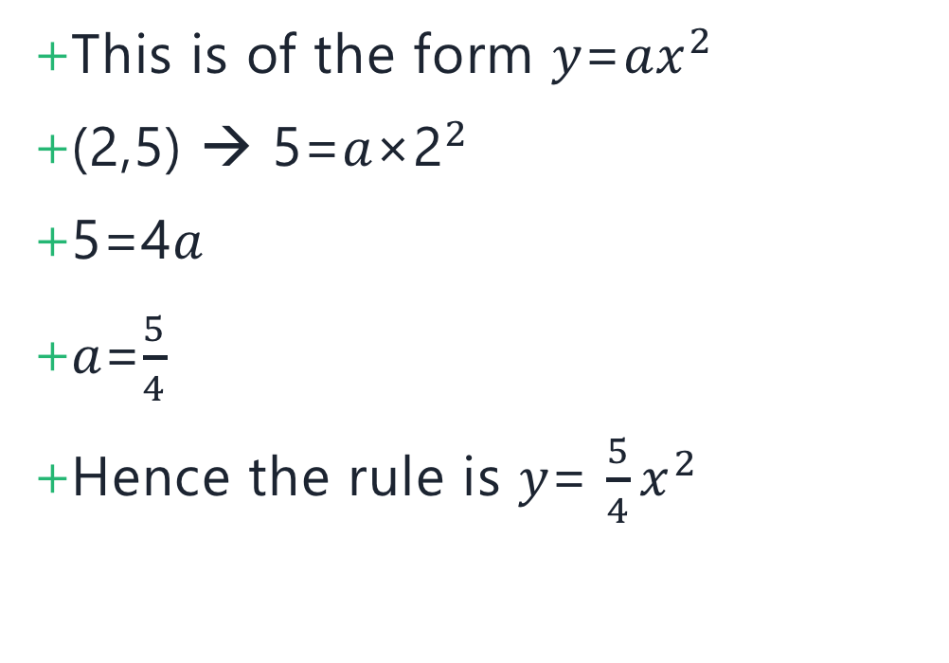
Determine the quadratic rule for each of the following parabolas:
This is of the form 𝑦=𝑎${\text{x}}^{2}$
(2,5) → 5=𝑎×${\text{2}}^{2}$
5=4𝑎
𝑎=$\frac{5}{4}$
Hence the rule is 𝑦= $\frac{5}{4}{\text{x}}^{2}$

Slide 11
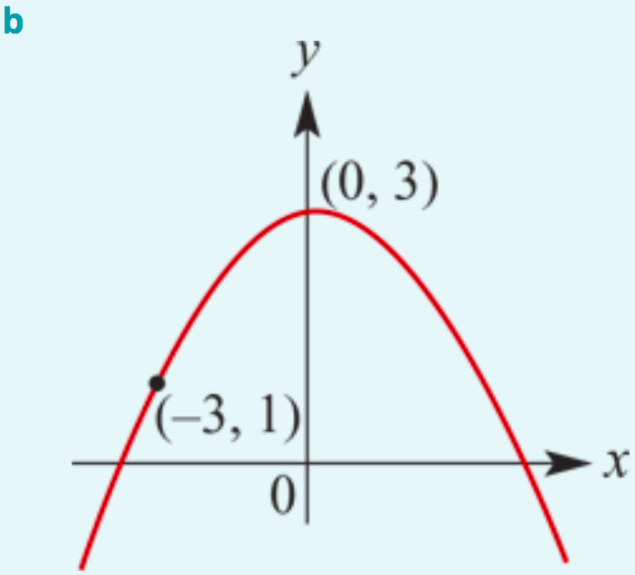
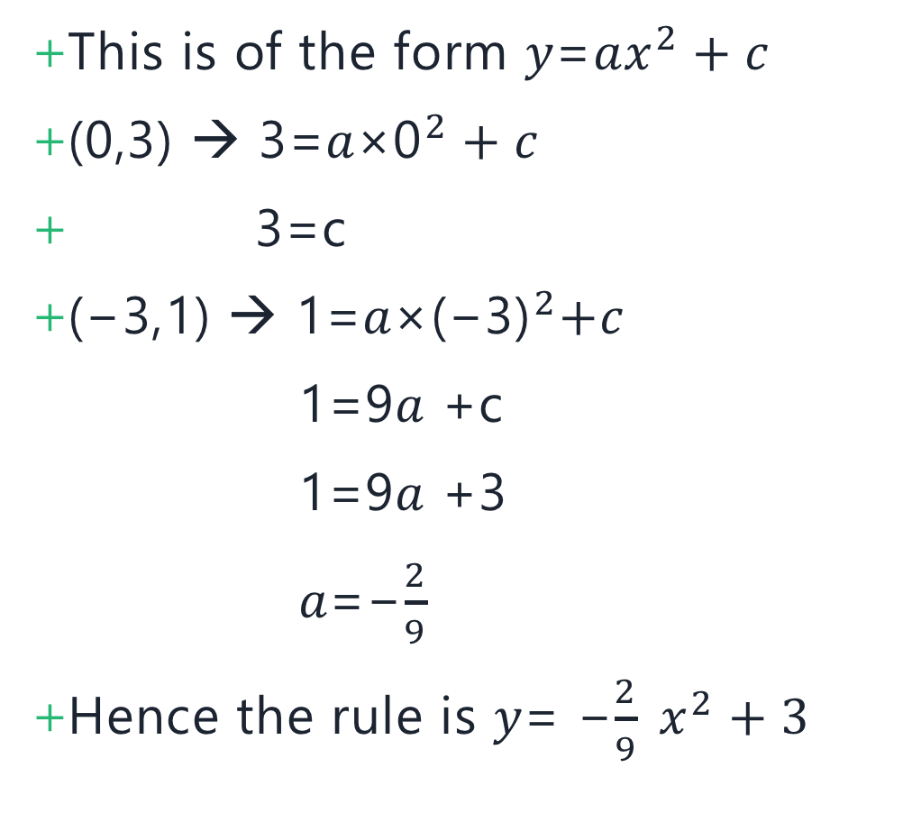
Determine the quadratic rule for each of the following parabolas:
This is of the form 𝑦=𝑎${\text{x}}^{2}+c$
(0,3) → 3=𝑎×${\text{0}}^{2}+c$
3=c
(−3,1) → 1=𝑎${\text{×}\text{(}\text{−}\text{3)}}^{2}+c$
1=9𝑎 +c
1=9𝑎 +3
𝑎=−$\frac{2}{9}$
Hence the rule is 𝑦= −$\frac{2}{9} {\text{x}}^{2}+3$

Slide 12
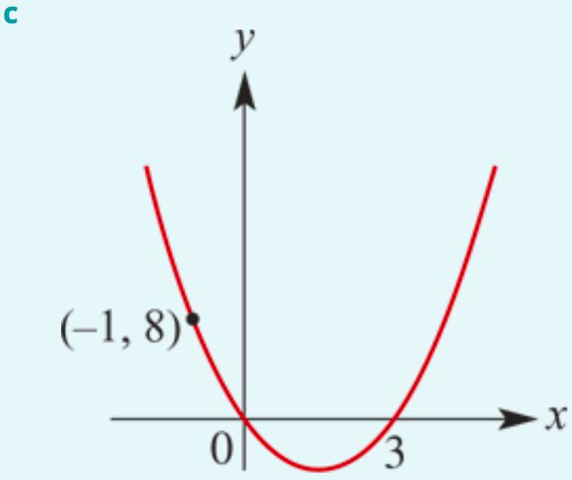
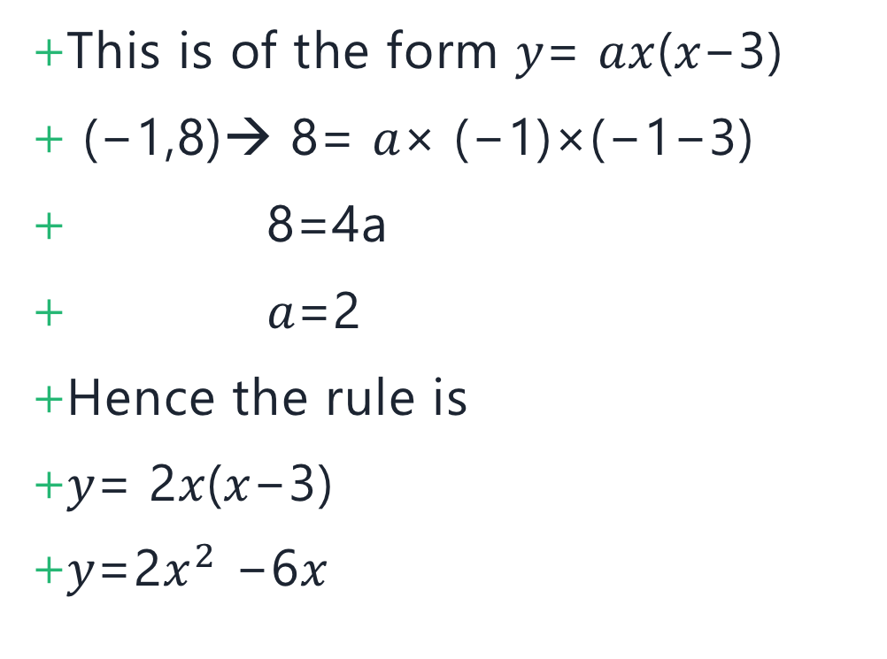
Determine the quadratic rule for each of the following parabolas:
This is of the form 𝑦= 𝑎𝑥(𝑥−3)
(−1,8)→ 8= 𝑎× (−1)×(−1−3)
8=4a
𝑎=2
Hence the rule is
𝑦= 2𝑥(𝑥−3)
𝑦=2${\text{x}}^{2}$ −6𝑥

Slide 13
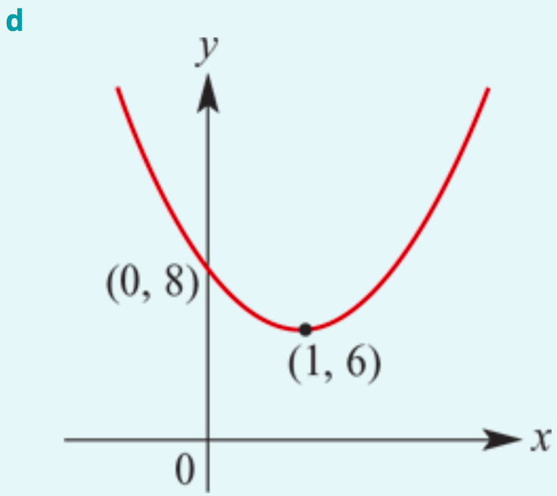
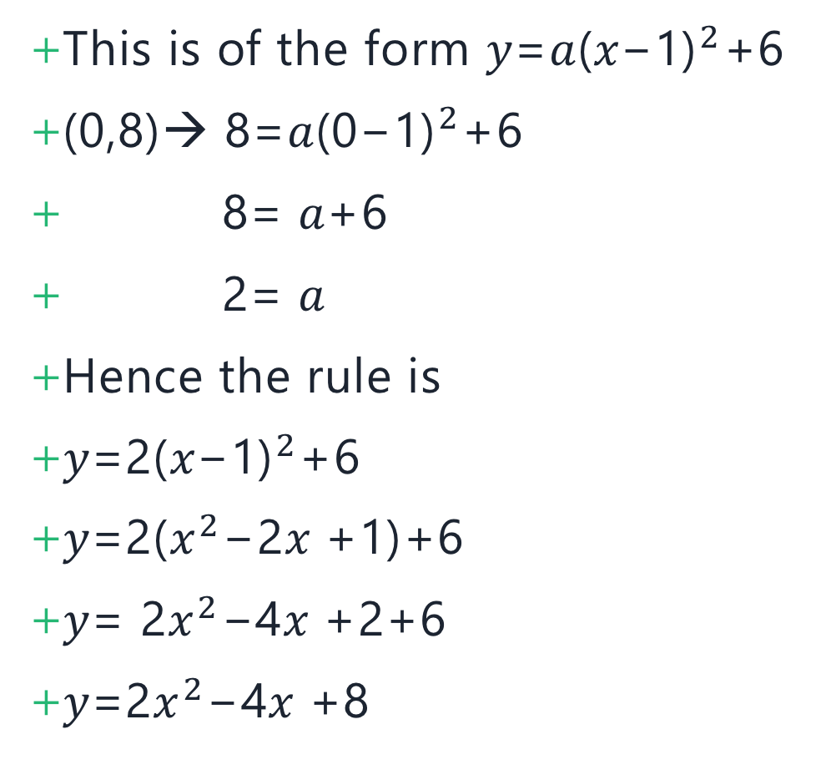
Determine the quadratic rule for each of the following parabolas:
This is of the form 𝑦=𝑎${\text{(}\text{x}\text{−1)}}^{2}$+6
(0,8)→ 8=𝑎${\text{(}\text{0}\text{−1)}}^{2}$+6
8= 𝑎+6
2= 𝑎
Hence the rule is
𝑦=2${\text{(}\text{x}\text{−1)}}^{2}$+6
𝑦=2(${\text{x}}^{2}\text{−}\text{2}\text{x} \text{+}\text{1}$)+6
𝑦= 2${\text{x}}^{2}\text{−}$4$\text{x}$+2+6
𝑦=2${\text{x}}^{2}\text{−}$4$\text{x}$+8

Slide 14
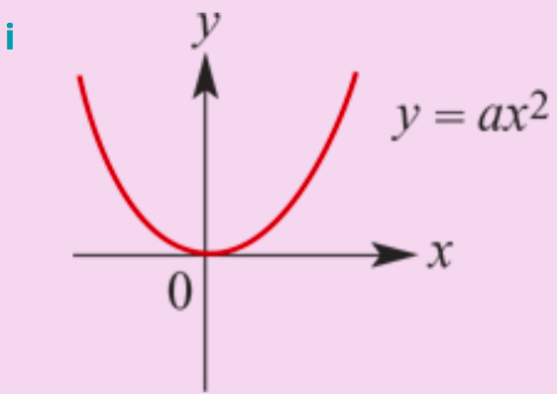
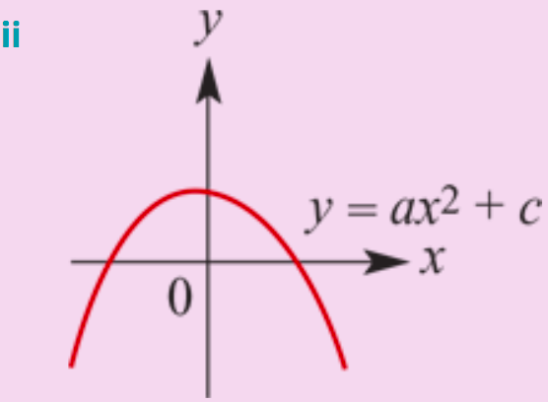
Section summary: To find a quadratic rule to fit given points, first choose the best form of quadratic expression to work with.
One point is needed to determine 𝑎.
Two points are needed to determine 𝑎 and 𝑐.

Slide 15
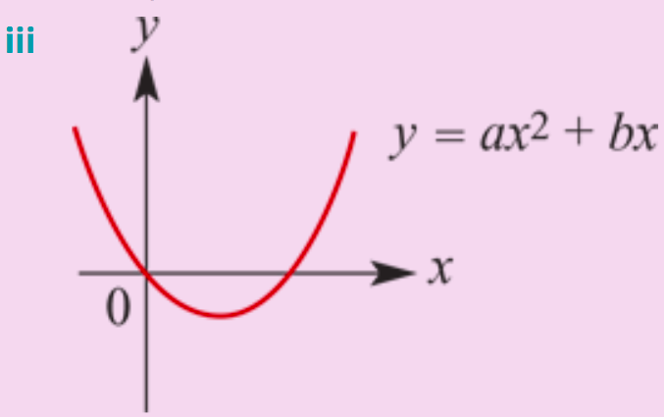
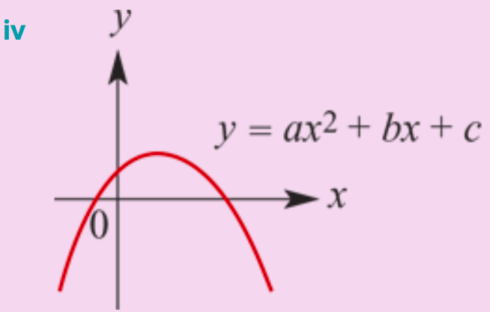
Section summary: To find a quadratic rule to fit given points, first choose the best form of quadratic expression to work with.
Two points are needed to determine 𝑎 and 𝑏.
Three points are needed to determine 𝑎, 𝑏 and 𝑐.

