Slide 1
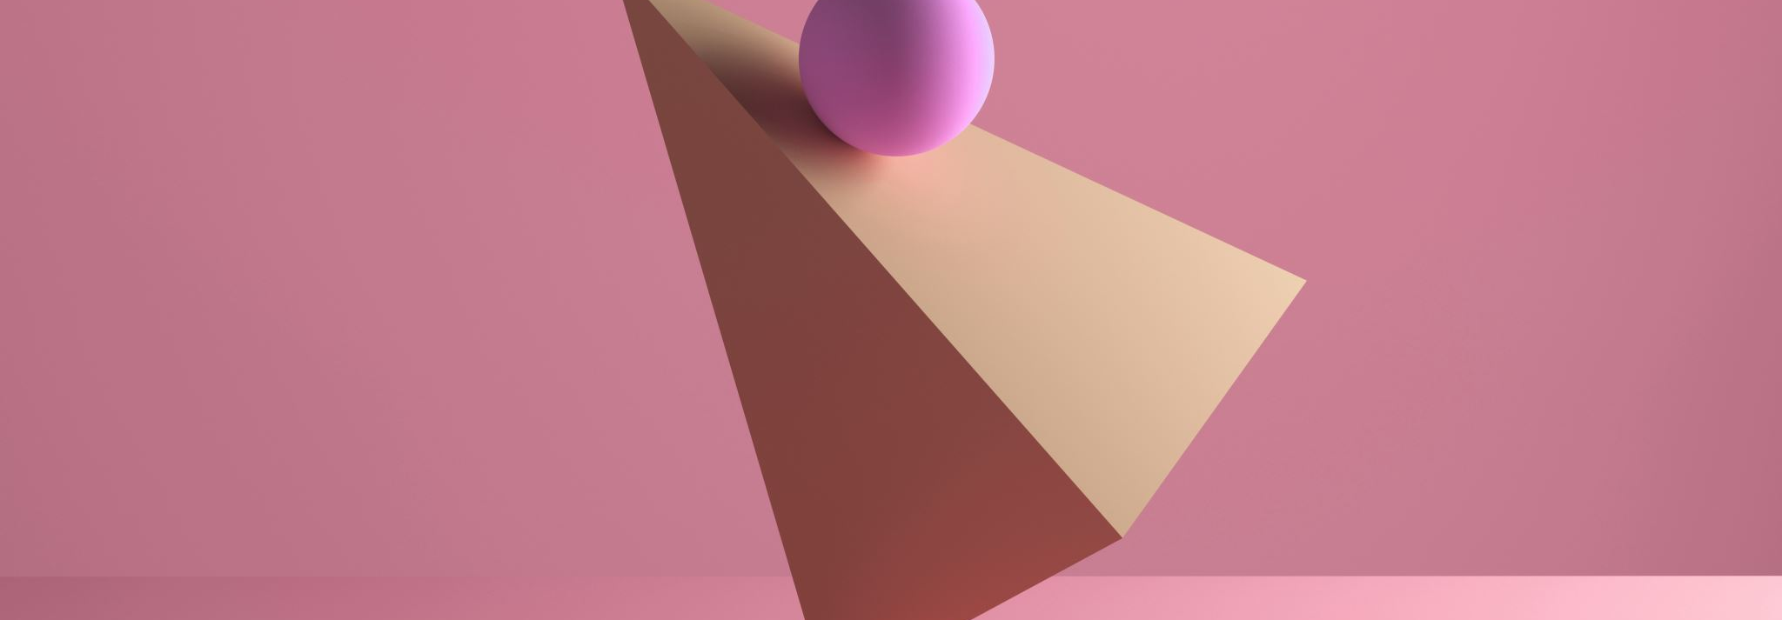
Quadratic models
3L Finding the maximum or minimum value of a quadratic polynomial.

Slide 2
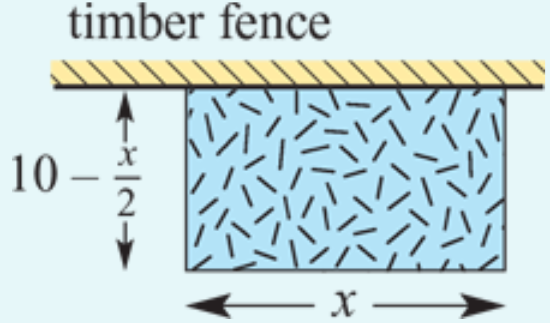
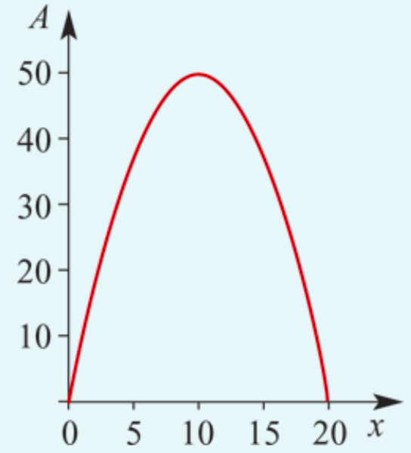
Jenny wishes to fence off a rectangular vegetable garden in her backyard. She has 20 m of fencing wire which she will use to fence three sides of the garden, with the existing timber fence forming the fourth side. Calculate the maximum area she can enclose.
Let
𝐴=area of the rectangular garden
𝑥=length of the garden
Then width=$\frac{\text{20−}\text{x}}{2}$ =10− $\frac{\text{x}}{2}$
Therefore
𝐴=𝑥(10− $\frac{\text{x}}{2}$)=10𝑥− $\frac{x^{2}}{2}$
= − $\frac{\text{1}}{2}$($x^{2}$−20𝑥+100−100)
= − $\frac{\text{1}}{2}$($x^{2}$−20𝑥+100)+50
= − $\frac{\text{1}}{2}$(${x−10)}^{2}$+50
Hence the maximum area is 50 $m^{2}$ when 𝑥=10.

Slide 3
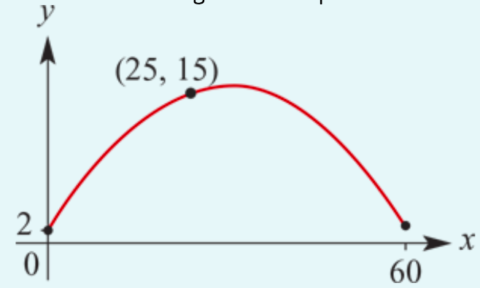
A cricket ball is thrown by a fielder. It leaves his hand at a height of 2 metres above the ground and the wicketkeeper takes the ball 60 metres away again at a height of 2 metres. It is known that after the ball has gone 25 metres it is 15 metres above the ground. The path of the cricket ball is a parabola with equation 𝑦=𝑎$x^{2}$+𝑏𝑥+𝑐.
1. Find the values of 𝑎, 𝑏 and 𝑐.
2. Find the maximum height of the ball above the ground.
3. Find the height of the ball when it is 5 metres horizontally before it hits the wicketkeeper’s gloves.
1. (0,2) ${→ \text{2}=0}^{2}$−20×0+c → c=2 (1)
(25,15) → 15=𝑎${\text{×}25}^{2}$+𝑏×25+𝑐 → 15=625𝑎 +25b+c (2)
(60,2) → 2=𝑎${\text{×}60}^{2}$+𝑏×60+𝑐 → 2=3600𝑎 +60b+c (3)
Substitute equation (1) in equations (2) & (3):
15=625𝑎 +25b+2 → 13=625𝑎 +25b (2′)
2=3600𝑎 +60b+2 → 0=3600𝑎+60𝑏 → 0=60𝑎+𝑏 (3′)
25 × (3′) − (2′) → −13=60×25𝑎 − 625𝑎 =875𝑎 ∴𝑎=− $\frac{13}{875} \&$𝑏= $\frac{156}{175}$
The path of the ball has equation 𝑦=− $\frac{13}{875}x^{2}$+ $\frac{156}{175}$𝑥+2
2. The maximum height occurs when 𝑥=30 and 𝑦= $\frac{538}{35}$. ∴ maximum height is $\frac{538}{35}$ m.
3. When 𝑥=5, 𝑦= $\frac{213}{35}$. ∴ height of the ball is $\frac{213}{35}$ m.

