Slide 1
Division of polynomials
6B

Slide 2
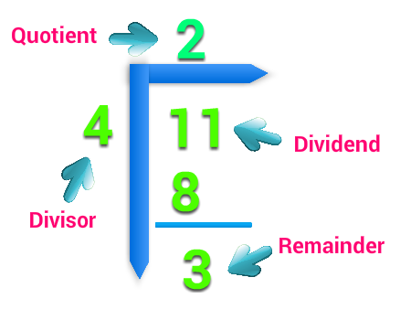
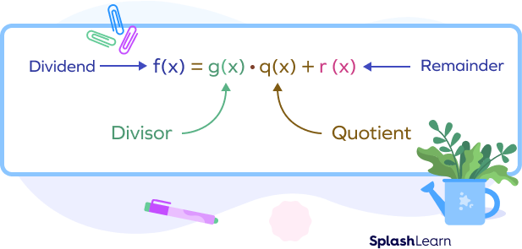
Definition
11=4×8+3

Slide 3
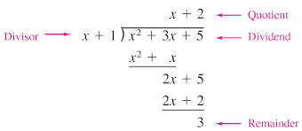
Definition

Slide 4
Long division with positive integers
As with quadratics, finding x-axis intercepts can be done by factorising and then solving the resulting equation using the null factor theorem.
We show the process for 274÷13.
We have
274=13×21+1
Here 274 is the dividend, 13 the divisor, 21 the quotient and 1 the remainder.

Slide 5
Long division with positive integers
When we divide the number p by d we obtain two integers, q the quotient and r the remainder, such that
p=dq+r and 0≤r<d
For example,
27=4×6+3
If r=0, then d is a factor of p. For example, 24=4×6.

Slide 6
Long division with polynomials
The process for dividing a polynomial by a linear polynomial follows very similar steps. For example, ($x^{2}$+7$x$+11)÷($x$−2) gives
Thus ($x^{2}$+7 $x$+11)÷($x$−2)= $x$+9 with remainder 29. We write
$x^{2}$+7$x$+11=($x$−2)($x$+9)+29
We can see in this example that $x$−2 is not a factor of $x^{2}$+7$x$+11. We can also write the result as
$\frac{x^{2} \text{+7}x \text{+11}}{x \text{−2}}$= $x$+9+ $\frac{29}{x \text{−2}}$
In this example:
$x^{2}$+7$x$+11 is the dividend
$x$−2 is the divisor
29 is the remainder.

Slide 7
Long division with polynomials
When we divide the polynomial P($x$) by the polynomial D($x$) we obtain two polynomials, Q($x$) the quotient and R($x$) the remainder, such that
P($x$)=D($x$)Q($x$)+R($x$)
and either R($x$)=0 or R($x$) has degree less than D($x$).
Here P($x$) is the dividend and D($x$) is the divisor.
Note:
If R($x$)=0, then D($x$) is a factor of P($x$). For example, let P($x$)= $x^{2}$+6$x$+8 and D($x$)= $x$+2. Then P($x$)=($x$+2)($x$+4)=D($x$)($x$+4)+0.

Slide 8
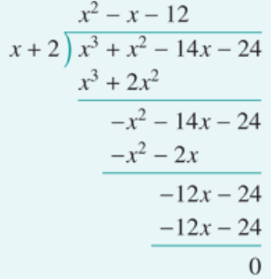
Example
Divide $x^{3}$+ $x^{2}$−14$x$−24 by $x$+2.
Divide $x$, from $x$+2, into the leading term $x^{3}$ to get $x^{2}$.
Multiply $x^{2}$ by $x$+2 to give $x^{3}$+2$x^{2}$.
Subtract from $x^{3}$+ $x^{2}$ −14$x$−24, leaving −$x^{2}$−14$x$−24.
Now divide $x$, from $x$+2, into − $x^{2}$ to get − $x$.
Multiply − $x$ by $x$+2 to give − $x^{2}$ −2$x$.
Subtract from − $x^{2}$ −14$x$−24, leaving −12$x$−24.
Divide x into −12$x$ to get −12.
Multiply −12 by $x$+2 to give −12$x$−24.
Subtract from −12$x$−24, leaving remainder of 0.
In this example we see that $x$+2 is a factor of $x^{3}$+ $x^{2}$−14$x$−24 , as the remainder is zero. Thus ($x^{3}$+ $x^{2}$−14$x$−24 )÷($x$+2)= $x^{2}$− $x$−12 with zero remainder.
∴ $\frac{x^{3} \text{+ }x^{2} \text{−14}x \text{−24}}{x \text{+}\text{2}}$= $x^{2}$− $x$−12

Slide 9
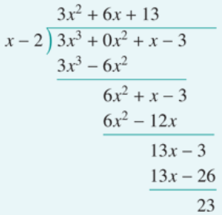
Example
Divide 3$x^{3}$+ $x$−3 by $x$−2.
Here there is no term in $x^{2}$, however we can rewrite the polynomial as 3$x^{3}$+0$x^{2}$+ $x$−3.
Divide $x$, from $x$−2, into 3$x^{3}$ to get 3$x^{2}$.
Multiply 3x2 by $x$−2 to give 3$x^{3}$−6$x^{2}$.
Subtract from 3$x^{3}$+0$x^{2}$+x−3, leaving 6$x^{2}$+ $x$−3.
Now divide $x$, from $x$−2, into 6$x^{2}$ to get 6 $x$.
Multiply 6$x$ by $x$−2 to give 6$x^{2}$−12$x$.
Subtract from 6$x^{2}$+ $x$−3, leaving 13$x$−3.
Divide $x$ into 13 $x$ to get 13.
Multiply 13 by $x$−2 to give 13$x$−26.
Subtract from 13$x$−3, leaving remainder of 23.
From this example, we have
3$x^{3}$+ $x$−3=($x$−2)(3$x^{2}$+6$x$+13)+23
Alternatively, we can write
$\frac{\text{3}x^{3} \text{+}\text{x}\text{−3}}{x \text{−2}}$=3$x^{2}$+6$x$+13+ $\frac{\text{23}}{x \text{−2}}$

Slide 10
Equating coefficients to divide
To divide $x^{3}$−7$x^{2}$+5$x$−4 by $x$−3, first write the identity
$x^{3}$−7$x^{2}$+5$x$−4 =($x$−3)($x^{2}$+b$x$+c)+r
We first find b, then c and finally r by equating coefficients of the left-hand side and right-hand side of this identity.
$x^{2}$ term Left-hand side: −7$x^{2}$. Right-hand side: −3$x^{2}$+b$x^{2}$=(−3+b)$x^{2}$.
Therefore −3+b=−7. Hence b=−4.
$x$ term Left-hand side: 5$x$. Right-hand side: 12$x$+c$x$=(12+c)$x$.
Therefore 12+c=5. Hence c=−7.
constant term Left-hand side: −4. Right-hand side: 21+r.
Therefore 21+r=−4. Hence r=−25.
So we can write $x^{3}$−7$x^{2}$+5$x$−4 =($x$−3)($x^{2}\text{−4}x\text{−}$7)−25.

Slide 11
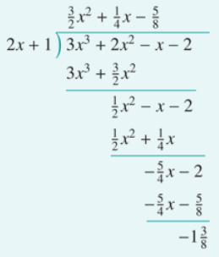
Example
Divide 3$x^{3}$+2$x^{2}$− $x$−2 by 2$x$+1.
We show the alternative method here.
First write the identity
3$x^{3}$+2$x^{2}$−$x$−2 =(2 $x$+1)(a$x^{2}$+b$x$+c)+r
Equate coefficients of $x^{3}$:
3=2a. Therefore a= $\frac{\text{3}}{\text{2}}$.
Equate coefficients of $x^{2}$:
2=a+2b. Therefore b= $\frac{\text{1}}{\text{2}}$(2− $\frac{\text{3}}{\text{2}}$)= $\frac{\text{1}}{\text{4}}$.
Equate coefficients of $x$:
−1=2c+b. Therefore c= $\frac{\text{1}}{\text{2}}$(−1− $\frac{\text{1}}{\text{4}}$)=− $\frac{\text{5}}{\text{8}}$.
Equate constant terms:
−2=c+r. Therefore r=−2+ $\frac{\text{5}}{\text{8}}$=− $\frac{\text{11}}{\text{8}}$.

Slide 12
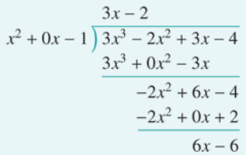
Dividing by a non-linear polynomial
We give one example of dividing by a non-linear polynomial. The technique is exactly the same as when dividing by a linear polynomial.
Divide 3$x^{3}$−2$x^{2}$+3$x$−4 by $x^{2}$−1. We write $x^{2}$−1 as $x^{2}$+0$x$−1.
∴ 3$x^{3}$−2$x^{2}$+3$x$−4 =($x^{2}$−1)(3$x$−2)+6$x$−6

Slide 13
Dividing Polynomials Using Synthetic Division

Slide 14
Synthetic Division
There is a shortcut for long division as long as the divisor is x – k where k is some number. (Can't have any powers on x).
Set divisor = 0 and solve. Put answer here.
1
x + 3 = 0 so x = - 3
- 3
1 6 8 -2
- 3
Add these up
- 9
3
Bring first number down below line
Add these up
Multiply these and put answer above line in next column
Add these up
Multiply these and put answer above line in next column
Multiply these and put answer above line in next column
1
x² + x
3
- 1
1
This is the remainder
Put variables back in (one x was divided out in process so first number is one less power than original problem).
So the answer is:
List all coefficients (numbers in front of x's) and the constant along the top. If a term is missing, put in a 0.

Slide 15
Let's try another Synthetic Division
0 x³
0 x
Set divisor = 0 and solve. Put answer here.
1
x - 4 = 0 so x = 4
4
1 0 - 4 0 6
4
Add these up
16
48
192
Bring first number down below line
Add these up
Multiply these and put answer above line in next column
Add these up
Add these up
Multiply these and put answer above line in next column
Multiply these and put answer above line in next column
Multiply these and put answer above line in next column
1
x³ + x² + x +
4
12
48
198
This is the remainder
Now put variables back in (remember one x was divided out in process so first number is one less power than original problem so x³).
So the answer is:
List all coefficients (numbers in front of x's) and the constant along the top. Don't forget the 0's for missing terms.

Slide 16
Let's try a problem where we factor the polynomial completely given one of its factors.
You want to divide the factor into the polynomial so set divisor = 0 and solve for first number.
- 2
4 8 -25 -50
- 8
Add these up
0
50
Bring first number down below line
Add these up
Multiply these and put answer above line in next column
Add these up
Multiply these and put answer above line in next column
Multiply these and put answer above line in next column
No remainder so x + 2 IS a factor because it divided in evenly
4
x² + x
0
- 25
0
Put variables back in (one x was divided out in process so first number is one less power than original problem).
So the answer is the divisor times the quotient:
List all coefficients (numbers in front of x's) and the constant along the top. If a term is missing, put in a 0.
You could check this by multiplying them out and getting original polynomial

Slide 17
Section Summary
When we divide the polynomial P($x$) by the polynomial D($x$) we obtain two polynomials, Q(x) the quotient and R(x) the remainder, such that
P($x$)=D($x$)Q($x$)+R($x$)
and either R($x$)=0 or R($x$) has degree less than D($x$). The polynomial P($x$) is the dividend.
Two methods for dividing polynomials are long division and equating coefficients.

