Slide 1
Cubic functions of the form f($x$)=${a(x−h)}^{3}$+$k$
6E

Slide 2
Cubic function graphs
$f\left(x\right)=\left(x+3\right)\left(x+1\right)$ $\left(x−3\right)$

Slide 3
Cubic functions
Let us first consider those cubics that are of the form
f($x$)= ${a(x−h)}^{3}$+$k$
The graphs of these functions can be formed by simple transformations of the graph of f($x$)= $x^{3}$.
For example, the graph of f($x$)= ${(x−1)}^{3}$+3 is obtained from the graph of f($x$)= $x^{3}$ by a translation of 1 unit in the positive direction of the $x$-axis and 3 units in the positive direction of the $y$-axis.

Slide 4
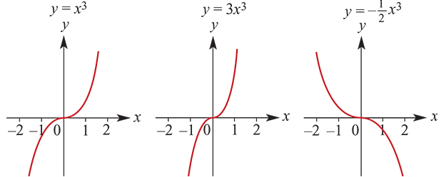
Transformations of the graph of f($x$)= $x^{3}$
Dilations from an axis and reflections in an axis
As with other graphs it has been seen that changing the value of a simply narrows or broadens the graph without changing its fundamental shape. Again, if $a$<0, the graph is reflected in an axis. Note that reflecting in the $x$-axis and reflecting in the $y$-axis result in the same graph. This is because ${(−x)}^{3}$=− $x^{3}$.
For example:
It should be noted that the implied domain of all cubics is R and the range is also R.

Slide 5
Transformations of the graph of f($x$)= $x^{3}$
Point of inflection
The significant feature of the graph of a cubic of this form is the point of inflection (a point of zero gradient). We note that it is the ‘flat point’ of the graph.
The point of inflection of $y$= $x^{3}$ is at the origin (0,0).
Vertical translations
By adding or subtracting a constant term to $y$= $x^{3}$, the graph moves either ‘up’ or ‘down’.
The graph of $y$= $x^{3}$+$k$ is the basic graph moved $k$ units up (for $k$>0). The point of inflection becomes (0, $k$). In this case, the graph of $y$= $x^{3}$ is translated $k$ units in the positive direction of the $y$-axis.

Slide 6
Transformations of the graph of f($x$)= $x^{3}$
Horizontal translations
The graph of $y$=${(x−h)}^{3}$ is simply the basic graph moved h units to the ‘right’ (for $h$>0). The point of inflection is at ($h$,0). In this case, the graph of $y$=$x^{3}$is translated $h$ units in the positive direction of the $x$-axis.
General form
For the graph of a cubic function of the form
$y$=${a(x−h)}^{3}$+$k$
the point of inflection is at ($h$, $k$).
When sketching cubic graphs of the form $y$=${a(x−h)}^{3}$+$k$, first identify the point of inflection. To add further detail to the graph, find the $x$-axis and $y$-axis intercepts.

Slide 7
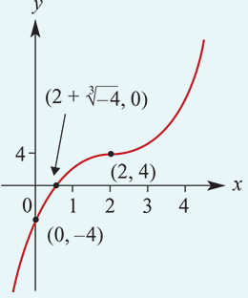
Example
Sketch the graph of the function $y$=${(x−2)}^{3}$+4.
The graph of $y$=$x^{3}$is translated 2 units to the right and 4 units up.
Point of inflection is (2,4).
$x$-axis intercept:
Let $y$ =0
0= ${(x−2)}^{3}$+4
−4= ${(x−2)}^{3}$
$\sqrt[3]{−4}$ = $x−2$
$x$= $2$ + $\sqrt[3]{−4}$ ≈0.413
$y$-axis intercept:
Let $x$=0
$y$=${(0−2)}^{3}$+4
$y$ =−8+4=−4

Slide 8
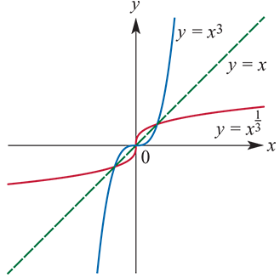
The function f:R→R, f($x$)=$x^{\frac{1}{3}}$
The functions with rules of the form f($x$)= ${a(x−h)}^{3}$+$k$ are one-to-one functions. Hence each of these functions has an inverse function.
The inverse function of f($x$)= $x^{3}$is $f^{−1}\left(x\right)$=$x^{\frac{1}{3}}$.
The graphs of $y$= $x^{3}$ and $y$= $x^{\frac{1}{3}}$ are shown above.
The graph of $y$= $x^{\frac{1}{3}}$is instantaneously vertical at $x$=0. The graphs of $y$= $x^{3}$and $y$= $x^{\frac{1}{3}}$ intersect at (1,1) and (−1,−1).

Slide 9
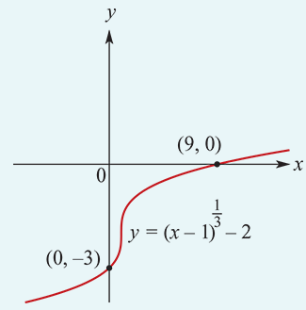
Example
Sketch the graph of $y$= ${(x−1)}^{\frac{1}{3}}$−2.
Find the axis intercepts.
The graph of $y$= ${(x−1)}^{\frac{1}{3}}$−2 is the graph of $y$= $x^{\frac{1}{3}}$ translated 1 unit to the right and 2 units down.
When $x$=0,
$y$= ${(0−1)}^{\frac{1}{3}}$−2 =−1−2=−3
When $y$=0,
$0$= ${(x−1)}^{\frac{1}{3}}$−2
$2$= ${(x−1)}^{\frac{1}{3}}$
8= $x−1$
$x$=9

Slide 10
Example
Find the inverse function $f^{−1}$ of $f$:R→R, $f\left(x\right)$=$2{\left(x−4\right)}^{3}$+3.
Remember that ($x$, $y$) ∈ $f$ if and only if ($y$, $x$) ∈ $f^{−1}$.
The opposite operation to cubing is taking the cube root. That is, $\sqrt[3]{x}$= $x^{\frac{1}{3}}$
Interchange $x$ and $y$:
$x$= $2{\left(y−4\right)}^{3}$+3
Solve for $y$:
$\frac{x−3}{2}={\left(y−4\right)}^{3}$
$y− 4$= ${\left(\frac{x−3}{2}\right)}^{\frac{1}{3}}$
$y$= ${\left(\frac{x−3}{2}\right)}^{\frac{1}{3}}$+4
Therefore $f^{−1}$ :R→R, $f^{−1}$($x$)=${\left(\frac{x−3}{2}\right)}^{\frac{1}{3}}$+4

Slide 11
Section Summary
The graph of $y$=${a(x−h)}^{3}$+$k$ has the same shape as $y$=${ax}^{3}$ but is translated $h$ units in the positive $x$-axis direction and $k$ units in the positive $y$-axis direction (where $h$ and $k$ are positive constants).
The implied domain of all cubic functions is R.
The functions $f\left(x\right)=x^{3}$ and $f^{−1}$($x$)= $x^{\frac{1}{3}}$ are inverse functions of each other.

Slide 12
Steps for Finding the Inverse of a One-to-One Function
y = f ⁻¹(x)
Solve for y
Trade x and y places
Replace f(x) with y

Slide 13
Find the inverse of
$$f\left(x\right)=2x^{3}+3$$
$$f^{−1}\left(x\right)={\left(\frac{x−3}{2}\right)}^{\frac{1}{3}}$$
y = f ⁻¹(x)
Solve for y
$$x−3=2y^{3}$$
$$\frac{x−3}{2}=y^{3}$$
Trade x and y places
$${\left(\frac{x−3}{2}\right)}^{\frac{1}{3}}={\left(y^{3}\right)}^{\frac{1}{3}}=y$$
$$x=2y^{3}+3$$
Replace f(x) with y
Ensure f(x) is one to one first. Domain may need to be restricted.
$$y=2x^{3}+3$$

