Slide 1

Adjacency matrices
Lesson 13B

Slide 2

Learning Intentions
Adjacency matrices

Slide 3
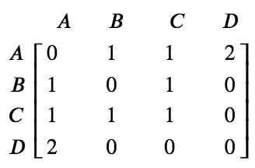
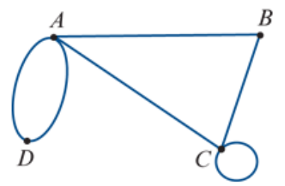




Adjacency matrices
An adjacency matrix is a square matrix that uses a zero or an integer to record the number of edges connecting each pair of vertices in the graph.
0
1
2
$$e_{1}$$
$$e_{2}$$
1

Slide 4
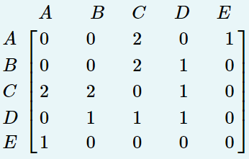
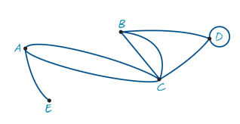
Drawing a graph from an adjacency matrix
A
C
E
D
B

Slide 5
Adjacency matrices
The adjacency matrix A of a graph is an n×n matrix in which, for example, the entry in row C and column F is the number of edges joining vertices C and F.
A loop is a single edge connecting a vertex to itself.
Loops are counted as one edge.

Slide 6
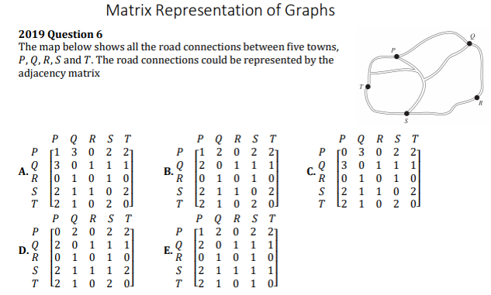

Slide 7
    exercises & Summary Book
1. Ex 14B
2. Summary notes for Homework.

