Slide 1
Graphs of factorised cubic functions
6F
Notes:
https://create.kahoot.it/details/608353e2-0eec-4258-bc27-441b79c032ee
https://create.kahoot.it/details/4d3a2454-6a09-4166-acf4-1a229391edc8

Slide 2
Vocabulary
Polynomial Function = a function in the form:
where , exponents are whole #’s, and coefficients are real #’s.
Standard/General Form = terms are written in descending order of exponents.
Degree = the highest exponent.

Slide 3
Remember integers are … –2, -1, 0, 1, 2 … (no decimals or fractions) so positive integers would be 0, 1, 2 …
A polynomial function is a function of the form:
n must be a positive integer
All of these coefficients are real numbers
The degree of one variable polynomial is the largest power on any x term in the polynomial.

Slide 4
Determine which of the following are polynomial functions. If the function is a polynomial, state its degree.
A polynomial of degree 4.
We can write in an x⁰ since this = 1.
x ⁰
A polynomial of degree 0.
Not a polynomial because of the square root since the power is NOT an integer
Not a polynomial because of the x in the denominator since the power is negative

Slide 5
Common Polynomial Functions
Degree | Type | Example
0 | constant | f(x)=14
1 | linear | f(x)=5x – 7
2 | quadratic | f(x)=x²+x-9
3 | cubic | f(x)=x³-x²
4 | quartic | f(x)=x⁴+x-1

Slide 6
Graphs of polynomials are smooth and continuous.
No sharp corners or cusps
No gaps or holes, can be drawn without lifting pencil from paper
This IS the graph of a polynomial
This IS NOT the graph of a polynomial

Slide 7
Let’s look at the graph of where n is an even integer.
and grows steeper on either side
Notice each graph looks similar to x² but is wider and flatter near the origin between –1 and 1
The higher the power, the flatter and steeper

Slide 8
Let’s look at the graph of where n is an odd integer.
Notice each graph looks similar to x³ but is wider and flatter near the origin between –1 and 1
and grows steeper on either side
The higher the power, the flatter and steeper

Slide 9
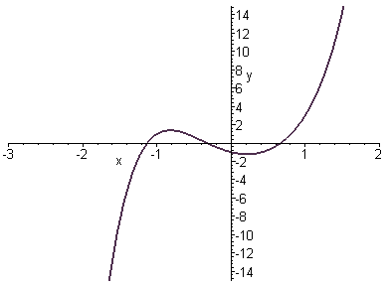
Odd degree polynomials fall on the left and rise on the right hand sides of the graph (like x³) if the coefficient is positive.
turning Points in the middle
right hand behaviour: rises
left hand behaviour: falls

Slide 10
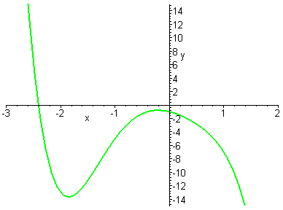
Odd degree polynomials rise on the left and fall on the right hand sides of the graph (like – x³) if the coefficient is negative.
turning points in the middle
left hand behaviour: rises
right hand behaviour: falls

Slide 11
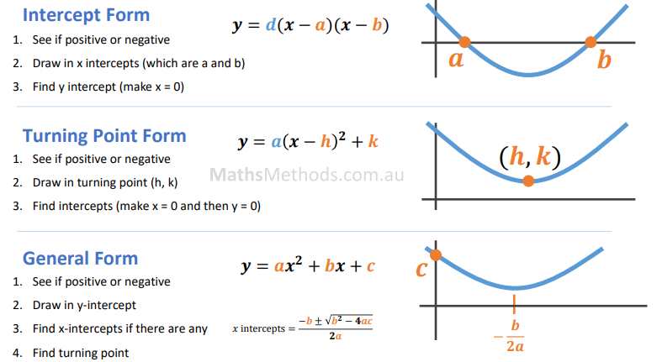

Slide 12
Identify the roots of a polynomial function
If a polynomial is factored completely, it is easy to solve the question f(x) = 0 using the Null Factor Law.
Example: Find the roots
of the function:
$$x −1=0 {\text{→} x}_{1}=2$$
$$x+3=0 {\text{→} x}_{2}=−3$$

Slide 13
So knowing the roots of a polynomial we can plot them on the graph. It tells us whether the graph cuts the x axis at this point or whether it just touches the axis(repeated factor):
Notice the negative out in front.
What would the y intercept be?
Root 1 (so cuts axis at 1)
Root -2 & repeated factor
(so touches at 2)
(0, 4)
Find the roots and their multiplicity

Slide 14
Cubic Polynomials
The following chart shows the properties of the graphs on the left.
Equation Factored form & Standard form | X-Intercepts Roots | Sign of Leading Coefficient | End Behaviour | Domain and Range
Factored y=(x+1)(x+4)(x-2) Standard y=x³+3x²-6x-8 | -4, -1, 2 | Positive | As x→∞, y→∞ and x→-∞, y→-∞ | Domain {x| x Є R} Range {y| y Є R}
Factored y=-(x+1)(x+4)(x-2) Standard y=-x³-3x²+6x+8 | -4, -1, 2 | Negative | As x→∞, y→-∞ and x→-∞, y→∞ | Domain {x| x Є R} Range {y| y Є R}

Slide 15
Cubic Polynomials
The following chart shows the properties of the graphs on the left.
Equation Factored form & Standard form | X-Intercepts Roots | Sign of Leading Coefficient | End Behaviour | Domain and Range
Factored y=(x+3)²(x-1) Standard y=x³+5x²+3x-9 | -3, 1 | Positive | As x→∞, y→∞ and x→-∞, y→-∞ | Domain {x| x Є R} Range {y| y Є R}
Factored y=-(x+3)²(x-1) Standard y=-x³-5x²-3x+9 | -3, 1 | Negative | As x→∞, y→-∞ and x→-∞, y→∞ | Domain {x| x Є R} Range {y| y Є R}

Slide 16
Cubic Polynomials
The following chart shows the properties of the graphs on the left.
Equation Factored form & Standard form | X-Intercepts Roots | Sign of Leading Coefficient | End Behaviour | Domain and Range
Factored y=(x-2)³ Standard y=x³-6x²+12x-8 | 2 | Positive | As x→∞, y→∞ and x→-∞, y→-∞ | Domain {x| x Є R} Range {y| y Є R}
Factored y=-(x-2)³ Standard y=-x³+6x²-12x+8 | 2 | Negative | As x→∞, y→-∞ and x→-∞, y→∞ | Domain {x| x Є R} Range {y| y Є R}

Slide 17
Graph the polynomial. Label intercepts, determine turning points, and end behavior. (May use graphing calculator for shape between intercepts.)

Slide 18
Graph the polynomial. Label intercepts, determine turning points, and end behavior. (May use graphing calculator for shape between intercepts.)

Slide 19
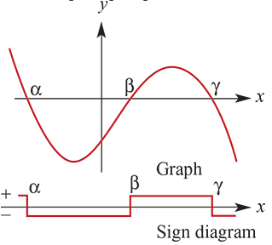
Sign diagrams
A sign diagram is a number-line diagram which shows when an expression is positive or negative.
The following is a sign diagram for a cubic function, the graph of which is also shown.
Using a sign diagram requires that the factors, and the $x$-axis intercepts, be found. The $y$-axis intercept and sign diagram can then be used to complete the graph.

Slide 20
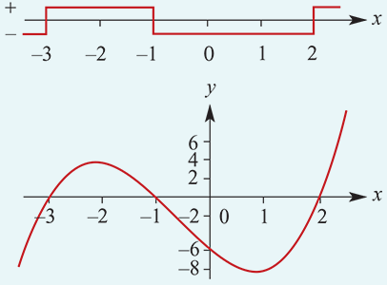
example
Sketch the graph of $y$= $x^{3}$+ ${2x}^{2}$− $5x$− $6$
Let P($x$)= $x^{3}$+ ${2x}^{2}$− $5x$− $6$
Then P(1)= 1+2−5−6≠0
P(−1)=−1+2+5−6=0
∴ $x$+1 is a factor.
By division, $y$=($x$+1)($x$−2)($x$+3).
∴ $x$-axis intercepts are −1, 2 and −3.
When $x$<−3, $y$ is negative.
When −3< $x$<−1, $y$ is positive.
When −1< $x$<2, $y$ is negative.
When $x$>2, $y$ is positive.
This gives the sign diagram.

Slide 21
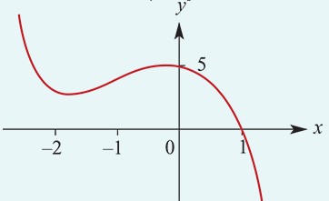
example
Sketch the graph of $y$=−($x$−1)($x^{2}$+4$x$+5).
To find the $x$-axis intercept, let $y$=0.
First, we note that the factor $x^{2}$+4$x$+5 cannot be factorised further:
Δ= $b^{2}$−4ac= ${(4)}^{2}$−4(1)(5)=−4
∴ there are no further linear factors.
Hence, when solving the equation −($x$−1)($x^{2}$+4$x$+5)=0, there is only one solution.
∴ $x$-axis intercept is $x$=1.
To find the $y$-axis intercept, let $x$=0. Then $y$=−(0−1)($0^{2}$+4(0)+5)=5.
It is found that the turning points are at (0,5) and (−1.82,2.91), where the values for the coordinates of the second point are given to two decimal places.

Slide 22
Section Summary
The graph of a cubic function can have one, two or three $x$-axis intercepts.
If a cubic can be written as the product of three linear factors, $y$=a($x$−$∝$)($x$−$β$)($x$−$γ$), then its graph can be sketched by following these steps:
1. Find the $y$-axis intercept.
2. Find the $x$-axis intercepts.
3. Prepare a sign diagram.
4. Consider the $y$-values as $x$ increases to the right of all $x$-axis intercepts.
5. Consider the $y$-values as $x$ decreases to the left of all $x$-axis intercepts.
If there is a repeated factor to the power 2, the $y$-values have the same sign immediately to the left and right of the corresponding $x$-axis intercept.

Slide 23
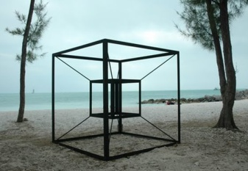
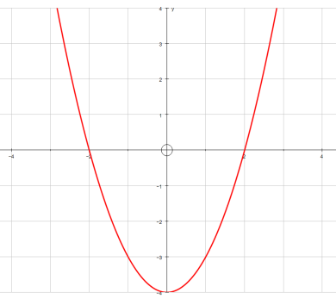
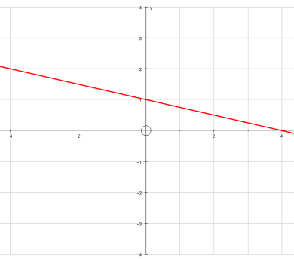
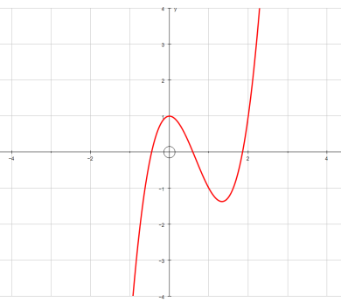
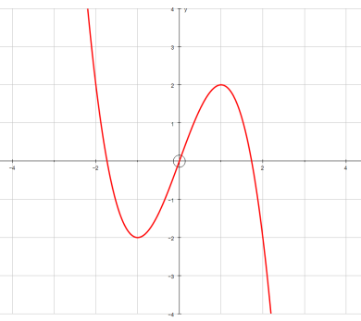
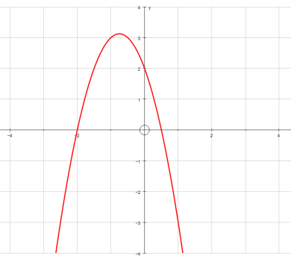
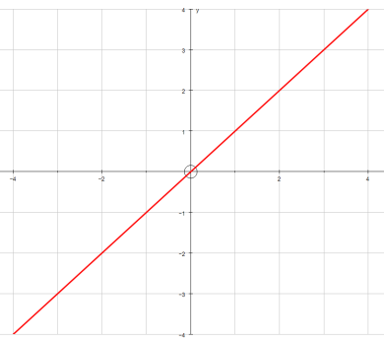
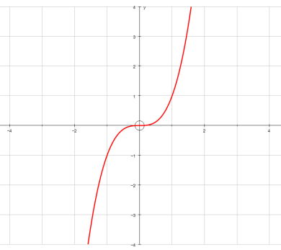
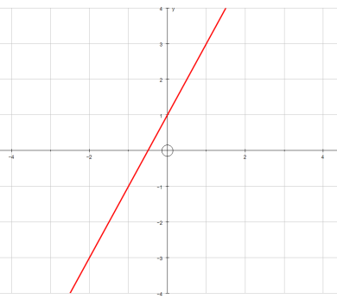
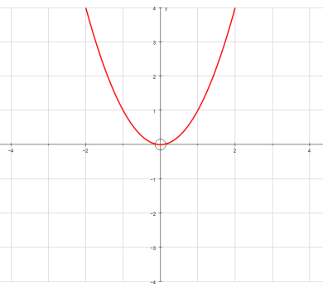
Plenary
Match up the graphs with the equations. Make sure you can explain your reasoning!
$$y=2x^{3}−4x^{2}+1$$
$$y=x^{3}$$
$$y=x^{2}$$
$$y=2x+1$$
$$y=x^{2}−4$$
$$y={2−3x−2x}^{2}$$
$$y=x$$
$$y=3x−x^{3}$$
$$y=1−0.25x$$

