Slide 1
Minimum spanning trees
9J
Notes:
https://create.kahoot.it/details/4a3c47f7-713a-40ca-8b3c-84ca46e5aee6
https://create.kahoot.it/details/0fb9bb76-7ba6-4203-b0f6-f4f566f3bccc

Slide 2
Learning Intentions
Tree
Spanning Trees
Minimum Spanning Trees
Prim’s Algorithm

Slide 3
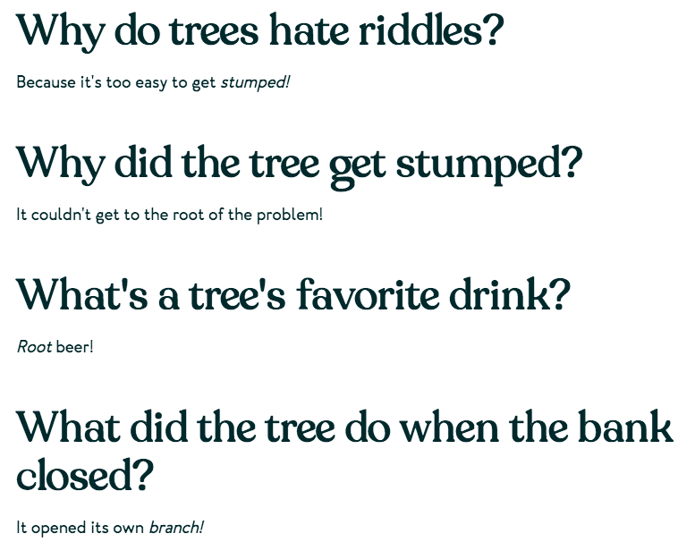

Slide 5
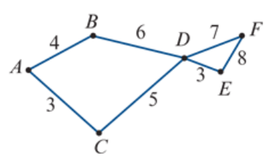
Finding the shortest path by Inspection
Find the shortest path from vertex 𝐴 to vertex 𝐸 in this network. The numbers represent time in hours.
$${10}^{B}$$
$$8^{C}$$
0
$${11}^{D}$$
3+5+3=11 Hours
$$3^{A}$$

Slide 6
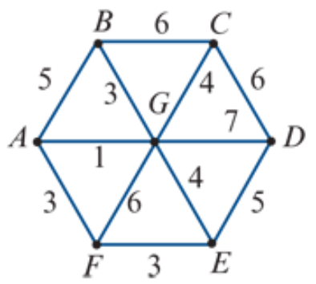
Finding the shortest path by Inspection
Find the shortest path from vertex 𝐵 to vertex 𝐹 in this network. The numbers represent time in minutes.
0
$$4^{G}$$
$$5^{B}$$
$$3^{B}$$
3+1+3=7 minutes
$$7^{A}$$

Slide 7
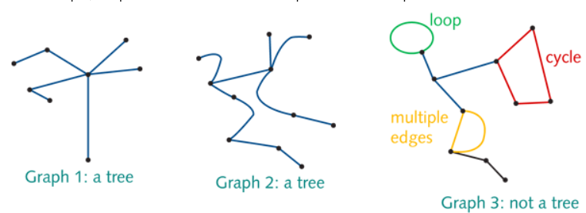
Tree
A connected graph that contains no cycles, multiple edges or loops. A tree may be part of a larger graph.
Graph 1, a tree, has 8 vertices and 7 edges.
Graph 2, a tree, has 11 vertices and 10 edges.

Slide 8
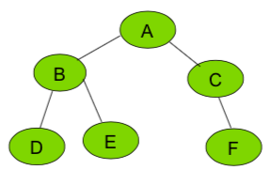
Rule connecting the number of edges of a graph to the number of vertices
A tree with 𝑛 vertices has 𝑛−1 edges.

Slide 9
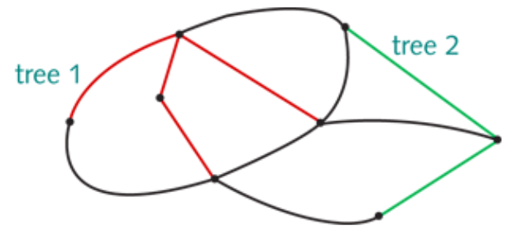
every connected graph contains one or more trees

Slide 10
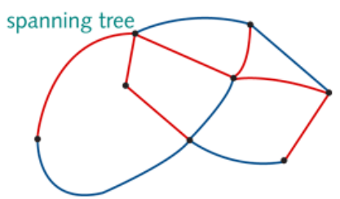
Spanning trees
A spanning tree is a tree that connects allof the vertices in a connected graph.
8 vertices. 8−1=7 edges

Slide 11
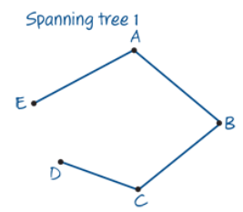
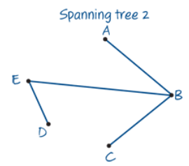
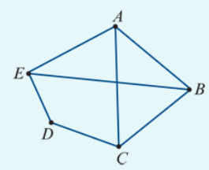
Finding a spanning tree in a network
Find two spanning trees for the graph shown below right corner.
The graph has 5 vertices and 7 edges. A spanning tree will have 5 (𝑛) vertices and 4 (𝑛−1) edges.
To form a spanning tree, remove any 3 edges, provided that:
All the vertices remain connected; There are no multiple edges or loops.

Slide 12
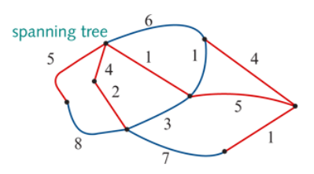
Minimum spanning tree
A minimum spanning tree = the spanning tree of minimum length (may be minimum distance, minimum time, minimum cost, etc.). There may be more than one minimum spanning tree in a weighted graph.
For weighted graphs or networks, it is possible to determine the ‘length’ of each spanning tree by adding up the weights of the edges in the tree.
For the spanning tree shown here:
Length=5+4+2+1+5+4+1=22 units

Slide 13
Prim’s algorithm for finding a minimum spanning tree
Choose a starting vertex (any will do). Inspect the edges starting from this vertex and choose the one with the lowest weight. (If two edges have the same weight, the choice can be arbitrary.)
Next, inspect the edges starting from the vertices. Choose the edge with the lowest weight.
Repeat the process until all the vertices are connected, and then stop. The result is a minimum spanning tree.

Slide 14
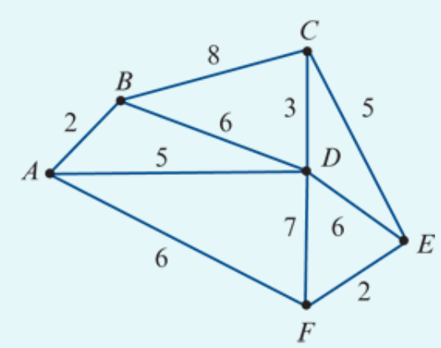
Applying Prim’s algorithm
Apply Prim’s algorithm to obtain a minimum spanning tree for the network shown and calculate its length.
Minimum spanning tree
Length =2+5+3+5+2=17 units

Slide 15
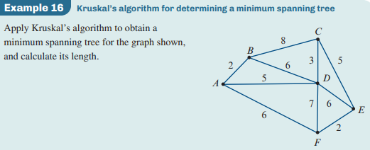

Slide 16
Kruskal’s Algorithm
Choose the edge with the least weight as the starting edge. If there is more than one least-weight edge, any will do.
Next, from the remaining edges, choose an edge of least weight which does not form a cycle. If there is more than one least-weight edge, any will do.
Repeat the process until all vertices are connected. The result is a minimum spanning tree.
Determine the length of the spanning tree by summing the weights of the chosen vertices.

Slide 17
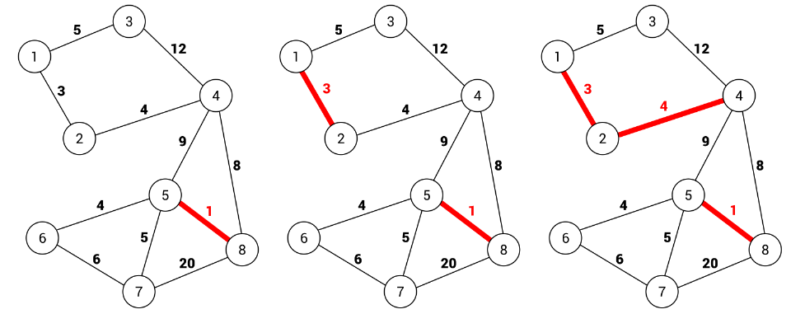
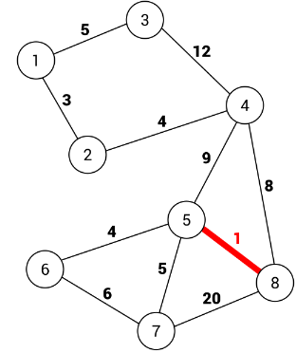
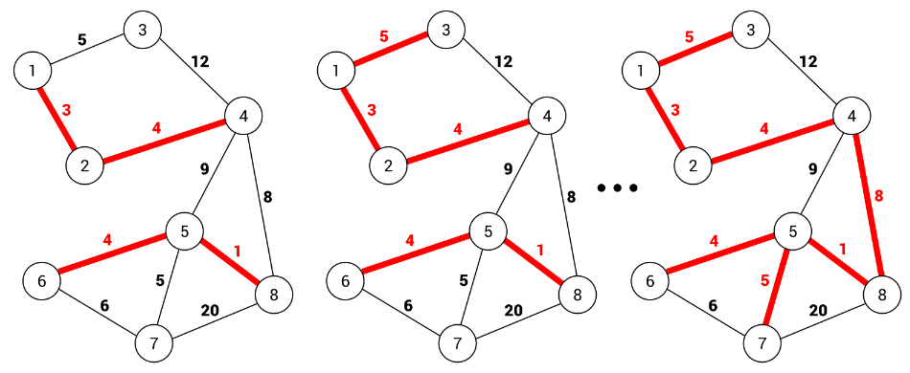
The algorithm takes an edge with the minimum weight from the remaining ones and adds it to the MST, only if adding it does not create a cycle. The algorithm stops when all nodes are connected.
Kruskal’s algorithm

Slide 18
Greedy algorithms
Prim’s and Kruskal’s algorithms are examples of greedy algorithms.
What is a greedy algorithm?
A greedy algorithm is a simple, intuitive set of rules that can be used to solve optimization problems. It breaks up the solution of the optimization problem into a series of simple steps that find the optimum solution at each step in the process.
Dijkstra’s greedy algorithm for finding the shortest path (Extension)
Next year, you will learn to use Dijkstra’s algorithm to find the shortest path between two points in a network. It is also a greedy algorithm.

Slide 19
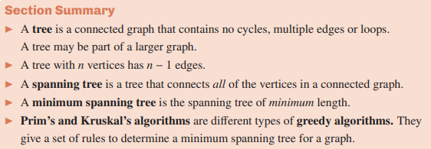

Slide 20
exercises & Summary Book
1. Ex 8H
2. Summary notes for Homework.

