Slide 1
Recognising relationships
16A
https://www.youtube.com/watch?v=tFzcq0H9NPQ
Notes:
https://teacher.desmos.com/activitybuilder/custom/5b743fc5ff7daf094572bcd5?collections=5f8a43dd06b0d9a8bd84c3d0%2C5f8a441e06b0d9a8bd84c3d3

Slide 2
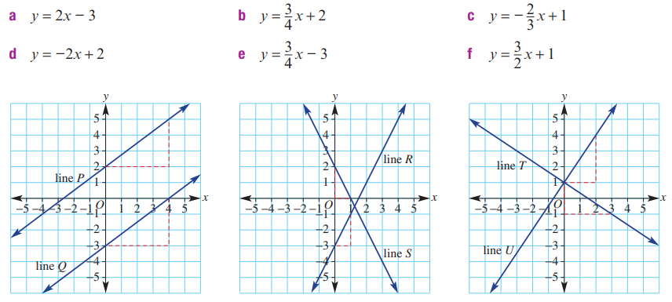
Matching up?

Slide 3
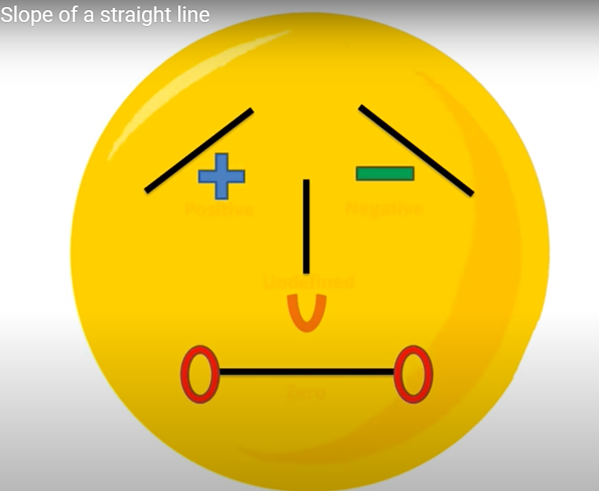
What is gradient?
Gradient is the measure of how steep a line is. The bigger the gradient, the steeper the line.

Slide 4
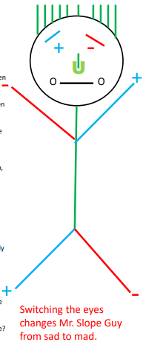

Slide 5
Mr. Slope

Slide 6
The way we work out the gradient of any line is by the formula:
change in y
Gradient =
change in x
Rise
Gradient = Slope =
Run

Slide 7
slope
$\frac{Rise}{Run}$
Unit rate
Hourly rate
Gradient
Rate of change
$\frac{the change in Y}{the change in X}$
m in y=mx+c
Next to the x in the equation y=mx+c

Slide 8
The equation of any straight line is of the form:
y = mx + c
Gradient
(steepness)
y-intercept
(where is crosses the y-axis)

Slide 9
Y-intercept
Initial value
Starting point
One time fee
Where the line crosses the y-axis
Down payment
The letter b in y=mx+c
Fixed
By itself in the equation y=mx+c
Where x=0
point

Slide 10
Notes:
https://www.transum.org/software/GraphMatch/Gradient.asp

Slide 11
Chapter 13 Revision Index laws
To multiply two powers with the same base, add the indices: $a^{m}$× $a^{n}$= $a^{m+n}$
To divide two powers with the same base, subtract the indices: $a^{m}$÷ $a^{n}$= $a^{m−n}$
To raise a power to another power, multiply the indices: ${(a^{m})}^{n}$= $a^{m\text{×}n}$

Slide 12
Chapter 13 Revision Index laws
Rational indices:
$a^{\frac{1}{n}}$=$\sqrt[n]{a}$ and $a^{\frac{m}{n}}$= ${(a^{\frac{1}{n}})}^{m}$
Graphs of exponential functions:
Image
For a∈$R^{+}$∖{1}:
if $a^{x}$= $a^{y}$, then x=y
For a∈ $R^{+}$∖{1}:
$a^{x}$=y is equivalent to $\log_{a}{y}$=x

Slide 13
Chapter 13 Revision Laws of logarithms
$\log_{a}{(mn)}$= $\log_{a}{m}$+ $\log_{a}{n}$
$\log_{a}{(\frac{m}{n})}$= $\log_{a}{m}$− $\log_{a}{n}$
$\log_{a}{( m^{p})}$= p $\log_{a}{m}$
$\log_{a}{( m^{−1})}$= − $\log_{a}{m}$
$\log_{a}{1}$=0 and $\log_{a}{a}$=1

Slide 14
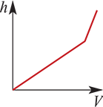
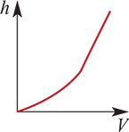
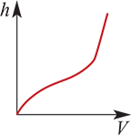
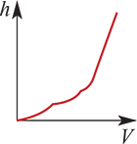
Example
Water is being poured steadily into each of these vessels. Draw a graph that shows the relationship between the height of the water (h) and the volume (V) that has been poured in.

Slide 15
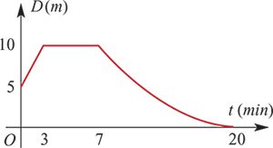
Example
A particle travels in a straight line.
The graph shows the distance, D metres, of the particle from a fixed point O over a period of 20 minutes.
Describe the motion of the particle.
The particle is initially 5 m from O. It travels away from O for 3 minutes at a constant speed of $\frac{5}{3}$ m/min. It then remains stationary at a distance of 10 m from O for 4 minutes, before returning to O at a speed which is gradually decreasing so that it comes to rest at O at time t=20 minutes.

Slide 16
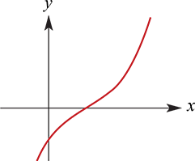
Rate of change -- positive
By examining the graph representing a function, it can be determined whether the rate of change is positive, negative or neither.
Consider the graph of a function y=f(x).
If the graph shows that y is increasing as x increases, then we can say that the rate of change of y with respect to x is positive. (The graph ‘slopes upwards’.)

Slide 17
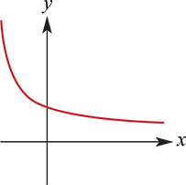
Rate of change -- negative
If the graph shows that y is decreasing as x increases, then we can say that the rate of change of y with respect to x is negative. (The graph ‘slopes downwards’.)

Slide 18
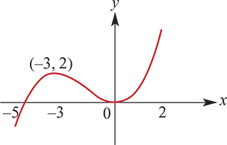
Example
For the graph shown below for x∈[−5,2], use interval notation to describe the set of values of x for which:
a. the rate of change of y with respect to x is negative
b. the rate of change of y with respect to x is positive.
a. The rate of change of y with respect to x is negative for x∈(−3,0).
b. The rate of change of y with respect to x is positive for x∈[−5,−3)∪(0,2].

Slide 19
Rate of change -- zero
If y remains the same value as x changes, the corresponding graph is a horizontal line, and we say that the rate of change of y with respect to x is zero.
All of this is consistent with the gradient (rate of change) of a linear function, which was discussed in Chapter 2.

Slide 20
Section summary
Consider the graph of a function with rule y=f(x).
If the graph shows that y is increasing as x increases over some interval, then the rate of change of y with respect to x is positive for that interval.
If the graph shows that y is decreasing as x increases over some interval, then the rate of change of y with respect to x is negative for that interval.
If y remains the same value as x changes, the corresponding graph is a horizontal line and the rate of change of y with respect to x is zero.

