Slide 1
Position and average velocity
16E

Slide 2
Notes:
https://www.transum.org/software/SW/Starter_of_the_day/starter_November18.asp

Slide 3
Slope (Gradient)
Rate of change ( Constant, average, instantaneous)
Average rate of change= $\frac{f(b)−f(a)}{b−a}$ = $\frac{y_{2}−y_{1}}{x_{2}−x_{1}}$ = $\frac{the change in Y}{the change in X}$ = $\frac{Rise}{Run}$ =$\frac{Δy}{Δx}$
Average speed (no direction, nil +, $−$)
Average velocity (with direction, +, $−$)
Constant rate of change = slope of a straight line m in y=mx+c
Instantaneous rate of change= slope of the tangent line at given point (Power Rule)

Slide 4
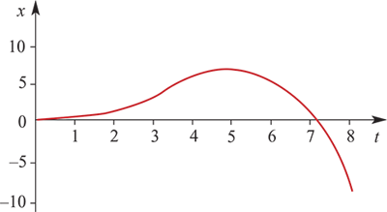
Position
The position of a particle is a specification of its location relative to a reference point.
Consider motion on a straight line with reference point O.
We say that position to the right of O is positive and to the left of O is negative.
A particle is moving along the straight line. Let x metres denote its position relative to O at time t (where time is measured in seconds).
At time t=0, x=0.
At time t=5, x=6.25.
At time t=8, x=−8.96.
At t=0, the particle starts from rest and moves to the right. At t=5, the particle stops and moves back in the opposite direction. Its position–time graph is shown below.
Note that from t=0 until t=7.1, the position is positive, i.e. the particle is to the right of O.
For t>7.1, the position is negative, i.e. the particle is to the left of O.

Slide 5
Average velocity
The average velocity of a particle is the average rate of change in position with respect to time:
average velocity = $\frac{change in position}{time elapsed }$
For the moving particle we have been considering:
At time t=0, x=0.
At time t=5, x=6.25.
At time t=8, x=−8.96.
Therefore the particle’s average velocity over the time interval 0≤t≤5 is given by
average velocity= $\frac{6.25}{5 }$= 1.25 metres per second (m/s)
and over the time interval 5≤t≤8,
average velocity= $\frac{−8.96−6.25}{3 }$=−5.07 metres per second (m/s)

Slide 6
Example
Let s(t)=6t−$t^{2}$ be the position function of a particle moving in a straight line, where t is in seconds and s is in metres.
Find the average velocity for the time interval [0,1].
Find the average velocity for the time interval [6,8].
Solution
s(0)=0 and s(1)=6− $1^{2}$ =5.
Hence, change in position =5 and
average velocity=average rate of change= $\frac{5}{1 }$=5
The average velocity for [0,1] is 5 m/s.
s(6)=0 and s(8)=6×8− $8^{2}$ =−16.
Hence, change in position =−16 and
average velocity=average rate of change= $\frac{−16}{8−6 }$=−8
The average velocity for [6,8] is −8 m/s.

Slide 7
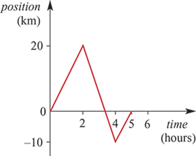
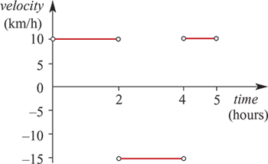
Velocity–time graphs Example
The graph shown is the position–time graph for the bicycle trip of a boy who lives on a long straight road. The road runs north–south, and north is chosen to be the positive direction.
Describe his trip.
Draw the corresponding velocity–time graph.
Solution
The boy heads north for 2 hours.
His velocity for this period is $\frac{20−0}{2 }$=10 km/h.
He then turns and rides south for 2 hours.
His velocity for this period is $\frac{−10−20}{2 }$=−15 km/h.
He turns and rides north until he reaches home.
His velocity for this period is 0−(−10)1=10 km/h.

Slide 8
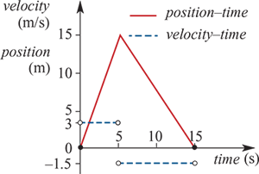
Example
A particle is moving in a straight line. It was initially at rest at a point O. It moves to the right of O with a constant velocity and reaches a point A, 15 metres from O, after 5 seconds. It then returns to O. The return trip takes 10 seconds. It stops at O.
On the one set of axes draw the position–time graph and the velocity–time graph for the motion.
Solution
The gradient of the position–time graph for 0<t<5 is 3.
The gradient for 5<t<15 is −1.5.
The gradient of the position–time graph determines the velocity–time graph.

Slide 9
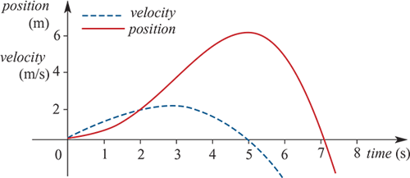
Instantaneous velocity
Instantaneous velocity is the instantaneous rate of change in position with respect to time. It can be thought of as the gradient of the tangent to the position–time graph at a particular point.
This graph illustrates the relationship between position and velocity. The vertical axis is in both metres per second for velocity and metres for position. In the following, we use velocity to mean instantaneous velocity.
We make the following observations from the graph:
For 0<t<5, the velocity is positive: the particle is travelling from left to right.
For t>5, the velocity is negative: the particle is travelling from right to left.
For t=5, the velocity is zero: the particle is instantaneously at rest.

Slide 10
Example
The position of a particle moving in a straight line is given by the function S(t)=$t^{3}$−6$t^{2}$, t≥0. The graph of S against t is shown. The corresponding velocity–time graph is also shown. The function describing the velocity is V(t)=3$t^{2}$−12$t$.
a. Find the average velocity of the particle for the intervals:
1. [3.5,4.5]
2. [3.9,4.1]
3. [3.99,4.01]
b. From part a, what is the instantaneous velocity when t=4?
c. 1. For what values of t is the velocity positive?
2. For what values of t is the velocity negative?
Average velocity = $\frac{S(4.5)−S(3.5)}{1 }$= $\frac{−30.375+30.625}{1 }$=0.25
Average velocity = $\frac{S(4.1)−S(3.9)}{0.2 }$= $\frac{−31.939+31.941}{0.2 }$=0.01
Average velocity = $\frac{S(4.01)−S(3.99)}{0.02 }$= $\frac{−31.999399+31.999401}{0.02 }$=0.0001
The results of part a suggest that the instantaneous velocity is zero when t=4, and this is consistent with both graphs.
From the position–time graph it can be seen that the velocity is positive for t>4.
From the position–time graph it can be seen that the velocity is negative for 0<t<4.

Slide 11
Section summary
The position of a particle moving along a straight line is a specification of its location.
The average velocity of a particle is the average rate of change in position with respect to time:
average velocity= $\frac{change in position}{time elapsed }$
Instantaneous velocity is the instantaneous rate of change in position with respect to time. It can be thought of as the gradient of the tangent to the position–time graph at a particular point.

