Slide 1
The derivative
17A

Slide 2
Notes:
https://www.transum.org/software/SW/Starter_of_the_day/starter_December5.asp

Slide 3
Derivative
https://en.wikipedia.org/wiki/Derivative#/media/File:Tangent_function_animation.gif

Slide 4
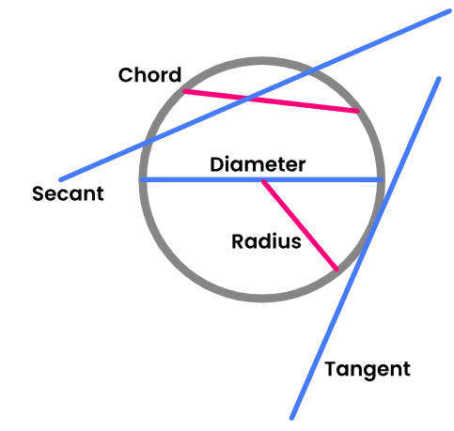
Secant Chord Tangent

Slide 5
Slope
Slope: the rate at which a line rises or falls
For a line, the rate (or slope) is the same at every point on the line.
For graphs other than lines, the rate at which the graph rises or falls changes from point to point.

Slide 6
Slope
This parabola is rising more quickly at point A than it is at point B.
At the vertex, point C, the graph levels off.
At point D the graph is falling.

Slide 7
Video Clip from Calculus-Help.com
The Difference Quotient

Slide 8
The Difference Quotient
The derivative is the slope of the tangent line to a graph f(x), and is usually denoted f’(x).
To calculate the slope of the tangent line we will use the difference quotient.

Slide 9
The Difference Quotient

Slide 10
Limit Definition of the Derivative
The derivative is the formula which gives
the slope of the tangent line at any point x
for f (x), and is denoted
provided this limit exists.

Slide 11
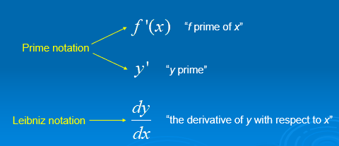
Derivatives
The derivative of the function y = f (x) may be expressed as …
“f prime of x”
Prime notation
“y prime”
Leibniz notation
“the derivative of y with respect to x”

Slide 12
Derivatives
The process of finding derivatives is called differentiation.
A function is differentiable at a point if its derivative exists at that point.

Slide 13
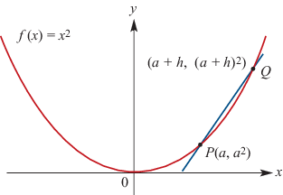
Limit Definition of the Derivative
Use the limit definition to find the derivative of:
f(x)=$x^{2}$
PQ=$\frac{{\left(a+h\right)}^{2}−a^{2}}{a+h{−a}}$= $\frac{a^{2}+2ah+h^{2}−a^{2}}{h}$=2$a$+h
$\lim_{h→0}$($\frac{{\left(a+h\right)}^{2}−a^{2}}{a+h{−a}}$)=$\lim_{h→0}$($\text{2}a \text{+}\text{h}$)= $\text{2}a$

Slide 14
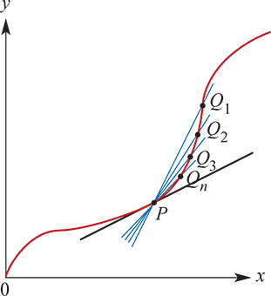
The gradient of the tangent
We first recall that a chord of a curve is a line segment joining points P and Q on the curve. A secant is a line through points P and Q on the curve.
Previously we looked at a sequence of secants P$Q_{1}$,P$Q_{2}$,…,P$Q_{n}$,…, where the points $Q_{i}$get closer and closer to P. The idea of instantaneous rate of change at P was introduced.
We now focus our attention on the gradient of the tangent at P.

Slide 15
The tangent to a curve at a point
Consider the function f:R→R, f(x)=$x^{2}$
The gradient of the secant PQ shown on the graph is
gradient of PQ=$\frac{{\left(a+h\right)}^{2}−a^{2}}{a+h{−a}}$= $\frac{a^{2}+2ah+h^{2}−a^{2}}{h}$=2$a$+h
The limit of 2a+h as h approaches 0 is 2a, and so the gradient of the tangent at P is said to be 2a.
The straight line that passes through the point P and has gradient 2a is called the tangent to the curve at P.
It can be seen that there is nothing special about a here. The same calculation works for any real number x. The gradient of the tangent to the graph of y= $x^{2}$ at any point x is 2x.
We say that the derivative of $x^{2}$ with respect to x is 2x, or more briefly, we can say that the derivative of $x^{2}$ is 2x.

Slide 16
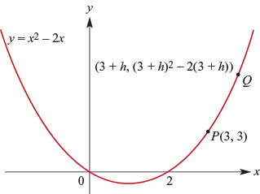
Example
By first considering the gradient of the secant PQ, find the gradient of the tangent line to y= $x^{2}$−2x at the point P with coordinates (3,3).
Solution
Gradient of PQ= $\frac{{\left(3+h\right)}^{2}−2\left(3+h\right)−3 }{3+h{−3}}$
$=\frac{{9+6h+h}^{2}−6−2h−3 }{h}$ = $\frac{{4h+h}^{2} }{h}$=4+h
Now consider the gradient of PQ as h approaches 0. The gradient of the tangent line at the point P(3,3) is 4.

Slide 17
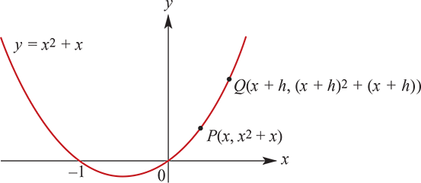
Example
Find the gradient of the secant PQ and hence find the derivative of $x^{2}$+x.
Solution
Gradient of
PQ= $\frac{{\left(x+h\right)}^{2}+(x+h)−(x^{2}+x)}{x+h{−x}}=\frac{x^{2}+2xh+h^{2}+x+h−x^{2}−x}{h}$= $\frac{2xh+h^{2}+h}{h}$=2x+h+1
From this it is seen that the derivative of $x^{2}$+x is 2x+1.

Slide 18
Limit notation
The notation for the limit of 2x+h+1 as h approaches 0 is
$\lim_{h→0}$(2x+h+1)
The derivative of a function with rule f(x) may be found by:
1. Finding an expression for the gradient of the line through P(x,f(x)) and Q(x+h,f(x+h))
2. Finding the limit of this expression as h approaches 0.

Slide 19
Example
Consider the function f(x)= $x^{3}$. By first finding the gradient of the secant through P(2,8) and Q(2+h, ${(2+h)}^{3}$), find the gradient of the tangent to the curve at the point (2,8).
Solution
Gradient of
PQ= $\frac{{\left(2+h\right)}^{3}−8}{2+h{−2}}$= $\frac{8+12h+6h^{2}+h^{3}−8}{h}$= $\frac{12h+6h^{2}+h^{3}}{h}$=12+6h+ $h^{2}$
The gradient of the tangent line at (2,8) is $\lim_{h→0}$(12+6h+ $h^{2}$)=12.

Slide 20
Example
Find:
$\lim_{h→0}$(22$x^{2}$+20xh+h)
$\lim_{h→0} \frac{3x^{2}h+{2h}^{2}}{h}$
$\lim_{h→0}$3x
$\lim_{h→0}$4
Solution
$\lim_{h→0}$(22$x^{2}$+20xh+h)=22$x^{2}$
$\lim_{h→0} \frac{3x^{2}h+{2h}^{2}}{h}$= $\lim_{h→0}$(3$x^{2}$+2h)=3$x^{2}$
$\lim_{h→0}$3x=3x
$\lim_{h→0}$4=4

Slide 21
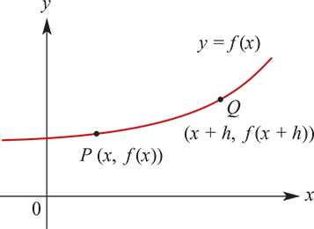
Definition of the derivative
In general, consider the graph y=f(x) of a function f:R→R.
Gradient of secant
PQ= $\frac{f(x+h)−f(x)}{x+h−x}$= $\frac{f(x+h)−f(x)}{h}$
The gradient of the tangent to the graph of y=f(x) at the point P(x,f(x)) is the limit of this expression as h approaches 0.

Slide 22
Derivative of a function
The derivative of the function f is denoted f′ and is defined by
f′(x)= $\lim_{h→0}$ $\frac{f(x+h)−f(x)}{h}$
The tangent line to the graph of the function f at the point (a,f(a)) is defined to be the line through (a,f(a)) with gradient f′(a).
Warning: This definition of the derivative assumes that the limit exists. For polynomial functions, such limits always exist. But it is not true that for every function you can find the derivative at every point of its domain.

Slide 23
Differentiation by first principles
Determining the derivative of a function by evaluating the limit is called differentiation by first principles.

Slide 24
Example
For f(x)= $x^{2}$+2x, find f′(x) by first principles.
Solution
f′(x) = $\lim_{h→0} \frac{f(x+h)−f(x)}{h}$= $\lim_{h→0}$ $\frac{({x+h)}^{2}+{2\left(x+h\right)−(x}^{2}+2x)}{h}$
= $\lim_{h→0}\frac{x^{2}+2xh+h^{2}+{2x+2h−x}^{2}−2x)}{h}$= $\lim_{h→0}\frac{2xh+h^{2}+2h}{h}$= $\lim_{h→0}$(2x+h+2)=2x+2
∴ f′(x) =2x+2

Slide 25
Example
For f(x)=2− $x^{3}$, find f′(x) by first principles.
Solution
f′(x)= $\lim_{h→0} \frac{f(x+h)−f(x)}{h}$= $\lim_{h→0}$ $\frac{2−({x+h)}^{3}{−(2−x}^{3})}{h}$
= $\lim_{h→0}\frac{{2−(x}^{3}+3x^{2}h+3xh^{2}+h^{3}){−(2−x}^{3})}{h}$
= $\lim_{h→0}\frac{−3x^{2}h−3xh^{2}−h^{3}}{h}$
= $\lim_{h→0}$($−3x^{2}−3xh−h^{2}$)=−3$x^{2}$

Slide 26
Section summary
The derivative of the function f is denoted f′ and is defined by
f′(x)= $\lim_{h→0}$ $\frac{f(x+h)−f(x)}{h}$
The tangent line to the graph of the function f at the point (a,f(a)) is defined to be the line through (a,f(a)) with gradient f′(a).

