Slide 1
Scheduling problems
15D

Slide 2
Scheduling problems/ Critical Path Steps
EST | LST
1. Draw a box for each going forward edge/activities.
2. EST = Going forward with Biggest Number.
3. LST= Going backward with Smallest Number.
4. Float time for each activity = LST — EST @ start of the edge
5. Label / Highlight Critical Path
6. Write minimum completion time.

Slide 3
Scheduling
Allocating time to the completion of activities in a project is called scheduling. Scheduling problems involve analysis to determine the minimum overall time it would take to complete a project.

Slide 4
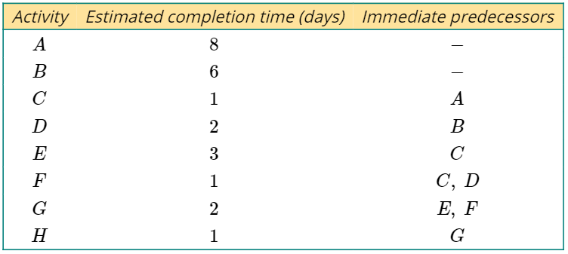
Weighted precedence tables
The weight (duration) of dummy activities is always zero.
A precedence table that contains the estimated duration, in days, of each activity is shown.

Slide 5
Float times
The diagram below shows a small section of an activity network. There are three activities shown, with their individual durations, in hours.
Activity A and B will take a total of 5+3=8 hours, while activity C only requires 6 hours. There is some flexibility around when activity C needs to start. There are 8−6=2 hours spare for the completion of activity C. This value is called the float time for activity C.
The flexibility around the starting time for activity C can be demonstrated with the following diagram.

Slide 6
Calculating and recording earliest starting times (EST)
In order for a project to be completed in the shortest time possible, it is important that activities start at the earliest possible time. The earliest starting time, or EST, for each activity is the earliest time after the start of the entire project that the individual activity can start. An EST of 8 means an activity can start 8 hours (or whatever time period is given) after the start of the project.
The EST for each activity is found by a process called forward scanning.

Slide 7
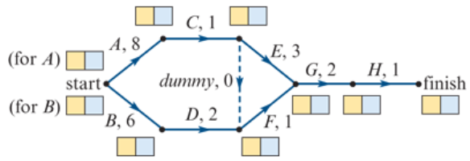
Forward scanning
Forward scanning will be demonstrated using the activity network below. The durations of each are in days.
1. Draw a box, split into two cells, next to each vertex of the activity network, as shown in the diagram. If more than one activity begins at a vertex, draw a box for each of these activities.

Slide 8
Forward scanning
2. Activities that begin at the start of the project have an EST of zero (0). Write this in the left box, shown shaded yellow in the diagram.

Slide 9
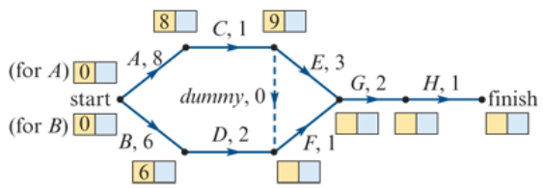
Forward scanning
3. Calculate the EST of each activity of the project by adding the EST of the immediate predecessor to the duration of the immediate predecessor.
EST of C= EST of A+ duration of A (EST of C=0+8=8)
EST of D= EST of B+ duration of B (EST of D=0+6=6)
EST of E= EST of C+ duration of C (EST of C=8+1=9)

Slide 10
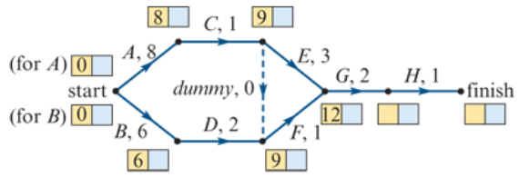
Forward scanning
4. If an activity has more than one predecessor, calculate the EST using each of the predecessors and choose the largest value.
EST of F=6+2=8 or EST of F=9+0=9. Use 9.
EST of G=9+1=10 or EST of G=9+3=12. Use 12.

Slide 11
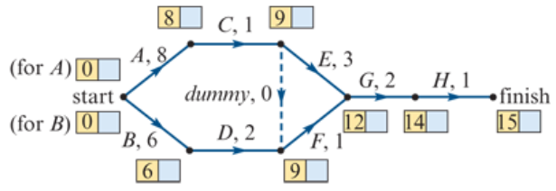
Forward scanning
5. The EST value at the finish of the project is the minimum time it takes to complete the project.
Note: The minimum time to complete this project is 15 days.

Slide 12
Calculating and recording latest starting times (LST)
Some activities, as we saw earlier, have some flexibility around the time that they can start. The latest start time, or LST, for each activity is the latest time after the start of the entire project that the individual activity can start. LSTs for each activity are calculated using the reverse of the process used to calculate the ESTs. This process is called backward scanning.

Slide 13
Backward scanning
Backward scanning will be demonstrated using the activity network with completed forward scanning from above.
1. Copy the minimum time to complete the project into the right cell shown shaded blue in the diagram.

Slide 14
Backward scanning
2. Calculate the LST for each activity by subtracting the duration of the activity from the LST of the following activity.
LST of H= LST of finish – duration of H (LST of H=15−1=14).
LST of G= LST of H – duration of G (LST of G=14−2=12).
LST of F= LST of G – duration of F (LST of F=12−1=11).
LST of E= LST of G – duration of E (LST of E=12−3=9).

Slide 15
Backward scanning
3. If more than one activity have the same predecessor, calculate the LST using each of the activities that follow and choose the smallest value.
Note: LST of E=12−3=9 (from duration of E) or LST of E=11−0=11 (from duration of dummy). Use 9.
The completed activity network with all EST and LST is shown below.

Slide 16
Identifying float times and the critical path
The boxes at the vertices in the activity network above give the EST and LST for the activity that begins at that vertex.
The EST for activity D is 6 and the LST for activity D is 9. This means activity D has a float time of 9−6=3 hours.
Activity D can be delayed by 3hours without delaying the rest of the project.
The EST for activity C is 8 and the LST for activity C is 8. This means activity C has a float time of 8−8=0 hours.

Slide 17
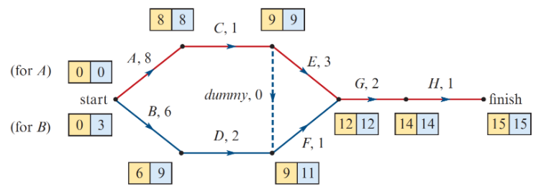
Critical path
The critical path is the sequence of activities that cannot be delayed without affecting the overall completion time of the project.
Tracking through the activity network along the edges of critical activities gives the critical path for the project. The critical path for this project is highlighted in red on the diagram below.

Slide 18
Critical path analysis
The process for determining the critical path is called critical path analysis.
Draw a box with two cells next to each vertex of the activity network.
Calculate the EST for each activity by forward scanning:
EST = EST of predecessor + duration of predecessor
If an activity has more than one predecessor, the EST is the largest of the alternatives.
The minimum overall completion time of the project is the EST value at the end vertex.
Calculate the LST for each activity by backward scanning:
LST = LST of following activity - duration of activity
If an activity has more than one following activity, the LST is the smallest of the alternatives.
Float = LST - EST
If float time =0, the activity is on the critical path.

Slide 19
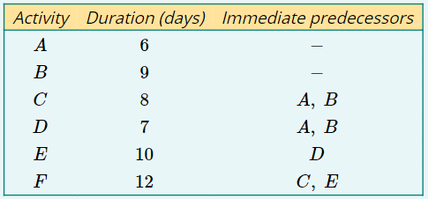
Finding the critical path
A project has six activities as shown in the precedence table opposite.
Draw an activity network for this project.
Complete the critical path analysis to calculate the EST and LST for each activity.
Write down the critical path of this project.
What is the minimum time required to complete the project?

Slide 20
Finding the critical path
The critical path of this project is B→D→E→F.
The minimum completion time of this project is 38 days.

