Slide 1
Crashing
14E
Notes:
https://quizizz.com/admin/quiz/5da548f9513b43001bf69ed4/vce-further-maths-revision-2?source=HeroSearchBar&page=FeaturedPage&searchLocale=&fromSearch=true

Slide 2
Crashing with cost Rules
Crashing activities on critical path
Possible new critical path
Crashing on new critical path
List all possible crashing options, choose minimum cost

Slide 3



Altering completion times
Sometimes, the managers of a project might arrange for one or more activities within the project to be completed in a shorter time than originally planned. Changing the conditions of an activity within a project, and recalculating the minimum completion time for the project, is called crashing.

Slide 4
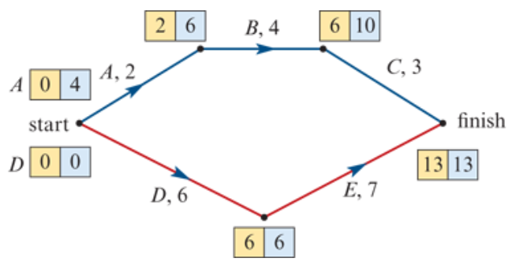
A simple crashing example
Activity D and E, lie on the critical path. Reducing the duration of these activities will reduce the overall time for the project. If activity D was reduced in time to 4 hours instead, the project will be completed in 11, not 13, hours.

Slide 5

Crashing with cost
Shortening the completion time for any individual activity could result in an extra cost for the project. In the simple example above, the cost of reducing the completion time of activity D by 1 hour is $150, while the cost of reducing the completion time of activity E by 1 hour is $18.
Clearly it is best to reduce the completion time, or crash, the activity that will cost the least.

Slide 6
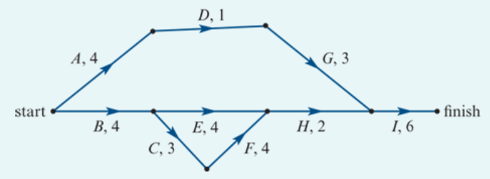
Crashing
A community centre is to be built on a new housing estate. Nine activities have been identified for this building project. The activity network shown on the right shows the activities and their completion times in weeks.
1. Determine the minimum time, in weeks, to complete this project.

Slide 7
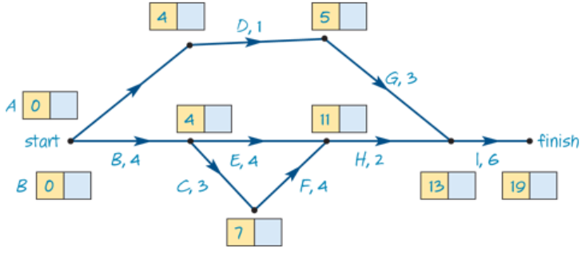
Crashing
1. Determine the minimum time, in weeks, to complete this project.
The minimum completion time of this project is 19 weeks.

Slide 8

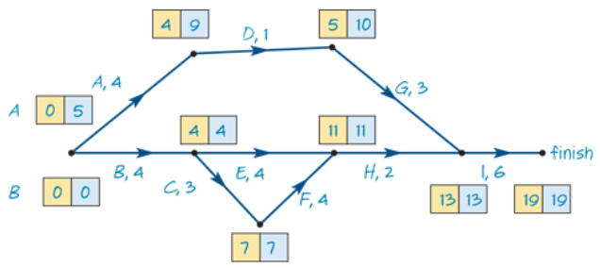
Crashing
2. Determine the slack time, in weeks, for activity D.
EST=4 and LST=9, Float=LST−EST=9−4=5 weeks

Slide 9
Crashing
3. Write down the critical path of this project.
The critical path of this project is B→C→F→H→I.

Slide 10
Crashing
4. The builders of the community centre are able to speed up the project.
Some of the activities can be reduced in time at an additional cost.
The activities that can be reduced in time are A, C, E, F and G.
Which of these activities, if reduced in time individually, would not result in an earlier completion of the project?
Activities A, E and G are not on
the critical path. These activities
would not result in an earlier
completion of the project.

Slide 11
Crashing
5. The owner of the estate is prepared to pay the additional cost to achieve early completion.
The cost of reducing the time of each activity is $5000 per week.
The maximum reduction in time for each one of the five activities, A, C, E, F and G is 2 weeks.
Determine the minimum time, in weeks, for the project to be completed now that certain activities can be reduced in time.
Activities C and F are on the
critical path. Reduce these by
2 weeks each to reduce the
path B→C→F→H→I by 4 weeks,
from 19 down to 15 weeks.

Slide 12
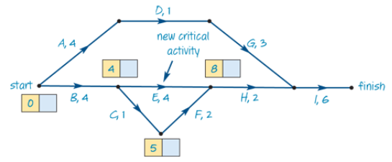
Crashing
5. The owner of the estate is prepared to pay the additional cost to achieve early completion.
The cost of reducing the time of each activity is $5000 per week.
The maximum reduction in time for each one of the five activities, A, C, E, F and G is 2 weeks.
Determine the minimum time, in weeks, for the project to be completed now that certain activities can be reduced in time.
This has resulted in a new
critical path.
E can be reduced by 1 week to
ensure overall minimum
completion time of 15 weeks.
3

Slide 13
Crashing
6. Determine the minimum additional cost of completing the project in this reduced time.
The cost of reducing the time of each activity is $5000 per week.
C and F have been reduced by
2 weeks. E has been reduced by
1 week. There is 5 weeks
reduction at $5000 per week.
Minimum cost is $25000.
3

