Slide 1
Logarithms
Notes:
https://www.transum.org/Maths/Exercise/Logarithms/Default.asp?Level=1
https://create.kahoot.it/details/3ebf869c-2761-43e8-a16d-bf0c49a71ea2

Slide 2
SCIENTIFIC NOTATION
A QUICK WAY TO WRITE
REALLY, REALLY BIG
OR
REALLY, REALLY SMALL NUMBERS.
https://www.transum.org/software/SW/Starter_of_the_day/Students/Standard_Form.asp?Level=1
Notes:
https://www.mathgames.com/skill/8.22-convert-between-standard-and-scientific-notation
https://mrnussbaum.com/scientific-notation-online

Slide 3
Soooo
137,000,000 can be rewritten as
1.37 × 10⁸

Slide 4
Now You Try
Using scientific notation, rewrite the following numbers.
347,000.
3.47 X 10⁵
902,000,000.
9.02 X 10⁸
61,400.
6.14 X 10⁴

Slide 5
Why does a Negative Exponent give us a small number?
10000 = 10 x 10 x 10 x 10 = 10⁴
1000 = 10 x 10 x 10 = 10³
100 = 10 x 10 = 10²
10 = 10¹
1 = 10⁰
Do you see a pattern?

Slide 6
Sooooo
$$\frac{1}{10}=0.1$$
= 1× 10⁻¹
= = 1× 10⁻²
= = 1× 10⁻³
= = 1× 10⁻⁴
$$\frac{1}{100}$$
$\frac{1}{10^{2}}$ = 0.01
$$\frac{1}{1000}$$
$\frac{1}{10^{3}}$ = 0.001
$$\frac{1}{10000}$$
$\frac{1}{10^{4}}$ = 0.0001

Slide 7
Your Turn
Using Scientific Notation,
rewrite the following numbers.
0.000882
8.82 X 10⁻⁴
0.00000059
5.9 X 10⁻⁷
0.00004
4 X 10⁻⁵

Slide 8
The logarithmic function to the base b, where b > 0, x > 0 and b ≠ 1 is defined:
y = log_{b}x if and only if x = b ^{y}
logarithmic form
exponential form
When you convert an exponential to log form, notice that the exponent in the exponential becomes what the log is equal to.
$$100={10}^{2}$$
$$\text{lo}{\text{g}}_{10}100=2$$
Convert to log form:
Convert to exponential form:
$$2^{3}=8$$
$$\log_{2}{8}=3$$

Slide 9
Index number
Power number
Log number
Order of magnitude
Number growth | 1 | 10 | 100 | 1000 | 10 000 | 100 000 | 1000 000
Number growth in Index form | $${10}^{0}$$ | $${10}^{1}$$ | $${10}^{2}$$ | $${10}^{3}$$ | $${10}^{4}$$ | $${10}^{5}$$ | $${10}^{6}$$
Log Index # only | 0 | 1 | 2 | 3 | 4 | 5 | 6

Slide 10
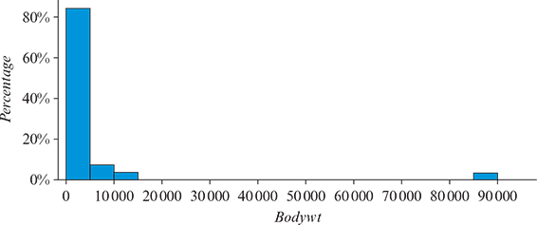
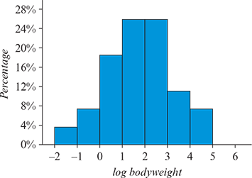
Why use logarithm?
The histogram below displays the body weights (in kg) of a number of animal species. Because the animals represented in this dataset have weights ranging from around 1 kg to 90 tonnes (a dinosaur), most of the data are bunched up at one end of the scale and much detail is missing. The distribution of weights is highly positively skewed, with an outlier.
0.01 | 0.1 | 1 | 10 | 100 | 1000

Slide 11
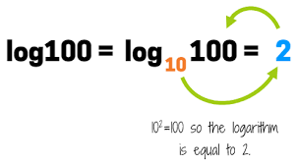

Slide 12
Number growth pattern
Number growth | 1 | 10 | 100 | 1000 | 10 000 | 100 000 | 1000 000
Number growth in Index form | $${10}^{0}$$ | $${10}^{1}$$ | $${10}^{2}$$ | $${10}^{3}$$ | $${10}^{4}$$ | $${10}^{5}$$ | $${10}^{6}$$
Log Index # only | 0 | 1 | 2 | 3 | 4 | 5 | 6

Slide 13
Order of magnitude

Slide 15
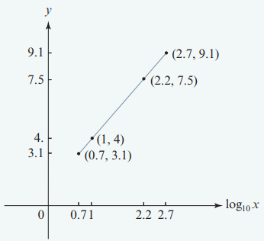
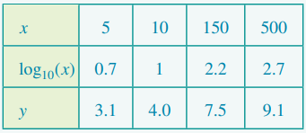
Using the logarithmic transformation: $\log_{10}\left(x\right)$

Slide 16
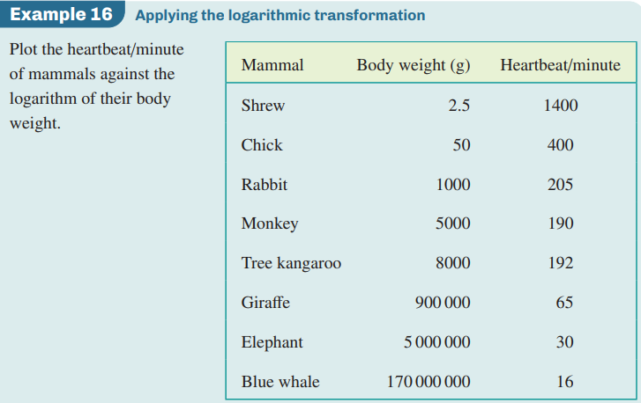
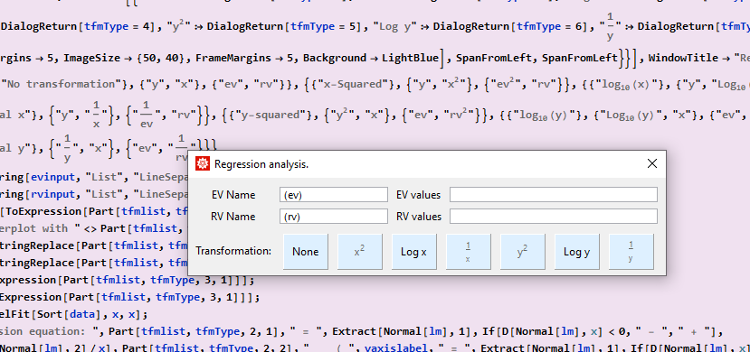

Slide 17
logx | 0.70 | 1 | 2.18 | 2.70 | 3

