Slide 1
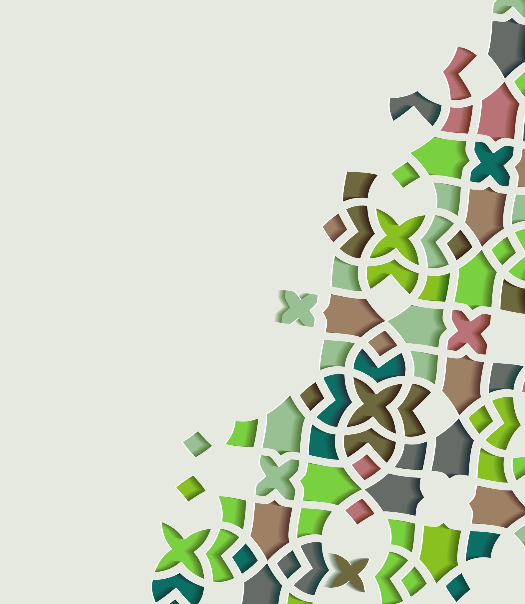
Numerical Distributions
1C
Notes:
https://create.kahoot.it/details/d10947ff-e260-400e-98f7-d1a11eaa1603
https://create.kahoot.it/details/9194c2c7-83bf-46bc-8dae-611d9f67b285
https://create.kahoot.it/details/eab4a192-093b-4904-8eb0-6455e4448081

Slide 3
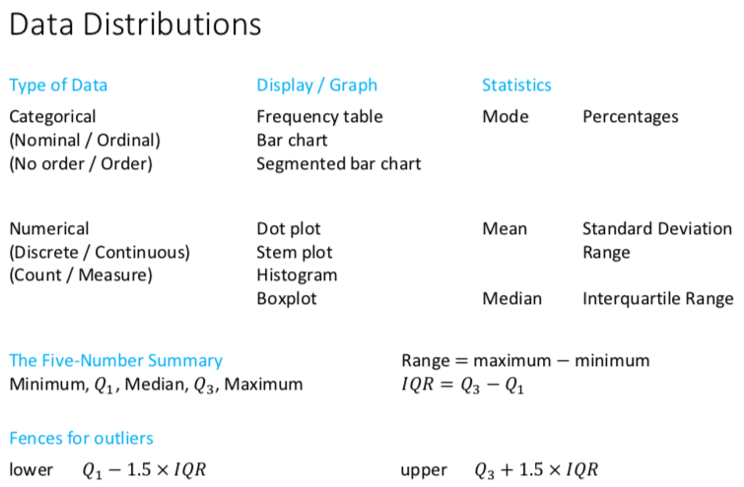

Slide 5
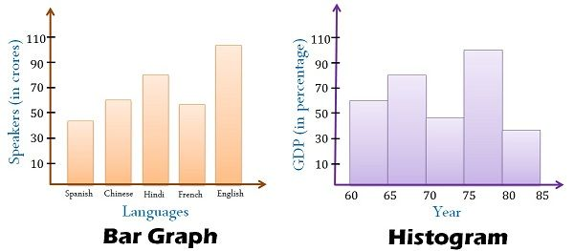
Difference between Histogram & Bar Chart

Slide 6
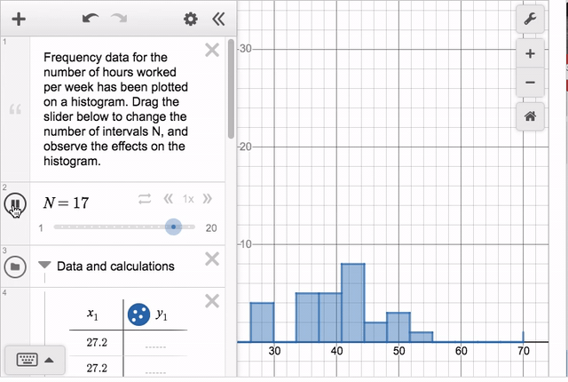
Histogram
A statistical graph used to display the frequency distribution of a numerical variable; most suitable for medium to large sized data sets.

Slide 7
The grouped frequency distribution: a large range of values
Average hours worked | Frequency
 | Number | Percentage
30.0−34.9 | 1 | 4.3
35.0−39.9 | 6 | 26.1
40.0−44.9 | 8 | 34.8
45.0−49.9 | 5 | 21.7
50.0−54.9 | 3 | 13.0
Total | 23 | 99.9
Set up a table as shown. Use five intervals: 30.0−34.9, 35.0−39.9, …, 50.0−54.9.
List these intervals, in ascending order, under ‘Average hours worked’.
Count the number of countries whose average working hours fall into each of the intervals. Record these values in the ‘Number’ column.
Convert the counts into percentages and record in the ‘Percentage’ column.
Total the number and percentage columns, which may not total 100% because of rounding.
$$\frac{1}{23}×100\%=4.3\%$$
$$\frac{6}{23}×100\%=26.1\%$$
$$\frac{8}{23}×100\%=34.8\%$$
$$\frac{5}{23}×100\%=21.7\%$$
$$\frac{3}{23}×100\%=13.0\%$$

Slide 8
Average hours worked | Frequency
30.0–34.9 | 1
35.0–39.9 | 6
40.0–44.9 | 8
45.0–49.9 | 5
50.0–54.9 | 3
Total | 23
Label the horizontal axis with the variable name, ‘Average hours worked’. Mark the scale using the start of each interval: 30, 35, …
Label the vertical axis ‘Frequency’. Scale allowing for the maximum frequency, 8.
Finally, for each interval draw a bar, making the height equal to the frequency.

Slide 9
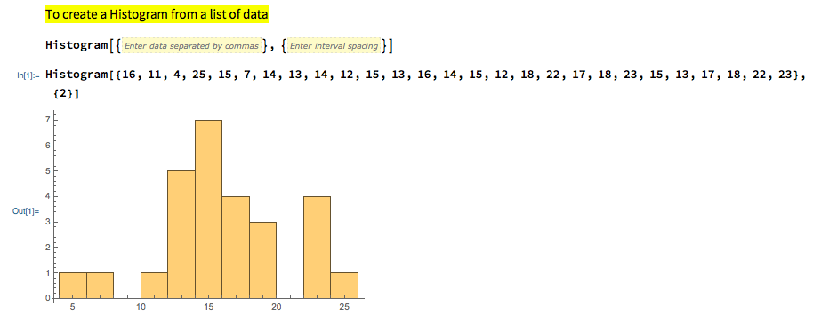
Constructing a histogram from raw data

Slide 10
What to look for in a histogram?
Symmetric distributions
shape and outliers
centre
spread
Skewed distributions

Slide 11
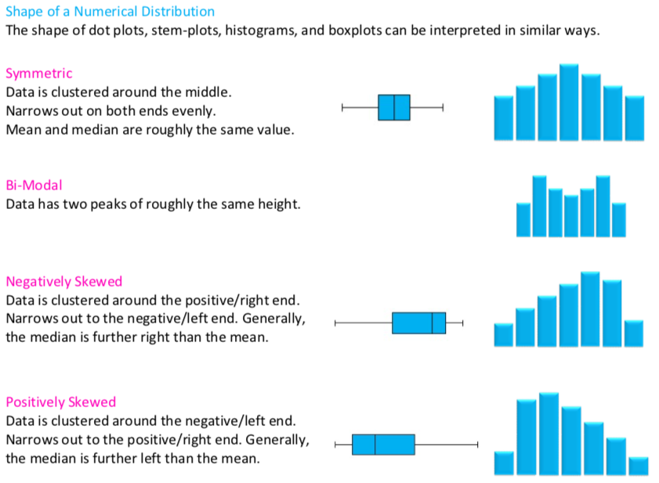

Slide 12
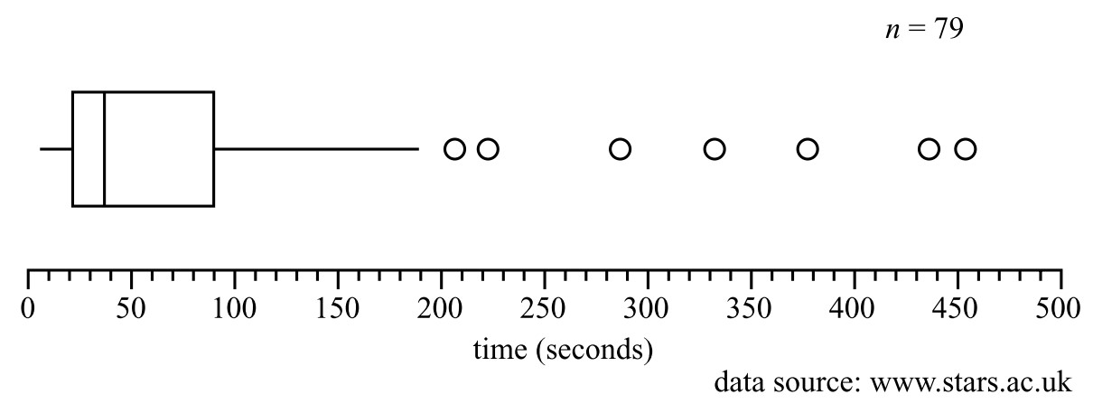
Outliers
Outliers are any data values that stand out from the main body of data.

Slide 13
Centre of a distribution
Look at a graph, or a list of the numbers, and see if the center is obvious.
Find the mean, the “average” of the data set.
Find the median, the middle number.
In general: use the mean if you do not have any outliers and use the median if you have outliers or if your graph is very skewed.
Histograms 6 to 8 display the distribution of test scores for three different classes taking the same subject. They are identical in shape, but differ in where they are located along the axis

Slide 14
Determining the median
The median is the middle value in an ordered dataset.
For 𝑛 data values the median is located at the ($\frac{n+1}{2}$)th position.
𝑛 is odd, the median will be the middle data value
𝑛 is even, the median will be the average of the two middle data values.

Slide 16
Spread
Range
Range = largest value - smallest value
Histogram 10 has a spread (maximum range) of 22(22−0) units. This is considerably greater than the spread of histogram 11 which has a spread of 12(18−6) units.

Slide 17
Shape and outliers | The distribution is positively skewed. There are no outliers.
Centre: Count up the frequencies from either end to find the middle interval. | The distribution is centred between 170 and 340 phones per 1000 people.
Spread: Use the maximum range to estimate the spread. | Spread=1020−0=1020 phones/1000 people
Report
For these 85 countries, the distribution of the number of phones per 1000 people is positively skewed. The centre of the distribution lies between 170 and 340 phones/1000 people. The spread of the distribution is 1020 phones/1000 people. There are no outliers.

Slide 18
Report writing: Shape, Centre, Spread
Report
For these 85 countries, the distribution of the number of phones per 1000 people is positively skewed. The centre of the distribution lies between 170 and 340 phones/1000 people. The spread of the distribution is 1020 phones/1000 people. There are no outliers.

Slide 19
exercises & Summary Book
1. Ex page 1C
2. Summary notes

