Slide 1
Dot Plots Stem Plots
1D

Slide 3
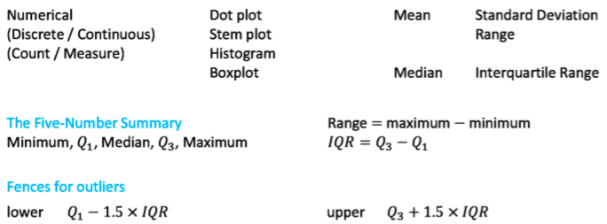
Summary statistics
Centre (at which point is the distribution centred?)
Spread (how are the scores in the distribution spread out?)

Slide 4
The dot plot
A statistical graph that uses dots to display individual data values on a number line. Suitable for small sets of data only.
N=13

Slide 6
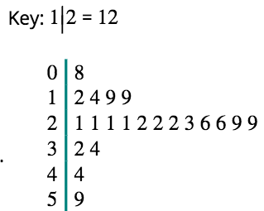
Stem Plot / Stem and Leaf Plot
A method for displaying data in which each observation is split into two parts, a ’stem’ and ‘leaf’.
An alternative display to a histogram.
Suitable for small to medium sized data sets.
N=21

Slide 7
We can now answer various questions about the data.
Stem Leaf Plots
Construction of Stem and Leaf
Example : Construct a stem and leaf graph for the following
weights in (kgs) :
Weight (kgs)
1
2
2
3
5
5
12 | 12 | 13 | 15 | 15
21 | 23 | 29 | 32 | 32
40 | 40 | 41 | 41 | 51
54 | 55 | 55 | 55 | 57
12 | 40 | 57 | 54 | 55
13 | 55 | 15 | 32 | 55
32 | 15 | 41 | 21 | 40
23 | 41 | 29 | 51 | 12
2
1
3
9
3
2
2
4
0
0
1
1
5
1
4
5
5
5
7
stem
leaves
Key : 2 3
N=20

Slide 8
Stem Leaf Plots
Construction of Stem and Leaf
A Stem – Leaf graph is another way of displaying information :
Ages
This stem and leaf graph shows
the ages of people waiting in a
queue at a post office
2
4
6
8
3
0
1
3
4
4
4
5
6
7
9
How many people in the queue?
20
5
0
3
4
9
6
1
4
5
6
How many people in their forties?
6
stem
leaves
n = 20 Key : 2 4

Slide 13
N=19

Slide 14
N=19

Slide 15
N=20

Slide 19
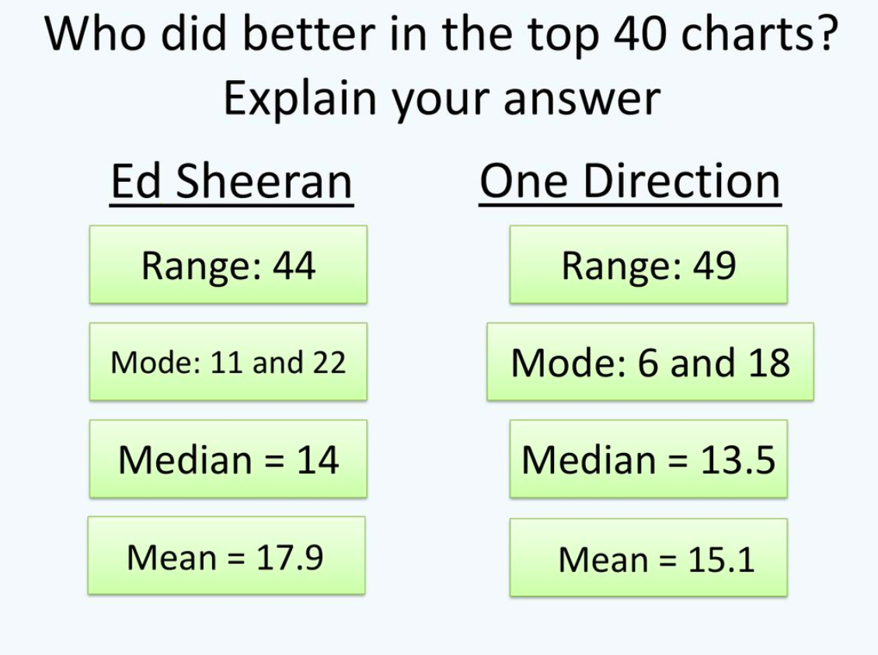

Slide 20
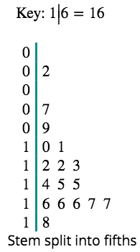
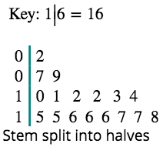
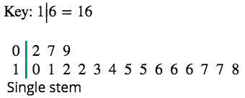
Stem plots with split stems

Slide 21
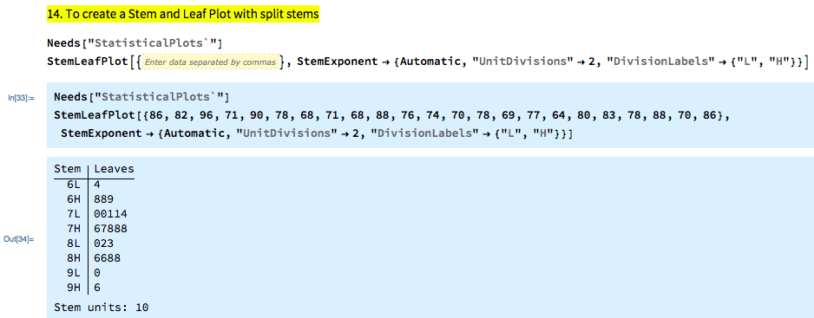
Mathematica

Slide 22
Notes:
https://www.mathspad.co.uk/interactives/averages/averages.php

Slide 23
exercises & Summary Book
1. Ex page 2A
2. Summary notes

