Slide 1

Describing the centre and spread of symmetric distributions
Mean & Standard Deviation
1F

Slide 2

Notes:
Einstein, Elon Musk CEO of SpaceX, Stephen W. Hawking

Slide 3
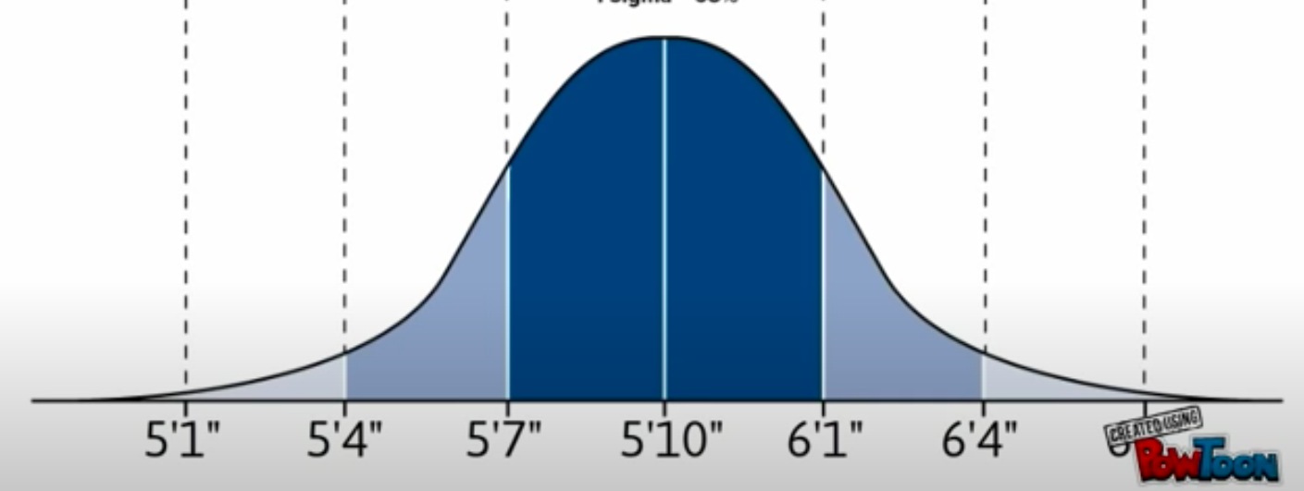
US Male Heights
1.55m 1.63m 1.70m 1.78m 1.85m 1.93m 2.01m

Slide 4
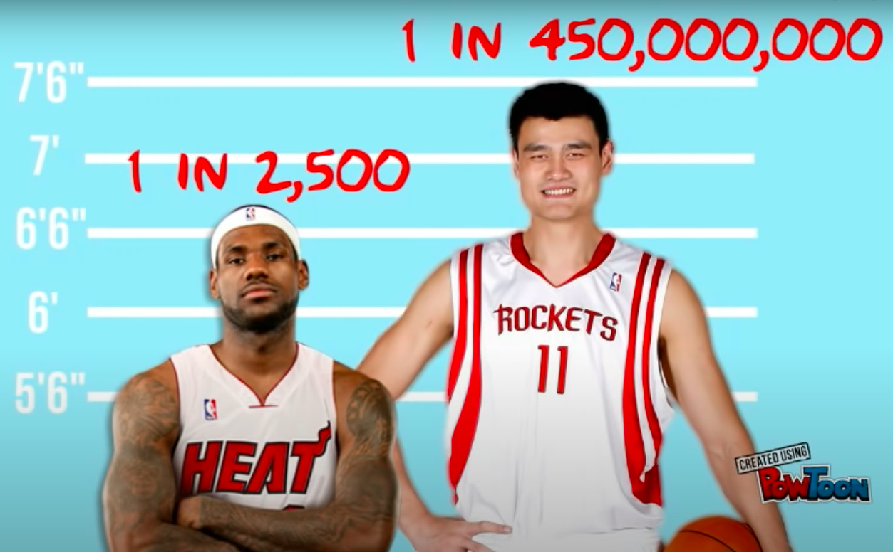
US Male Heights
2.03m 2.29m

Slide 5
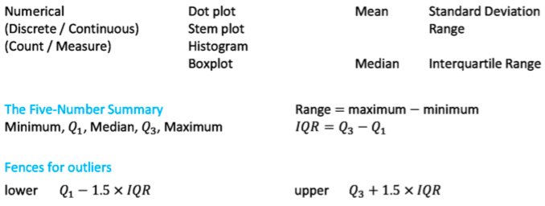
Data Distribution

Slide 6
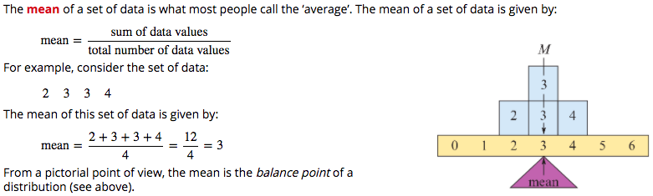
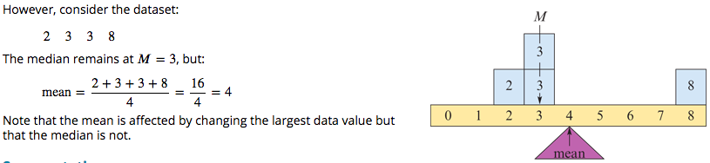
Mean

Slide 7
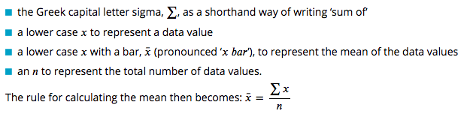
Mean Notation

Slide 8
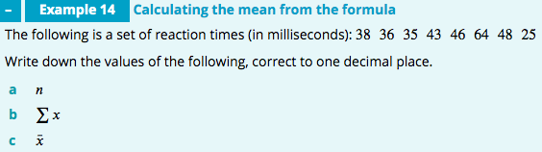
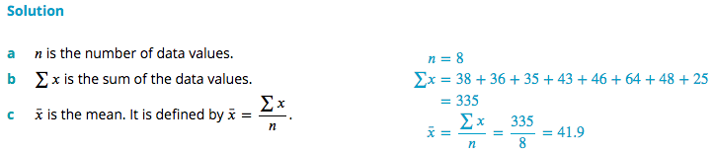

Slide 9
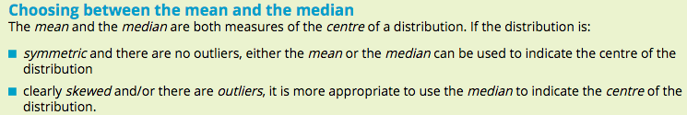
Using mean or median
mortality rates for 60 US cities
the population distribution of different cities
mean = 940 / 100 000
median =944 / 100 000 people
mean =1.4 million
median = 0.9 million

Slide 10
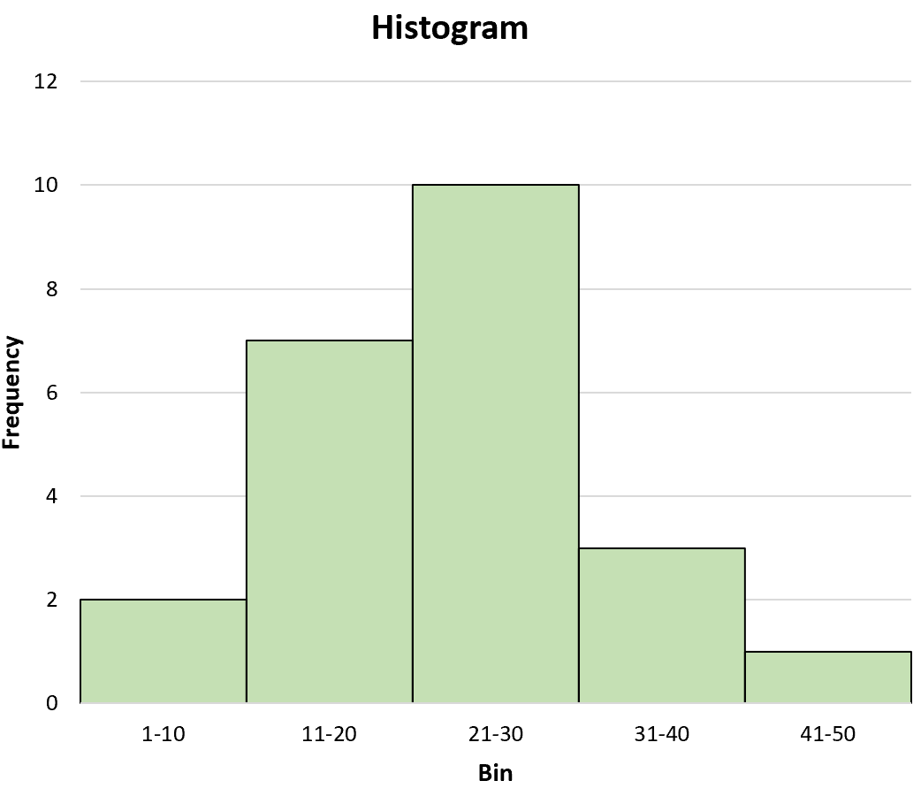
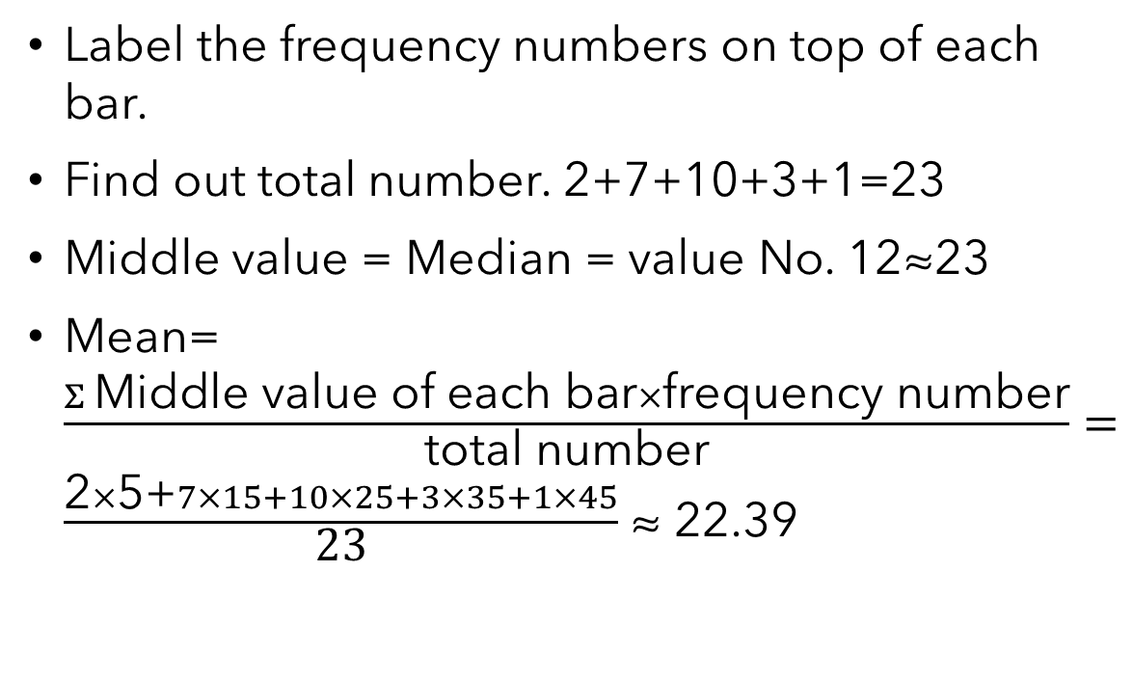
How to estimate mean and median from a histogram?
Label the frequency numbers on top of each bar.
Find out total number. 2+7+10+3+1=23
Middle value = Median = value No. 12≈23
Mean=$\frac{Σ \text{Middle} \text{value} \text{of} \text{each} \text{bar}×\text{frequency} \text{number}}{\text{total} \text{number}}=$ $\frac{\text{2}×\text{5+}7×15+10×25+3×35+1×45}{\text{23}}$ ≈ 22.39
10
7
3
2
1

Slide 11
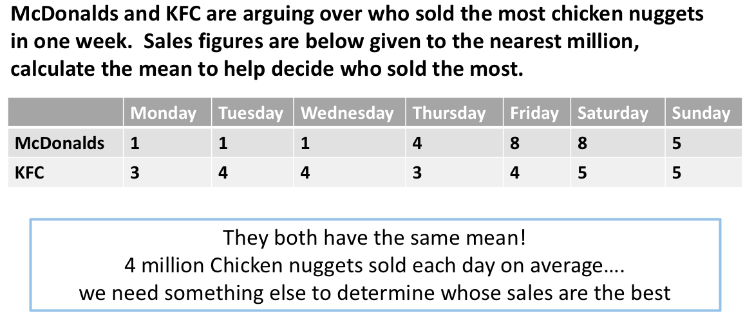



Slide 12
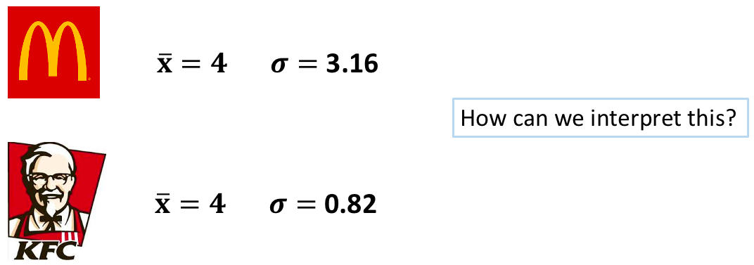

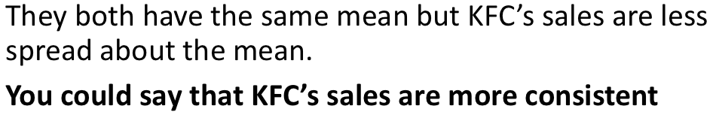
More Consistent
More Variable

Slide 13
The Standard Deviation
https://www.youtube.com/watch?v=MRqtXL2WX2M

Slide 14

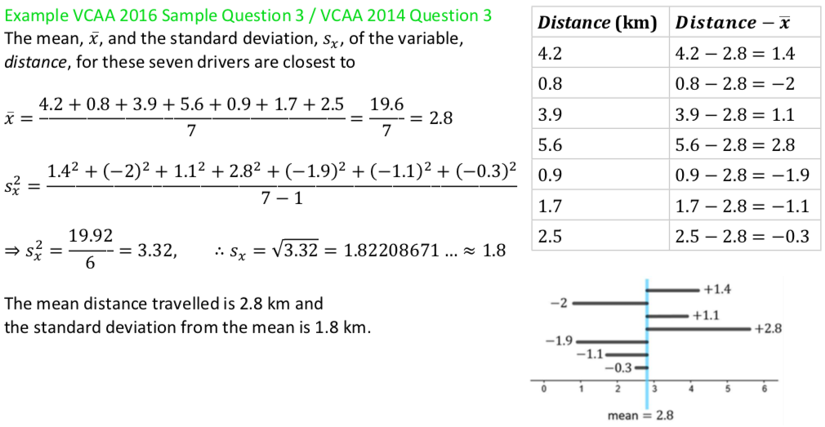
The standard deviation

Slide 15
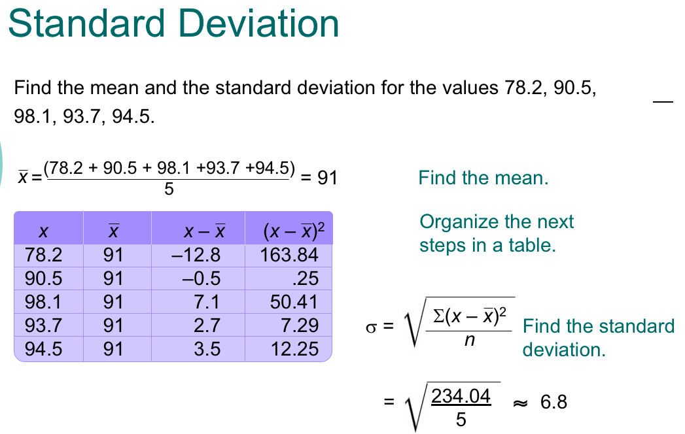
-1
-1

Slide 16
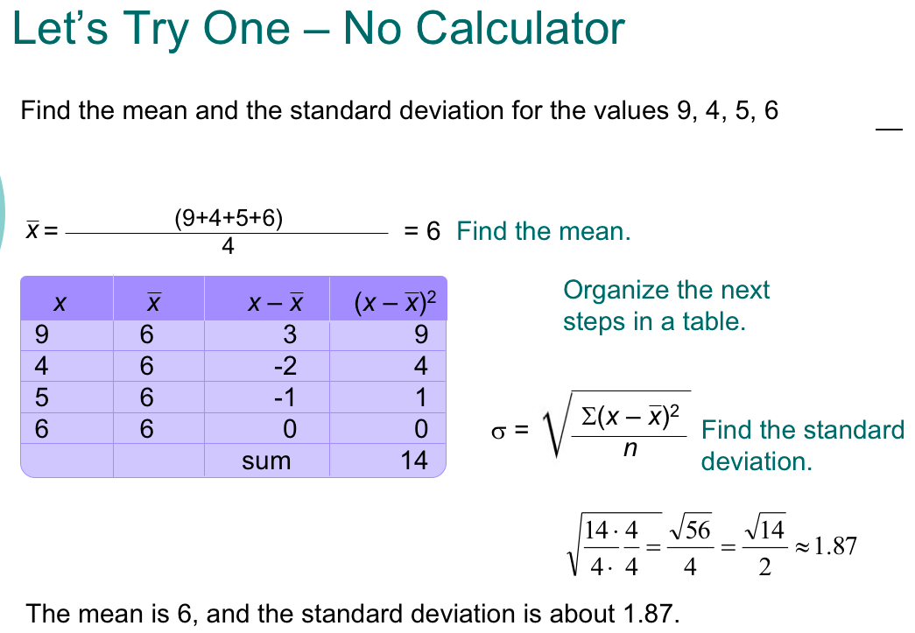
-1

Slide 17
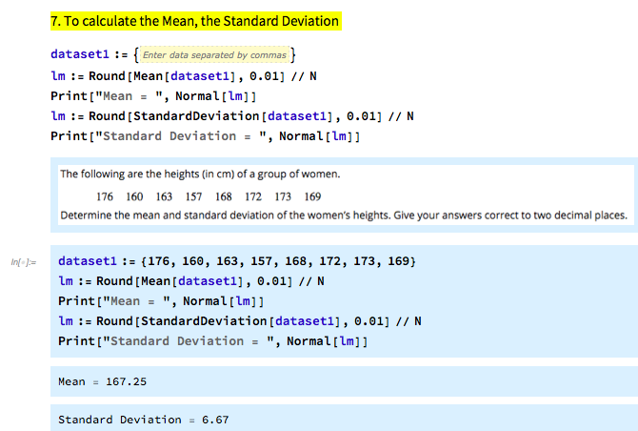
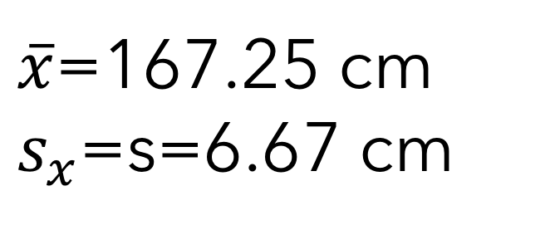
The Standard Deviation
$\overline{x}$=167.25 cm
$s_{x}$=s=6.67 cm

Slide 18
    exercises & Summary Book
1. Ex page 2F
2. Summary notes

