Slide 1
The five-number summary and the box plot
1G

Slide 2
Starter
Unscramble these key words for today’s lesson
Can you work out the title?
dome
nademi
Mode
Median
grean
Range

Slide 5
Five-number summary
minimum, $Q_{1}$, 𝑀, $Q_{3}$, maximum
is known as a five-number summary.
The box plot
The box-and-whisker plot
The box plot is a graphical display of a five-number summary of a data set showing outliers if present.

Slide 6
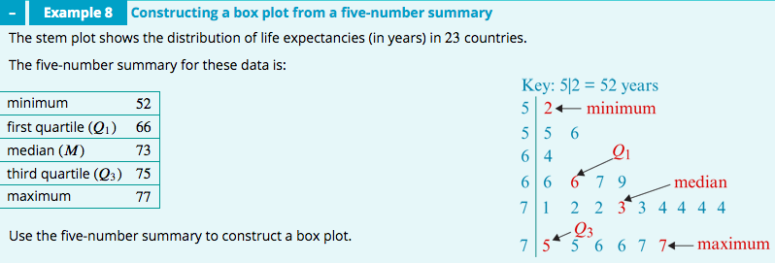
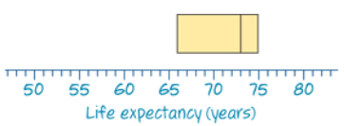
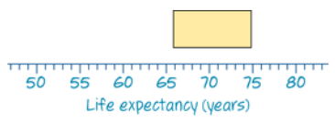
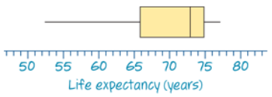
Minimum=52, maximum=77
$Q_{1}$=66, $Q_{3}$=75,
𝑀=73,
Minimum=52, maximum=77

Slide 7
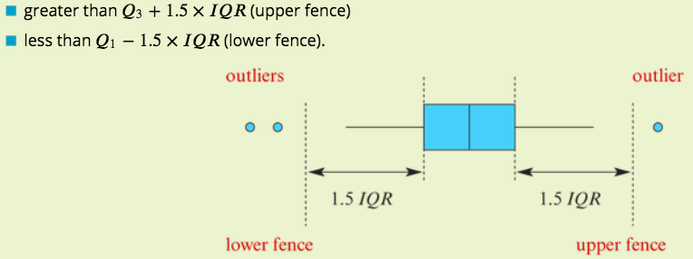
Box plots with outliers

Slide 8
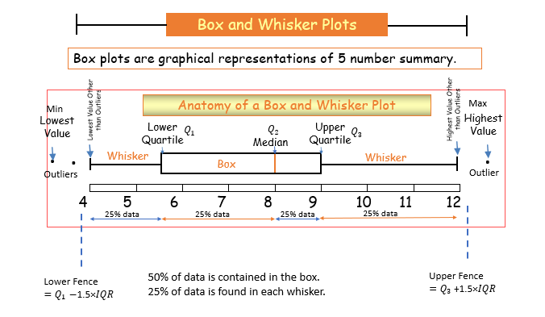

Slide 9
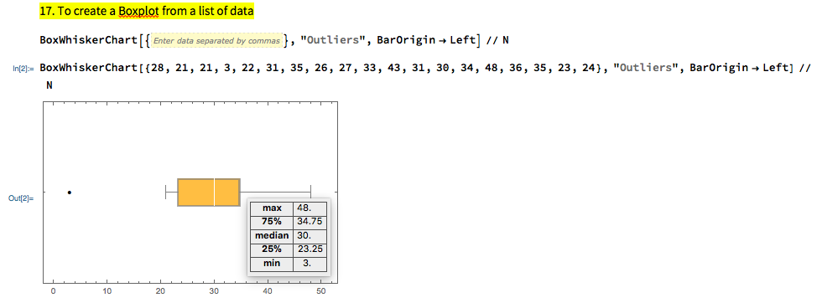
How to construct a box plot with outliers

Slide 10
𝑀=36
$Q_{1}$=30, $Q_{3}$=44
𝐼𝑄𝑅= $Q_{3}$−$Q_{1}$=44−30=14
Min =4, Max =92
4, 70, 84 and 92 are possible outliers
Upper fence= $Q_{3}$+1.5×IQR=44+1.5×14=65, Any value above 65 is an outlier.
Lower fence= $Q_{1}$−1.5×IQR=30−1.5×14=9, Any value below 9 is an outlier.

Slide 11
$Q_{1}$= 54; 25% of values are less than $Q_{1}\left(one whisker\right)$ a. 25%
$Q_{2}$= M=55; 50% of values are less than $Q_{2} (half box and one whisker)$. b. 50%
$Q_{3}$= 59; 75% of values are less than $Q_{3}(whole box and one whisker)$. c. 75%
$Q_{3}$= 59; 25% of values are greater than $Q_{3}(one whisker)$. d. 25%
50% of values between 54 $Q_{1}$and 59 $Q_{3}(whole box)$. e. 50%
75% of values are between 54 and 86. $(whole box and one whisker)$ f. 75%

Slide 12
Mode, Median, Mean & Range
Hint: Start with the median!
Finisher
Use the information given to work out the set of data:
___ ___ ___ ___ ___
Mode = 3 Range = 7
Median = 5 Mean = 6
3
3
5
9
10
Keywords
Average, mean, median, mode, range, data, frequency

Slide 13
exercises & Summary Book
1. Ex page 2C
2. Summary notes

