Slide 1
Using box plots to describe and compare distributions
2E

Slide 2
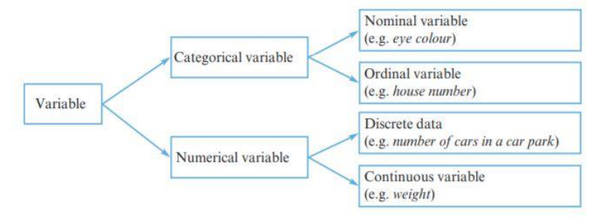

Slide 3
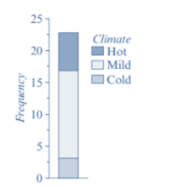
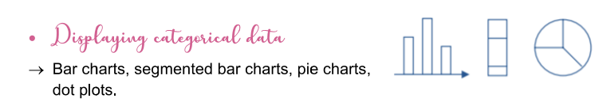
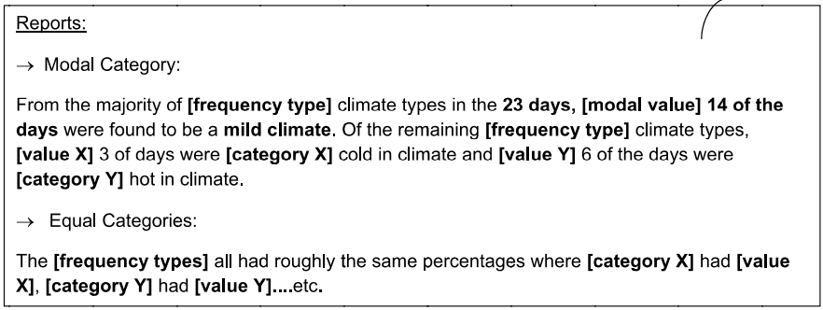

Slide 4
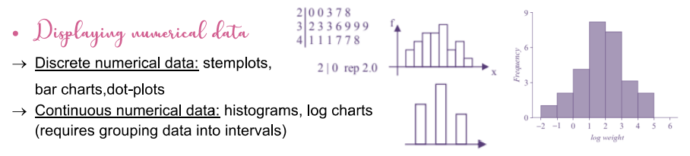
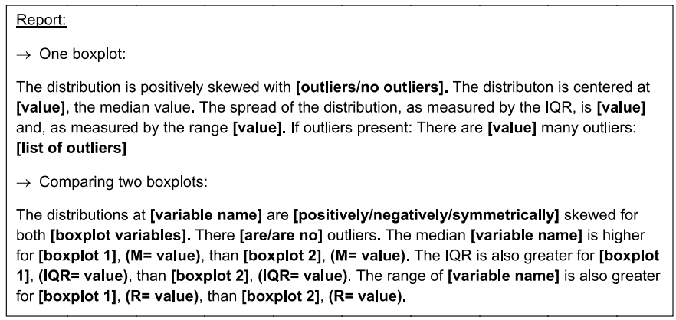

Slide 5
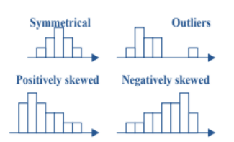
Shape

Slide 6
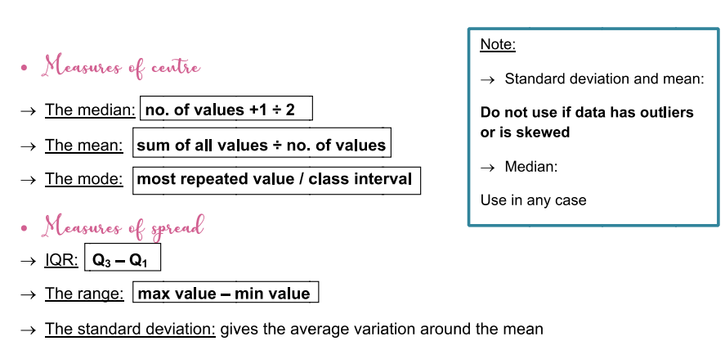

Slide 7
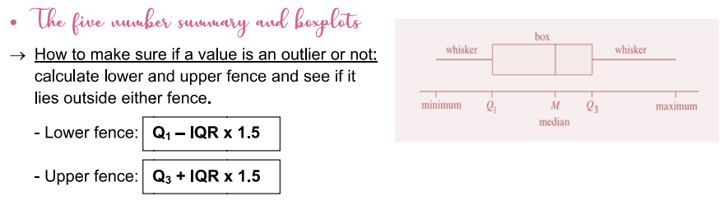

Slide 8
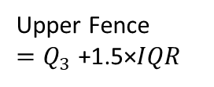

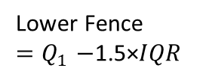


Box and Whisker Plots
Box plots are graphical representations of 5 number summary.
Anatomy of a Box and Whisker Plot
Max
Lowest Value Other than Outliers
Highest Value Other than Outliers
Min
Lowest Value
Highest Value
Lower Quartile
$$Q_{1}$$
$$Q_{2}$$
Upper Quartile
$$Q_{3}$$
.
.
Median
.
Whisker
Whisker
Box
Outliers
Outlier
4
5
6
7
8
9
10
11
12
25% data
25% data
25% data
25% data
Lower Fence
${=Q}_{1}−$1.5×𝐼𝑄𝑅
50% of data is contained in the box.
25% of data is found in each whisker.
Upper Fence
${=Q}_{3}$+1.5×𝐼𝑄𝑅

