Slide 1
Standard scores
2H
Notes:
https://create.kahoot.it/details/7d6f53b7-0165-40d8-9dcc-1a3cc2df942d

Slide 2
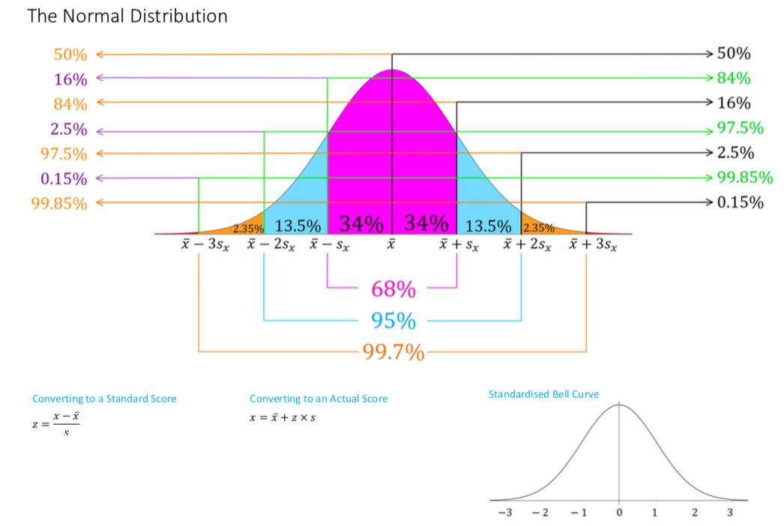

Slide 3
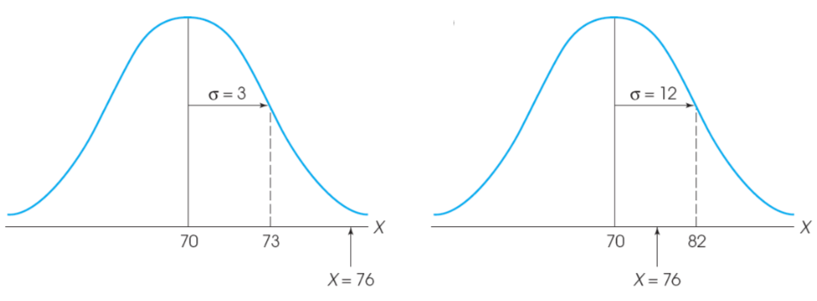
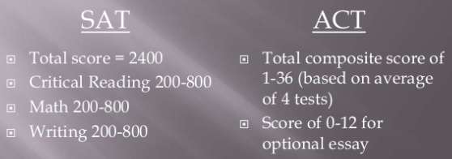

Slide 4
0 1
0 1

Slide 5
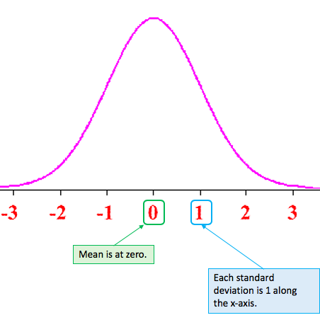
Standardised or z-scores
The value of the standard score gives the distance and direction of a data value from the mean in term of standard deviations.
The rule for calculating a standardized score is

Slide 8
Above 93.32% of the sample group

Slide 9
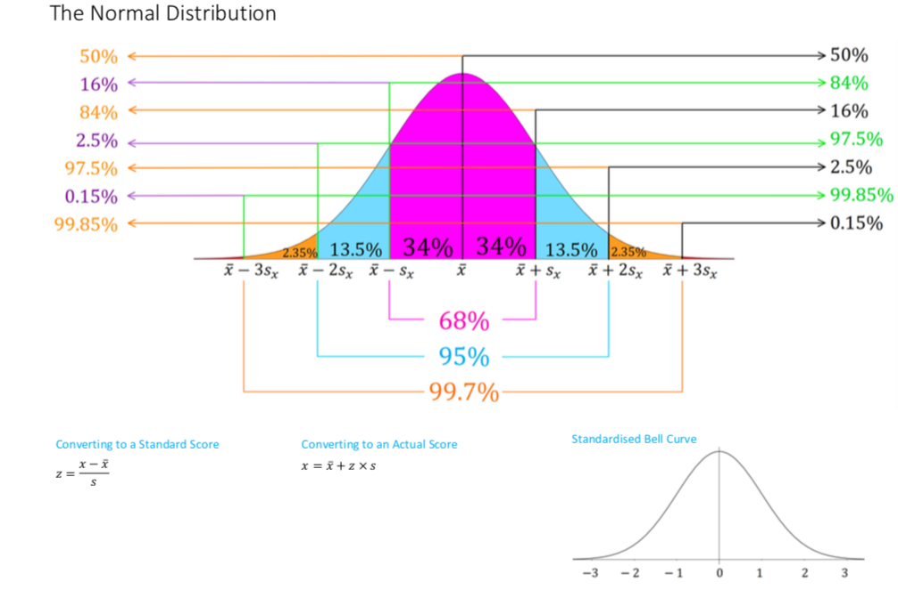

Slide 10
Above 84% of the sample group

Slide 11
Above 30.85% of the sample group

Slide 12
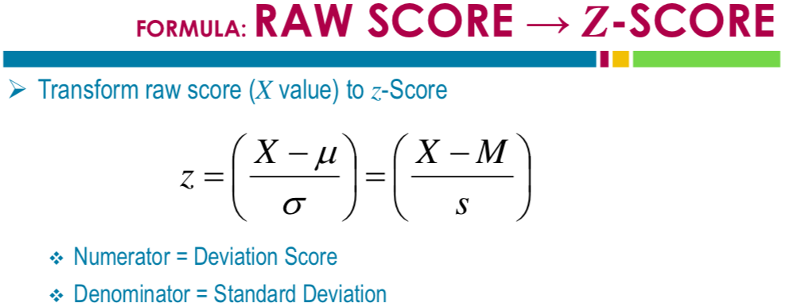
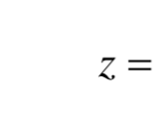
$$\overline{x}$$

Slide 13
$$\overline{x}$$
$$\overline{x}$$
Above 69.15% of the sample group

Slide 14
$$\overline{x}$$
$$\overline{x}$$

Slide 15
Above 22.66% of the sample group
$$\overline{x}$$
$$\overline{x}$$

Slide 16
Which subject has the higher score?
Above 84.13% of the sample group
Above 97.73% of the sample group

Slide 17
exercises & Summary Book
1. Ex page 2H
2. Summary notes

