Slide 1
Populations and samples
1I

Slide 2
Populations and Samples
https://www.youtube.com/watch?v=e_h3RBgBx8M&feature=youtu.be

Slide 3
Selecting participants for an experiment
population
is the entire set of individuals of interest to a researcher
although the entire population usually does not participate in a research study, the results from the study are generalized to the entire population
sample
a set of individuals selected from a population and usually is intended to represent the population in a research study

Slide 4
Population Parameters vs. Sample Statistics
Population Parameters 𝜇=110.
a number describing a population.
Greek symbols are used to represent population parameters.
Sample Statistics $\overline{x}=113.8$
Sample Statistics 𝑥 ̅=113.8
a number that can be calculated from sample data
For the population mean we use the symbol 𝜇(mu).
Roman letters are used to represent sample statistics.
We use the familiar symbol $\overline{x}$to indicate that we are working with a sample mean.
We use the familiar symbol 𝑥 ̅ to indicate that we are working with a sample mean.
𝜇=110

Slide 5
Types of sampling
Simple Random sample SRS- unbiased and fair sample of the population. Everyone had equal chance of being chosen e.g. lottery number draw, post codes, computerised sampling
Stratified sample- Involves dividing the population to be sampled into distinct subgroups or strata then selecting a separate sample from each stratum in the same proportions as they occur in the target population e.g. sex, religion, age culture.
Opportunity/convenience sample- Quick and easy way of selecting participants based on accessibility. e.g. at University, local school, supermarket.

Slide 6
Simple Random Sample SRS
+ Unbiased
+ Results can be applied to the population
- Can be difficult to obtain information
- Can be costly

Slide 7
Stratified Sampling
+ Unbiased
+ Results can be applied to population
+ Ensures certain groups are represented appropriately
- Time consuming
- Requires access to strata i.e. information about each participant in the group

Slide 8
Convenience Sampling
+ Fast
+ Inexpensive
- Bias
- Unable to be generalised to the population

Slide 9
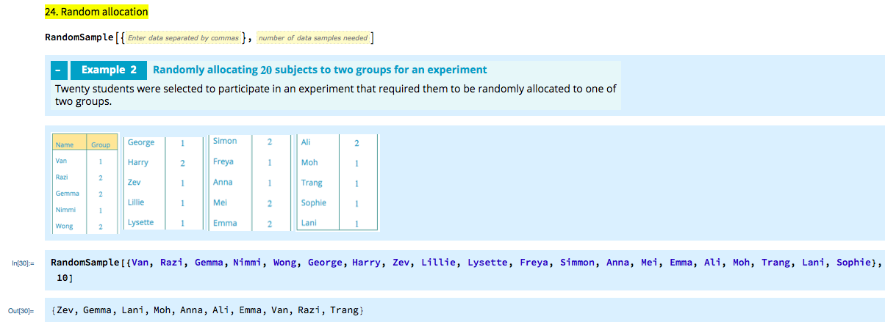

Slide 10
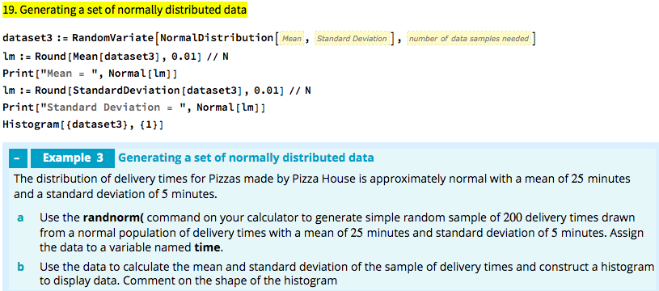
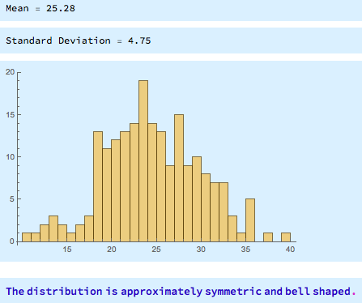

Slide 11
exercises & Summary Book
1. Ex page 2I
2. Summary notes

