Slide 1
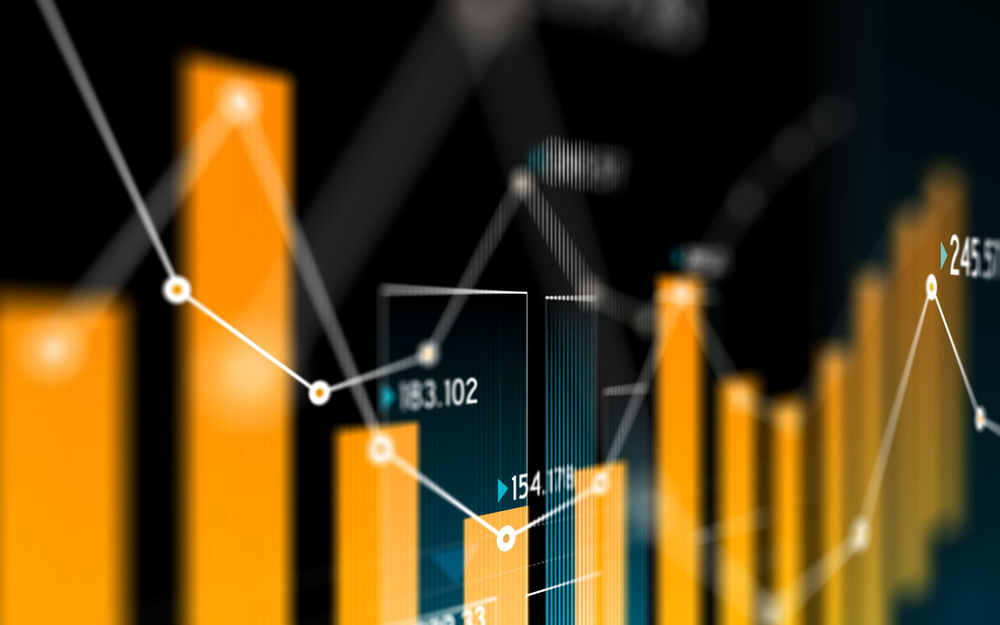
The log transformation
4B The log transformation
Pear deck
ttps://docs.google.com/presentation/d/1ab7UmeQn-5wiltTM77VCs6XqQmHBeTH4xP0FLfy_Zkc/edit#slide=id.g167af955d7d_0_8
Notes:
https://create.kahoot.it/details/chapter-5-regression-and-data-transformation/9ad91423-8579-4a49-badf-1af2bd244702
https://create.kahoot.it/details/data-transformation-basic-skills/e1be7d0b-faf1-45c7-bb54-279b47ca0a6a

Slide 2
Scientific Notation
$${10}^{3}$$
$${10}^{2}$$
$${10}^{1}$$
$${10}^{0}$$
$${10}^{−1}$$
$${10}^{−2}$$
$${10}^{−3}$$

Slide 3
Properties of logs to the base 10
If a number is greater than one, its log to the base 10 is greater than zero.
If a number is greater than zero but less than one, its log to the base 10 is negative.
If the number is zero, then its log is undefined.

Slide 4
Why use logarithm?
The histogram below displays the body weights (in kg) of a number of animal species. Because the animals represented in this dataset have weights ranging from around 1 kg to 90 tonnes (a dinosaur), most of the data are bunched up at one end of the scale and much detail is missing. The distribution of weights is highly positively skewed, with an outlier.

Slide 5
Working with logs
On your calculator, type log (45) and press .
If the log of a number is 2.7125, then the number is ${10}^{2.7125}$.
type 10 $x^{y}$ 2.7125 buttons .

Slide 7
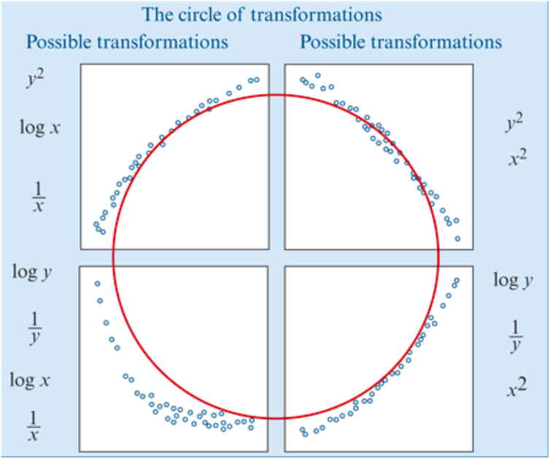
Data Transformation
Use a mathematical rule to change the scale on either x- or y-axis in order to linearise a non-linear scatterplot.
The types of scatterplots that can be transformed by the squared, log or reciprocal transformations can be fitted together into what we call the circle of transformations.

Slide 8
Log transformation

Slide 9
The logarithmic transformation
The logarithmic transformation is a compressing transformation and the upper end of the scale on either the x- or the y-axis. The effect of applying a log x transformation to a scatterplot is illustrated graphically below.

Slide 10
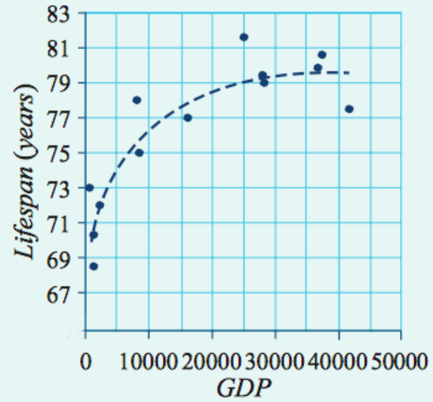
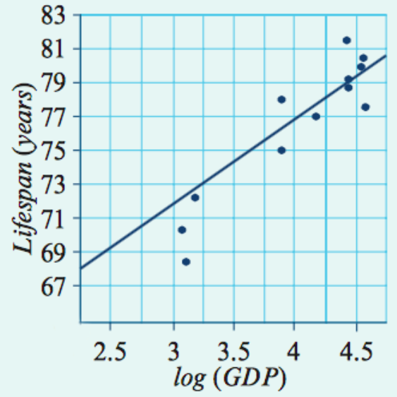
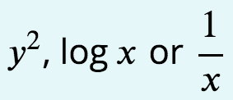
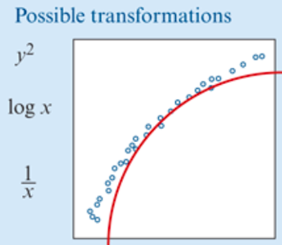
Applying the log transformation
The general wealth of a country, often measured by its Gross Domestic Product (GDP), is one of several variables associated with lifespan in different countries. However, the association it not linear, as can be seen in the scatterplot below which plots lifespan (in years) against GDP (in dollars) for 13 different countries.

Slide 11
Applying the log transformation
The general wealth of a country, often measured by its Gross Domestic Product (GDP), is one of several variables associated with lifespan in different countries. However, the association it not linear, as can be seen in the scatterplot below which plots lifespan (in years) against GDP (in dollars) for 13 different countries.

Slide 12
Using Mathematica to perform a log transformation

Slide 13
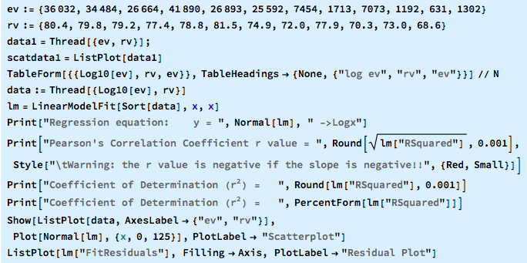
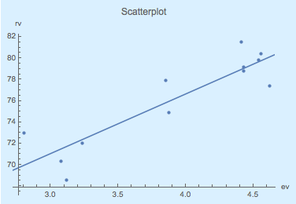
All in one Command
To 3 Sig. Fig.
To 2 Decimal Places

