Slide 1
Using data transformation to linearise a scatterplot
4C The reciprocal transformation
Notes:
https://create.kahoot.it/details/469e7171-6a4b-4909-836b-d27bb62f9074
https://quizizz.com/admin/quiz/5ec0a0811401fd001bac3476?source=quiz_share

Slide 2
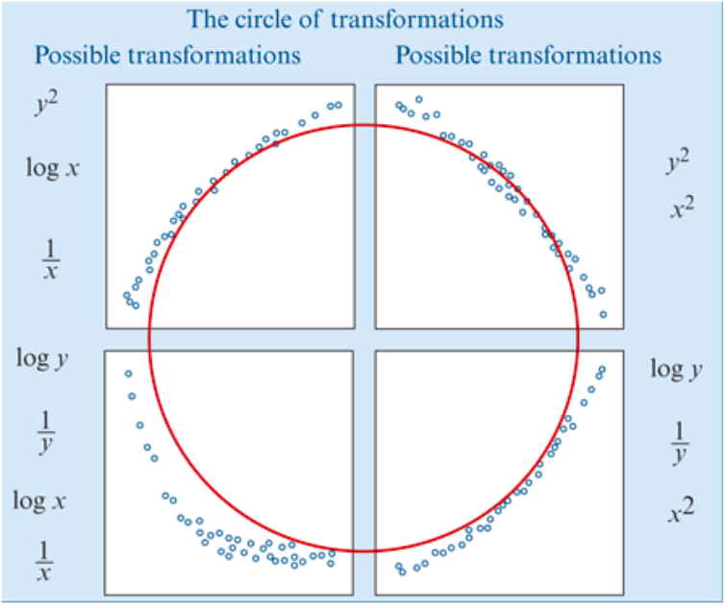
Data Transformation
Use a mathematical rule to change the scale on either x- or y-axis in order to linearise a non-linear scatterplot.
The types of scatterplots that can be transformed by the squared, log or reciprocal transformations can be fitted together into what we call the circle of transformations.

Slide 3
The reciprocal transformation
The reciprocal transformation is a stretching transformation that compresses the upper end of the scale on either the 𝑥- or 𝑦-axis. The effect of applying a reciprocal y transformation to a scatterplot is illustrated below.

Slide 4
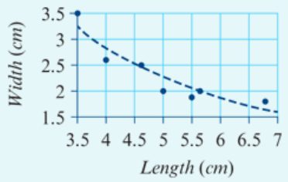
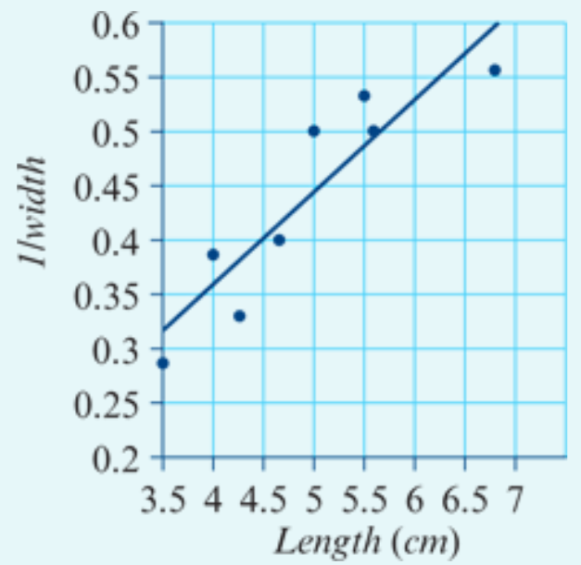
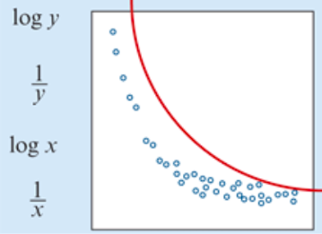
Applying the reciprocal transformation
A homeware company makes rectangular sticky labels with a variety of lengths and widths.
The scatterplot opposite displays the width (in cm) and length (in cm) of eight of their sticky labels.

Slide 5
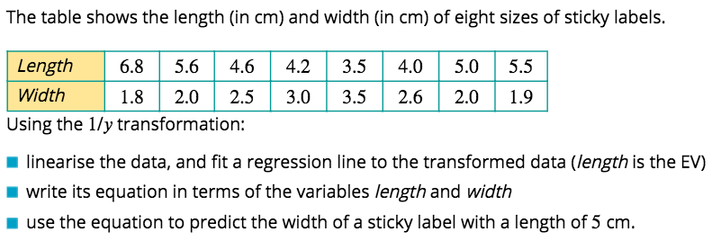
Using Mathematica to perform a reciprocal transformation
$$\frac{1}{y}$$
X
Y
$Transformed scatterplot with a straight line.$
$\frac{1}{Width}$= + ×length
$\frac{1}{Width}$= + ×5
Notes:
Know Maths calculation by heart. Then find key words.

Slide 6
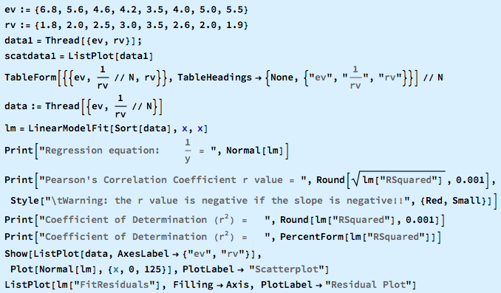
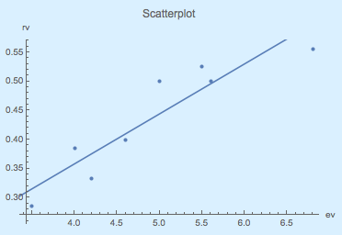
All in one Command
To 3 Sig. Fig.
To 2 Decimal Places

