Slide 1
Rates of Change
Lesson 18B

Slide 2
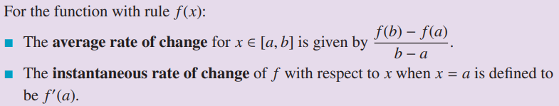
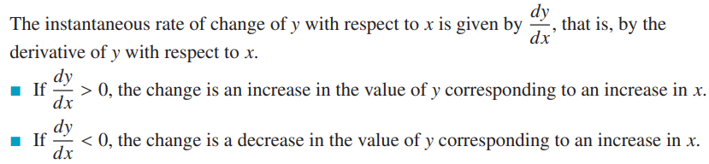

Slide 3

Rate of Change
Consider a table of
ordered pairs
(time, height)
T | H
0.00 | 200
0.25 | 199
0.50 | 196
0.75 | 191
1.00 | 184
1.25 | 175
1.50 | 164
1.75 | 151
2.00 | 136
2.25 | 119
2.50 | 100
2.75 | 79
3.00 | 56
3.25 | 31
3.50 | 4
Using this data, how could we find the speed (in feet per second) of the sky diver?

Slide 4
Average Rate of Change
Recall formula for slope of a line through two points
For any function we could determine the slope for two points on the graph
  This is the average rate of change for the function on the interval from x₁ to x₂

Slide 5
Calculate the
Average Rate of Change
View TI Nspire
Demo

Slide 6
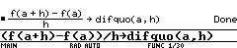
Difference Quotient
The average range of change of f(x) with respect to x
  As x changes from a to b is
This is known as the difference quotient
Possible to have calculator function for difference quotient
Note: use of the difquo() function assumes the definition of f(x) exists in the calculator memory

Slide 7
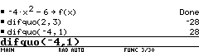
Try It Out
Given a function f(x)
  Define in your calculator
Now determine the average rate of change for f(x) between
  x=2 and x = 5
  x = -4 and x = -3
h = 3
h = ?

Slide 8
Rate of Change from a Table
Year | Value
0 | $500.00
1 | $550.00
2 | $605.00
3 | $665.50
4 | $732.05
5 | $805.26
6 | $885.78
7 | $974.36
8 | $1,071.79
9 | $1,178.97
10 | $1,296.87
Consider the increasing
value of an investment
Determine the rate
of change of the
value for successive
years
Is the rate of change
a) decreasing, b) same, c) increasing ?

Slide 9
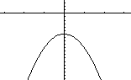
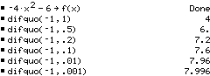
Instantaneous Rate of Change
Rate of change for a large interval is sometimes not helpful
Better to use points close to each other

Slide 10
Instantaneous Rate of Change
What if we let the distance between the points approach zero
Note that the difference quotient seems to approach a limit

Slide 11
Instantaneous Rate of Change
Given
  Find the instantaneous rate of change at x = 1
We seek
Problem … h ≠ 0
Strategy
  Evaluate difference quotient using 1
  Simplify
  Now let h = 0

Slide 12
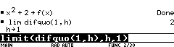
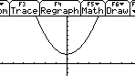
Instantaneous Rate of Change
Calculator can determine limits
  Define f(x)
  Invoke limit function
Variable to take to the limit
Expression to find limit of
Limit to use
Instantaneous rate of change = 2

Slide 13
