Slide 1
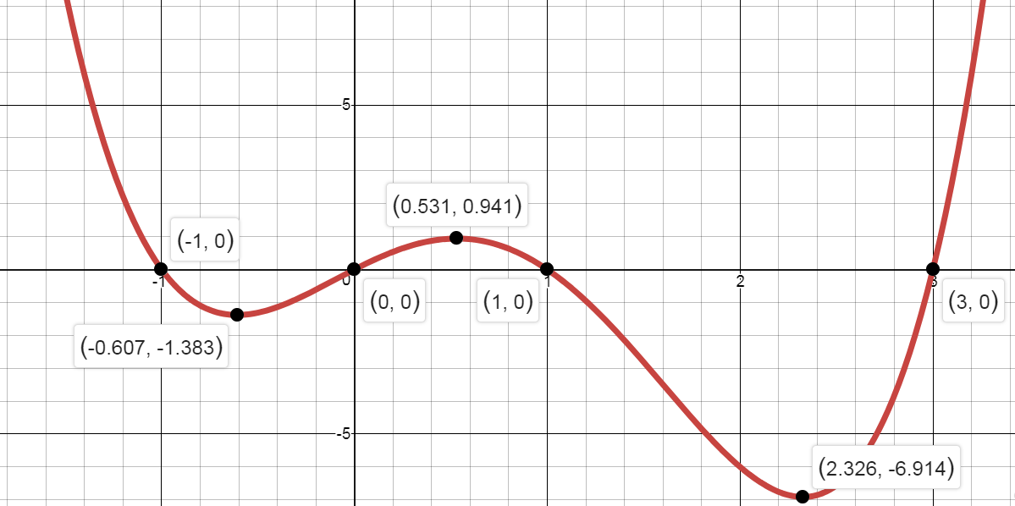
Notes:
This lesson contains resources taken from Boardworks, DrFrostMaths & Edexcel C2 Textbook.

Slide 2
Stationary Points
Recognise a stationary point on a curve Find the coordinates of a stationary point on a curve Identify whether a stationary point is a maximum, minimum or inflexion point

Slide 3
Stationary Points

Slide 4
A stationary point is where the gradient is 0, i.e. $f^{′}\left(x\right)=0$.
Local maximum
$$f^{′}\left(x\right)=0$$
Note: It’s called a ‘local’ maximum because it’s the function’s largest output within the vicinity. Functions may also have a ‘global’ maximum, i.e. the maximum output across the entire function. This particular function doesn’t have a global maximum because the output keeps increasing up to infinity. It similarly has no global minimum, as with all cubics.
Local minimum
$$f^{′}\left(x\right)=0$$
Find the coordinates of the turning points of $y=x^{3}+6x^{2}−135x$
?
$$\frac{dy}{dx}=3x^{2}+12x−135=0 \\ x^{2}+4x−45=0 \\ \left(x+9\right)\left(x−5\right)=0 \\ x=−9 or x=5$$
When $x=5, y=5^{3}+6\left(5^{2}\right)−135\left(5\right)=−400 → \left(5,−400\right)$
When $x=−9, y={\left(−9\right)}^{3}+6{\left(−9\right)}^{2}−135\left(−9\right)=972 → (−9,972)$

Slide 5
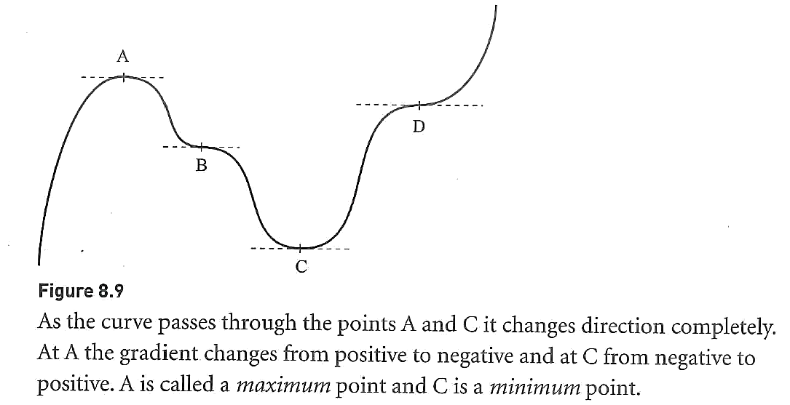

Slide 6
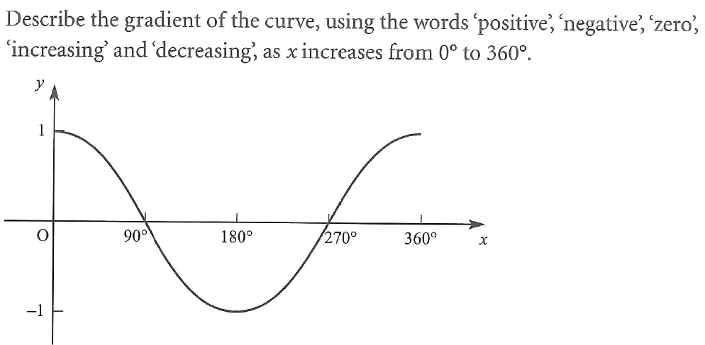
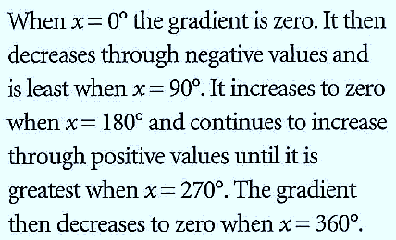
Your Turn

Slide 7
Example
We can find the coordinates of the stationary point on a
given curve by solving For example:
Find the coordinates of the stationary points on the curve with equation y = x³ – 12x + 7.
3x² – 12 = 0
x² – 4 = 0
(x – 2)(x + 2) = 0
x = 2 or x = –2

Slide 8
Find the coordinates of the stationary points on the curve with equation y = x³ – 12x + 7.
Substituting x = 2 into y = x³ – 12x + 7 gives
y = 2³ – 12(2) + 7
= 8 – 24 + 7
= –9
So one of the stationary points has the coordinates (2, –9).
Substituting x = –2 into y = x³ – 12x + 7 gives
y = (–2)³ – 12(–2) + 7
= –8 + 24 + 7
= 23
So the other stationary point has the coordinates (–2, 23).

Slide 9
Your Turn
Find the least value of
$$f\left(x\right)=x^{2}−4x+9$$
Find the turning point of
$$y=\sqrt{x}−x$$
? Method 1: Differentiation
?
Method 1: Differentiation
$$f^{′}\left(x\right)=2x−4=0 \\ x=2 \\ f\left(2\right)=2^{2}−4\left(2\right)+9=5$$
So 5 is the minimum value.
$$y=x^{\frac{1}{2}}−x \\ \frac{dy}{dx}=\frac{1}{2}x^{−\frac{1}{2}}−1=0 \\ \frac{1}{2}x^{−\frac{1}{2}}=1 \\ x^{−\frac{1}{2}}=2 → \frac{1}{\sqrt{x}}=2 \\ \sqrt{x}=\frac{1}{2} → x=\frac{1}{4}$$
When $x=\frac{1}{4}$,
$$y=\sqrt{\frac{1}{4}}−\frac{1}{4}=\frac{1}{4}$$
So turning point is $\left(\frac{1}{4},\frac{1}{4}\right)$
? Method 2: Completing the Square
Method 2: Completing the square
$$f\left(x\right)={\left(x−2\right)}^{2}+5$$
Therefore the minimum value of $f(x)$ is 5, and this occurs when $x=2$.
Note: Method 2 is only applicable for quadratic functions. For others, differentiation must be used.

Slide 10
Your Turn
Edexcel C2 May 2013 (Retracted)
(2,9)
Although it might be interesting to know if this is a minimum point or a maximum point...
?

Slide 11
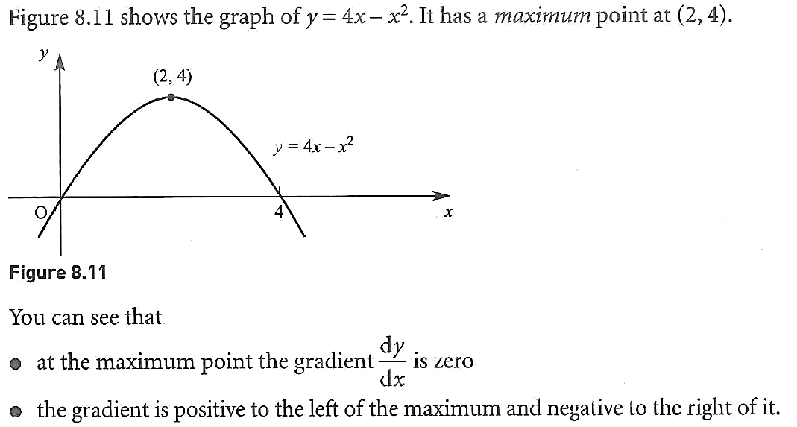
Maximum & Minimum Points

Slide 12
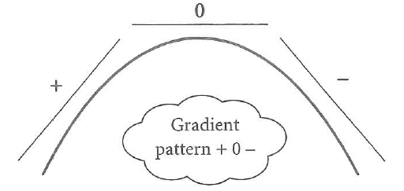
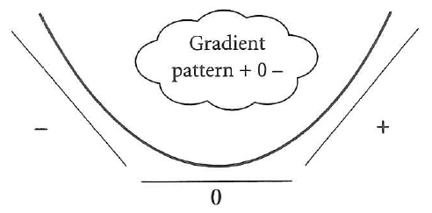
Maximum & Minimum
A maximum point can often be called a ‘peak’ and a minimum point a ‘trough’.

Slide 13
Do we have a maximum or minimum?
Method 1:
Consider the points immediately before and after the stationary point.
Method 2:
Use the second-order derivative to see whether the gradient is increasing or decreasing.
?
?

