Slide 1
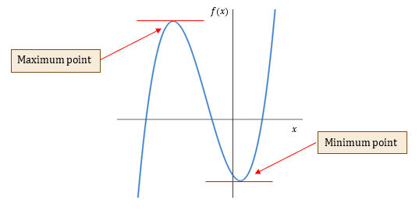
Types of stationary points
18D

Slide 2
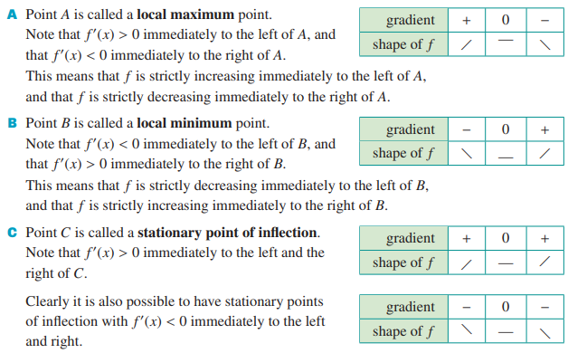

Slide 3
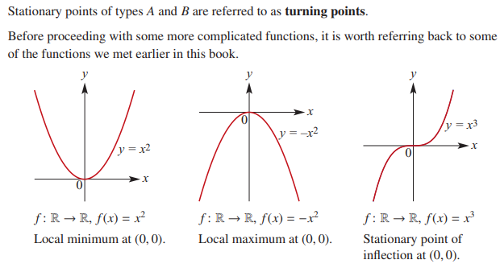

Slide 4
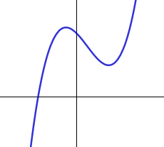
Stationary Points
Do Warmup Exercises
We often want to find the points on a graph where the gradient is zero.
We call these the stationary points.
$$f(x)$$
Maximum point
Minimum point
$$x$$
Do Exercise 1

Slide 5
Maxima and minima
We could see from the graph of the previous function that one stationary point was a maximum and the other was a minimum.
Do Exercise 2

Slide 6
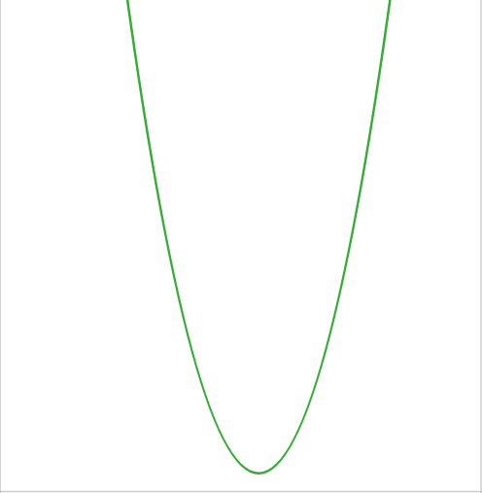
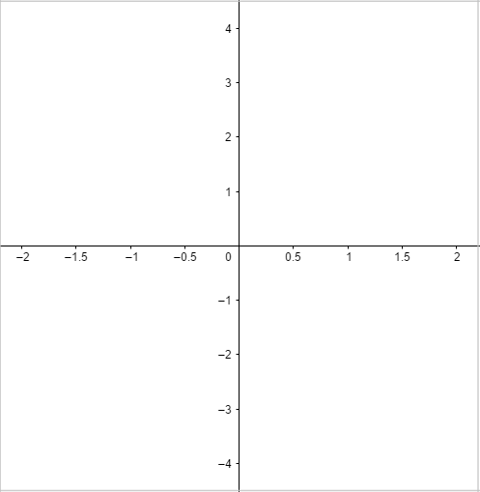
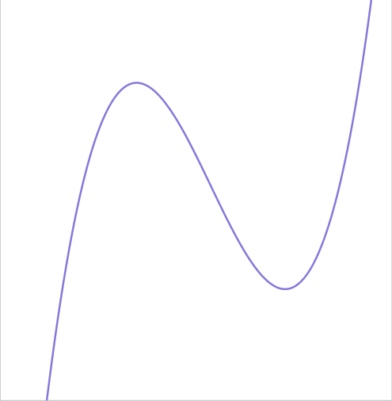
The second derivative
What do you notice about the gradient graph of the gradient function at each of the stationary points?
$$y=\frac{dy}{dx}$$
We can find the gradient of the graph of by
differentiating a second time.
$$\frac{d^{2}y}{dx^{2}}$$
$$y=2x^{3}−x^{2}−4x+1$$
We label this second derivative
If we’re using function notation, we label the second derivative
$$f^{′′}\left(x\right)$$
Write down the second derivative for the function on page 5.
$$y=2x^{3}−x^{2}−4x+1$$
$$\frac{dy}{dx}=$$
$${6x}^{2}−2x−4$$
$$\frac{d^{2}y}{dx^{2}}=$$
$$12x−2$$
Sketch the graph of the second derivative on the above axes.
What can you say about the sign of the second derivative at each of the stationary points?
$${6x}^{2}−2x−4$$
$$12x−2$$
Do activity 1

Slide 7
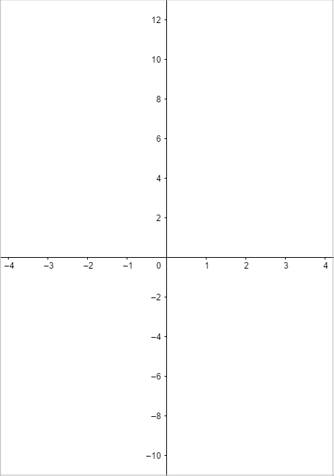
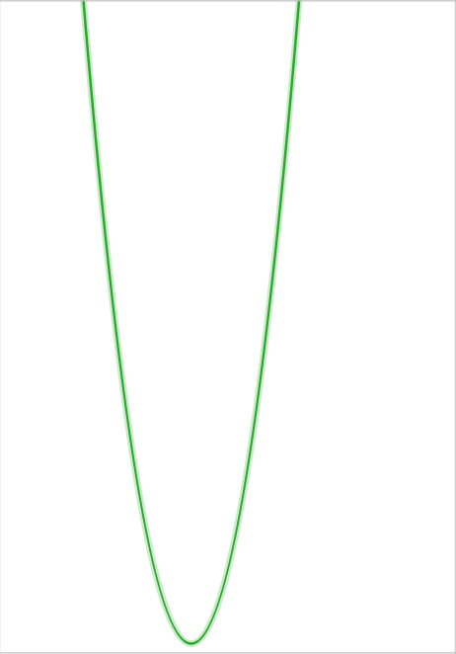
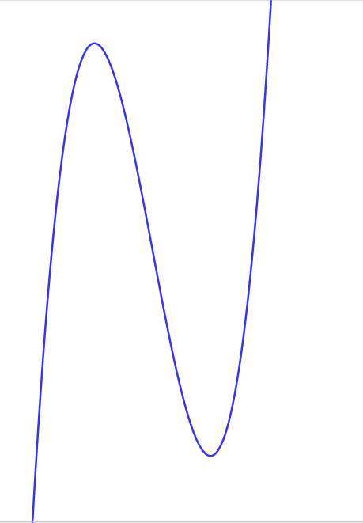
Activity 1
1)
$$y=2x³ + 4x² − 8x − 5$$
$$\frac{dy}{dx}=6x^{2}+ 8x −8$$
$$\frac{d^{2}y}{dx^{2}}=12x+8$$
$$6x^{2}+ 8x −8=0$$
$$3x^{2}+4x −4=0$$
$$x=\frac{2}{3}⇒$$
$$\frac{d^{2}y}{dx^{2}}=14$$
$$\left(3x−2\right)\left(x+2\right)=0$$
$$x=\frac{2}{3}$$
$$\frac{d^{2}y}{dx^{2}}=−16$$
$$x=−2⇒$$
$$x=−2$$
$$y=−\frac{215}{27}$$
$$y=11$$
The second derivative is negative at a maximum and positive at a minimum.

Slide 8
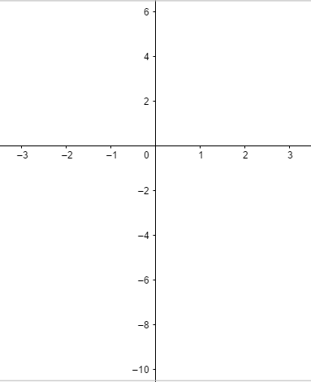
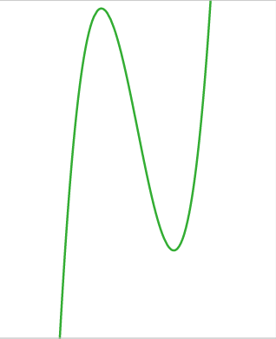
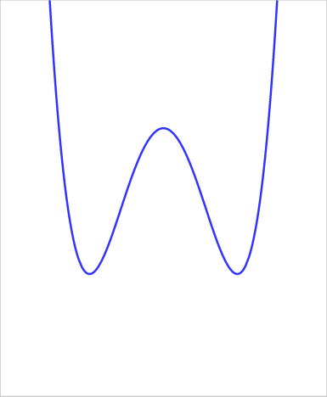
Activity 1
2)
$$y=x^{4}−5x^{2}+1$$
$$\frac{dy}{dx}=$$
$${4x}^{3}−10x$$
$${4x}^{3}−10x=0⇒$$
$$2x\left({2x}^{2}−5\right)=0$$
$$x=0⇒$$
$$y=2$$
$$x=\sqrt{\frac{5}{2}}⇒$$
$$y=−\frac{21}{4}$$
$${2x}^{2}−5=0⇒$$
$$\frac{d^{2}y}{dx^{2}}=$$
$$12x^{2}−10$$
$$\frac{d^{2}y}{dx^{2}}=$$
$$x=0⇒$$
$$−10$$
Do Exercise 3
$$x=\sqrt{\frac{5}{2}}⇒$$
$$y={12x}^{2}−10$$
$$\frac{d^{2}y}{dx^{2}}=$$
$$20$$
$$y={4x}^{3}−10x$$
The second derivative is negative at a maximum and positive at a minimum.

Slide 9
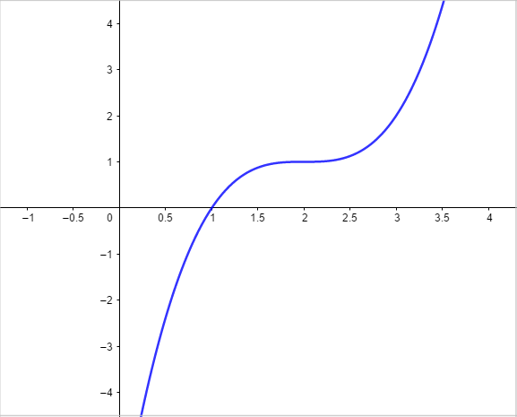
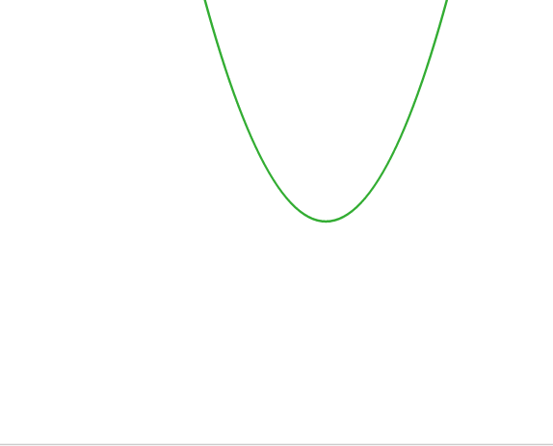
Points of inflection
Here is the graph of
$$y=x^{3}−6x^{2}+12x−7$$
$$\frac{dy}{dx}=$$
$$3x^{2}−12x+12$$
$$\frac{d^{2}y}{dx^{2}}=$$
$$6x−12$$
$$3x^{2}−12x+12=0$$
$$x^{2}−4x+4=0$$
$${\left(x−2\right)}^{2}=0$$
$$x=2$$
$$\frac{d^{2}y}{dx^{2}}=0$$
$$x=2⇒$$
The sign of the derivative stays the same either side of the stationary point.
The stationary point for our function is called a point of inflection.
Do Activity 3
The above point of inflection is a stationary point, but this is not all points of inflection are stationary points.

Slide 10
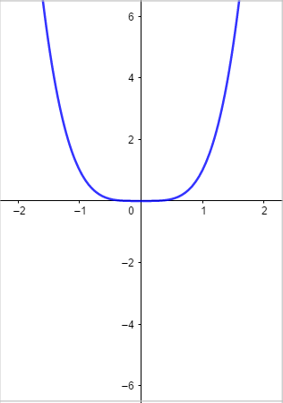
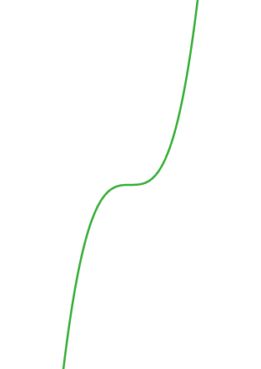
Activity 3
2)
$$y=x^{4}$$
$$\frac{dy}{dx}=$$
$$4x^{3}$$
$$12x^{2}$$
$$\frac{d^{2}y}{dx^{2}}=$$
$$12x^{2}$$
$$\frac{d^{2}y}{dx^{2}}=0⇒$$
$$12x^{2}=0⇒$$
$$x=0$$
$$\frac{dy}{dx}=$$
$$x=−0.1⇒$$
$$−0.004$$
$$\frac{dy}{dx}=$$
$$x=+0.1⇒$$
$$0.004$$
The sign of the derivative changes either side of P.
$$4x^{3}$$
The stationary point is not a point of infection, even though
$$\frac{d^{2}y}{dx^{2}}=0$$

Slide 11
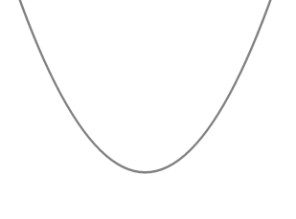
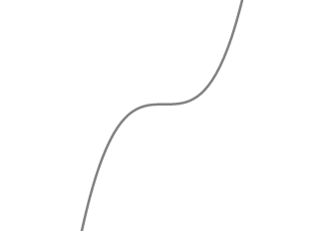
Summary
To find stationary points, we need to find the coordinates where $f′(x)=0$.
$$\frac{dy}{dx}=0⇒stationay point$$
$$\frac{d^{2}y}{dx^{2}}<0⇒maximum$$
At a stationary point
$$\frac{d^{2}y}{dx^{2}}>0⇒minimum$$
Do Exercise 4
If $\frac{d^{2}y}{dx^{2}}=0$, $check either side of the point$.
For a minimum, gradient changes $−ve→0→+ve$.
For a maximum, gradient changes $−ve→0→+ve$.
For a point of inflection, the gradient is the same either side.

