Slide 1
Your Turn
Find the gradient of the curve y = 3x⁴ at the point (–2, 48).
Differentiating:
At the point (–2, 48) x = –2 so:
The gradient of the curve y = 3x⁴ at the point (–2, 48) is –96.

Slide 2
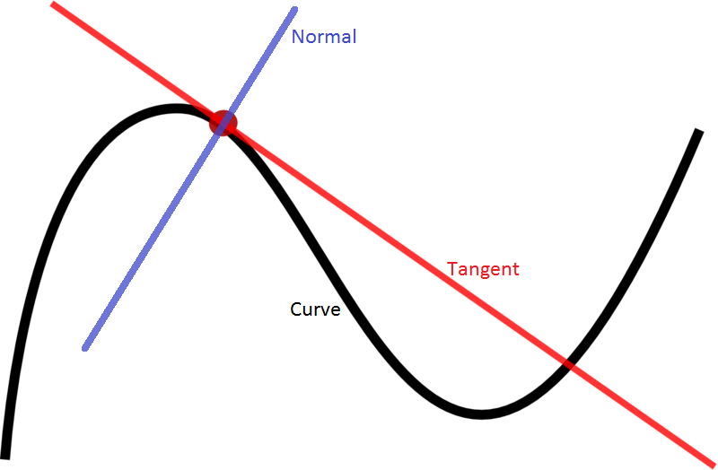

Slide 4
Find equation of the Tangent at the given point
Power Rule to find derivative $\frac{ⅆy}{ⅆx}{ or f}^{′}\left(x\right)$
Substitute $x$ value into derivative to find slope/ gradient
Using point slope formula to write equation: $y−y_{1}=m\left(x−x_{1}\right)$
Let $f\left(x\right)=4x^{2}−8x+3$
Find the gradient of $y=f\left(x\right)$ at the point $\left(\frac{1}{2},0\right)$
Find the equation of the tangent line at this point

Slide 5
Find equation of the Normal at the given point
Power Rule to find derivative $\frac{ⅆy}{ⅆx}{ or f}^{′}\left(x\right)$
Substitute $x$ value into derivative to find slope/ gradient
Using formula to find slope of Normal : $m_{1}m_{2}=−1$
Using point slope formula to write equation: $y−y_{1}=m_{2}\left(x−x_{1}\right)$

Slide 6
Using the result of differentiation
Let $f\left(x\right)=4x^{2}−8x+3$
Find the gradient of $y=f\left(x\right)$ at the point $\left(\frac{1}{2},0\right)$
Find the coordinates of the point on the graph of $y=f\left(x\right)$ where the gradient is 8.
Find the gradient of $y=f\left(x\right)$ at the points where the curve meets the line $y=4x−5$.
$$f^{′}\left(x\right)=8x−8$$
When $f^{′}\left(\frac{1}{2}\right)=8\left(\frac{1}{2}\right)−8=4$
a
?
Remember that the ‘gradient function’ allows you to find the gradient for a particular value of $x$.
b
$$8=8x−8 \\ x=2 \\ y=4{\left(2\right)}^{2}−8\left(2\right)+3=3$$
Point is $\left(2,3\right)$
This example is important!
Previously you used a value of $x$ to get the gradient $f^{′}\left(x\right)$. This time we’re doing the opposite: using a known gradient $f^{′}\left(x\right)$ to get the value of $x$. We therefore substitute $f^{′}\left(x\right)$ for 8.
?
Once you have your $x$, you need to work out $y$.
Ensure you use the correct equation!
c
First find point of intersection:
$$4x^{2}−8x+3=4x−5$$
Solving, we obtain: $x=1$ or $x=2$
When $x=1, f^{′}\left(1\right)=0$
When $x=2, f^{′}\left(2\right)=8$
?

Slide 7
Your Turn
Let $f\left(x\right)=x^{2}−4x+2$
Find the gradient of $y=f\left(x\right)$ at the point $\left(1,−1\right)$
Find the coordinates of the point on the graph of $y=f\left(x\right)$ where the gradient is 5.
Find the gradient of $y=f\left(x\right)$ at the points where the curve meets the line $y=2−x$.
a
$$f^{′}\left(x\right)=2x−4$$
When $f^{′}\left(1\right)=2\left(1\right)−4=−2$
?
$$5=2x−4 \\ x=\frac{9}{2} \\ y={\left(\frac{9}{2}\right)}^{2}−4\left(\frac{9}{2}\right)+2=\frac{17}{4}$$
Point is $\left(\frac{9}{2},\frac{17}{4}\right)$
b
?
$$x^{2}−4x+2=2−x$$
Solving: $x=0$ or $x=3$
When $x=0, f^{′}\left(0\right)=−4$
When $x=3, f^{′}\left(3\right)=2$
c
?

Slide 8
Finding the equation of a tangent
Find the equation of the tangent to the curve $y=x^{2}$ when $x=3$.
We can use $y−y_{1}=m\left(x−x_{1}\right)$ for the tangent (as it is a straight line!). Therefore we need:
A point $\left(x_{1},y_{1}\right)$
The gradient $m$.
Gradient function: $\frac{dy}{dx}=2x$
Gradient when $x=3$: $m=6$
$y$-value when $x=3$: $y=9$
So equation of tangent:
$$y−9=6\left(x−3\right)$$
?
?
?
tangent
$$(3,?)$$
?

Slide 9
Your Turn

Slide 10
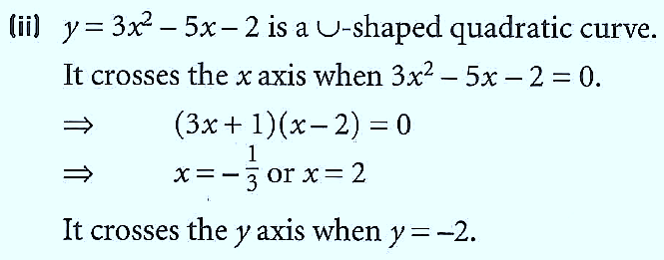
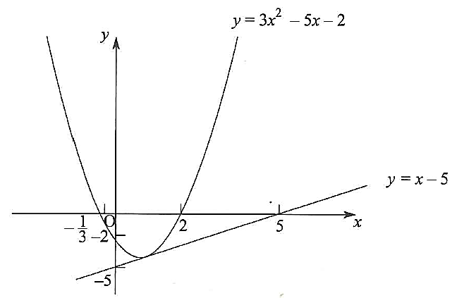
Your Turn

Slide 11
Finding the equation of the normal
Find the equation of the normal to the curve $y=x^{2}$ when $x=3$.
Gradient function: $\frac{dy}{dx}=2x$
Gradient when $x=3$: $m=6$
$y$-value when $x=3$: $y=9$
The normal to a curve is the line perpendicular to the tangent.
Equation of tangent (from earlier):
$$y−9=6(x−3)$$
Therefore equation of normal:
$$y−9=−\frac{1}{6}\left(x−3\right)$$
normal
tangent
?
$$(3,9)$$
Exam Tip: A very common error is for students to accidentally forget whether the question is asking for the tangent or for the normal.

Slide 12
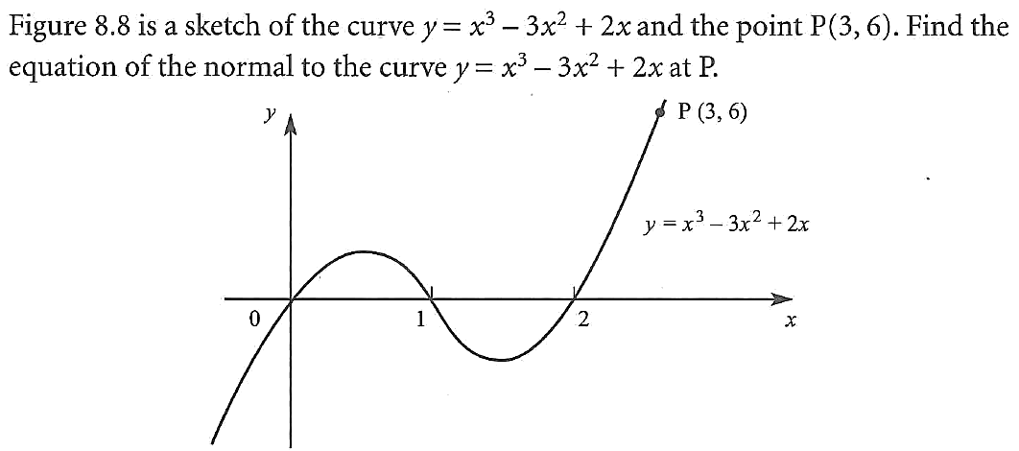
Your Turn

Slide 13
Your Turn
Find the equation of the normal to the curve $y=x+3\sqrt{x}$ when $x=9$.
? y
When $x=9$, $y=9+3\sqrt{9}=18$
$$y=x+3x^{\frac{1}{2}}$$
$$∴\frac{dy}{dx}=1+\frac{3}{2}x^{−\frac{1}{2}}$$
$$m_{T}=1+\frac{3}{2}\left(9^{−\frac{1}{2}}\right)=\frac{3}{2} \\ ∴m_{N}=−\frac{2}{3}$$
Equation of normal: $y−18=−\frac{2}{3}\left(x−9\right)$
? gradient
Tip: I like to use $m_{T}$ and $m_{N}$ to make clear to the examiner (and myself) what gradient I’ve found.
? Final equation

Slide 14
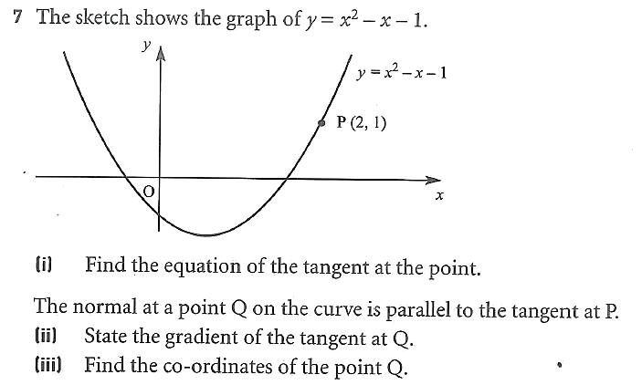
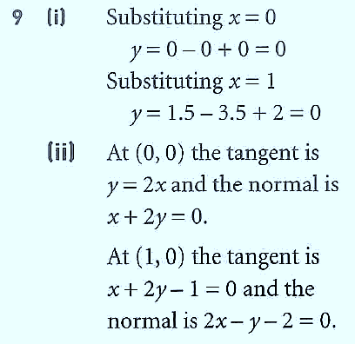
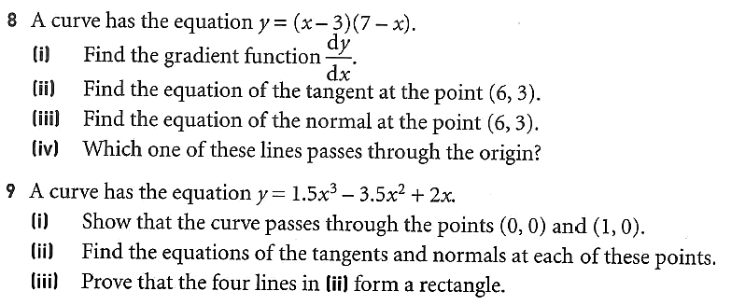
Your Turn
?
?
?
?
?
?
?
?
?

