Slide 1
Investigating associations between two numerical variables
2D
Notes:
https://create.kahoot.it/details/5baa8445-f785-40f3-9491-a8d0cd07fe1b
https://create.kahoot.it/details/b19d1fc1-eba5-4443-8950-5c3535a17d7c

Slide 6
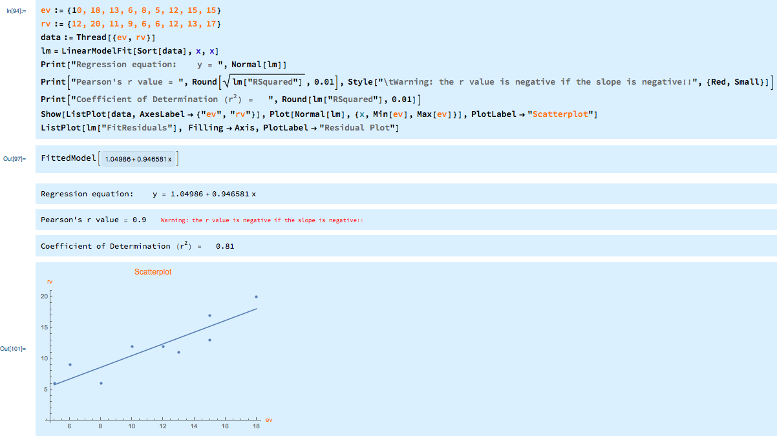
How to construct a scatterplot using Mathematica

Slide 7
exercises & Summary Book
1. Ex page 3D
2. Summary notes

