Slide 1
Using a log scale to display data
1E

Slide 2
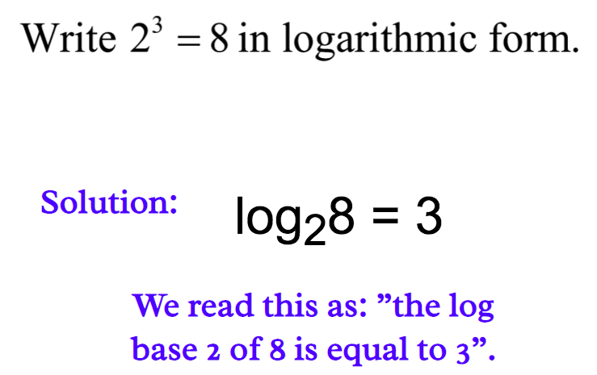
https://www.youtube.com/watch?v=zzu2POfYv0Y
Logarithm
$$100={10}^{2}$$
$$\text{lo}{\text{g}}_{10}100=2$$
Convert to log form:
Convert to exponential form:
$$2^{3}=8$$
$$\log_{2}{8}=3$$

Slide 3
Scientific Notation
$${10}^{3}$$
$${10}^{2}$$
$${10}^{1}$$
$${10}^{0}$$
$${10}^{−1}$$
$${10}^{−2}$$
$${10}^{−3}$$

Slide 4
Properties of logs to the base 10
If a number is greater than one, its log to the base 10 is greater than zero.
If a number is greater than zero but less than one, its log to the base 10 is negative.
If the number is zero, then its log is undefined.

Slide 5
Why use logarithm?
The histogram below displays the body weights (in kg) of a number of animal species. Because the animals represented in this dataset have weights ranging from around 1 kg to 90 tonnes (a dinosaur), most of the data are bunched up at one end of the scale and much detail is missing. The distribution of weights is highly positively skewed, with an outlier.

Slide 6
Working with logs
On your calculator, type log (45) and press .
If the log of a number is 2.7125, then the number is ${10}^{2.7125}$.
type 10 $x^{y}$ 2.7125 buttons .

Slide 7
Analysing data displays with a log scale
${a. 10}^{4}$=10,000kg
b. 7% of 27 animals = 7% $×$ 27 = 1.89 $≈$ 2 animals
c. log(3.3) = 0.518514 $≈0.52$
d. ${10}^{3.4}$= 2511.89 $≈$ 2512 kg

Slide 8
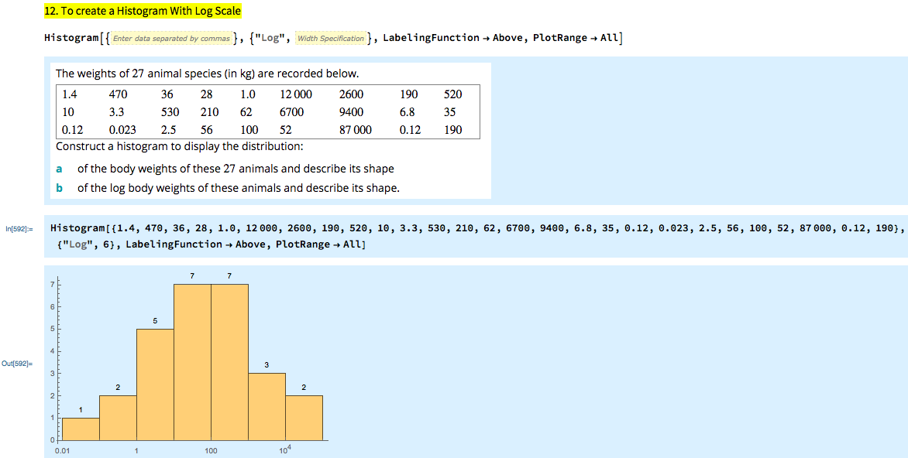
Constructing a histogram with a log scale
Shape: approximately symmetric

Slide 9
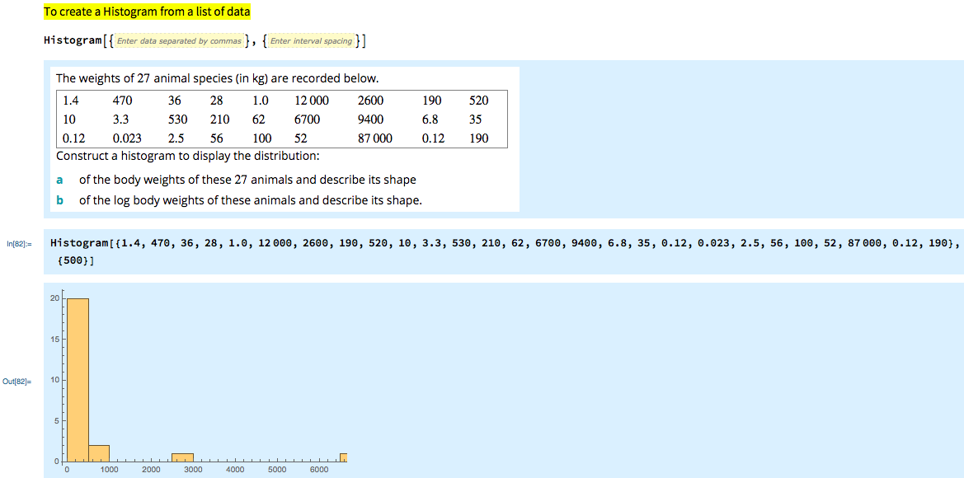
Shape: positively skewed with outliers

Slide 11
exercises & Summary Book
1. Ex page 1E
2. Summary notes

