Slide 1
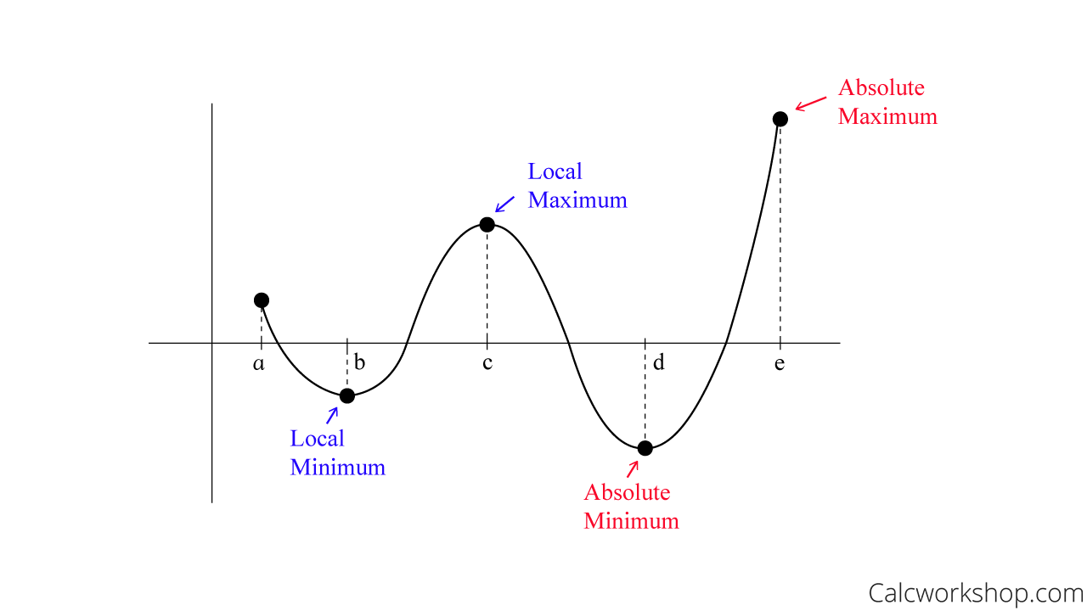
Application to Maximum and Minimum
18E

Slide 2
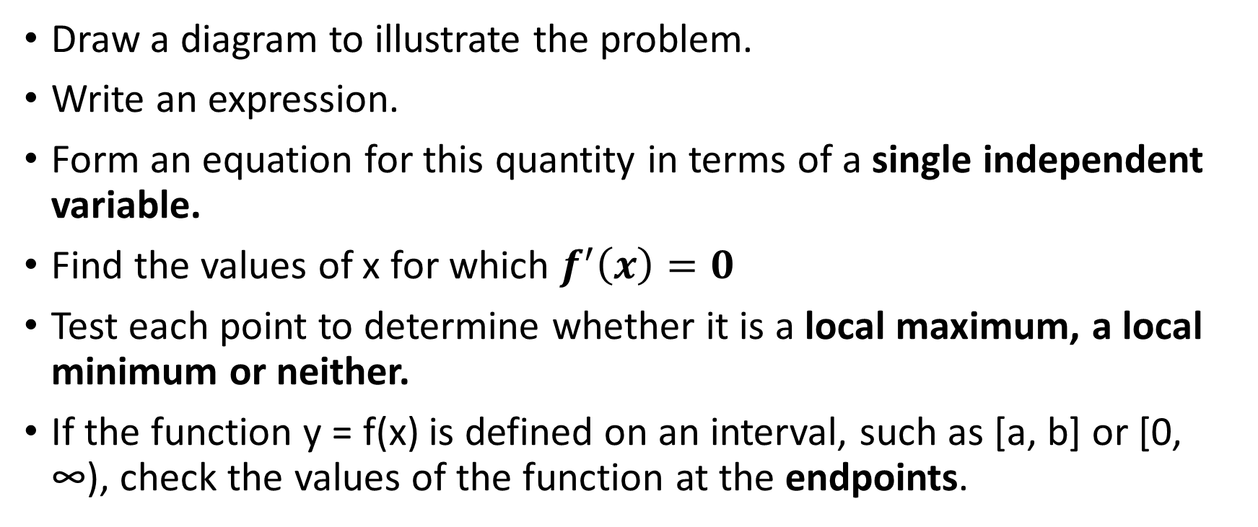
Steps
Draw a diagram to illustrate the problem.
Write an expression.
Form an equation for this quantity in terms of a single independent variable.
Find the values of x for which $f^{′}\left(x\right)=0$
Test each point to determine whether it is a local maximum, a local minimum or neither.
If the function y = f(x) is defined on an interval, such as [a, b] or [0, ∞), check the values of the function at the endpoints.

Slide 3
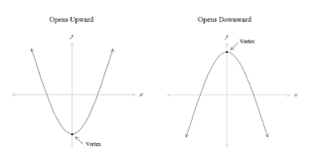
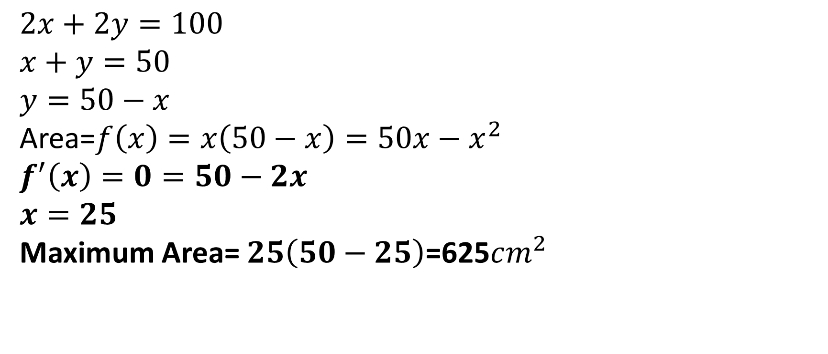
$$2x+2y=100$$
$$x+y=50$$
$$y=50−x$$
Area=$f\left(x\right)=x\left(50−x\right)=50x−x^{2}$
$$f^{′}\left(x\right)=0=50−2x$$
$$x=25$$
Maximum Area= $25\left(50−25\right)$=625$cm^{2}$

Slide 4
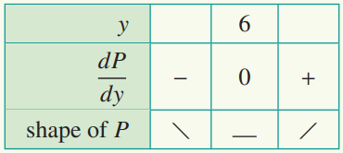

$x+2y=4⇒x=4−2y$
$P=x^{2}+xy+y^{2}={\left(4−2y\right)}^{2}+y\left(4−2y\right)−y^{2}$
$P=16−16y+{4y}^{2}+\left(4y−2y^{2}\right)−y^{2}$
$\begin{matrix} \\ P=16−16y+4y^{2}+4y−2y^{2}−y^{2}=16−12y+y^{2}\end{matrix}$
$\frac{ⅆP}{ⅆy}=−12+2y$
Stationary values occur when $\frac{ⅆP}{ⅆy}$=0
−12 + 2y = 0
y = 6
$P_{minimum}=16−12y+y^{2}=16−12×6+6^{2}=−20$

Slide 5
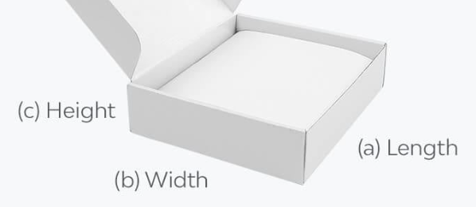
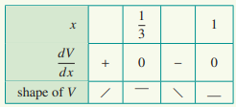
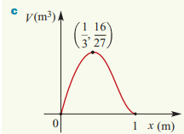
x
2-2x
2-2x
2-2x
x
2-2x
$V=x{\left(2−2x\right)}^{2}=x\left(4−8x+4x^{2}\right)=4x−8x^{2}+4$ $x^{3}$
$\frac{ⅆV}{ⅆx}=4−16x+12x^{2}=0$ → $3x^{2}−4x+1=0=\left(3x−1\right)\left(x−1\right)=0$
$x_{1}=\frac{1}{3}{ or x}_{2}=1$(not applicable) → $V_{maximum}$= $\frac{1}{3}\left(2−2\left(\frac{1}{3}\right)\right)=\frac{16}{27}m^{3}$
d. $4x−8x^{2}+4$ $x^{3}$=0.5 → x = $\frac{1}{2}$or x = $\frac{3−\sqrt{5}}{4}$

Slide 6
Maximum or minimum at an endpoint
Calculus can be used to find a local maximum or local minimum, but these are often not the actual maximum or minimum values of the function.
The actual maximum value of the function is called the absolute maximum
The actual minimum value of the function is called the absolute minimum.
The corresponding points on the graph of the function are not necessarily stationary points.

Slide 7
