Slide 1
Applications to motion in a straight line
18F

Slide 2
Position

Slide 3
Distance and displacement

Slide 4
Velocity

Slide 5
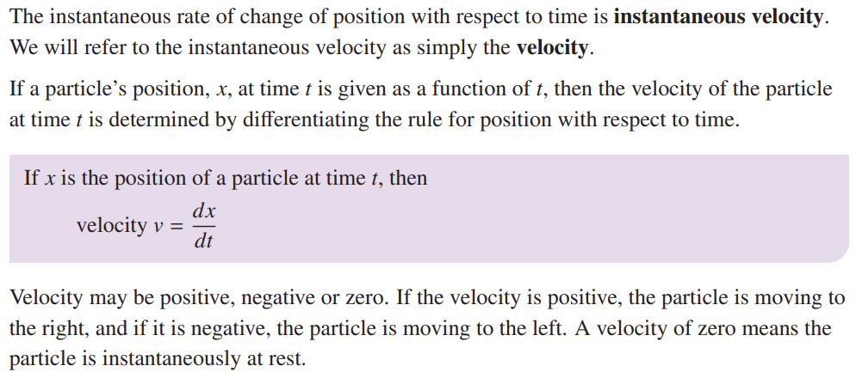
Velocity

Slide 6
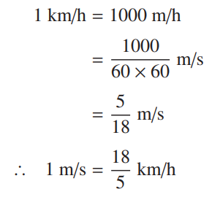
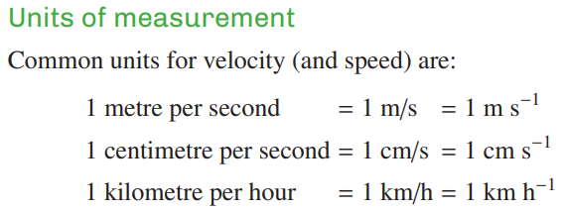
Speed and average speed

Slide 7
$$f^{′}\left(0\right)$$
$f^{′}\left(t\right)$=0 → t=?
$$x=f\left(t\right)=?$$

Slide 8
$$t_{1}=O x_{1}=0^{2}−7∗0+6=6$$
$$t_{2}=4 x_{2}=4^{2}−7∗4+6=−6$$
$$Average Velocity=\frac{x_{2}−x_{1}}{t_{2}−t_{1}}$$

Slide 9
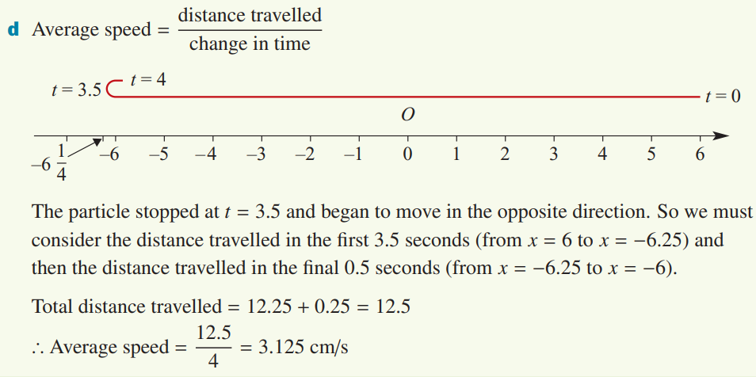
${b. f}^{′}\left(t\right)$=0 → t=?
$$x=f\left(t\right)=?$$
$$c.{ t}_{1}=O x_{1}=0^{2}−7∗0+6=6$$
$$t_{2}=4 x_{2}=4^{2}−7∗4+6=−6$$
Total distance
= ${Distance}_{from 0 to 3.5}$ $+{Distance}_{from 3.5 to 4}$

Slide 10
Acceleration

Slide 11
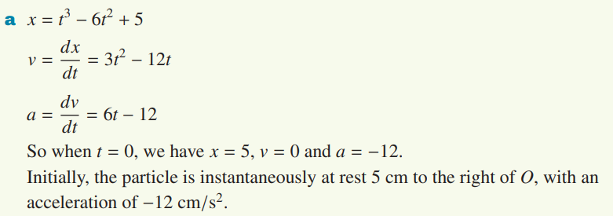

Slide 12
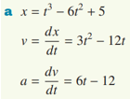
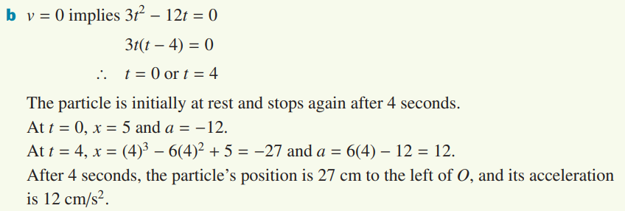

Slide 13
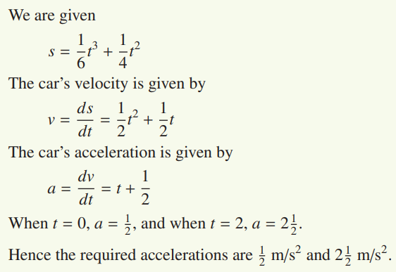

Slide 14
