Slide 1
18G Families of functions and transformations

Slide 2
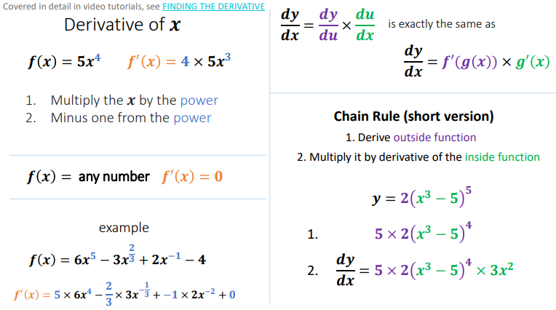

Slide 3
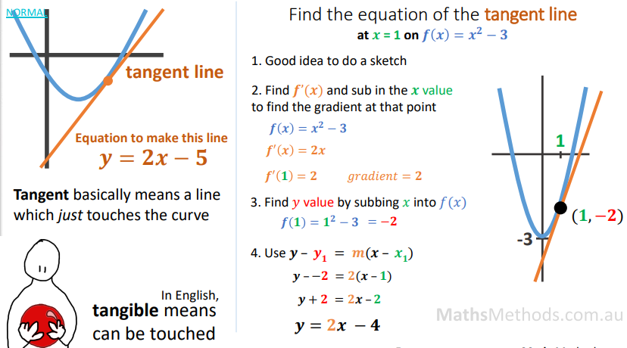

Slide 4
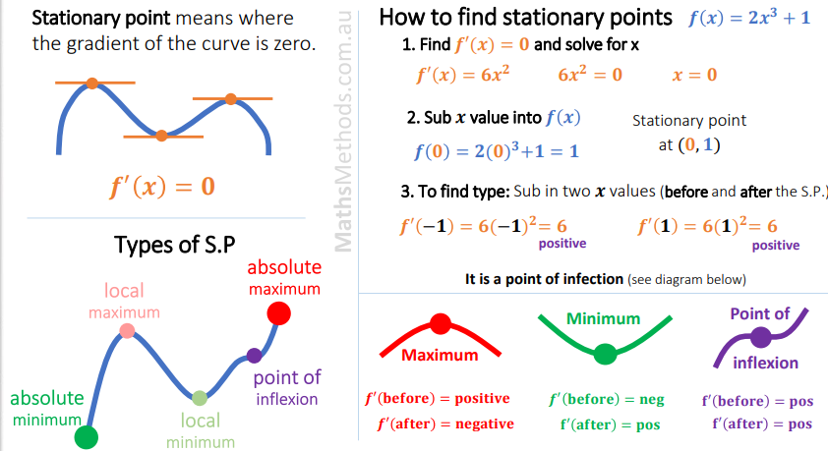

Slide 5
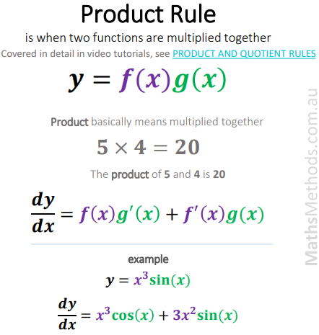
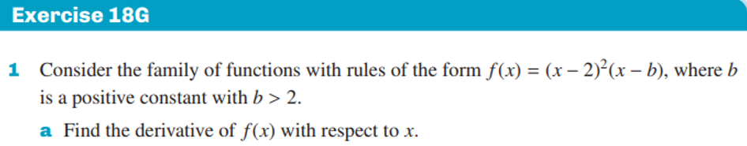


Slide 6

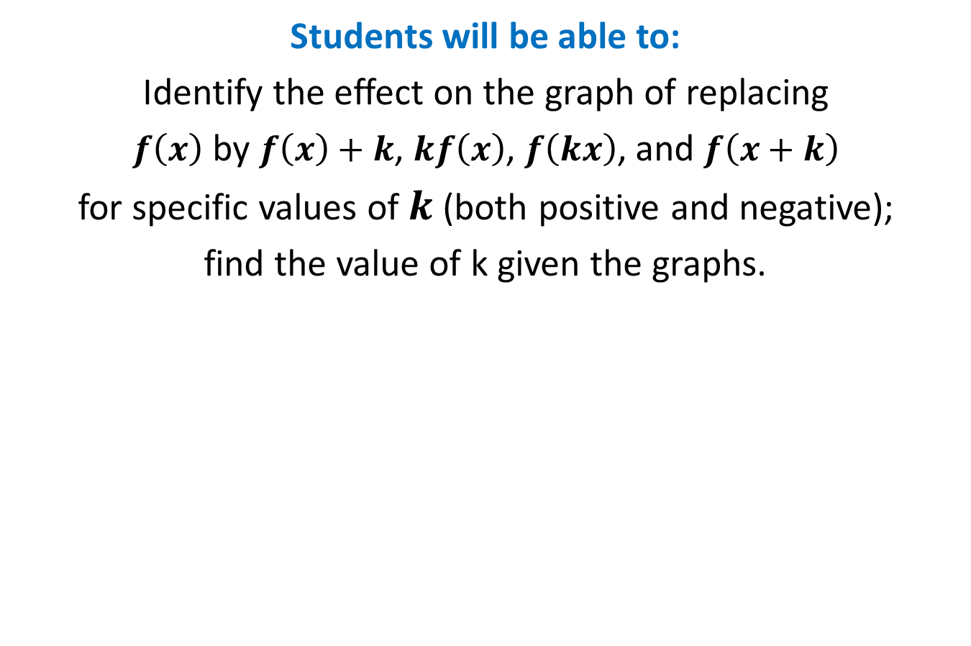
Parent Functions and Transformations
Students will be able to:
Identify the effect on the graph of replacing
$f\left(x\right)$ by $f\left(x\right)+k$, $kf\left(x\right)$, $f\left(kx\right)$, and $f\left(x+k\right)$
for specific values of $k$ (both positive and negative);
find the value of k given the graphs.

Slide 7
Parent Functions and Transformations
Key Vocabulary:
Parent function
Transformation
Translation
Dilation

Slide 8

Parent Functions and Transformations
A family of functions is a group of functions with graphs that display one or more similar characteristics.
The Parent Function is the simplest function with the defining characteristics of the family. Functions in the same family are transformations of their parent functions.

Slide 9
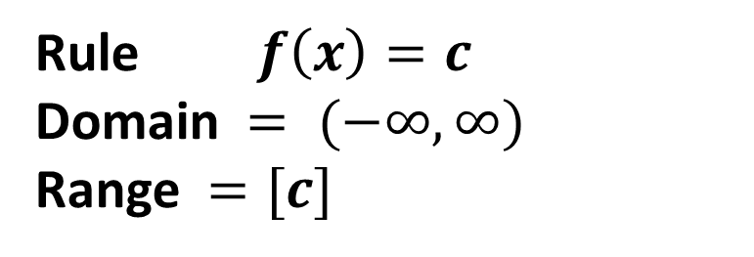
Parent Functions and Transformations
Family - Constant Function
Graph:
Rule $f\left(x\right)=c$
Domain $= (−∞,∞)$
Range $=[c]$

Slide 10
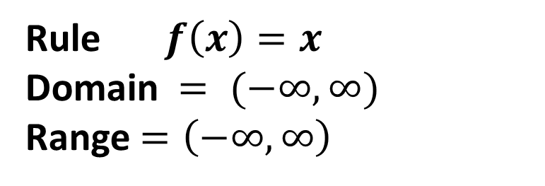
Parent Functions and Transformations
Family - Linear Function
Graph:
Rule$f\left(x\right)=x$
Domain $= (−∞,∞)$
Range$=\left(−∞,∞\right)$

Slide 11
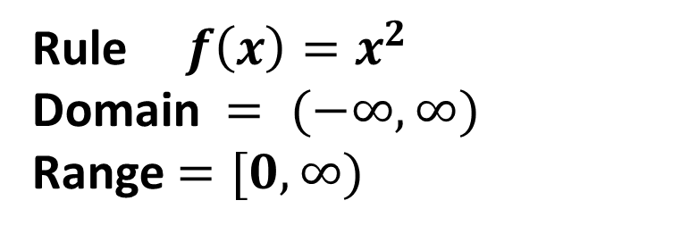
Parent Functions and Transformations
Family - Quadratic Function
Graph:
Rule${ f\left(x\right)=x}^{2}$
Domain $= (−∞,∞)$
Range$=[0,∞)$

Slide 12
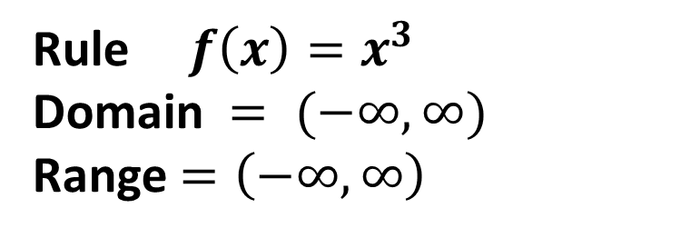
Parent Functions and Transformations
Family - Cubic Function
Graph:
Rule$f\left(x\right)=x^{3}$
Domain $= (−∞,∞)$
Range$=\left(−∞,∞\right)$

Slide 13
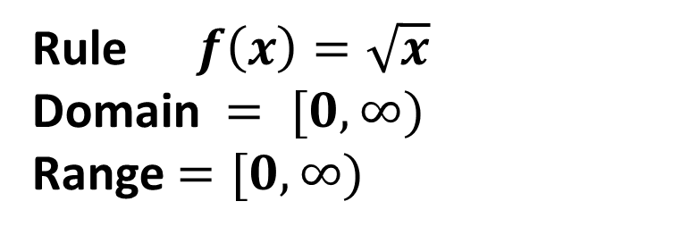
Parent Functions and Transformations
Family - Square Root Function
Graph:
Rule$f\left(x\right)=\sqrt{x}$
Domain $= [0,∞)$
Range$=[0,∞)$

Slide 14
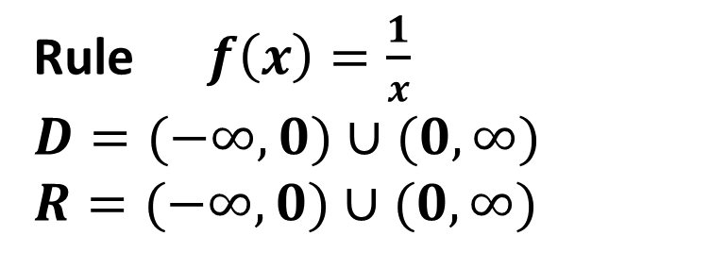
Parent Functions and Transformations
Family - Reciprocal Function
Graph:
Rule$f\left(x\right)=\frac{1}{x}$
$$D=(−∞,0)∪(0,∞)$$
$$R=(−∞,0)∪(0,∞)$$

Slide 15
Parent Functions and Transformations
Transformations
A change in the size or position of a figure or graph of the function is called a transformation.
Rigid transformations change only the position of the graph, leaving the size and shape unchanged.
Non rigid transformations distort the shape of the graph.

Slide 16
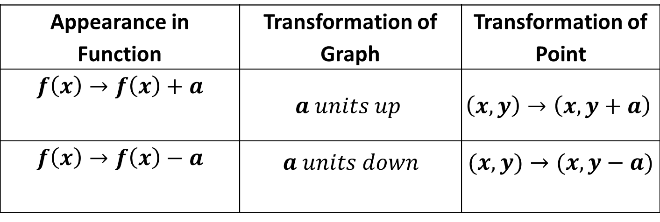
Parent Functions and Transformations
Rigid transformations
Vertical Translations
Appearance in Function | Transformation of Graph | Transformation of Point
$$f\left(x\right)→f\left(x\right)+a$$ | $$a units up$$ | $$\left(x,y\right)→\left(x,y+a\right)$$
$$f\left(x\right)→f\left(x\right)−a$$ | $$a units down$$ | $$(x,y)→(x,y−a)$$

Slide 17
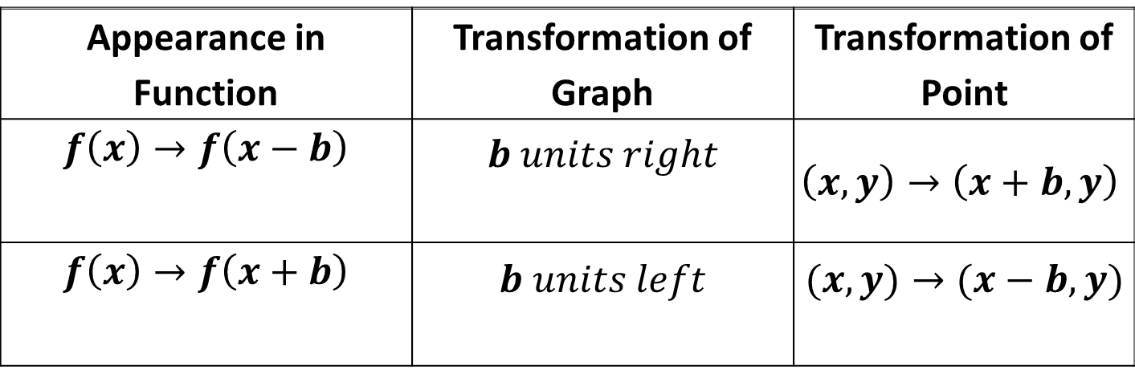
Parent Functions and Transformations
Rigid transformations
Horizontal Translations
Appearance in Function | Transformation of Graph | Transformation of Point
$$f\left(x\right)→f\left(x−b\right)$$ | $$b units right$$ | $$\left(x,y\right)→\left(x+b,y\right)$$
$$f\left(x\right)→f\left(x+b\right)$$ | $$b units left$$ | $$(x,y)→(x−b,y)$$

Slide 18
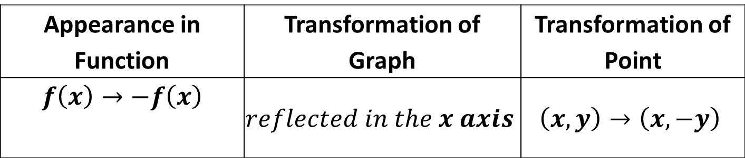
Parent Functions and Transformations
Rigid transformations
Reflections in x-axes
Appearance in Function | Transformation of Graph | Transformation of Point
$$f\left(x\right)→−f\left(x\right)$$ | $$reflected in the x axis$$ | $$\left(x,y\right)→\left(x,−y\right)$$

Slide 19
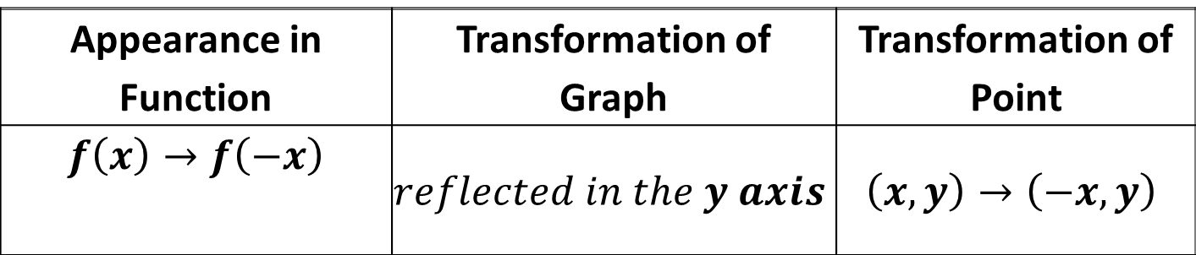
Parent Functions and Transformations
Rigid transformations
Reflections in y-axes
Appearance in Function | Transformation of Graph | Transformation of Point
$$f\left(x\right)→f\left(−x\right)$$ | $$reflected in the y axis$$ | $$\left(x,y\right)→\left(−x,y\right)$$

Slide 20
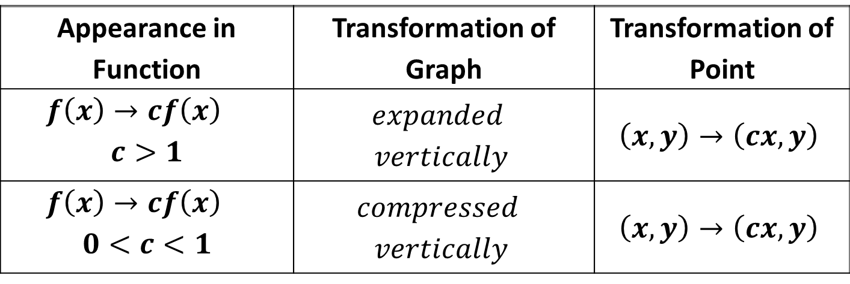
Parent Functions and Transformations
Non rigid transformations
Vertical Dilations
Appearance in Function | Transformation of Graph | Transformation of Point
$$f\left(x\right)→cf\left(x\right)$$ $$c>1$$ | $$expanded$$ $$vertically$$ | $$\left(x,y\right)→\left(cx,y\right)$$
$$f\left(x\right)→cf\left(x\right)$$ $$0<c<1$$ | $$compressed$$ $$vertically$$ | $$\left(x,y\right)→\left(cx,y\right)$$

Slide 21
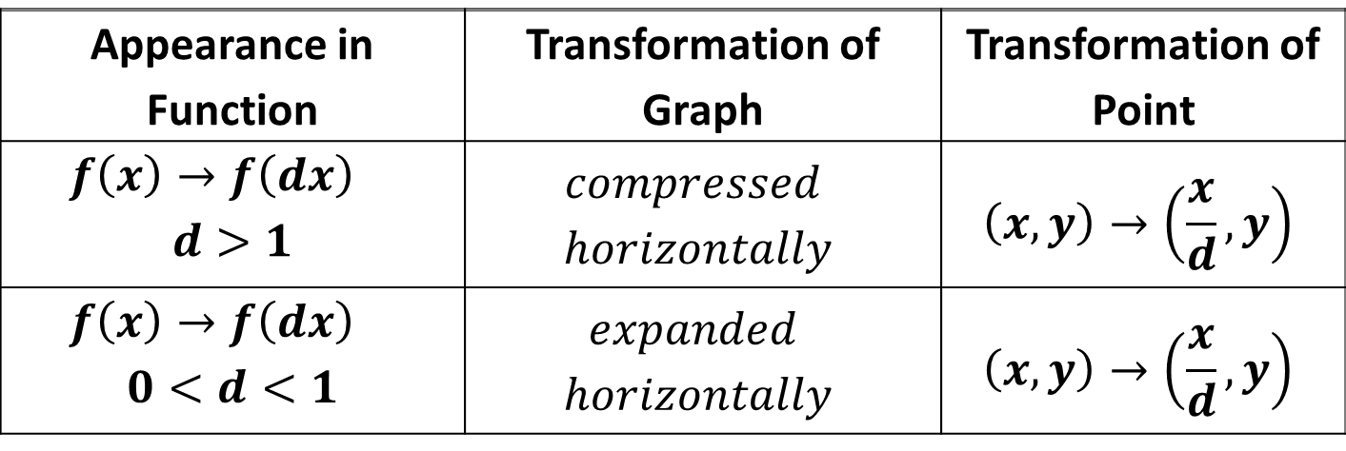
Parent Functions and Transformations
Non rigid transformations
Horizontal Dilations
Appearance in Function | Transformation of Graph | Transformation of Point
$$f\left(x\right)→f\left(dx\right)$$ $$d>1$$ | $$compressed$$ $$horizontally$$ | $$\left(x,y\right)→\left(\frac{x}{d},y\right)$$
$$f\left(x\right)→f\left(dx\right)$$ $$0<d<1$$ | $$expanded$$ $$horizontally$$ | $$\left(x,y\right)→\left(\frac{x}{d},y\right)$$

Slide 22

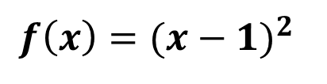
Parent Functions and Transformations
Sample Problem 1: Identify the parent function and describe the transformations.
a.
$${f\left(x\right)=(x−1)}^{2}$$

Slide 23

Parent Functions and Transformations
Sample Problem 1: Identify the parent function and describe the transformations.
a.
$${f\left(x\right)=(x−1)}^{2}$$
Parent : ${ f\left(x\right)=x}^{2}$
Transformation: Translation 1 unit right

Slide 24
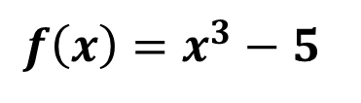
Parent Functions and Transformations
Sample Problem 1: Identify the parent function and describe the transformations.
b.
$$f\left(x\right)=x^{3}−5$$

Slide 25
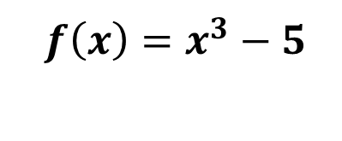
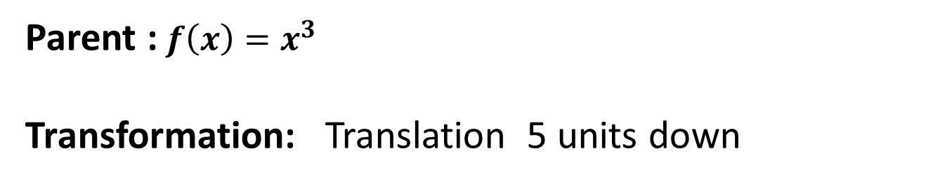
Parent Functions and Transformations
Sample Problem 1: Identify the parent function and describe the transformations.
b.
$$f\left(x\right)=x^{3}−5$$
Parent :$f\left(x\right)=x^{3}$
Transformation: Translation 5 units down

Slide 26
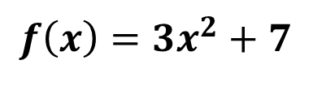
Parent Functions and Transformations
Sample Problem 1: Identify the parent function and describe the transformations.
d.
$$f\left(x\right)=3x^{2}+7$$

Slide 27
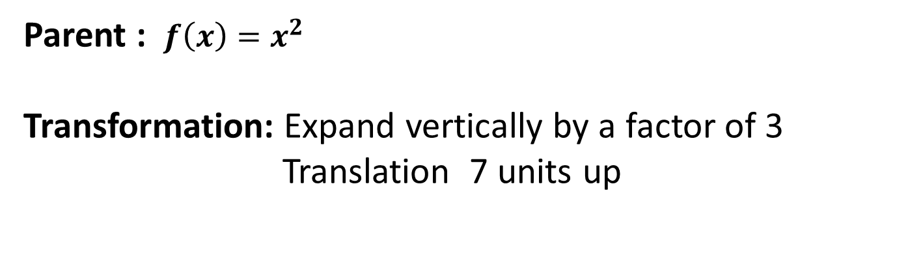
Parent Functions and Transformations
Sample Problem 1: Identify the parent function and describe the transformations.
d.
$$f\left(x\right)=3x^{2}+7$$
Parent : $f\left(x\right)=x^{2}$
Transformation: Expand vertically by a factor of 3
Translation 7 units up

Slide 28
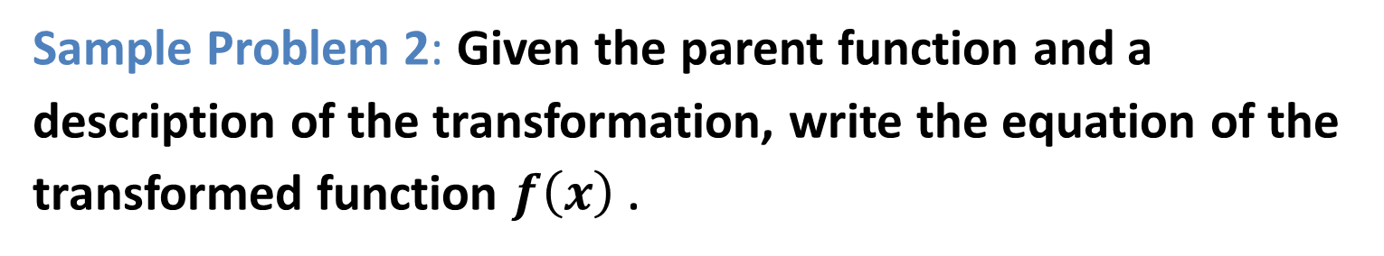
Parent Functions and Transformations
Sample Problem 2: Given the parent function and a description of the transformation, write the equation of the transformed function $f\left(x\right)$ .
a.
Quadratic - expanded horizontally by a factor of 2,
translated 7 units up.

Slide 29
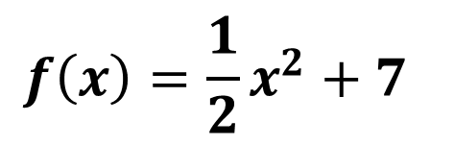
Parent Functions and Transformations
Sample Problem 2: Given the parent function and a description of the transformation, write the equation of the transformed function $f\left(x\right)$ .
a.
Quadratic - expanded horizontally by a factor of 2,
translated 7 units up.
$$f\left(x\right)=\frac{1}{2}x^{2}+7$$

Slide 30
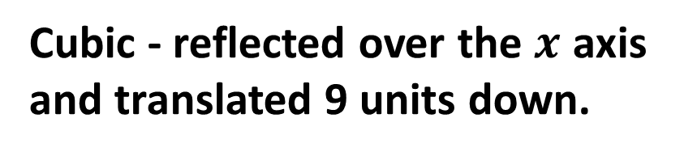
Parent Functions and Transformations
Sample Problem 2: Given the parent function and a description of the transformation, write the equation of the transformed function $f\left(x\right)$ .
b.
Cubic - reflected over the $x$ axis
and translated 9 units down.

Slide 31
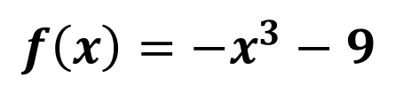
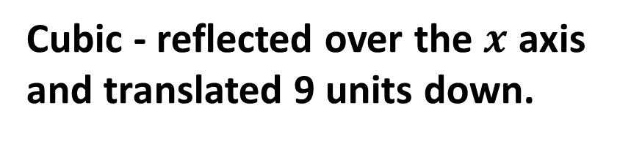
Parent Functions and Transformations
Sample Problem 2: Given the parent function and a description of the transformation, write the equation of the transformed function $f\left(x\right)$ .
b.
Cubic - reflected over the $x$ axis
and translated 9 units down.
$$f\left(x\right)=−x^{3}−9$$

Slide 32
Parent Functions and Transformations
Sample Problem 2: Given the parent function and a description of the transformation, write the equation of the transformed function $f\left(x\right)$ .
d.
Reciprocal - translated 1 unit up.

Slide 33
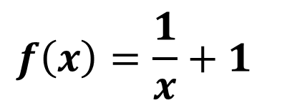
Parent Functions and Transformations
Sample Problem 2: Given the parent function and a description of the transformation, write the equation of the transformed function $f\left(x\right)$ .
d.
Reciprocal - translated 1 unit up.
$$f\left(x\right)=\frac{1}{x}+1$$

Slide 34
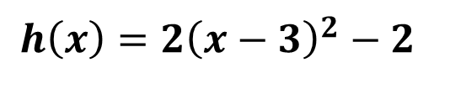
Parent Functions and Transformations
Sample Problem 3: Use the graph of parent function to graph each function. Find the domain and the range of the new function.
a.
$$h\left(x\right)={2\left(x−3\right)}^{2}−2$$

Slide 35
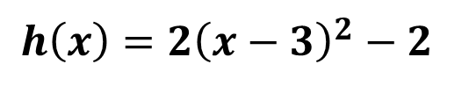
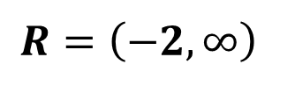
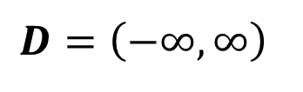
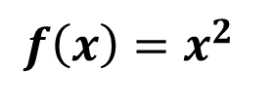
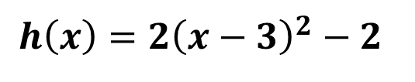
Parent Functions and Transformations
Sample Problem 3: Use the graph of parent function to graph each function. Find the domain and the range of the new function.
a.
$$h\left(x\right)={2\left(x−3\right)}^{2}−2$$
$$h\left(x\right)={2\left(x−3\right)}^{2}−2$$
Parent function
$$f\left(x\right)=x^{2}$$
Transformation:
Compressed horizontally by a factor of 2
Translated 2 units down
Translated 3 units right
$$D=\left(−∞,∞\right)$$
$$R=\left(−2,∞\right)$$

Slide 36
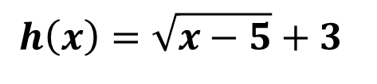
Parent Functions and Transformations
Sample Problem 3: Use the graph of parent function to graph each function. Find the domain and the range of the new function.
b.
$$h\left(x\right)=\sqrt{x−5}+3$$

Slide 37
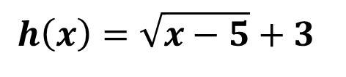
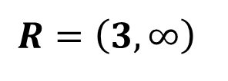
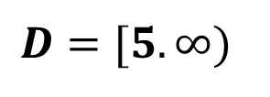
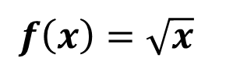
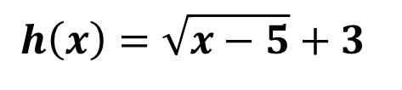
Parent Functions and Transformations
Sample Problem 3: Use the graph of parent function to graph each function. Find the domain and the range of the new function.
b.
$$h\left(x\right)=\sqrt{x−5}+3$$
$$h\left(x\right)=\sqrt{x−5}+3$$
Parent function
$$f\left(x\right)=\sqrt{x}$$
Transformation:
Translated 3 units up
Translated 5 units right
$$D=[5.∞)$$
$$R=\left(3,∞\right)$$

