Slide 1
Calculating the correlation coefficient
2F
Notes:
https://create.kahoot.it/details/d7caa4bc-8345-4c2f-8622-2fea61e445a3

Slide 2
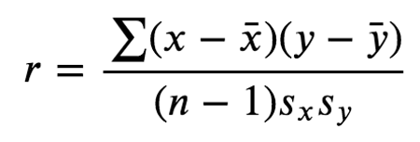
Pearson’s correlation coefficient, 𝑟
$\overline{x}$ and $s_{x}$are the mean and standard deviation of the 𝑥-values, and $\overline{y}$ and $s_{y}$are the mean and standard deviation of the 𝑦-values.

Slide 3
3 Assumptions of using the value of the correlation coefficient r as a measure of the strength of an association
1: variables numerical; 2: association linear; 3: no clear outliers
Notes:
A: strong, positive, non-linear relationship with no outliersB: strong, negative, linear relationship with an outlier
C: weak, negative, linear relationship with no outliers
A: non-linearB: outlier

Slide 4
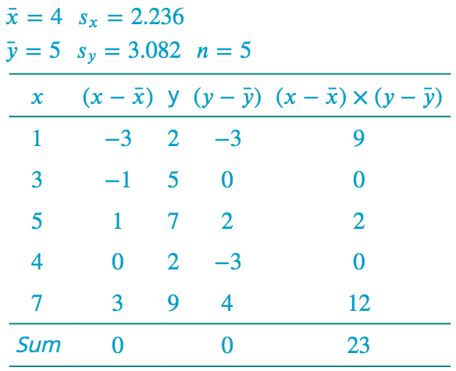

Slide 5
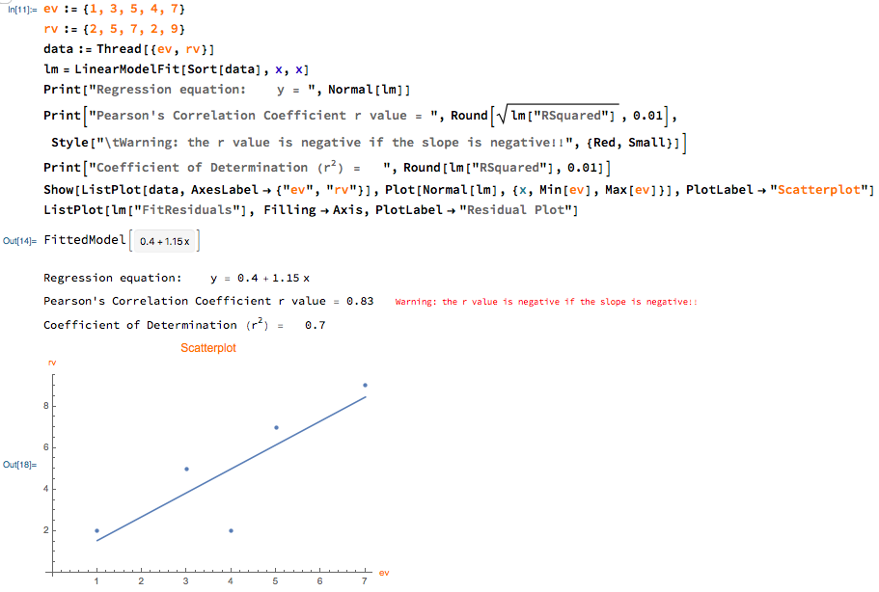
Mathematica

Slide 6
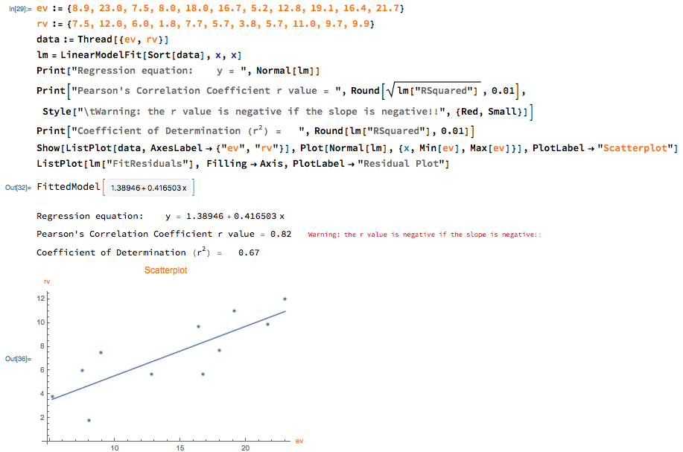

Slide 7

Calculating a Correlation Coefficient
Calculating a Correlation Coefficient
In Words In Symbols
Find the difference of the x-values and mean of x.
Find the difference of the y-values and mean of y.
Multiply each result from step 1 by its corresponding result from step 2
Find the sum of all above values of step 3.
Find the product of number of pairs take away 1 and standard deviation of x and y.
Use this formula to calculate the correlation coefficient.
$$x−\overline{x}$$
$$y−\overline{y}$$
$(x−\overline{x}$)($y−\overline{y})$
$$∑(x−\overline{x}\text{)(}y−\overline{y})$$
$$\left(n−1\right)s_{x}s_{y}$$
$$r=\frac{∑(x−\overline{x}\text{)(}y−\overline{y}) }{\left(n−1\right)s_{x}s_{y}}$$

Slide 8
$$=$$
$$=27.565408$$

Slide 9
exercises & Summary Book
1. Ex page 2F
2. Summary notes

