Slide 1
Applications of circular functions
14O

Slide 2
Notes:
https://www.transum.org/software/Online_Exercise/Transumometry/WhichSide/

Slide 3
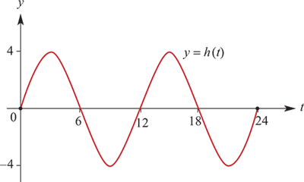
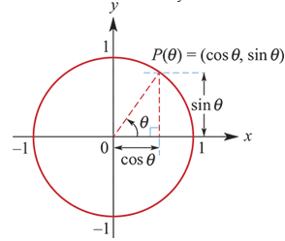
Example
It is suggested that the height, h(t) metres, of the tide above mean sea level on 1 January at Warnung is given approximately by the rule h(t)=4sin($\frac{π}{6}$t), where t is the number of hours after midnight.
a. Draw the graph of y=h(t) for 0≤t≤24.
b. When was high tide?
Note: Period =2π÷$\frac{π}{6}$=12
b. High tide occurs when h(t)=4:
4sin($\frac{π}{6}$t) =4
sin($\frac{π}{6}$t) =1
$\frac{π}{6}$t = $\frac{π}{2}$, $\frac{5π}{2}$
∴t =3, 15
i.e. high tide occurs at 03:00 and 15:00 (3 p.m.).
(0,1)

Slide 4
Example
It is suggested that the height, h(t) metres, of the tide above mean sea level on 1 January at Warnung is given approximately by the rule h(t)=4sin($\frac{π}{6}$t), where t is the number of hours after midnight.
c. What was the height of the high tide?
d. What was the height of the tide at 8 a.m.?
e. A boat can only cross the harbour bar when the tide is at least 1 metre above mean sea level. When could the boat cross the harbour bar on 1 January?
c. The high tide has height 4 metres above the mean height.
d. h(8)=4sin($\frac{8π}{6}$)=4sin($\frac{4π}{3}$)=4× $\frac{−\sqrt{3}}{2}$=−2 $\sqrt{3}$
The water is 2 $\sqrt{3}$ metres below the mean height at 8 a.m.
e. We first consider 4sin($\frac{π}{6}$t)=1.
Thus sin($\frac{π}{6}$t)= $\frac{1}{4}$
∴ $\frac{π}{6}$t =0.2526, 2.889, 6.5358, 9.172
∴ t =0.4824, 5.5176, 12.4824, 17.5173
i.e. the water is at height 1 metre at 00:29, 05:31, 12:29, 17:31.
Thus the boat can pass across the harbour bar between 00:29 and 05:31, and between 12:29 and 17:31.

Slide 5
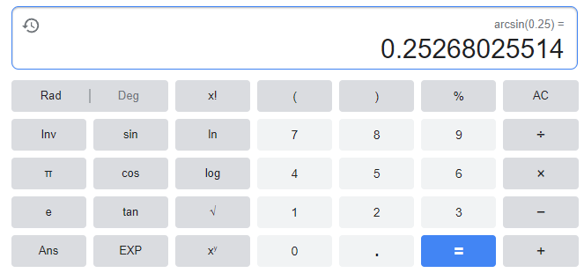
Example
It is suggested that the height, h(t) metres, of the tide above mean sea level on 1 January at Warnung is given approximately by the rule h(t)=4sin($\frac{π}{6}$t), where t is the number of hours after midnight.
Thus sin($\frac{π}{6}$t)= $\frac{1}{4}$
∴ $\frac{π}{6}$t =0.2526, 2.889, 6.5358, 9.172
∴ t =0.4824, 5.5176, 12.4824, 17.5173
sin($\frac{π}{6}$t)= $\frac{1}{4}$ → angles in I & II Quadrants.
0.2526, $π$ $−$ 0.2526, 2 $π$ $+$ 0.2526, 2 $π+(π−$0.2526)
∴ $\frac{π}{6}$t =0.2526, 2.889, 6.5358, 9.172

