Slide 1
Chapter 14 Circular functions
revision

Slide 2
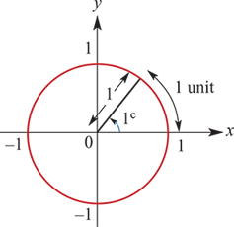
Definition of a radian
One radian (written $1^{c}$) is the angle formed at the centre of the unit circle by an arc of length 1 unit.
$1^{c}$=$\frac{180°}{π}$1°= $\frac{{\text{π}}^{c}}{180}$

Slide 3
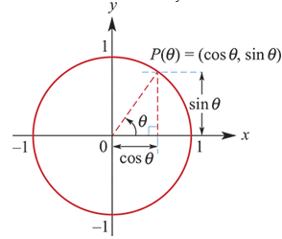
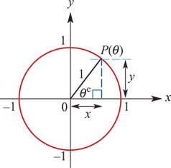
Sine and cosine
x-coordinate of P(θ) on unit circle:
x=cosine θ, θ∈R
y-coordinate of P(θ) on unit circle:
y=sine θ, θ∈R
Abbreviated to
x =cosθ
y =sinθ

Slide 4
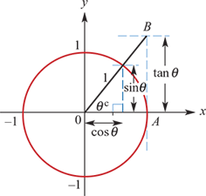
Tangent
If the tangent to the unit circle at A is drawn, then the y-coordinate of B is called tangent θ (abbreviated to tanθ). By using similar triangles:
tanθ=$\frac{\sin{θ}}{\cos{θ}}$

Slide 5
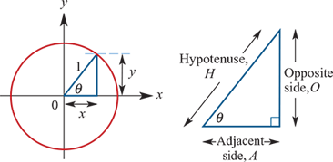
Circular functions and trigonometric ratios
Sinθ = $\frac{O}{H}$= $\frac{y}{1}$=y
Cosθ = $\frac{A}{H}$= $\frac{x}{1}$=x
Tanθ = $\frac{O}{A}$= $\frac{y}{x}$= $\frac{\sin{θ}}{\cos{θ}}$

Slide 6
Symmetry properties of circular functions

Slide 7
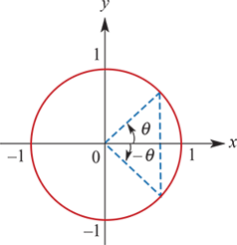
Further symmetry properties
Negative angles:
cos(−θ) = cosθ
sin(−θ) = −sinθ
tan(−θ) = − $\frac{\sin{θ}}{\cos{θ}}$=−tanθ
Complementary angles:
sin($\frac{π}{2}$ −θ) = cosθ, sin($\frac{π}{2}$+θ) = cosθ
cos($\frac{π}{2}$−θ) = sinθ, cos($\frac{π}{2}$+θ) = −sinθ

Slide 8
Pythagorean identity
$\cos^{2}{θ}$+ $\sin^{2}{θ}$=1

Slide 9
Exact values of circular functions

Slide 10
Graphs of circular functions

Slide 11
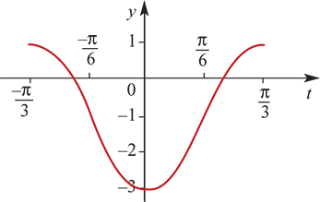
Graphs of circular functions
Graphs of circular functions of the type y=asinn(t±ϵ)±b and y=acosn(t±ϵ)±b
e.g. y=2cos3(t+ $\frac{π}{3}$)−1
Amplitude, a=2
Period = $\frac{2π}{n}$= $\frac{2π}{3}$
The graph is the same shape as y=2cos(3t) but is translated $\frac{π}{3}$ units in the negative direction of the t-axis and 1 unit in the negative direction of the y-axis.
Solutions of trigonometric equations of the type sinx°=a and cosx°=a
e.g. Solve cosx°=−0.7 for x∈[0,360].
First look at the 1st quadrant: If cosα°=0.7, then α=45.6.
Since cosx° is negative for P(x°) in the 2nd and 3rd quadrants, the solutions are
x=180−45.6=134.4 and x=180+45.6=225.6

