Slide 1
Sets of numbers
1A

Slide 2
What is a set?
In maths, it’s often useful to represent a collection of items.
We use curly braces to indicate a set of items...
!
𝐴={−3,3}={𝑥:$x^{2}$=9}
A set is a collection of items with 2 properties:
a. It doesn’t contain duplicates.
?
b. The order of the elements does not matter. (but we usually write the items in ascending order)
?
Note: {𝑥:…} is read as ‘the set of all 𝑥 such that …’.
Notes:
Note: {𝑥:…}{x:…} is read as ‘the set of all 𝑥 such that …’.

Slide 3
Elements of a set
a ∊ A means that element a is in the set A
Example: A = the set of all odd integers bigger than 2 but less than or equal to 11
3 ∊ A
4 ∉ A
15 ∉ A

Slide 4
Empty set & universal
Empty set ∅: The set with no elements.
The universal set 𝜉: the set of all elements which are being considered.
Notes:
𝜉 zai

Slide 5
Subsets
Set B is called a subset of the set A if any element of B is also an element of A
B⊆A
Example
If A = [0,10] and B={1,3,5} then B⊆A
If A = [0,10] and C = [-1,3), C is not a subset of A
𝐴⊆𝐴 & ∅⊆𝐴
A
B

Slide 6
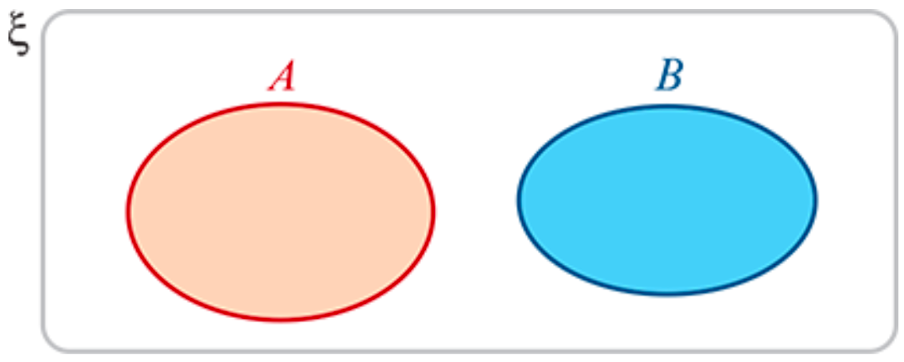
Venn diagrams
Venn diagrams are used to illustrate sets.
Disjoint: Two sets have no elements in common.

Slide 7
Union
The union of two sets A and B is the set of all elements x such that x is in A OR x is in B
Notation: A ∪ B = { x | x ∊ A or x ∊ B}
A
B
A ∪ B

Slide 8
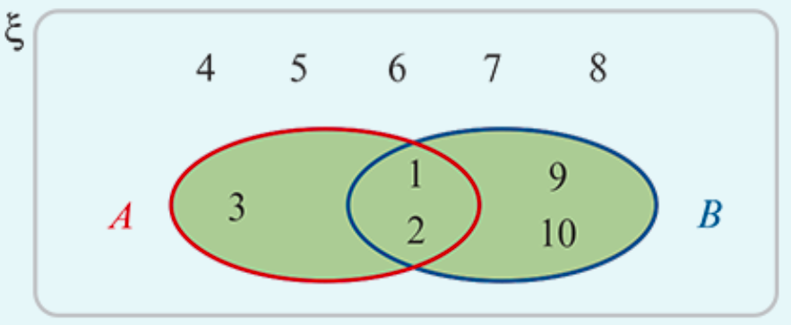
Union Examples
Let 𝜉={1,2,3,4,5,6,7,8,9,10}, 𝐴={1,2,3} and 𝐵={1,2,9,10}.
Find 𝐴∪𝐵 and illustrate on a Venn diagram.
𝐴∪𝐵={1,2,3,9,10} The shaded area illustrates 𝐴∪𝐵.

Slide 9
Intersection
The intersection of two sets A and B is the set of all elements x such that x is in A AND x is in B
Notation: A ∩ B = { x | x ∊ A and x ∊ B}
A
B
A ∩ B

Slide 10
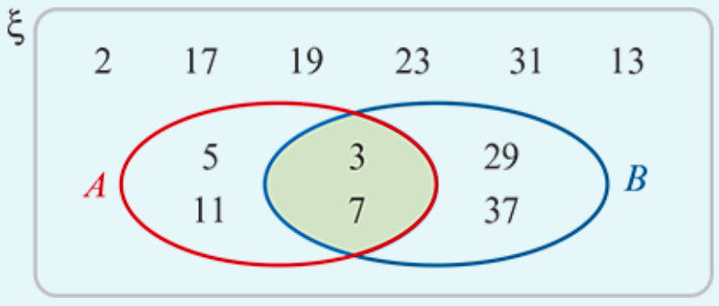
Intersection Examples
Let 𝜉= {prime numbers less than 40}, 𝐴={3,5,7,11} and 𝐵={3,7,29,37}.
Find 𝐴∩𝐵 and illustrate on a Venn diagram.
𝐴∩𝐵={3,7}
The shaded area illustrates 𝐴∩𝐵.

Slide 11
The complement of a set
If 𝜉={1,2,3,4,5,6,7,8,9,10} and 𝐴={1,3,5,7,9}, then 𝐴′={2,4,6,8,10}.
𝜉

Slide 12
Numbers

Slide 13
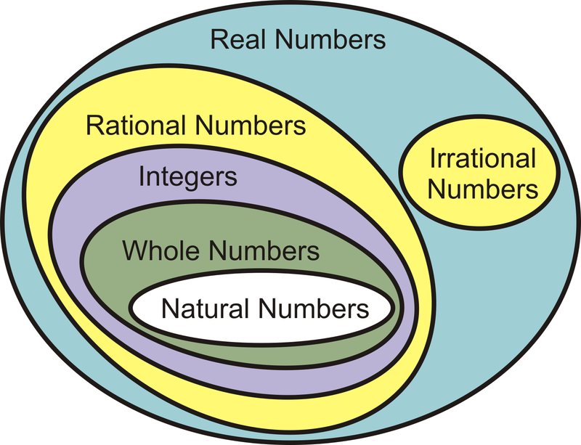
Numbers
Recall that the elements of {1,2,3,4,…} are called natural numbers, and the elements of {…,−2,−1,0,1,2,…} are called integers.
The numbers of the form $\frac{p}{\text{q}}$, with 𝑝 and 𝑞 integers, 𝑞≠0, are called rational numbers.
The real numbers which are not rational are called irrational. Some examples of irrational numbers are $\sqrt{2}$, $\sqrt{3}$, 𝜋, 𝜋+2 and $\sqrt{6}$+$\sqrt{7}$. These numbers cannot be written in the form $\frac{p}{\text{q}}$, for integers 𝑝,𝑞; the decimal representations of these numbers do not terminate or repeat.

Slide 14
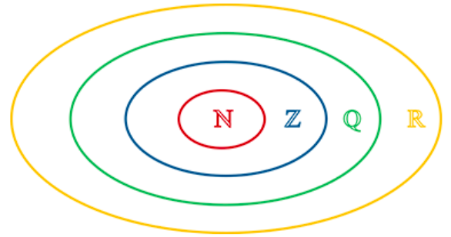
Numbers
The set of real numbers is denoted by ℝ.
The set of rational numbers is denoted by ℚ.
The set of integers is denoted by ℤ.
The set of natural numbers is denoted by ℕ.
It is clear that ℕ⊆ℤ⊆ℚ⊆ℝ, and this may be represented by the diagram on the right.

Slide 15
Real numbers

Slide 16
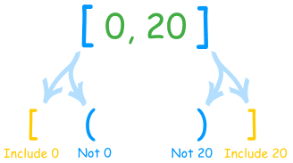
Interval notations
Closed interval: [a,b] is the set of all numbers not smaller than a and not bigger than b
[a,b] = {x: a≤x≤b}
Example:
[-1,3]
-1
3
x

Slide 17
Interval notations
Open intervals: (a,b) is the set of all numbers bigger than a and smaller than b
(a,b) = {x: a<x<b}
Example:
(-1,3)
-1
3
x

Slide 18
Interval notations
Half-Open (half-closed) intervals: (a,b] is the set of all numbers bigger than a and smaller than or equal to b
(a,b] = {x: a<x≤b}
Example:
(-1,3]
The interval [a,b) is defined similarly
-1
3
x

Slide 19
Infinite intervals
[a,∞) = {x: a≤x}
(a, ∞) = {x: a<x}
(-∞,a] = {x: x≤a}
(-∞,a) = {x: x<a}
The whole real line R = (-∞, ∞)
a
a
a
a
Note: ∞ is not a number!

Slide 20
Interval notation
Among the most important subsets of ℝ are the intervals. We suppose that 𝑎 and 𝑏 are real numbers with 𝑎<𝑏.
(a, b) = {x: a < x < b} [a, b] = {x: a ≤ x ≤ b}
(a, b] = {x: a < x ≤ b}. [a, b) = {x: a ≤ x < b}
(a, ∞) = {x: a < x} [a, ∞) = {x: a ≤ x}
(-∞, a) = {x: x < a} (-∞, a] = {x: x ≤ a}
The ‘closed’ circle (∙) indicates that the number is included.
The ‘open’ circle (∘) indicates that the number is not included.
The following are subsets of the real numbers for which we have special notation:
Positive real numbers: ${\text{ℝ}}^{+}$ ={𝑥: 𝑥 > 0}
Negative real numbers: ${\text{ℝ}}^{−}$ ={𝑥: 𝑥 < 0}
Real numbers excluding zero: ℝ∖ {0}

Slide 21
Illustrate each of the following intervals of real numbers:
[−2,3]
(−3,4]
(−∞,2]
(−2,4)
(−3,∞)

Slide 22
Section summary
Sets of numbers:
Real numbers: ℝ
Rational numbers: ℚ
Integers: ℤ
Natural numbers: ℕ
For real numbers 𝑎 and 𝑏 with 𝑎<𝑏, we can consider the following intervals:
(a, b) = {x: a < x < b} [a, b] = {x: a ≤ x ≤ b}
(a, b] = {x: a < x ≤ b}. [a, b) = {x: a ≤ x < b}
(a, ∞) = {x: a < x} [a, ∞) = {x: a ≤ x}
(-∞, a) = {x: x < a} (-∞, a] = {x: x ≤ a}

