Slide 1
Identifying and describing relations and functions
1B
Notes:
https://create.kahoot.it/details/49477f89-7e27-47e4-953d-575b54805de4
https://create.kahoot.it/details/4f20949e-e120-4114-9340-f8934c66695f
https://create.kahoot.it/details/21f288db-d99f-4d8c-99af-667a79f30eef
https://create.kahoot.it/details/2520f82f-5388-40ee-b1cd-5d5fa1159a25
https://create.kahoot.it/details/d878278a-3664-43c6-8e2b-0b3fe8057ccd

Slide 2
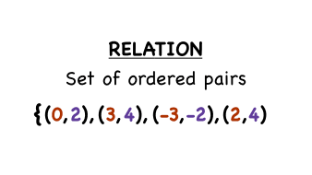
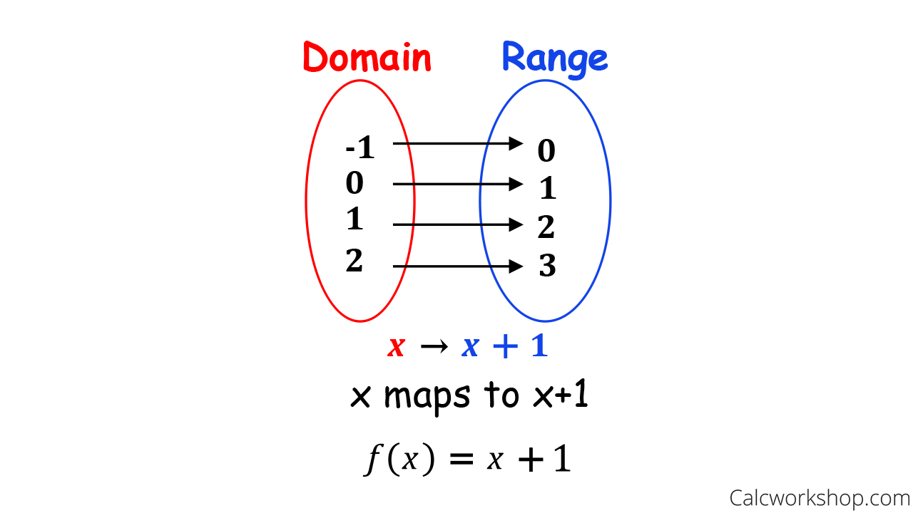
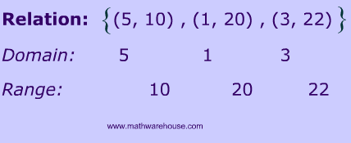
Domain, Range Relations

Slide 3
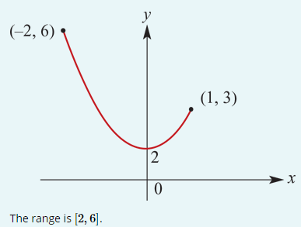
Examples
Sketch the graph of the relation y= $x^{2}$+2 for $x$∈[−2,1] and state the range.
Note that the range is not determined by considering the endpoints alone. The minimum value is 2, not 3.

Slide 4
Implied (maximal) domain
When the rule for a relation is written and no domain is stipulated, then it is understood that the domain taken is the largest for which the rule has meaning. This domain is called the maximal or implied domain.
For example, the implied domain of y= $x^{2}$ is R, and the implied domain of $x^{2}$+ $y^{2}$=1 is [−1,1].

Slide 5
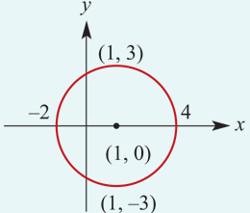
Examples
For each of the following relations, state the implied domain and the range:
a. (${x−1)}^{2}$+ $y^{2}$=9
This relation is a circle with centre (1,0) and radius 3. The implied domain is [−2,4] and the range is [−3,3].

Slide 6
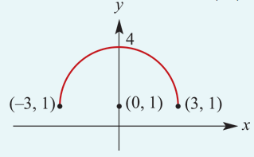
Examples
For each of the following relations, state the implied domain and the range:
b. $y =\sqrt{{9−x}^{2}}$+1
This relation is a semicircle with centre (0,1) and radius 3. The implied domain is [−3,3] and the range is [1,4].

Slide 7
{($x$, $y$): $y=x^{2}$, $x$∈[–1, $∞)$}

Slide 10
functions
A function is a relation such that for each x-value there is only one corresponding y-value. This means that, if (a,b) and (a,c) are ordered pairs of a function, then b=c. In other words, a function cannot contain two different ordered pairs with the same first coordinate.

Slide 11
Examples
Which of the following sets of ordered pairs defines a function?
a. {(−3,−4),(−1,−1),(−6,7),(1,5)}
{(−3,−4),(−1,−1),(−6,7),(1,5)} is a function, because for each x-value there is only one y-value.
b. {(−4,1),(−4,−1),(−6,7),(−6,8)}
{(−4,1),(−4,−1),(−6,7),(−6,8)} is not a function, because there is an x-value with two different y-values. The relation contains two ordered pairs, (−4,1) and (−4,−1), with the same first coordinate.

Slide 12
Vertical-line test
One way to identify whether a relation is a function is to draw a graph of the relation and then apply the following test.
If a vertical line can be drawn anywhere on the graph and it only ever intersects the graph a maximum of once, then the relation is a function.

Slide 13
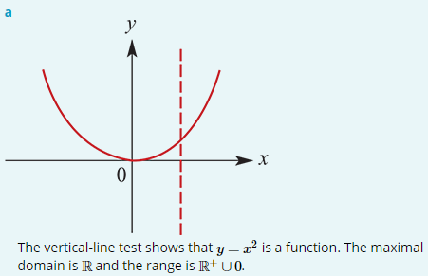
Examples
a. Is y= $x^{2}$ a function? State the maximal domain and range of y= $x^{2}$.
For each x-value there is only one y-value.
The ordered pairs of the relation are all of the form ($a$, $a^{2}$).

Slide 14
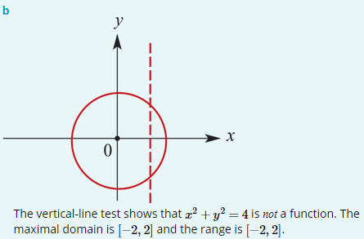
Examples
b. Is $x^{2}$+ $y^{2}$=4 a function? State the maximal domain and range of $x^{2}$+ $y^{2}$=4.
Note that ($\sqrt{2}$, $\sqrt{2}$) and ($\sqrt{2}$,− $\sqrt{2}$) are ordered pairs of the relation.
There is an x-value with more than one y-value.

Slide 15
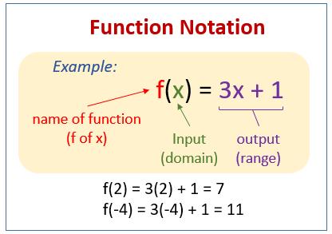
Function notation
Functions are usually denoted with lowercase letters such as f, g, h.
If f is a function, then for each x in the domain of f there is a unique element y in the range such that (x,y)∈f. The element y is called ‘the image of x under f’ or ‘the value of f at x’, and the element x is called ‘a pre-image of y’.
Since the y-value obtained is a function of the x-value, we use the notation f(x), read as ‘f of x’, in place of y.
For example, instead of y=2x+1 we can write f(x)=2x+1. Then f(2) means the y-value obtained when x=2.
e.g. f(2) =2(2)+1=5
f(−4) =2(−4)+1=−7
f(a) =2a+1

Slide 16
Function notation
By incorporating this notation, we have an alternative way of writing functions:
For the function {(x, y):y= $x^{2}$} with domain R, we write f: R → R, f(x)= $x^{2}$.
For the function {(x, y):y=2x−1, x∈[0,4]}, we write f:[0,4]→ R, f(x)=2x−1.
For the function {(x, y):y= $\frac{1}{x}$ } with domain R ∖0, we write f: R ∖0→ R, f(x)= $\frac{1}{x}$.

Slide 17
Function notation
If the domain is R, we often just write the rule. For example: f(x)= $x^{2}$.
Note that in using the notation f: X→Y, the set X is the domain but Y is not necessarily the range. It is a set that contains the range and is called the codomain. With this notation for functions, we write the domain of f as dom f and the range of f as ran f.
A function f:R→R, f(x)=a is called a constant function. For such a function f, we have dom f= R and ran f=a. For example, let f(x)=7. Then dom f= R and ran f=7.
A function f: R → R, f(x)=mx+c is called a linear function. For example, let f(x)=3x+1. Then dom f= R and ran f= R. Note that if the domain of a linear function is R and m≠0, then the range is R.

Slide 18
examples
Rewrite each of the following using the f:X→Y notation:
1. {(x,y):y=−3x+2}
2. {(x,y):y=−2x+5, x≥0}
3. y=5$x^{2}$+6, −1≤x≤2
4. y= $\frac{1}{{(x−2)}^{2}}$, x≠2
f : R → R, f(x)=−3x+2
f : ${\text{R}}^{+}$∪ 0→ R, f(x)=−2x+5 or f:[0,∞)→ R, f(x)=−2x+5
f :[−1,2]→ R, f(x)=5$x^{2}$+6
f : R ∖2→ R, f(x)= $\frac{1}{{(x−2)}^{2}}$

Slide 19
Restriction of a function
Consider the following functions:
The different letters, f, g and h, used to name the functions emphasise the fact that there are three different functions, even though they all have the same rule. They are different because they are defined for different domains. We say that g and h are restrictions of f, since their domains are subsets of the domain of f.

Slide 20
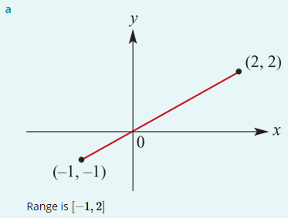
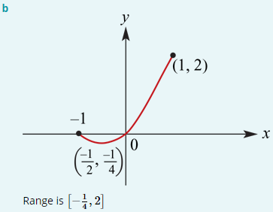
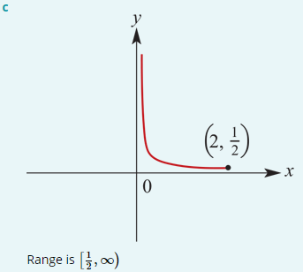
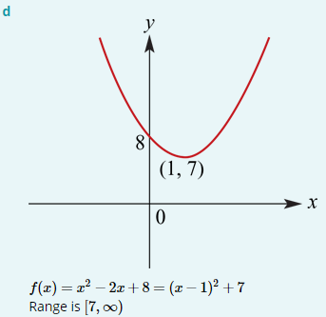
Examples
Sketch the graph of each of the following functions and state its range:
a. f :[−1,2]→ R, f(x)=x b. f :[−1,1]→ R, f(x)= $x^{2}$+ $x$
c. f :(0,2]→ R, f(x)=$\frac{1}{x}$ d. f : R → R, f(x)=$x^{2}$−2$x$+8

Slide 23
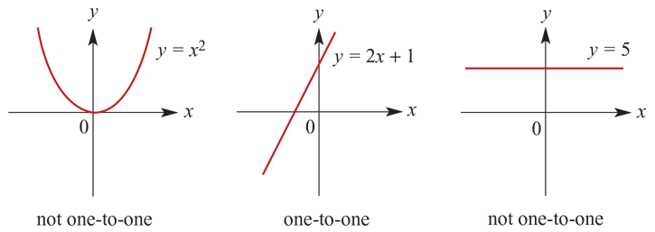
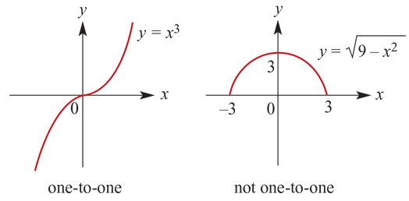
Horizontal-line test

Slide 24
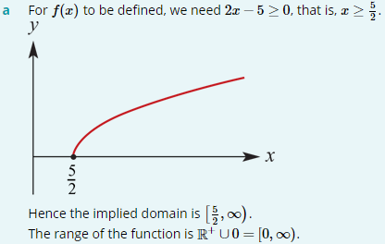
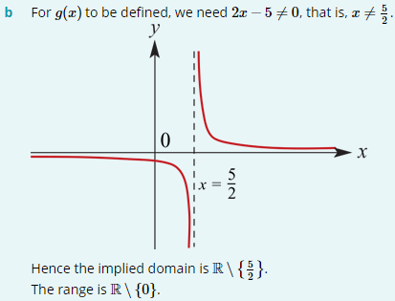
Examples
State the implied domain, sketch the graph and find the corresponding range of each of the following:
a. f(x)= $\sqrt{2x−5}$
b. g(x)=$\frac{1}{2x−5}$

