Slide 1
Types of functions and implied domains
1C
Notes:
https://quizizz.com/admin/quiz/62faff64072c6f001d2165e5?source=quiz_share
https://quizizz.com/admin/quiz/634f1c352574da001d7f4e10?source=quiz_share
https://quizizz.com/admin/quiz/62f2fd406bf071001defc623?source=quiz_share

Slide 2
Learning objective:
To be able to:
Calculate the gradient of a straight line
Work out the equation of a straight line
Write the learning objective into your books and discuss in pairs the following question:
What is gradient?
Notes:
https://quizizz.com/admin/quiz/62faff64072c6f001d2165e5?source=quiz_share
https://quizizz.com/admin/quiz/634f1c352574da001d7f4e10?source=quiz_share
https://quizizz.com/admin/quiz/62f2fd406bf071001defc623?source=quiz_share
https://create.kahoot.it/share/052e2d1f-e01a-4265-8ea8-580bb7c47065
https://create.kahoot.it/share/b65a58b4-aaac-4635-a05f-cbcf3f1154c3
https://dashboard.blooket.com/set/62fc174f624294b64fc0fdc9
https://dashboard.blooket.com/set/60c7d7e13fce2f001bfc6e90
https://dashboard.blooket.com/set/61f9a4f90f3147aec55b805e
https://dashboard.blooket.com/set/61a6654e1ce3b064598f25aa
https://dashboard.blooket.com/set/62267faa2ab8f1122daae152

Slide 3
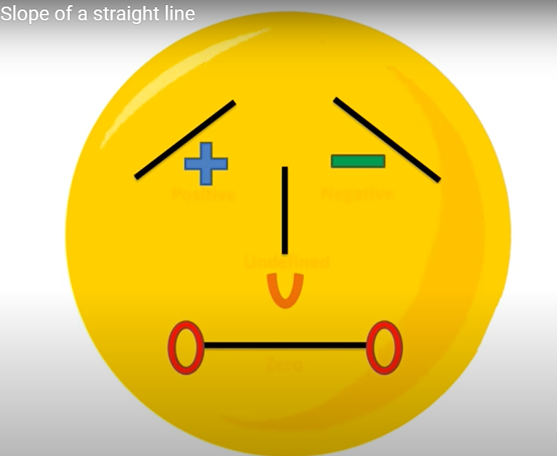
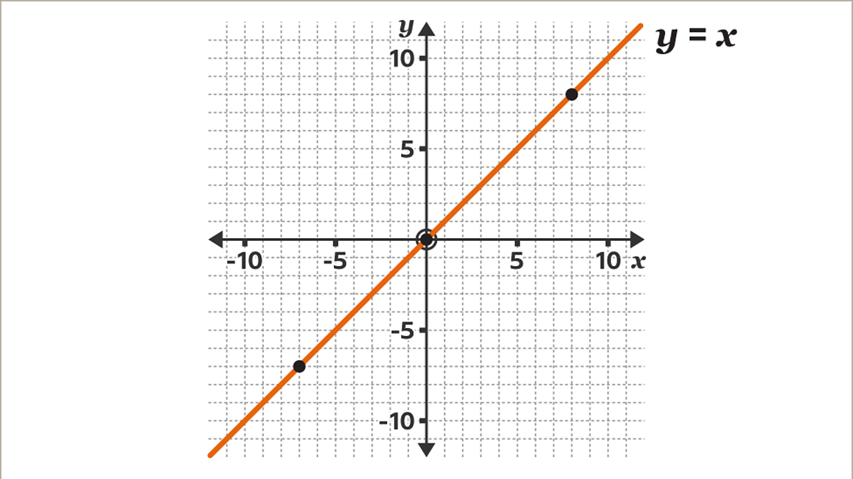
What is gradient?
Gradient is the measure of how steep a line is. The bigger the gradient, the steeper the line.

Slide 4
The way we work out the gradient of any line is by the formula:
change in y
Gradient =
change in x
Rise
Gradient = Slope =
Run

Slide 5
The equation of any straight line is of the form:
y = mx + c
Gradient
(steepness)
y-intercept
(where is crosses the y-axis)

Slide 6
y = mx + c
Gradient of 2
crosses y-axis
Gradient
Increase of 2 up the y-axis
For 1 along the x-axis
Crosses y-axis at 3
y = 2x + 3

Slide 7
y = mx + c
Gradient of 3
crosses y-axis
Gradient
Increase of 3 up the y-axis
Crosses y-axis at 2
For 1 along the x-axis
y = 3x + 2

Slide 8
y = mx + c
Gradient of 1
crosses y-axis
Gradient
Increase of 1 up the y-axis
Crosses y-axis at 4
For 1 along the x-axis
y = x + 4

Slide 9
-1
Gradient of
change in y
y = mx + c
3
Gradient =
change in x
-1
crosses y-axis
Gradient
-1 ÷ 3 =
3
-1
Gradient of
3
Crosses y-axis at 5
Decrease of 1 down the y-axis
-1
y = x + 5
For 3 along the x-axis
3

Slide 10
-2
Gradient of
change in y
y = mx + c
3
Gradient =
change in x
crosses y-axis
Gradient
-2
-2 ÷ 3 =
3
-2
Crosses y-axis at 5
Gradient of
3
-2
y = x + 5
3
Decrease of 2 down the y-axis
For 3 along the x-axis

Slide 11
Parallel and Perpendicular Lines.
Monday, 16 October 2023
ALL will be able to identify parallel lines from their equations.
MOST will be able to identify perpendicular lines from their equations.
SOME will be able to solve problems involving parallel and perpendicular lines.
Lesson Objective: To be able to find the equation of graphs parallel or perpendicular to others and passing through a specific point.
The lines are parallel
Investigation (Part 1):
Draw the graphs of the following –
y = 2x
y = 2x – 4
y = 2x + 3
y = 2x - 9
They’ll never meet!
What do you notice about the lines…?
Keywords: Equation → y = mx + c → Negative Reciprocal → Parallel → Perpendicular.

Slide 12
Parallel and Perpendicular Lines.
Monday, 16 October 2023
ALL will be able to identify parallel lines from their equations.
MOST will be able to identify perpendicular lines from their equations.
SOME will be able to solve problems involving parallel and perpendicular lines.
Lesson Objective: To be able to find the equation of graphs parallel or perpendicular to others and passing through a specific point.
Investigation (Part 1):
We’ve established that these lines are parallel. What similarity do you notice between all four of these lines…?
y = 2x
y = 2x – 4
y = 2x + 3
y = 2x - 9
Each line has the same gradient of 2.
So what can we deduce about the equations of parallel lines…?
…Parallel lines have equal gradients…!
Keywords: Equation → y = mx + c → Negative Reciprocal → Parallel → Perpendicular.

Slide 13
Parallel and Perpendicular Lines.
Monday, 16 October 2023
ALL will be able to identify parallel lines from their equations.
MOST will be able to identify perpendicular lines from their equations.
SOME will be able to solve problems involving parallel and perpendicular lines.
Lesson Objective: To be able to find the equation of graphs parallel or perpendicular to others and passing through a specific point.
Whiteboard Task:
Write down the equation of a line parallel to…
y = 4x
y = 4x – 6
y = 4x - ½
y = 4x – 2
y = 4x + 2
y = 4x + 5
y = 4x – 10
y = 4x + 1
y = 4x – 24
Keywords: Equation → y = mx + c → Negative Reciprocal → Parallel → Perpendicular.

Slide 14
Parallel and Perpendicular Lines.
Monday, 16 October 2023
ALL will be able to identify parallel lines from their equations.
MOST will be able to identify perpendicular lines from their equations.
SOME will be able to solve problems involving parallel and perpendicular lines.
Lesson Objective: To be able to find the equation of graphs parallel or perpendicular to others and passing through a specific point.
They are perpendicular
Investigation (Part 2):
The graph drawn has a gradient of 2. What is the equation of that line?
y = 2x – 1
Draw the graph of y = -½x – 1.
They meet at right angles!
What do you notice about the lines…?
Keywords: Equation → y = mx + c → Negative Reciprocal → Parallel → Perpendicular.

Slide 15
Parallel and Perpendicular Lines.
Monday, 16 October 2023
ALL will be able to identify parallel lines from their equations.
MOST will be able to identify perpendicular lines from their equations.
SOME will be able to solve problems involving parallel and perpendicular lines.
Lesson Objective: To be able to find the equation of graphs parallel or perpendicular to others and passing through a specific point.
Investigation (Part 2):
The graph drawn has a gradient of -¼. What is the equation of that line?
y = -¼x + 2
Draw the graph of y = 4x – 2.
Again, they are perpendicular!
What do you notice about the lines…?
Keywords: Equation → y = mx + c → Negative Reciprocal → Parallel → Perpendicular.

Slide 16
Parallel and Perpendicular Lines.
Monday, 16 October 2023
ALL will be able to identify parallel lines from their equations.
MOST will be able to identify perpendicular lines from their equations.
SOME will be able to solve problems involving parallel and perpendicular lines.
Lesson Objective: To be able to find the equation of graphs parallel or perpendicular to others and passing through a specific point.
Investigation (Part 2):
We’ve established that these pairs of lines are perpendicular. What similarity do you notice between these pairs of lines…?
y = 2x – 1
y = -½x – 1
Think about the gradients of each pair of lines. Multiply them together. What do you get?
2 x -½ = -1
y = -¼x + 2
y = 4x – 2
-¼ x 4 = -1
The gradients of two perpendicular lines multiply to make -1.
Keywords: Equation → y = mx + c → Negative Reciprocal → Parallel → Perpendicular.

Slide 17
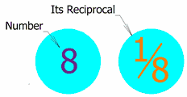
Parallel and Perpendicular Lines.
Monday, 16 October 2023
ALL will be able to identify parallel lines from their equations.
MOST will be able to identify perpendicular lines from their equations.
SOME will be able to solve problems involving parallel and perpendicular lines.
Lesson Objective: To be able to find the equation of graphs parallel or perpendicular to others and passing through a specific point.
The ‘Negative Reciprocal’:
In fact, the gradient of a line perpendicular to another is the negative reciprocal of the original line.
The reciprocal of a number is defined as 1 divided by the number.
If a line has a gradient of -2, the perpendicular line has a gradient of:
- $\frac{\text{1}}{\text{−2}}$
$\frac{\text{1}}{\text{2}}$
=
Keywords: Equation → y = mx + c → Negative Reciprocal → Parallel → Perpendicular.

Slide 18
Parallel and Perpendicular Lines.
Monday, 16 October 2023
ALL will be able to identify parallel lines from their equations.
MOST will be able to identify perpendicular lines from their equations.
SOME will be able to solve problems involving parallel and perpendicular lines.
Lesson Objective: To be able to find the equation of graphs parallel or perpendicular to others and passing through a specific point.
Perpendicular Lines:
So…
…Perpendicular lines have gradients that multiply to make -1 with one of them being the negative reciprocal of the other…!
Keywords: Equation → y = mx + c → Negative Reciprocal → Parallel → Perpendicular.

Slide 19
Parallel and Perpendicular Lines.
Monday, 16 October 2023
ALL will be able to identify parallel lines from their equations.
MOST will be able to identify perpendicular lines from their equations.
SOME will be able to solve problems involving parallel and perpendicular lines.
Lesson Objective: To be able to find the equation of graphs parallel or perpendicular to others and passing through a specific point.
Fill in the Gaps:
Fill in the gaps in the following calculations (use the rules that we learnt on the last few slides).
$\text{−}\frac{\text{1}}{\text{3}}$
$\frac{\text{1}}{\text{5}}$
3 x _____ = -1
7 x _____ = -1
-9 x _____ = -1
4) -5 x _____ = -1
5) $\text{−}\frac{\text{1}}{\text{5}}$ x _____ = -1
6) $\frac{\text{2}}{\text{7}}$ x _____ = -1
$\text{−}\frac{\text{1}}{\text{7}}$
5
$\frac{\text{1}}{\text{9}}$
$\text{−}\frac{\text{7}}{\text{2}}$
Keywords: Equation → y = mx + c → Negative Reciprocal → Parallel → Perpendicular.

Slide 20
Piecewise-defined functions
Functions which have different rules for different subsets of their domain are called piecewise-defined functions. They are also known as hybrid functions.

Slide 21
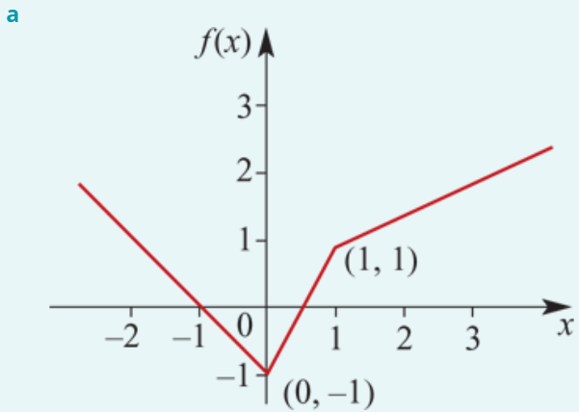
Piecewise Examples
a. Sketch the graph of the function f given by:
b. State the range of f.
The graph of y=−x−1 is sketched for x<0. Note that when x=0, y=−1 for this rule.
The graph of y=2x−1 is sketched for 0≤x≤1. Note that when x=0, y=−1 and when x=1, y=1 for this rule.
The graph of y=$\frac{1}{2}$x+ $\frac{1}{2}$ is sketched for x>1. Note that when x=1, y=1 for this rule.
b. The range is [−1,∞).

Slide 22
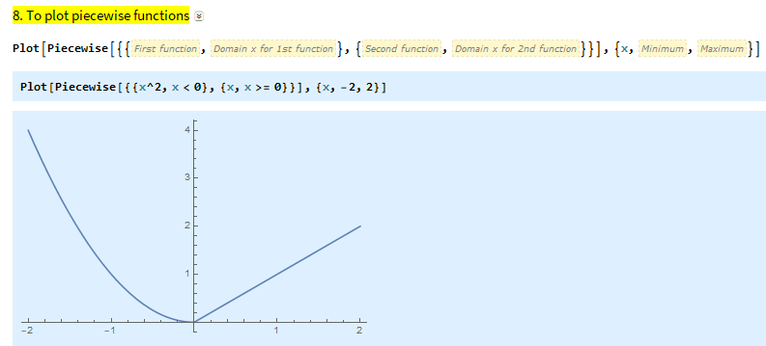
$$f\left(x\right)=\left\{\begin{matrix}x^{2}, x<0 \\ x, x≥0\end{matrix}\right.$$

Slide 23
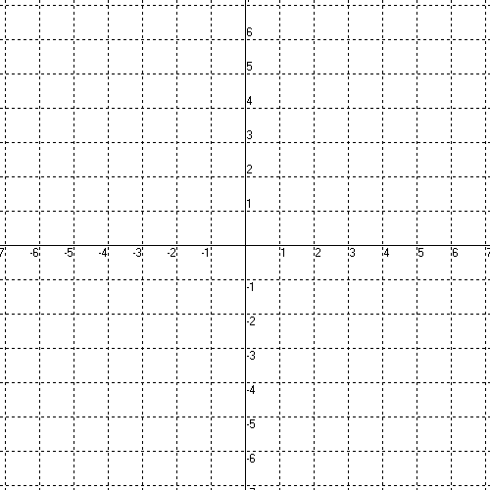
Graphing Piecewise Functions
Domain -
Range -

Slide 24
Domain -
(-7, 7]
Range -
(-4, -2), [-1, 4]

Slide 25
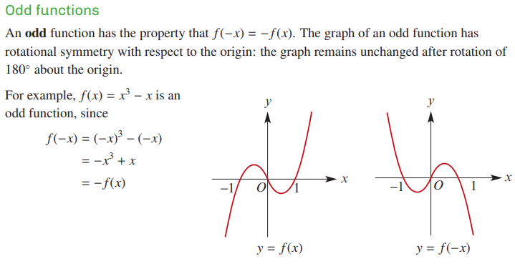

Slide 26
Let’s look at the graph of where n is an odd integer.
Notice each graph looks similar to x³ but is wider and flatter near the origin between –1 and 1
and grows steeper on either side
The higher the power, the flatter and steeper

Slide 27
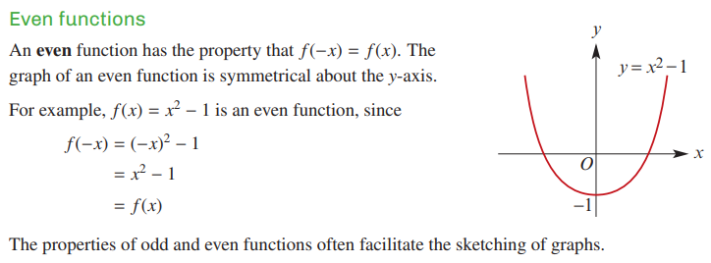

Slide 28
Let’s look at the graph of where n is an even integer.
and grows steeper on either side
Notice each graph looks similar to x² but is wider and flatter near the origin between –1 and 1
The higher the power, the flatter and steeper

