Slide 1
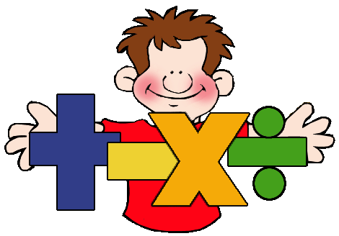
1D
Sums and products of functions
What is meant by operations in mathematics?
or

Slide 3
Have I seen operations on functions before??
quadratic
linear
linear
linear
constant
*
New functions can be formed by performing operations with functions.

Slide 4
Basic Function Operations
are functions that exist and are defined over a domain.
Sum
Difference
Product
Quotient
*
*
Linear
Quadratic
Radical
linear
Cubic
Exponential
Logarithmic

Slide 5
Sums and Differences of Functions
The sum f + g
Algebraically
To find the sum of two functions, add them together. Simplify by combining like terms.
New function

Slide 6
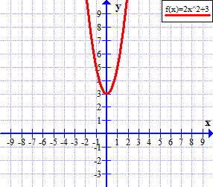
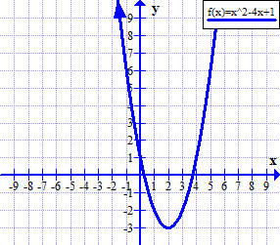
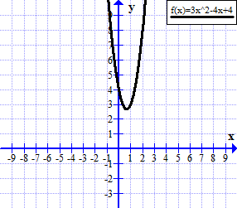
Graphing with technology
$$\left\{y|y≥−3,y∈ℜ\right\}$$

Slide 7
The difference f - g
Algebraically
To find the difference between two functions, subtract the second from the first. Simplify by combining like terms.
New function

Slide 8
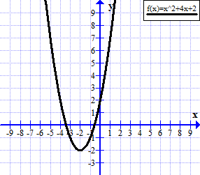
Sketch the graph using technology and determine the domain and range.
$$\left\{y|y≥−3,y∈ℜ\right\}$$

Slide 9
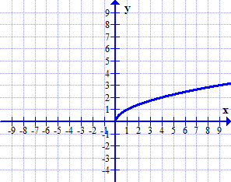
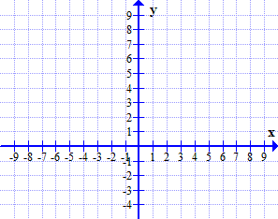
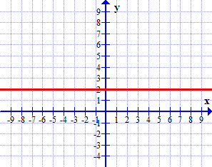
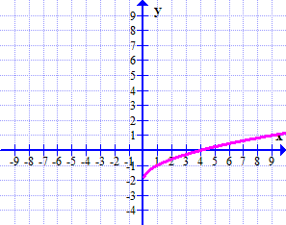
Sketch a graph of the difference of f(x) and g(x).
Use your knowledge of transformations to verify the graph.
Domain
Range

Slide 10
In Summary
To sketch the graph of a sum of two functions given their graphs, ______ the ____coordinates at each x-value.
add
y
To sketch the graph of a difference of two functions given their graphs, __________ the ____coordinates at each x-value.
subtract
y
Domain and Range
The domain of f(x) + g(x) is the overlap (intersection) of the domains of the individual functions.
The range of f(x) + g(x) is determined from the graph of the sum or difference.

Slide 11
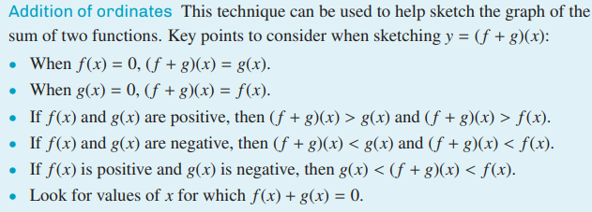

Slide 12
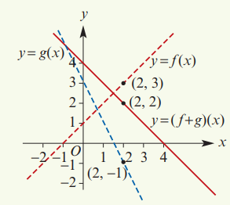
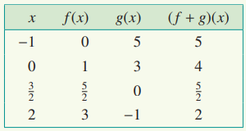

Slide 13
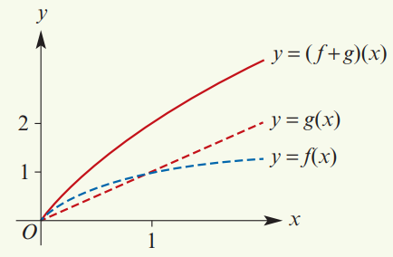

Slide 14
