Slide 1



1E
Composite functions
Copyright © Cengage Learning. All rights reserved.

Slide 2
1E
Combinations of Functions
Copyright © Cengage Learning. All rights reserved.

Slide 3
What You Should Learn
Add, subtract, multiply, and divide functions.
Find compositions of one function with another function.

Slide 4
Arithmetic Combinations of Functions
Just as two real numbers can be combined by the operations of addition, subtraction, multiplication, and division to form other real numbers, two functions can be combined to create new functions. When
f (x) = 2x – 3 and g (x) = x² – 1
you can form the sum, difference, product, and quotient of
f and g as follows.

Slide 5
Arithmetic Combinations of Functions
f (x) + g (x) = (2x – 3) + (x² – 1)
Sum
= x² + 2x – 4
f (x) – g (x) = (2x – 3) – (x² – 1)
Difference
= –x² + 2x – 2

Slide 6
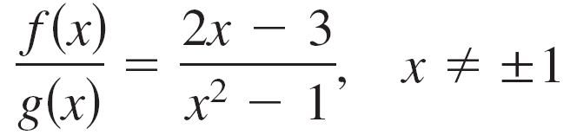
Arithmetic Combinations of Functions
Quotient
f (x)  g (x) = (2x – 3)(x² – 1)
Product
= 2x³ – 3x² – 2x + 3

Slide 7
Arithmetic Combinations of Functions
The domain of an arithmetic combination of functions f and g consists of all real numbers that are common to the domains of f and g. In the case of the quotient
there is the further restriction that g (x) ≠ 0.

Slide 8
Example 1 – Finding the Sum of Two Functions
Given f (x) = 2x + 1 and g (x) = x² + 2x – 1, find (f + g) (x).
Then evaluate the sum when x = 2.
Solution:
(f + g) (x) = f (x) + g (x)
= (2x + 1) + (x² + 2x – 1)
= x² + 4x
When x = 2, the value of this sum is
(f + g) (2) = 2² + 4(2)
= 12.

Slide 9
Compositions of Functions

Slide 10
Compositions of Functions
Another way of combining two functions is to form the composition of one with the other.
For instance, when f (x) = x² and g (x) = x + 1, the composition of f with g is
f (g (x)) = f (x + 1)
= (x + 1)².
This composition is denoted as f ° g and is read as
“f composed with g”.

Slide 11
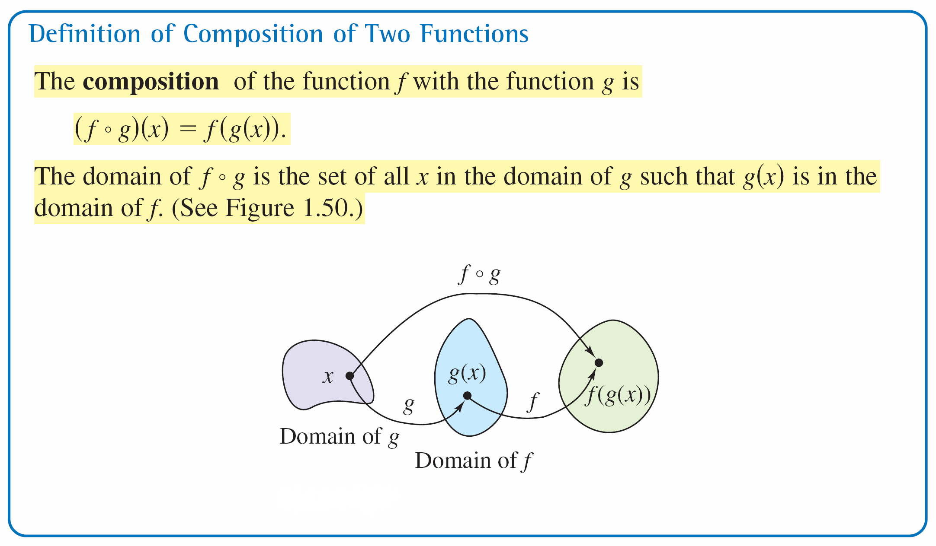
Compositions of Functions
Figure 1.50

Slide 12


Example 5 – Forming the Composition of f with g
Definition of f ° g
Definition of g (x)
Definition of f (x)
Find (f ° g)(x) for and g (x) = x – 1, x ≥ 1.
If possible, find (f ° g)(2) and (f ° g)(0).
Solution:
The composition of f with g is
(f ° g) (x) = f (g (x))
= f (x – 1)
=

Slide 13

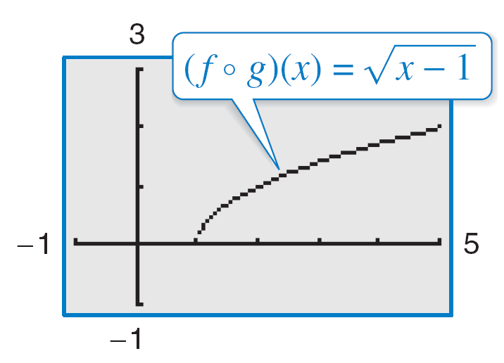

Example 5 – Solution
cont’d
Figure 1.51
The domain of f ° g is [1, ) (See Figure 1.51).
So,
(f ° g) (2) = = 1
is defined, but (f ° g)(0) is not defined because 0 is not in the domain of f ° g.

