Slide 1
INVERSE
FUNCTIONS
Notes:
https://quizizz.com/admin/quiz/57c48717517ec3d3300bc473/writing-inverse-functions

Slide 2
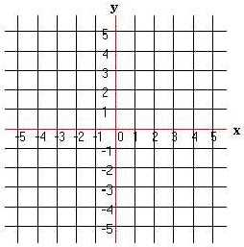
Warm Up #3: Graph & give the domain & range.
x
y
x
y
-3
-4
-5
2
1
0
1
2
3
4
-3
-2
-1
0

Slide 3
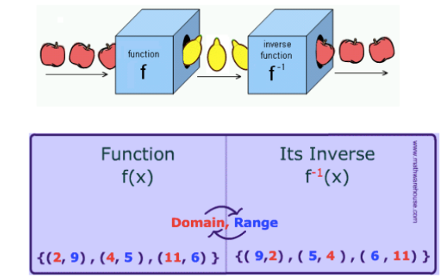
Remember we talked about functions---taking a set X and mapping into a Set Y
An inverse function would reverse that process and map from SetY back into Set X

Slide 4
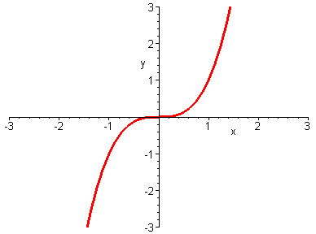
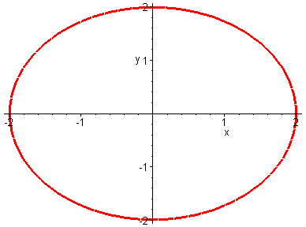
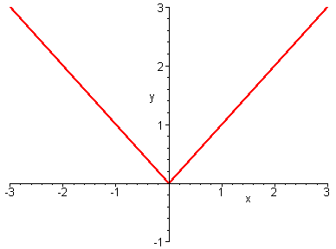
Recall that to determine by the graph if an equation is a function, we have the vertical line test.
If a vertical line intersects the graph of an equation more than one time, the equation graphed is NOT a function.
This is NOT a function
This is a function
This is a function

Slide 5
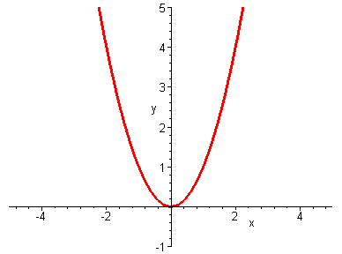
To be a one-to-one function, each y value could only be paired with one x. Let’s look at a couple of graphs.
Look at a y value (for example y = 3)and see if there is only one x value on the graph for it.
For any y value, a horizontal line will only intersection the graph once so will only have one x value
This is a many-to-one function
This then IS a one-to-one function

Slide 6
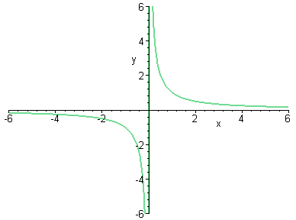
If a horizontal line intersects the graph of an equation more than one time, the equation graphed is NOT a one-to-one function and will NOT have an inverse function.
This is NOT a one-to-one function
This is a
one-to-one function
This is NOT a one-to-one function

Slide 7
Notice that the x and y values traded places for the function and its inverse.
These functions are reflections of each other about the line y = x
Let’s consider the function and compute some values and graph them.
This means “inverse function”
x f (x)
(2,8)
-2 -8
-1 -1
0 0
1 1
2 8
(8,2)
x f ⁻¹(x)
-8 -2
-1 -1
0 0
1 1
8 2
Let’s take the values we got out of the function and put them into the inverse function and plot them
(-8,-2)
(-2,-8)
Is this a one-to-one function?
Yes, so it will have an inverse function
What will “undo” a cube?
A cube root

Slide 8
Draw the inverse. Compare to the line y = x. What do you notice?

Slide 9
Graph the inverse of the following:
The function and
its inverse are
symmetric with
respect to the
Line y = x.
x
y
0
-3
1
1
-5
-4
2
4

Slide 10
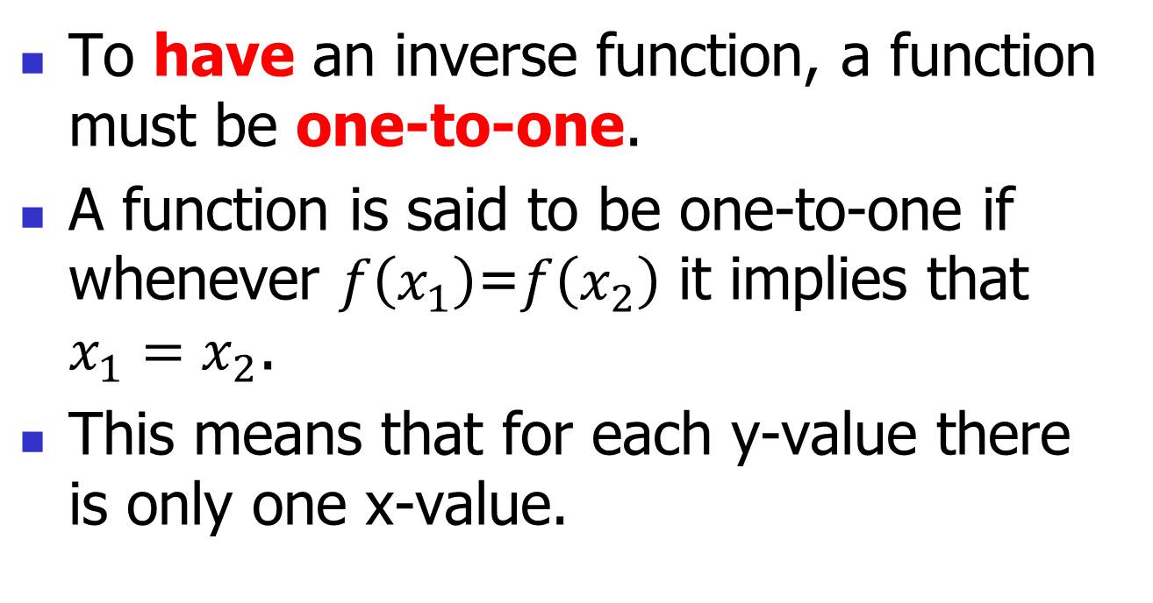
How Does an Inverse Exist

Slide 11
Verify that the functions f and g are inverses of each other.
If we graph (x - 2)² it is a parabola shifted right 2.
Is this a one-to-one function?
This would not be one-to-one but they restricted the domain and are only taking the function where x is greater than or equal to 2 so we will have a one-to-one function.

Slide 12
Steps for Finding the Inverse of a One-to-One Function
y = f ⁻¹(x)
Solve for y
Trade x and y places
Replace f(x) with y

Slide 13
Find the inverse of
y = f ⁻¹(x)
or
Solve for y
Trade x and y places
Replace f(x) with y
Ensure f(x) is one to one first. Domain may need to be restricted.

Slide 14
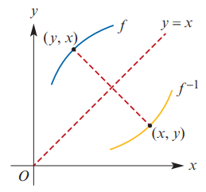


Slide 15
