Slide 1
Chapter 2C: Income
Flexibly convert between fractions, decimals, and percentages
Use and understand ratio and proportions
Solve money-related problems

Slide 2
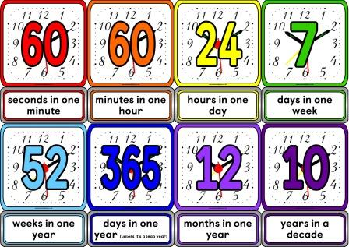
Income and Deductions
Wage:
If you are paid according to the number of hours worked or goods produced,
this is called a wage.
Salary:
If you are paid the same amount regardless of the number of hours worked or goods produced, this is called a salary.
Gross pay:
Gross pay or gross income is money earned before deductions are made.
Net pay:
Net pay or net income or take-home income is money received after all deductions have been made.

Slide 3
Income
Net income =
Total(Gross) Income – Deductions
Time and a half rate= 1.5× Hourly rate
Double time rate= 2× Hourly rate

Slide 4
Examples
38 ×12 + 1.5 ×12 ×2 + 5 ×2 ×12 = $ 612
Frazer worked 45 hours last week. 38 hours of normal rate $12, next two hours 1.5 rate and thereafter double time rate. How much is his income last week?

